Slide 1
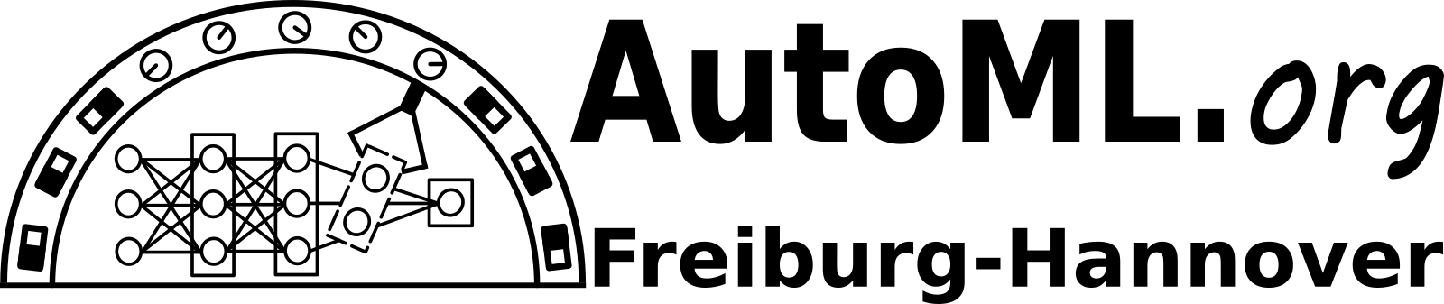
Bulk and Cut
Multi-objective
Optimization
for CNNs
Guilherme Miotto

Slide 2

Bodybuilder’s multi-objective problem
muscle
fat

Slide 3
First
Bulk-up
Then
Slim-down

Slide 4

Bulk and Cut
Hyper-parameter tuning
Phase 1:
Initialization
Phase 2:
Bulk-up
Phase 3:
Slim-down
35%
40%
25%
Architecture:
random sampling
Architecture:
network morphisms
Architecture:
Structured pruning
AdamW’s HP:
Constrained BO
target: validation loss
AdamW’s HP:
Constrained BO
target: validation loss
AdamW’s HP:
Constrained BO
target: training loss
Guilherme Miotto

Slide 5
Bulk and Cut
Model training
Phase 1:
Initialization
Phase 2:
Bulk-up
Phase 3:
Slim-down
Data:
Mix-up images
Mix-up labels
Data:
Mix-up images
Mix-up labels
Data:
Mix-up images
Parent’s logits
Schedule:
50 epochs
Schedule:
50 epochs
Schedule:
17 epochs
Guilherme Miotto

Slide 6
Results
GPU Gigabyte GeForce RTX 2080 Ti 11GB
Total budget: 8 hours

Slide 7
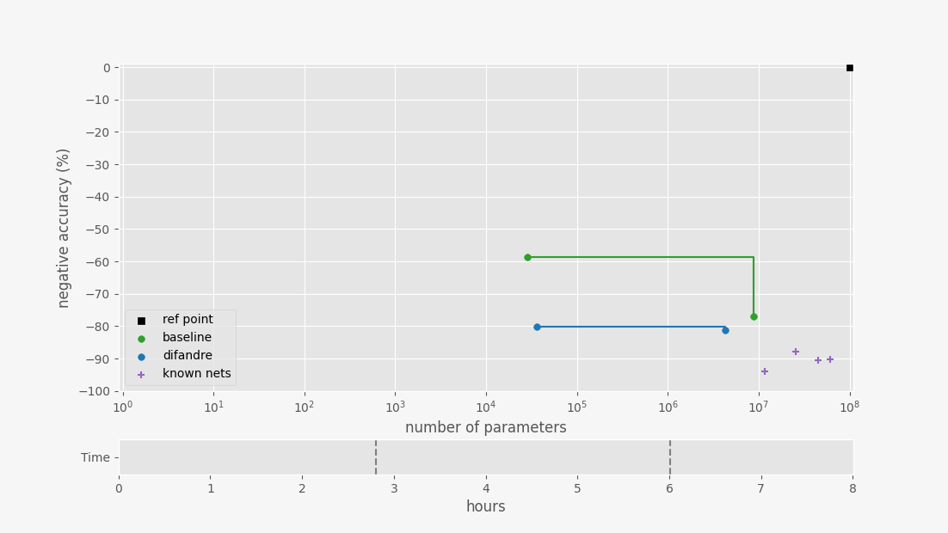

Slide 8
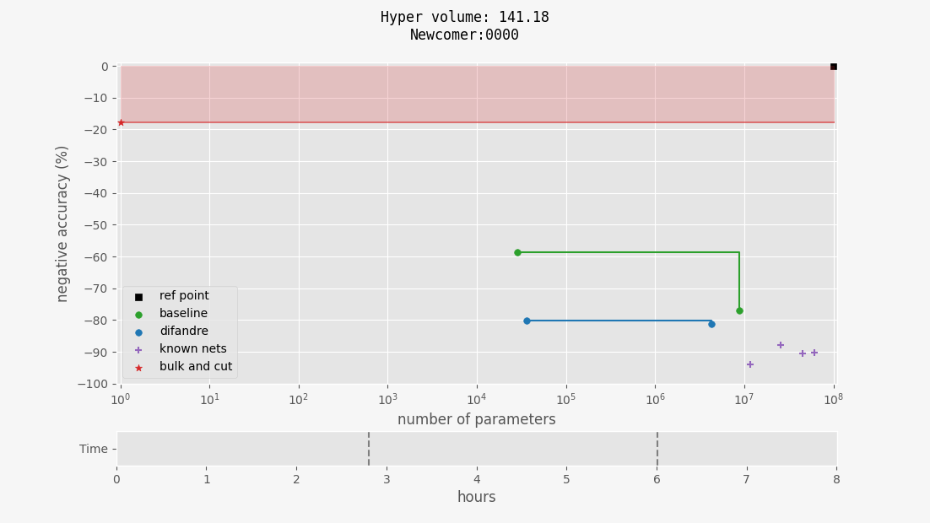

Slide 9
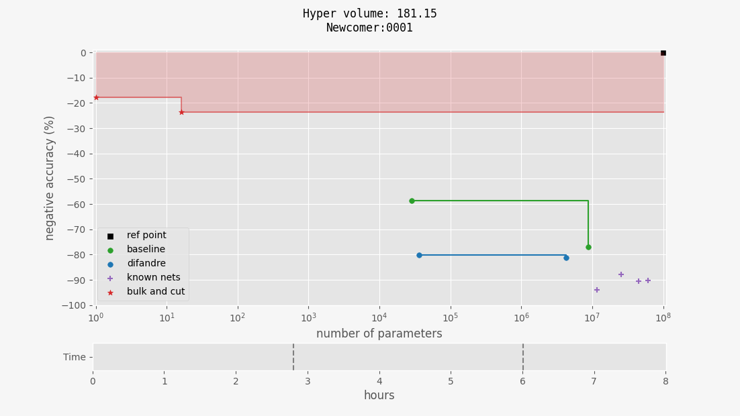

Slide 10
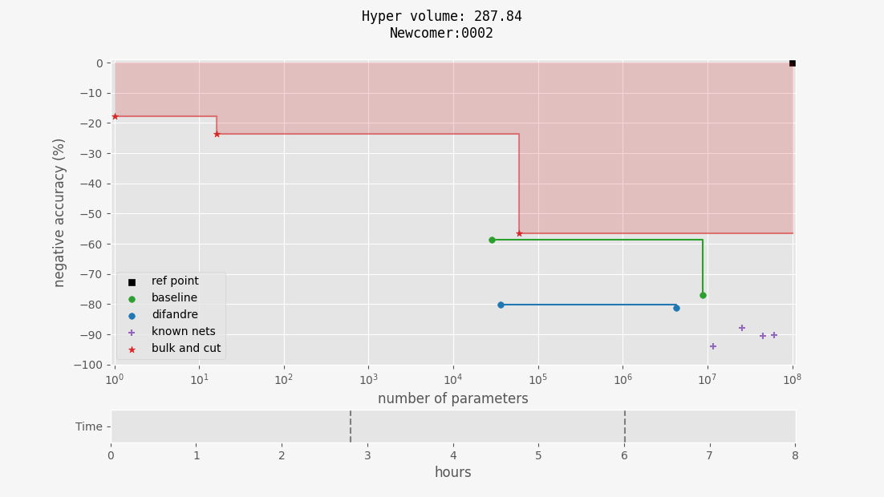

Slide 12
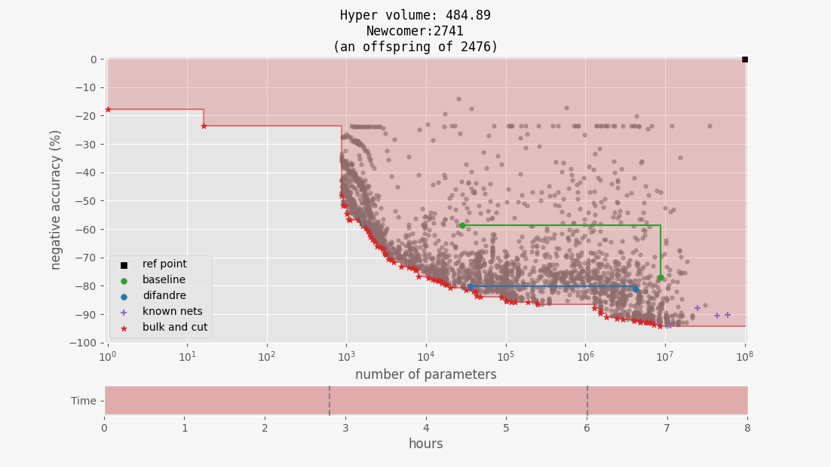
CV-split 1

Slide 13
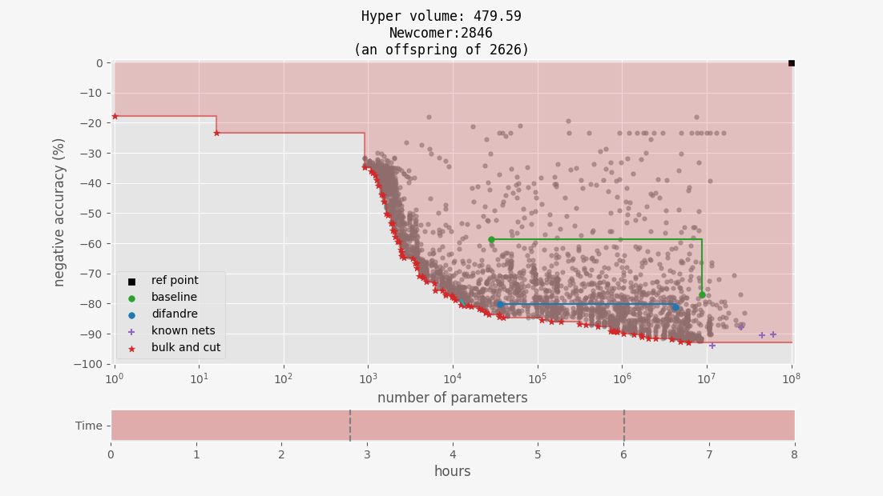
CV-split 2

Slide 14
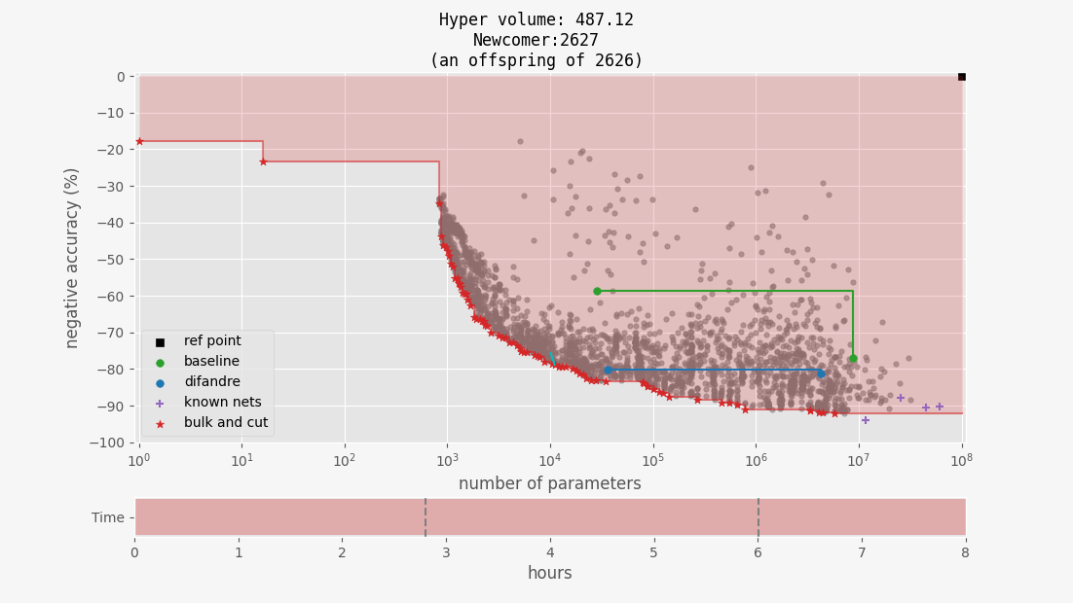
CV-split 3

Slide 15
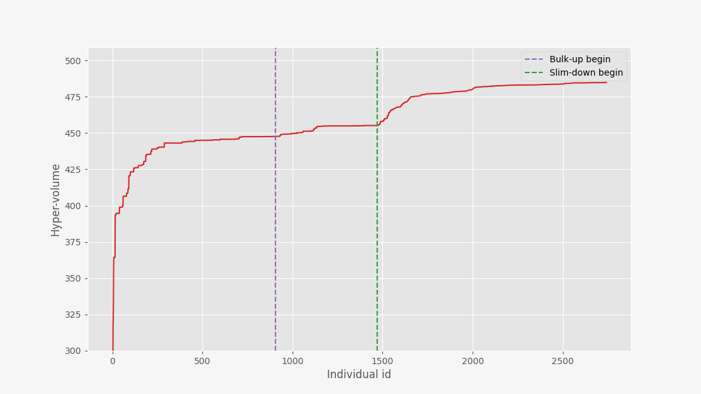

Slide 16
Final
Remarks

Slide 17
Hypervolume:
Domination:
‘New’ ideas:
484
Bulk and Cut
Package coded from scratch
Constrained BO
Paretslon-greedy
Mix-up + Knowledge distillation
OOM-safe batch size selection
277
difandre
baseline
AlexNet
Res101
Res18*
Res50
difandre
bnc
*but not always
Guilherme Miotto

Slide 18
Constrained Bayesian optimization
Paretslon-greedy criterion
Mix-up and knowledge distillation
Results with low budget – 2 hours
Results with low GPU memory – 3 GB
Hyper-parameter search space
Extra
slides
Guilherme Miotto

Slide 19
BO
NLL
Model
NCL
Conventional
Bayesian
Optimization
LR
acc
Guilherme Miotto

Slide 20
error
Conventional
Bayesian
Optimization
#pars
Guilherme Miotto

Slide 21
something else
(e.g. random)
NCL
NLL
BO
NLL
Model
NCL
Conventional
Bayesian
Optimization
LR
acc
Guilherme Miotto

Slide 22
error
Constrained
Bayesian
Optimization
#pars
Guilherme Miotto

Slide 23
something else
(e.g. random)
Hey BO, which LR
should we try next
for a model with
x CL and y LL?
NCL
NLL
f(p)
NCL
NLL
NCL
NLL
depth
BO
Model
LR
Constrained
Bayesian
Optimization
acc
Guilherme Miotto

Slide 24
EA
NCL
NLL
f(p)
NCL
NLL
depth
BO
Model
LR
Constrained
Bayesian
Optimization
acc
Guilherme Miotto

Slide 25
epslon-greedy
meets
non-dominated sorting
Paretslon-greedy:
1. Given a set of solutions Ɓ
2. Let Ƒ ← front(Ɓ)
3. With probability ϵ:
    return a random item from Ƒ
4. With probability (1 – ϵ):
    let Ɓ ← Ɓ – Ƒ
    go to step 2
Paretslon-greedy
Selection
Criterion
Guilherme Miotto

Slide 26
Paretslon-greedy
Selection
Criterion
Guilherme Miotto

Slide 27

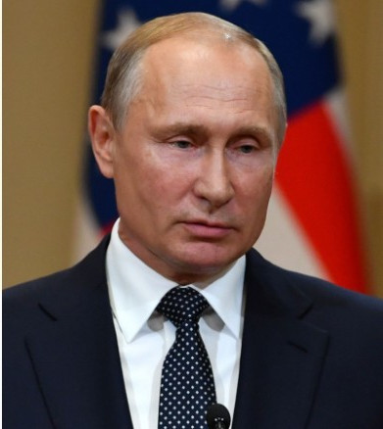
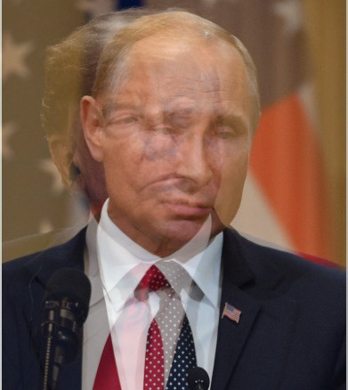
Phase 1:
Initialization
Random architectures
Phase 2:
Bulk-up
Network morphisms
Phase 3:
Slim-down
Knowledge distillation
High dropout rate – avoid creation of essential units
Mix-up – increase the entropy of the parent prediction
λ = 0.4
Growing
To
Shrink
[1, 0]
[0, 1]
[0.4, 0.6]
Guilherme Miotto

Slide 28
Results
Under lower budget
GPU Gigabyte GeForce RTX 2080 Ti 11GB
Total budget: 2 hours

Slide 29
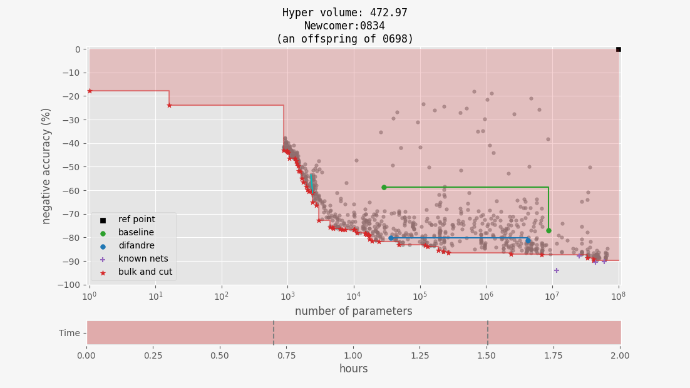

Slide 30
Results
Under lower memory
GPU Asus GeForce GTX 1060 3GB
Total budget: 8 hours

Slide 31
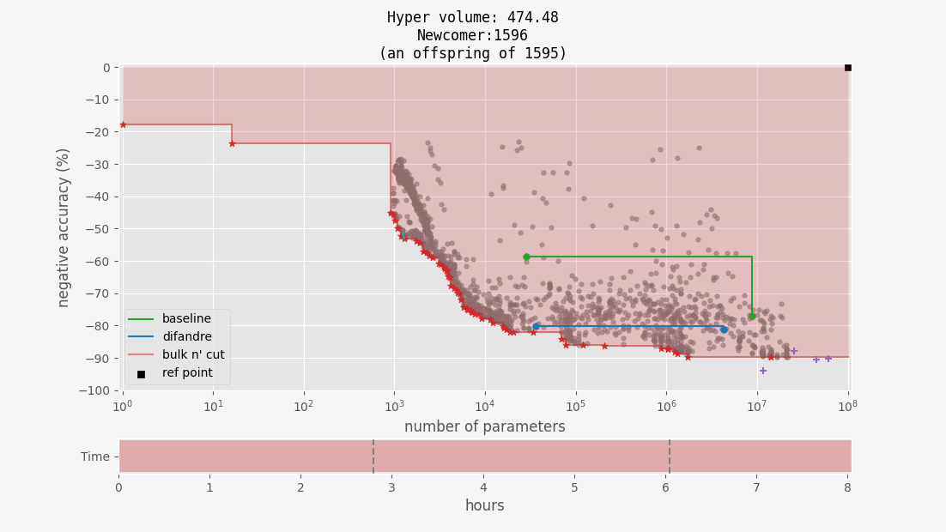

Slide 32
Search space
Hyper-parameter tuning
Parameter | Class | Min | Baseline | Max | Remarks:
num_conv_layers | conv_layers | 1 | 2 | ∞ | blind models have none
num_filters | conv_layers | 64 | 457/511 | 1024 | log₂ sampling
kernel_size | conv_layers | 3 | 3 | 5 | either-or sampling
dropout_p | conv_layers | 0.0 | 0.0 | 0.5
num_linear_layers | linear_layers | 1 | 3 | ∞
num_units | linear_layers | 16 | 27/17/273/16 | 512 | log₂ sampling
dropout_p | linear_layers | 0.0 | 0.2 | 0.5
skip_connect | skip_connections | no | no | yes
learning_rate | optimizer | 1E-5 | 2.25E-5 | 1E-2 | log₁₀ sampling
w_decay | optimizer | 1E-4 | 1E-2 | 1E-1 | log₁₀ sampling
lr_sched_gamma | optimizer | 0.1 | 1.0 | 1.0 | 1.0 means constant LR
lr_sched_step | optimizer | 2 | 50 | 50 | 50 means constant LR

