Slide 1

MODERN PRINCIPLES OF ECONOMICS
Fifth Edition
Chapter 2 The Power of Trade and Comparative Advantage
© 2021 Worth Publishers. All Rights Reserved.

Slide 2
Outline
Trade and Preferences
Specialization, Productivity, and the Division of Knowledge
Comparative Advantage
Trade and Globalization
Takeaway

Slide 3
Discussion Question
Think of the last time you bought or sold something. Why did you make the trade?
Answer: You probably traded because you preferred what you got over what you gave up. For example, if you bought a candy bar for $1, you probably preferred the candy bar to having $1 in your pocket.

Slide 4
Introduction
Benefits of Trade
Trade makes people better off when preferences differ.
Trade increases productivity through specialization and the division of knowledge.
Trade increases productivity through comparative advantage.

Slide 5
Trade and Preferences
Trade Creates Value
Trade moves goods from people who value them less to people who value them more.
Trade makes people with different preferences better off.

Slide 6
Specialization (1 of 4)
Trade Allows Specialization
With no trade, there is no specialization.
People will specialize in the production of a single good only when they can trade for other goods.

Slide 7
Specialization (2 of 4)
Increased Productivity
We can produce more through trade than by individual production.
People who specialize have more knowledge about their field.
Because they sell large quantities, people who specialize can take advantage of large-scale equipment.

Slide 8
Specialization (3 of 4)
Division of Knowledge
Without specialization, each person produces their own food, clothing, and so on.
Each person has about the same amount of knowledge as everybody else.
The combined knowledge of a society is not much more than that of a single person.

Slide 9
Specialization (4 of 4)
Division of Knowledge
With specialization, much more knowledge is used than could exist in a single brain.
Knowledge increases productivity, so specialization increases total output.
Every increase in world trade is an opportunity to increase the division of knowledge.

Slide 10
Self-Check (1 of 2)
One of the benefits of specialization is:
less pollution.
more equality.
increased productivity.

Slide 11
Self-Check (1 of 2) (Answer)
One of the benefits of specialization is:
less pollution.
more equality.
increased productivity.
Answer:
Increased productivity.

Slide 12
Comparative Advantage (1 of 11)
Absolute and Comparative Advantage
Another reason to trade is to take advantage of differences.
Countries have different climates, levels of human capital, and so on.
Different countries are therefore suited to produce different goods.

Slide 13
Definition (1 of 3)
Absolute advantage:
The ability to produce the same good using fewer inputs than another producer.

Slide 14
Absolute Advantage
Units of Labor
Country | Computers | Shirts
Mexico | 12 | 2
United States | 1 | 1
The United States can produce both computers and shirts at lower cost (less labor).
The United States has an absolute advantage in the production of both goods.

Slide 15
Definition (2 of 3)
Comparative advantage:
Producing goods at the lowest opportunity cost compared to another producer.

Slide 16
Comparative Advantage (2 of 11)
Units of Labor
Country | Computers | Shirts
Mexico | 12 | 2
United States | 1 | 1
Assuming each country has 24 units of labor:
Production Possibilities
Country | Computers |  | Shirts
Mexico | 2 | or | 12
United States | 24 | or | 24

Slide 17
Comparative Advantage (3 of 11)
Units of Labor
Country | Computers | Shirts
Mexico | 12 | 2
United States | 1 | 1
Production Possibilities
Country | Computers | Shirts
Mexico | 2 | 12
United States | 24 | 24

Slide 18
Comparative Advantage (4 of 11)
Production Possibilities
Country | Computers | Shirts
Mexico | 2 | 12
United States | 24 | 24
With no trade, each country will produce some of each good.
The opportunity cost of a good is the amount of the other good that is given up.

Slide 19
Comparative Advantage (5 of 11)
Production Possibilities
Country | Computers | Shirts
Mexico | 2 | 12
United States | 24 | 24
In Mexico, 1 computer will cost 6 shirts, while 1 shirt will cost 1/6 of a computer.
In the United States, 1 computer will cost 1 shirt, and 1 shirt will cost 1 computer.

Slide 20
Comparative Advantage (6 of 11)
Production Possibilities
Country | Computers | Shirts
Mexico | 2 | 12
United States | 24 | 24
Mexico can produce 2 computers or 12 shirts, so:
1 computer will cost 6 shirts
1 shirt will cost 1/6 of a computer.

Slide 21
Comparative Advantage (7 of 11)
Production Possibilities
Country | Computers | Shirts
Mexico | 2 | 12
United States | 24 | 24
The United States can produce 24 computers or 24 shirts, so:
1 computer will cost 1 shirt.
1 shirt will cost 1 computer.

Slide 22
Comparative Advantage (8 of 11)
Opportunity Cost
Country | 1 computer | 1 shirt
Mexico | 6 shirts | 1/6 computer
United States | 1 shirt | 1 computer
Mexico has a comparative advantage (lowest opportunity cost) in shirts.
The United States has a comparative advantage (lowest opportunity cost) in computers.

Slide 23
Self-Check (2 of 2)
If country A is able to produce furniture at a lower cost than country B, we would say that country A has a(n):
absolute advantage.
comparative advantage.
no advantage.

Slide 24
Self-Check (2 of 2) (Answer)
If country A is able to produce furniture at a lower cost than country B, we would say that country A has a(n):
absolute advantage.
comparative advantage.
no advantage.
Answer:
Absolute advantage means producing a good with fewer inputs (lower cost).

Slide 25
Comparative Advantage (9 of 11)
Absolute and Comparative Advantage
To benefit from trade, a country doesn’t need to have an absolute advantage.
A country can benefit from trade if it has a comparative advantage.
Comparative advantage can be illustrated with a production possibilities frontier.

Slide 26
Definition (3 of 3)
Production possibilities frontier:
Shows all the combinations of goods that a country can produce given its productivity and supply of inputs.

Slide 27
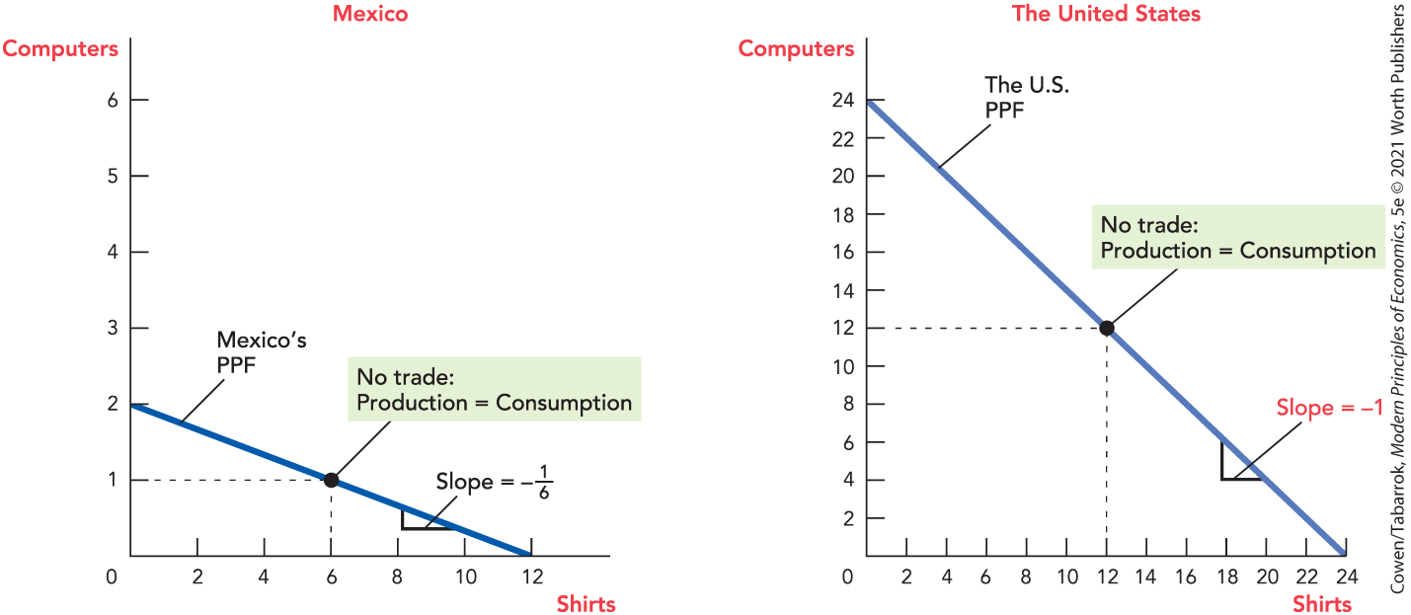
Production Possibilities Curves

Slide 28
Trade Increases Productivity (1 of 4)
If each country produces some of each good and only consumes what it produces:
Production Possibilities (No trade)
Country | Computers | Shirts
Mexico | 1 | 6
United States | 12 | 12
TOTAL: | 13 | 18

Slide 29
Trade Increases Productivity (2 of 4)
If each country specializes and trades, there is more of everything:
Production Possibilities (With trade)
Country | Computers | Shirts
Mexico | 0 | 12
United States | 14 | 10
TOTAL: | 14 | 22

Slide 30
Trade Increases Productivity (3 of 4)
After trade, if Mexico gives 3 shirts to the United States for 1 computer:
Consumption (After trade)
Country | Computers | Shirts
Mexico | 0 + 1 = 1 | 12 – 3 = 9
United States | 14 – 1 = 13 | 10 + 3 = 13
TOTAL: | 14 | 22

Slide 31
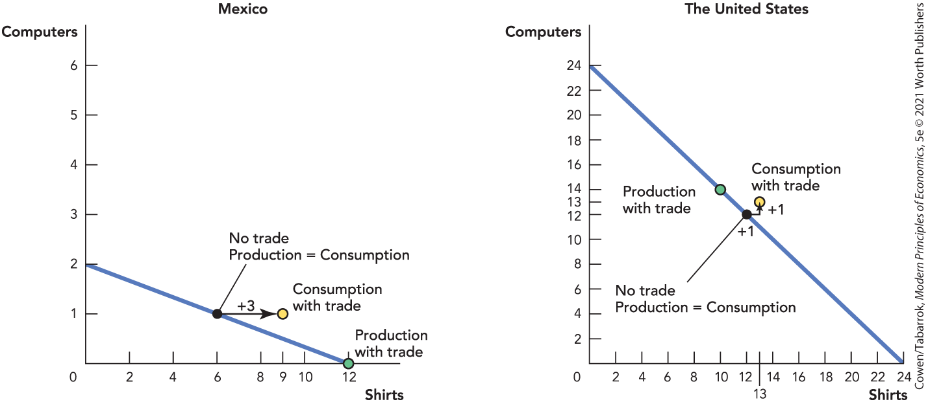
Trade Increases Productivity (4 of 4)
Notes:
Figure 2-2: Production and Consumption in Mexico and the United States with Trade

Slide 32
Comparative Advantage (10 of 11)
What makes trade profitable is differences in comparative advantage.
A country will always have some comparative advantage.
Thus, everyone can benefit from trade.

Slide 33
Comparative Advantage (11 of 11)
Comparative Advantage and Wages
Differences in wages reflect differences in productivity.
Wages will be higher in high-productivity countries than in low-productivity countries.
Trade raises wages to the highest levels allowed by a country’s productivity.

Slide 34
Trade and Globalization
Globalization and Wages
Wages will rise in high-demand industries and fall in low-demand industries.
Workers will move from low-wage industries to high-wage industries until wages equalize.
The transition isn’t always quick or easy.

Slide 35
Takeaway
Trade makes people better off when preferences differ.
With specialization and trade, the total sum of knowledge used in an economy increases tremendously.
A country can increase its standard of living by specializing in what it can make at low opportunity cost and trading.

