Slide 1

MODERN PRINCIPLES OF ECONOMICS
Fifth Edition
Chapter 5 Elasticity and Its Applications
© 2021 Worth Publishers. All Rights Reserved.

Slide 2
Outline
The Elasticity of Demand
Applications of Demand Elasticity
The Elasticity of Supply
Applications of Supply Elasticity
Using Elasticities for Quick Predictions
Appendix: Other Types of Elasticities

Slide 3
Introduction
In this chapter, we develop the tools of demand and supply elasticity.
In Chapter 4, we discussed how to shift the supply and demand curves to produce qualitative predictions about changes in prices and quantities.
Estimating elasticity is the first step in quantifying how changes in demand and supply will affect prices and quantities.

Slide 4
Definition (1 of 2)
Elasticity of Demand:
Measures how responsive the quantity demanded is to a change in price.
More responsive = more elastic.

Slide 5
Elasticity of Demand (1 of 2)
Elasticity is not the same as slope, but they are related.
Elasticity rule: If two linear demand (or supply) curves run through a common point, then the curve that is flatter is more elastic.

Slide 6
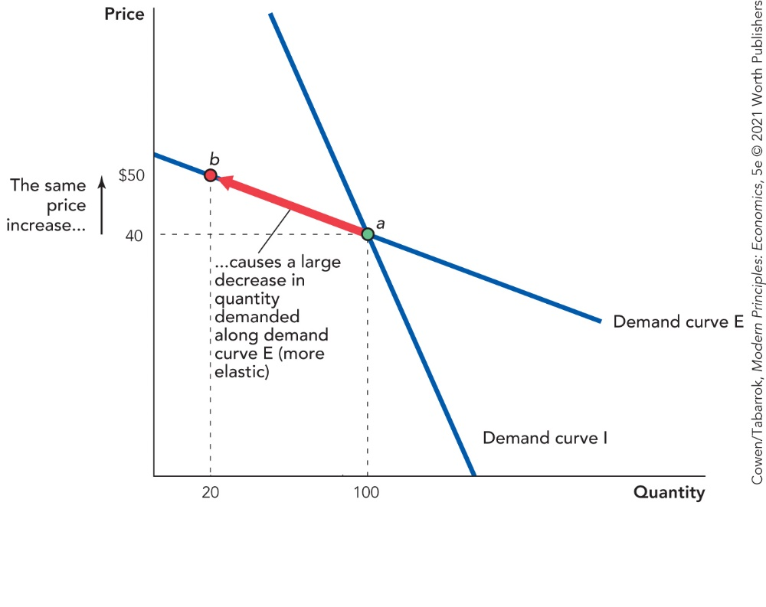
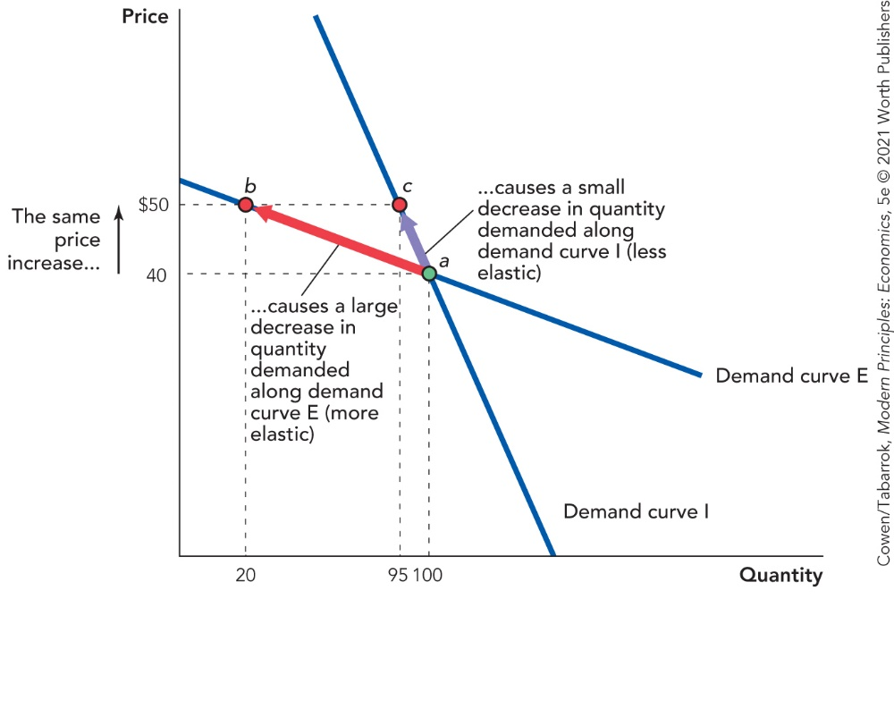
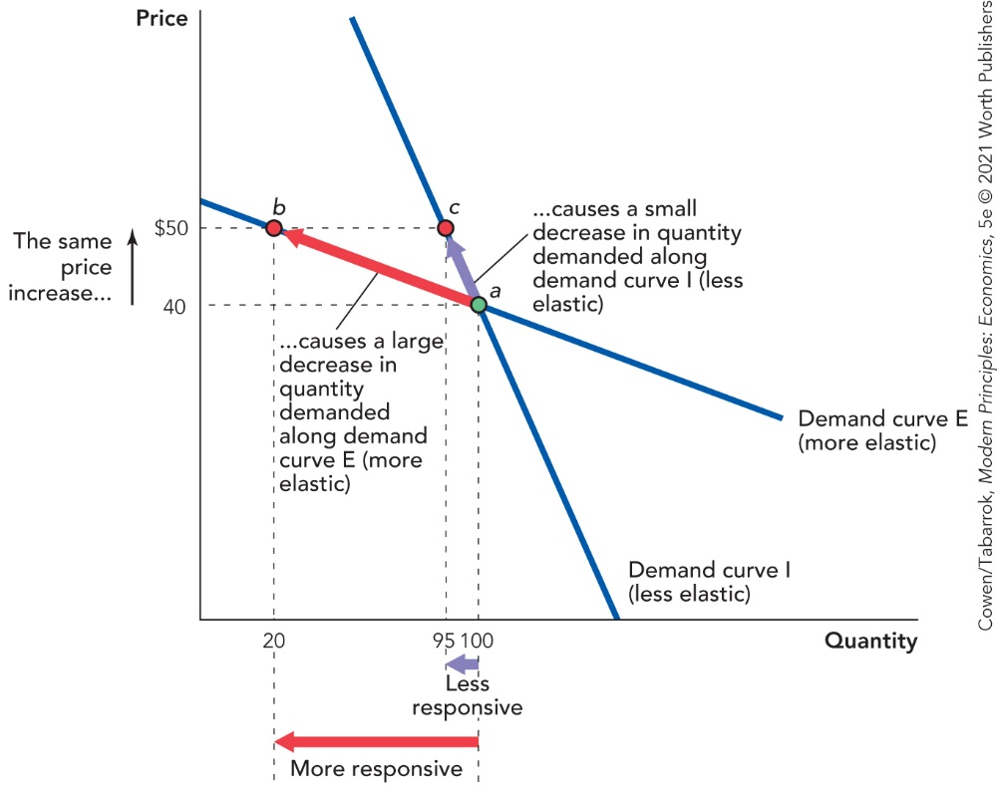
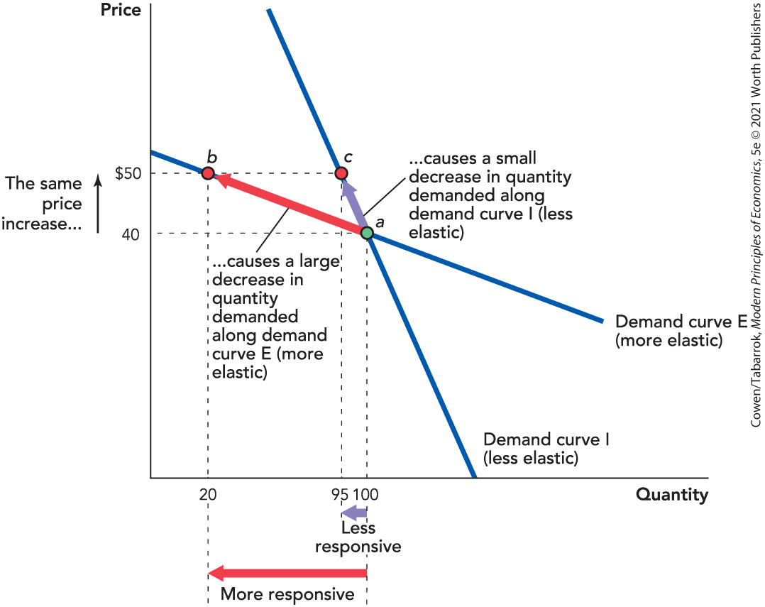
Elasticity of Demand (2 of 2)

Slide 7
Determinants of Elasticity of Demand (1 of 3)
Ease in finding substitutes
Easier to substitute → greater elasticity
Time to adjust to price change
More time → more substitutes → greater elasticity
The definition of the commodity
Narrow definition/specific brand → more substitutes → greater elasticity
Notes:
As the text indicates, there are relatively few substitutes for oil in many uses, such as powering cars. This implies that, at least in the short run, users continue to purchase oil and products made using oil—the elasticity of demand for oil is inelastic. But over time, users will seek out and find alternatives to oil, so the demand elasticity becomes greater as more time passes.

Slide 8
Determinants of Elasticity of Demand (2 of 3)
Necessities versus luxuries
Luxuries → greater elasticity
Share of budget devoted to the good
Larger share → greater elasticity

Slide 9
Determinants of Elasticity of Demand (3 of 3)
Less Elastic | More Elastic
Fewer substitutes | More substitutes
Short run (less time) | Long run (more time)
Categories of product | Specific brands
Necessities | Luxuries
Small part of budget | Large part of budget

Slide 10
Self-Check (1 of 6)
Would demand for BMW cars be more elastic or less elastic than demand for cars in general?
more elastic
less elastic

Slide 11
Self-Check (1 of 6) (Answer)
Would demand for BMW cars be more elastic or less elastic than demand for cars in general?
more elastic
less elastic
Answer:
Specific brands are more elastic than general categories, and luxuries are more elastic than necessities.

Slide 12
Calculating the Elasticity of Demand (1 of 4)
Formula for elasticity of demand:

Slide 13
Calculating the Elasticity of Demand (2 of 4)
Use the midpoint (average) as the base:

Slide 14
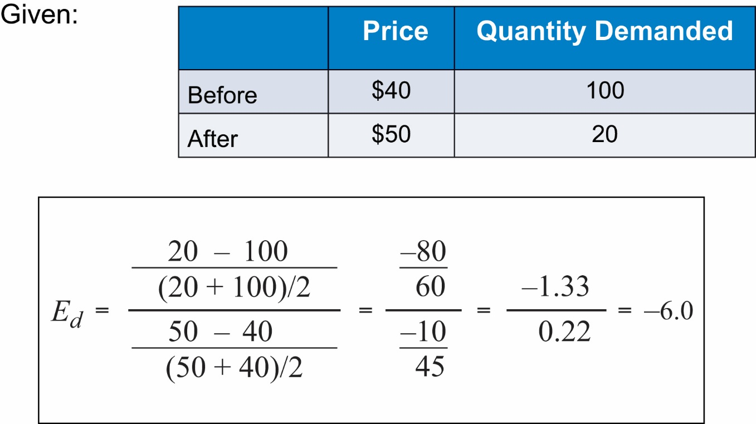
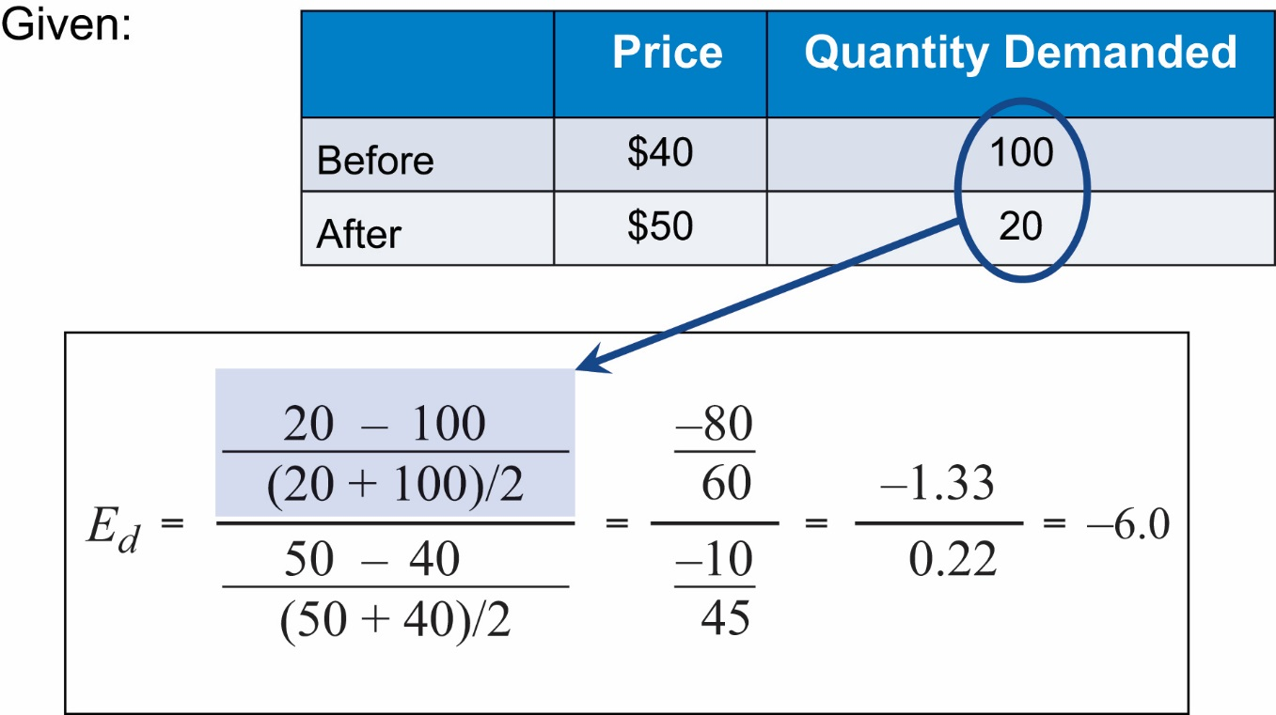
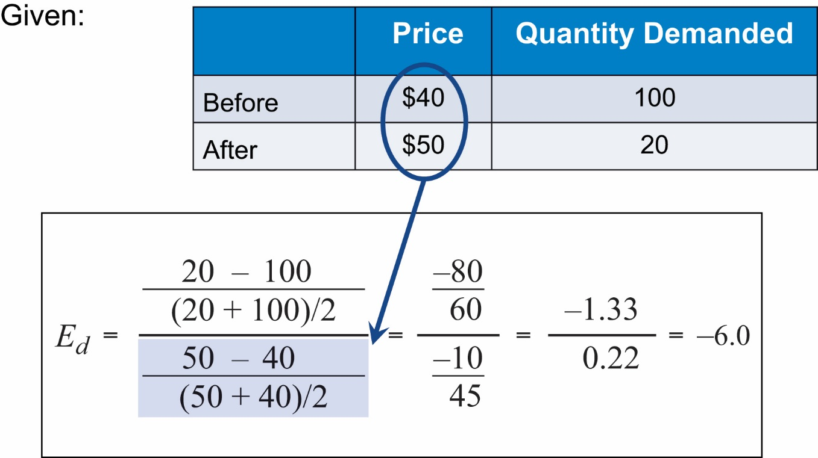
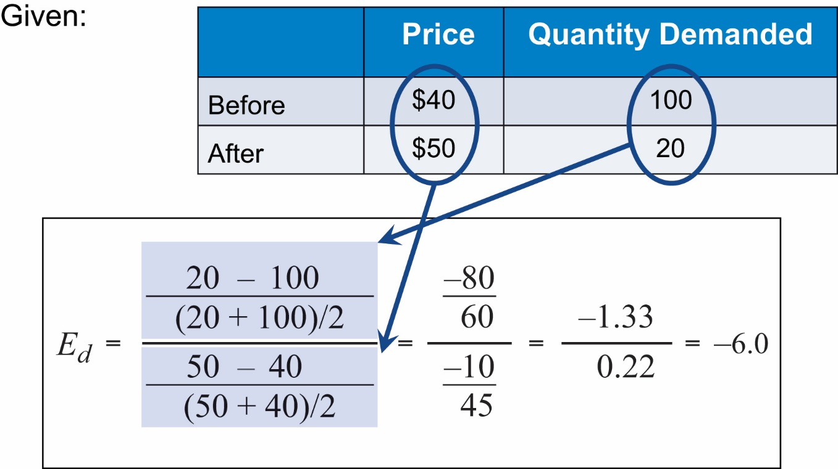
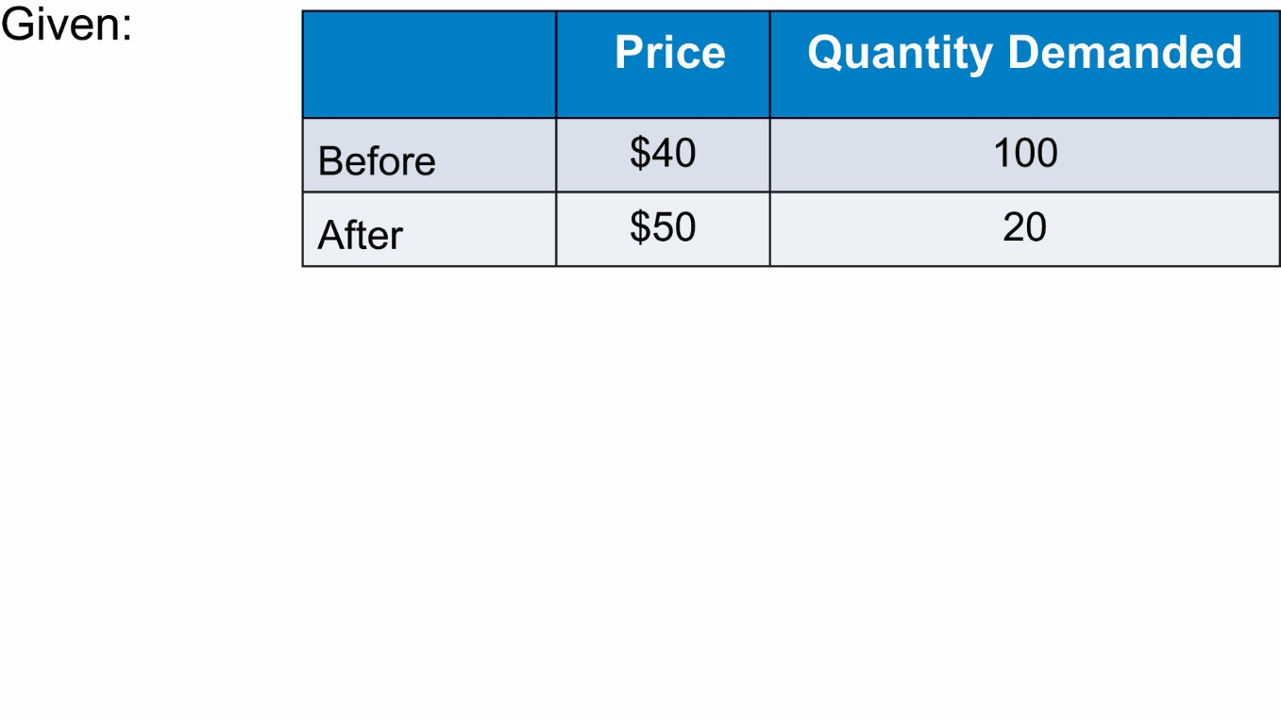
Calculating the Elasticity of Demand (3 of 4)

Slide 15
Self-Check (2 of 6)
What is the elasticity of demand if a price drop from $4 to $3 causes quantity to increase from 120 to 150?
−1.2857
−0.0635
−0.7778

Slide 16
Self-Check (2 of 6) (Answer)
What is the elasticity of demand if a price drop from $4 to $3 causes quantity to increase from 120 to 150?
−1.2857
−0.0635
−0.7778
Answer:
−0.7778

Slide 17
Self-Check (2 of 6) (Solved)
Price drop from $4 to $3 Quantity increase from 120 to 150

Slide 18
Calculating the Elasticity of Demand (4 of 4)
Usually interpreted using the absolute value (drop the minus sign)

Slide 19
Self-Check (3 of 6)
A price elasticity of 1.27 means that demand is:
elastic.
inelastic.
unit elastic.

Slide 20
Self-Check (3 of 6) (Answer)
A price elasticity of 1.27 means that demand is:
elastic.
inelastic.
unit elastic.
Answer:
Demand is elastic because 1.27 > 1.

Slide 21
Total Revenues and Elasticity (1 of 4)
A firm’s revenues = price per unit × quantity sold.
Revenue = Price × Quantity, or R = P × Q
Elasticity measures how much Q goes down when P goes up.

Slide 22
Total Revenues and Elasticity (2 of 4)
Relationship between elasticity and revenue:
If the demand curve is inelastic, then revenues ↑ when price ↑.
If the demand curve is elastic, then revenues ↓ when price ↑.

Slide 23
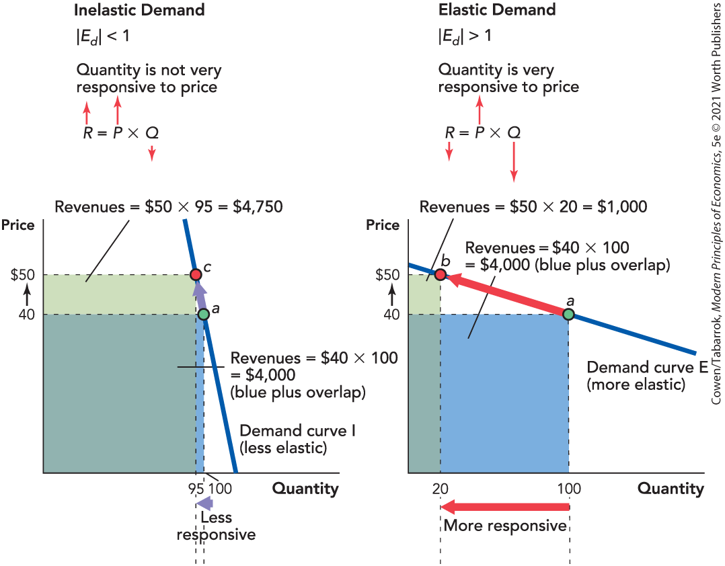
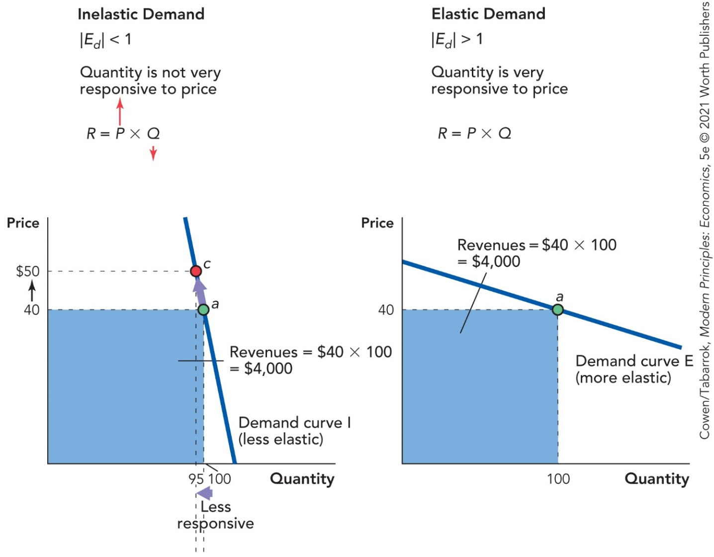
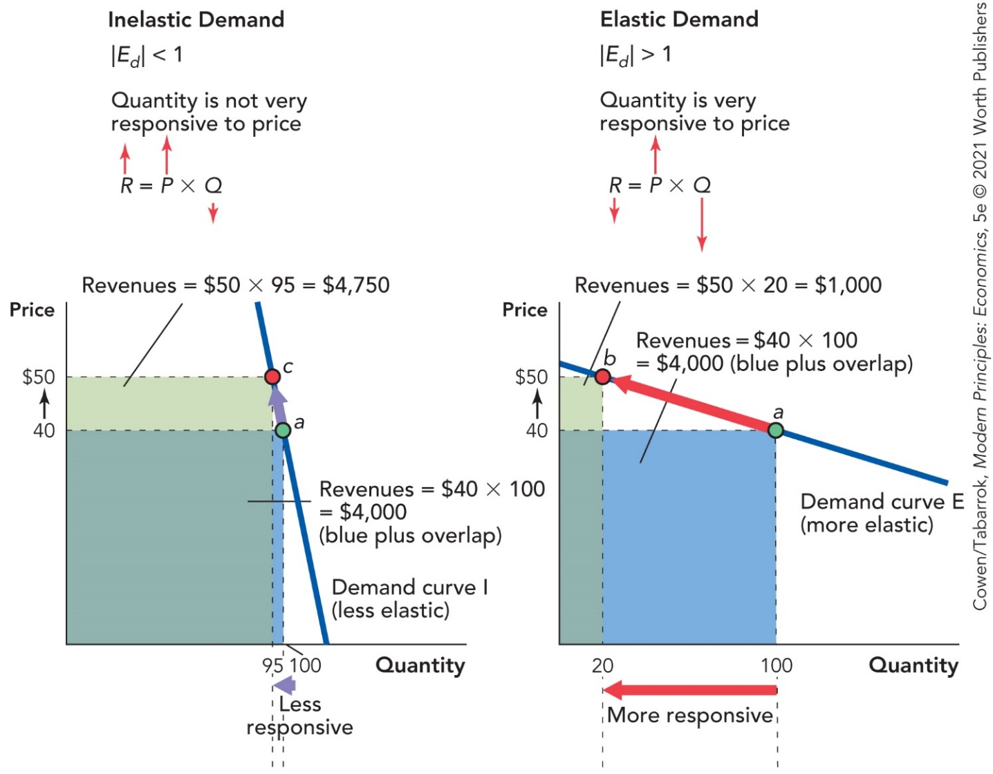
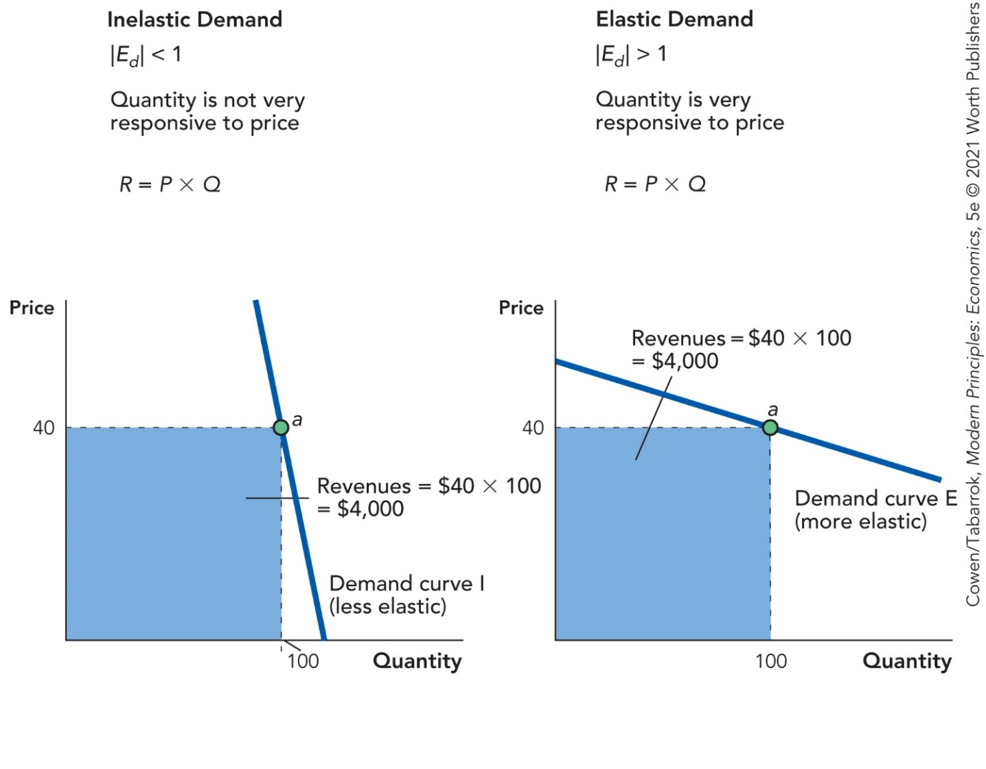
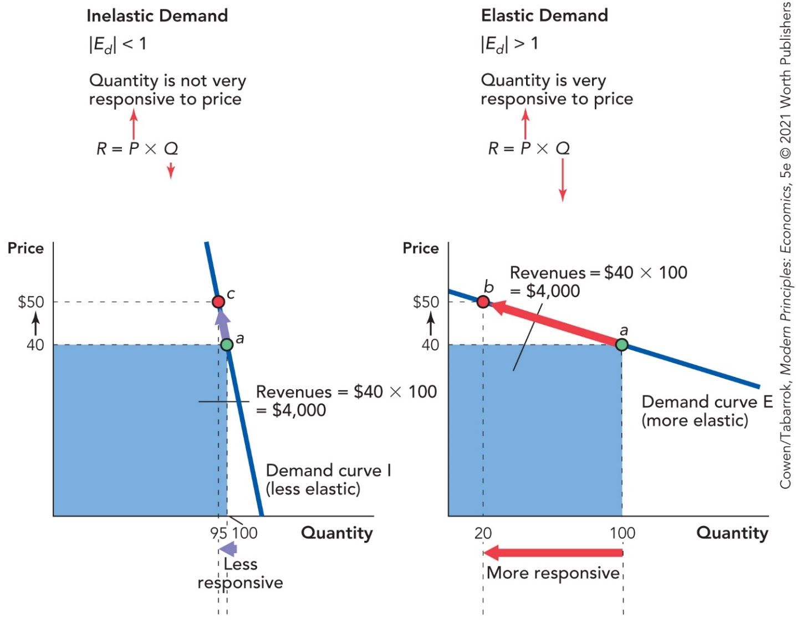
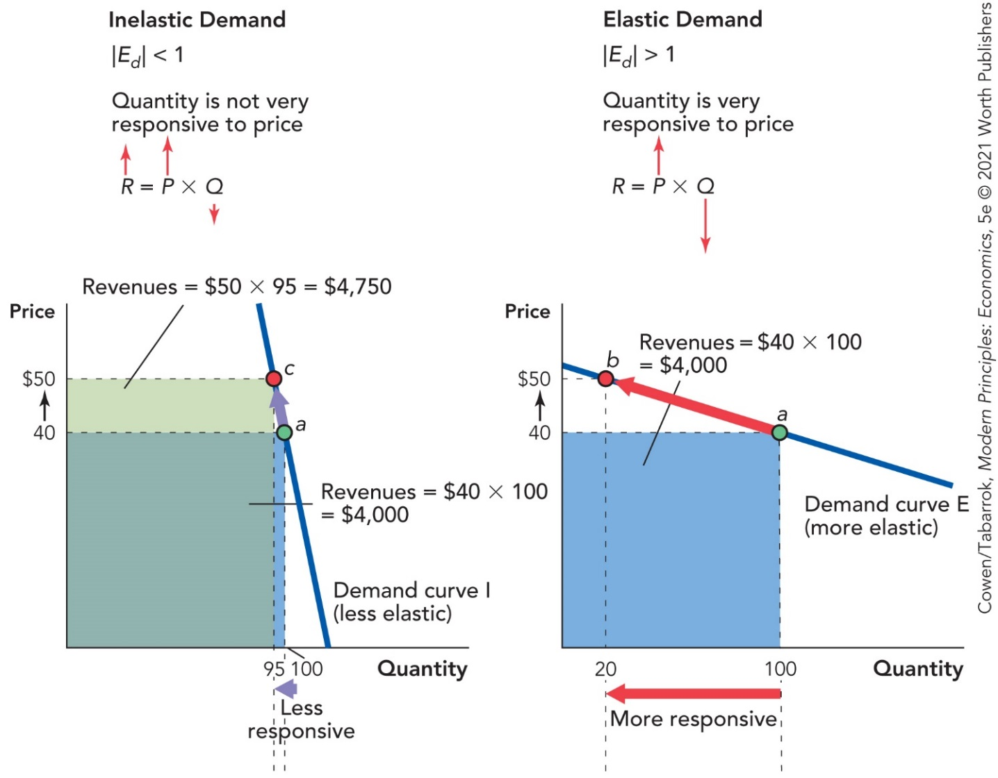
Total Revenues and Elasticity (3 of 4)

Slide 24
Total Revenues and Elasticity (4 of 4)
Summary: Absolute Value of E_{d} | Summary: Elasticity | Summary: Total Revenue and Price
|E_{d} | < 1 | Inelastic | TR and P move together
|E_{d} | > 1 | Elastic | TR and P move in opposite directions
|E_{d} | = 1 | Unit elastic | P changes but TR remains the same

Slide 25
Self-Check (4 of 6)
If the price elasticity of demand for wine is 1.2, and the price of wine increases, the total revenues of the wine industry would:
increase.
decrease.
remain the same.

Slide 26
Self-Check (4 of 6) (Answer)
If the price elasticity of demand for wine is 1.2, and the price of wine increases, the total revenues of the wine industry would:
increase.
decrease.
remain the same.
Answer:
Demand is elastic, so a price increase would cause revenues to decrease.

Slide 27
Applications of Demand Elasticity (1 of 4)
Productivity has increased in both farming and computer chips.
Farming revenues have declined, while revenues for computer chips have increased.
Demand for food is inelastic, while demand for computer chips is elastic.

Slide 28
Applications of Demand Elasticity (2 of 4)
Inelastic demand for food:
Increase in supply
→ Lower price
→ Lower revenues
Elastic demand for computer chips:
Increase in supply
→ Lower price → Higher revenues

Slide 29
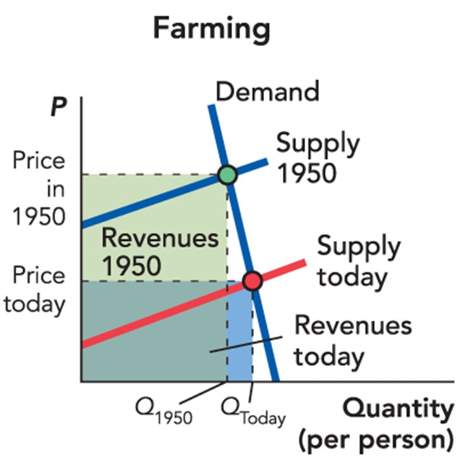
Applications of Demand Elasticity (3 of 4)

Slide 30
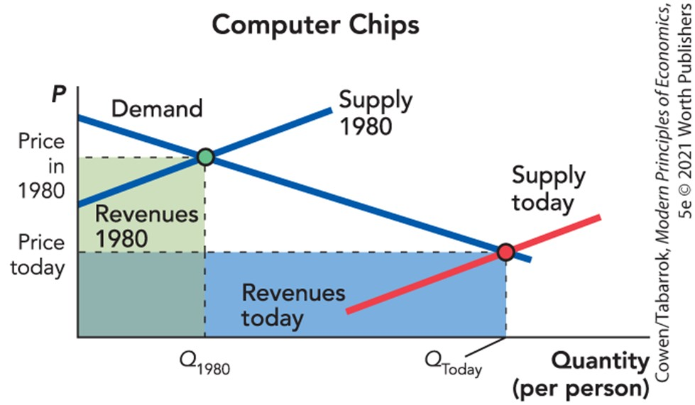
Applications of Demand Elasticity (4 of 4)

Slide 31
Self-Check (5 of 6)
If demand for iPhones is inelastic, an increased supply of iPhones would result in:
increased revenues.
decreased revenues.
unchanged revenues.

Slide 32
Self-Check (5 of 6) (Answer)
If demand for iPhones is inelastic, an increased supply of iPhones would result in:
increased revenues.
decreased revenues.
unchanged revenues.
Answer:
The increase in quantity sold would be offset by a much larger decrease in price.

Slide 33
Definition (2 of 2)
Elasticity of Supply:
Measures how responsive the quantity supplied is to a change in price.

Slide 34
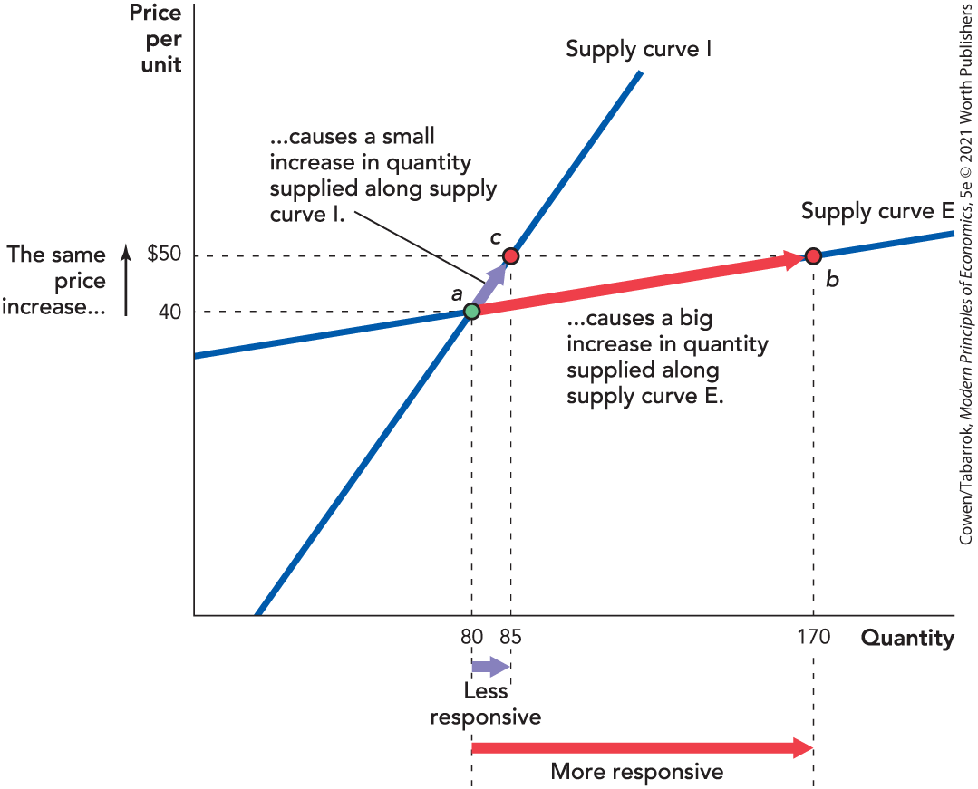
Elasticity of Supply
When price increases from $40 to $50:

Slide 35
Determinants of the Elasticity of Supply (1 of 4)
The fundamental determinant is how quickly per-unit costs increase with an increase in production.
If increased production requires much higher per-unit costs, then supply will be inelastic.
If production can increase without increasing per-unit costs very much, then supply will be elastic.

Slide 36
Determinants of the Elasticity of Supply (2 of 4)
Supply is more elastic when the industry can be expanded without causing a big increase in the demand for that industry’s inputs.
The local supply of a good is much more elastic than the global supply.
Supply tends to be more elastic in the long run than in the short run.

Slide 37
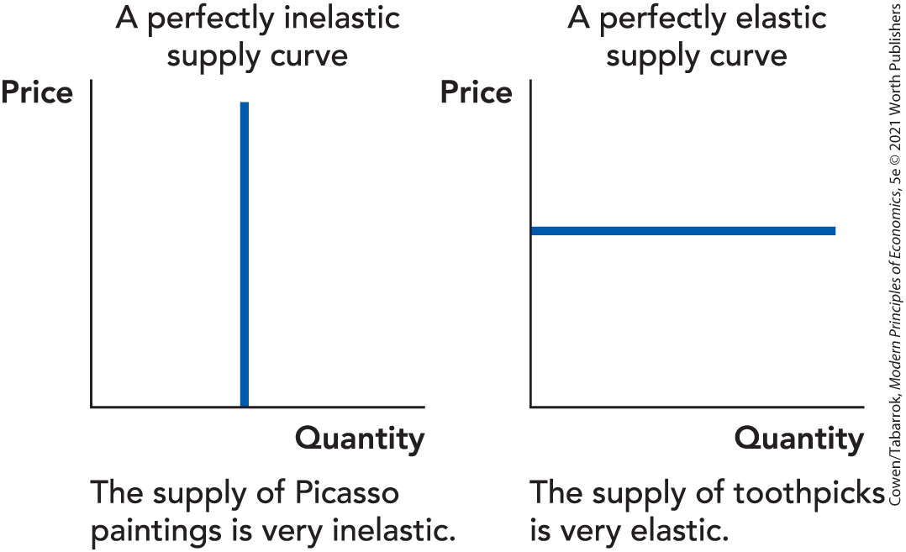
Determinants of the Elasticity of Supply (3 of 4)
Picasso painting
Toothpicks
Notes:
Figure 5-7: The Elasticity of Supply of Toothpicks and Picasso Paintings
The supply of Picasso paintings is inelastic because Picasso won’t paint any more no matter how high the price rises.
The supply of toothpicks is very elastic because it’s easy for suppliers to make more in response to even a small increase in price.

Slide 38
Determinants of the Elasticity of Supply (4 of 4)
Less Elastic | More Elastic
Difficult to increase production at constant unit cost (e.g., some raw materials) | Easy to increase production at constant unit cost (e.g., some manufactured goods)
Large share of market for inputs | Small share of market for inputs
Global supply | Local supply
Short run | Long run

Slide 39
Self-Check (6 of 6)
Would the supply of roofing nails in Fargo, North Dakota, be relatively elastic or inelastic?
elastic
inelastic

Slide 40
Self-Check (6 of 6) (Answer)
Would the supply of roofing nails in Fargo, North Dakota, be relatively elastic or inelastic?
elastic
inelastic
Answer:
It would be easy to increase production at constant unit cost; nails are a small share of the market for galvanized steel; and the local supply in Fargo is more elastic than the global supply.

Slide 41
Calculating the Elasticity of Supply (1 of 2)
Formula for elasticity of supply:

Slide 42
Calculating the Elasticity of Supply (2 of 2)
Use the midpoint (average) as the base:

Slide 43
Applications of Supply Elasticity (1 of 6)
Gun buyback programs:
Several cities in the United States have spent millions of dollars buying back guns.
The objective was to reduce the number of guns so as to lower crime rates.
Principles of economics predict that these programs are unlikely to reduce the number of guns on the streets.

Slide 44
Applications of Supply Elasticity (2 of 6)
When police buy guns, the demand for guns increases.
Since the supply of guns to a local region is very elastic, the street price of guns does not increase.
As a result, there is no decrease in the number of guns on the street.

Slide 45
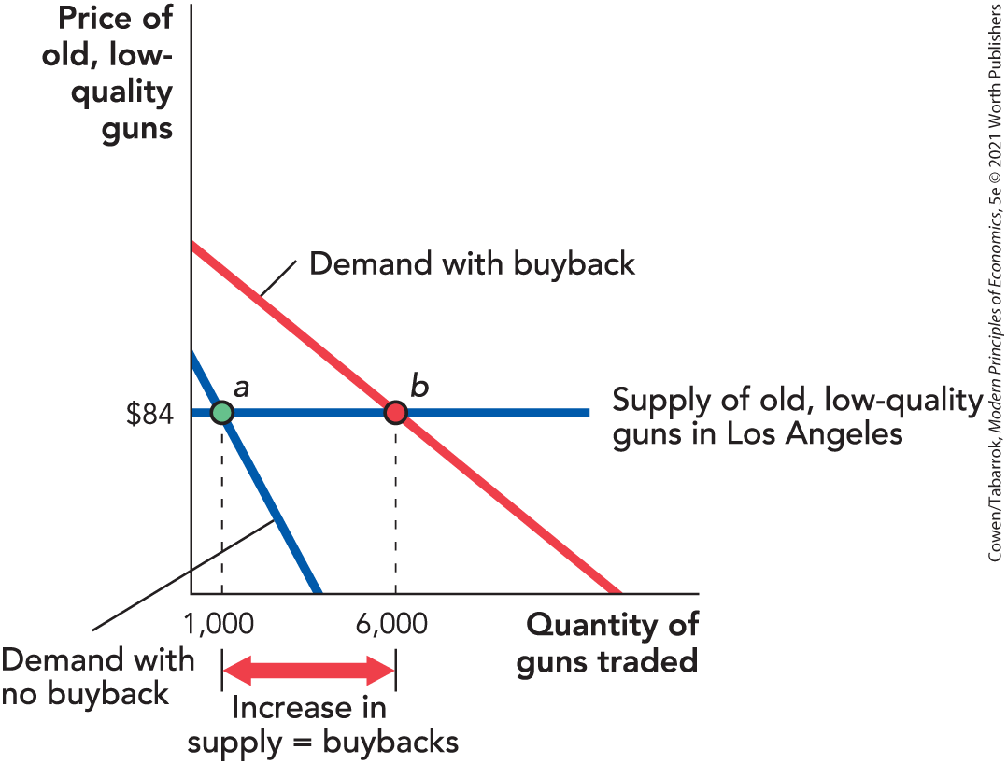
Applications of Supply Elasticity (3 of 6)

Slide 46
Applications of Supply Elasticity (4 of 6)
Economics of the housing supply:
The price of housing in the United States has increased dramatically.
Increases in population and income could be one reason for the change, as they increase demand.
Increases in demand have not led to increased housing prices in all cities.
The answer depends on the elasticity of supply.

Slide 47
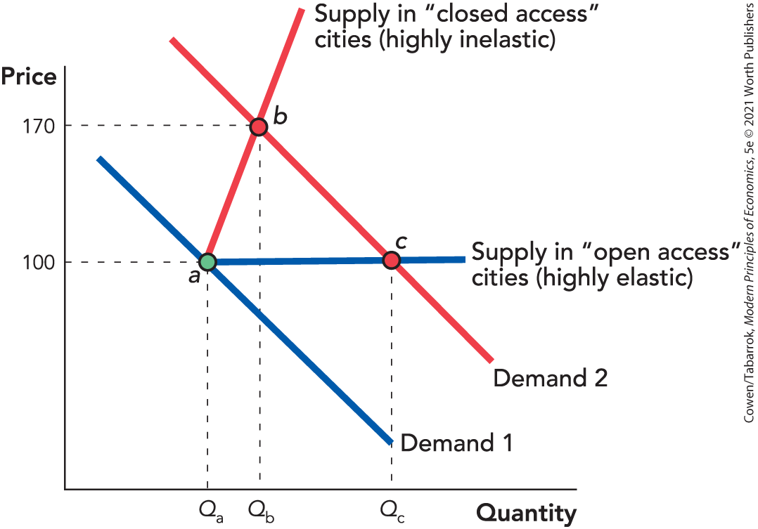
Applications of Supply Elasticity (5 of 6)
Inelastic supply:
Market price ↑ to $170
Number of houses bought ↑ to Q_{b}

Slide 48
Applications of Supply Elasticity (6 of 6)
Highly elastic supply:
Market price stays at $100
Number of houses bought ↑ to Q_{c}

Slide 49
Takeaway
Elasticity of demand measures how responsive the quantity demanded is to a change in price.
Elasticity of demand also tells you how revenues respond to changes in price.
If |E_{d}| < 1, price and revenue move together.
If |E_{d}| > 1, price and revenue move in opposite directions.
Elasticity can be used to explain many real-world problems.

