Slide 1

MODERN PRINCIPLES OF ECONOMICS
Fifth Edition
Chapter 8 (5) Price Ceilings and Floors
© 2021 Worth Publishers. All Rights Reserved.

Slide 2
Outline
Price Ceilings
Rent Controls
Arguments for Price Ceilings
Universal Price Controls
Price Floors
Takeaway

Slide 3
Introduction
Price controls
Laws making it illegal for prices to move above a maximum price (price ceilings) or below a minimum price (price floors)
Interfere with market signals
Delink some markets and link others in ways that are counterproductive

Slide 4
Definition (1 of 4)
Price ceiling:
A maximum price allowed by law.

Slide 5
Price Ceilings (1 of 11)
Price ceilings create five important effects:
Shortages
Reductions in product quality
Wasteful lines and other search costs
A loss of gains from trade
A misallocation of resources

Slide 6
Price Ceilings (2 of 11)
Shortages
When the price ceiling is below market price, Q^{d} > Q^{s}, which leads to a shortage.
The shortage is measured by the difference between Q^{d} and Q^{s} at the controlled price.
The lower the controlled price is relative to the market equilibrium price, the larger the shortage.

Slide 7
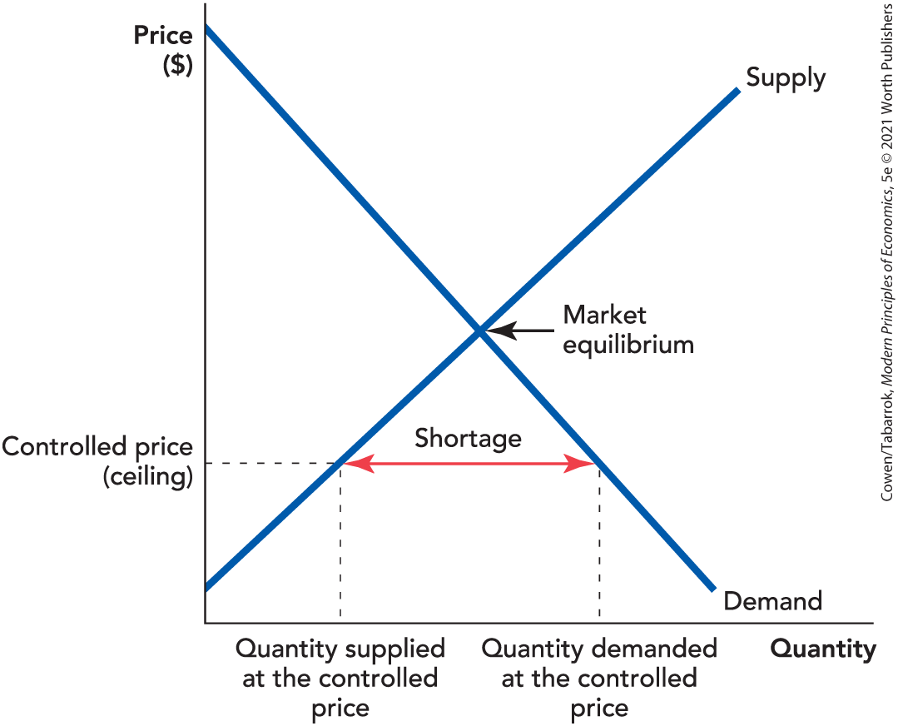
Price Ceilings (3 of 11)
Notes:
Figure 5-1 (8-1): Price Ceilings Create Shortages

Slide 8
Self-Check (1 of 5)
Price ceilings create shortages because when the controlled price is lower than market price:
Q_{d} = Q_{s}.
Q_{d} < Q_{s}.
Q_{d} > Q_{s}.

Slide 9
Self-Check (1 of 5) (Answer)
Price ceilings create shortages because when the controlled price is lower than market price:
Q_{d} = Q_{s}.
Q_{d} < Q_{s}.
Q_{d} > Q_{s}.
Answer:
The quantity demanded is greater than the quantity supplied.

Slide 10
Price Ceilings (4 of 11)
Reductions in Quality
At the controlled price, sellers find there is an excess of demand.
Sellers can evade the law by cutting quality rather than raising price.
Another way quality can fall is with reductions in service.

Slide 11

Price Ceilings (5 of 11)
In 1972, AFL-CIO boss George Meany complained that the number of matzo balls in his favorite soup had sunk from four to three, in effect raising the price.

Slide 12
Price Ceilings (6 of 11)
Wasteful Lines
At the controlled price, demanders are willing to pay more.
The price controls make a higher price illegal.
Other ways to pay:
Bribes
Waiting in line (includes value of time)
A bribe goes to the supplier, while time in line goes to no one.

Slide 13
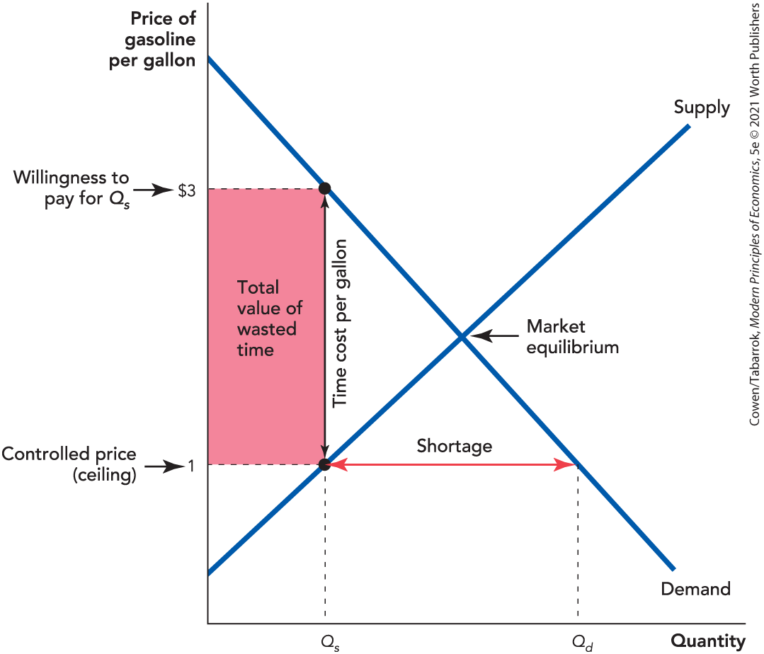
Price Ceilings (7 of 11)
At the controlled price:
Buyers are willing to pay $3/gallon
The line will grow until total cost = price + time, or $3
Notes:
Figure 5-2 (8-2): Price Ceilings Create Wasteful Line

Slide 14
Price Ceilings (8 of 11)
Lost Gains from Trade
As long as
there are mutually profitable trades that can be made.
With price controls, some profitable trades will not be made.
This creates a deadweight loss.

Slide 15
Definition (2 of 4)
Deadweight loss:
The reduction in surplus caused by a market distortion or inefficiency.

Slide 16
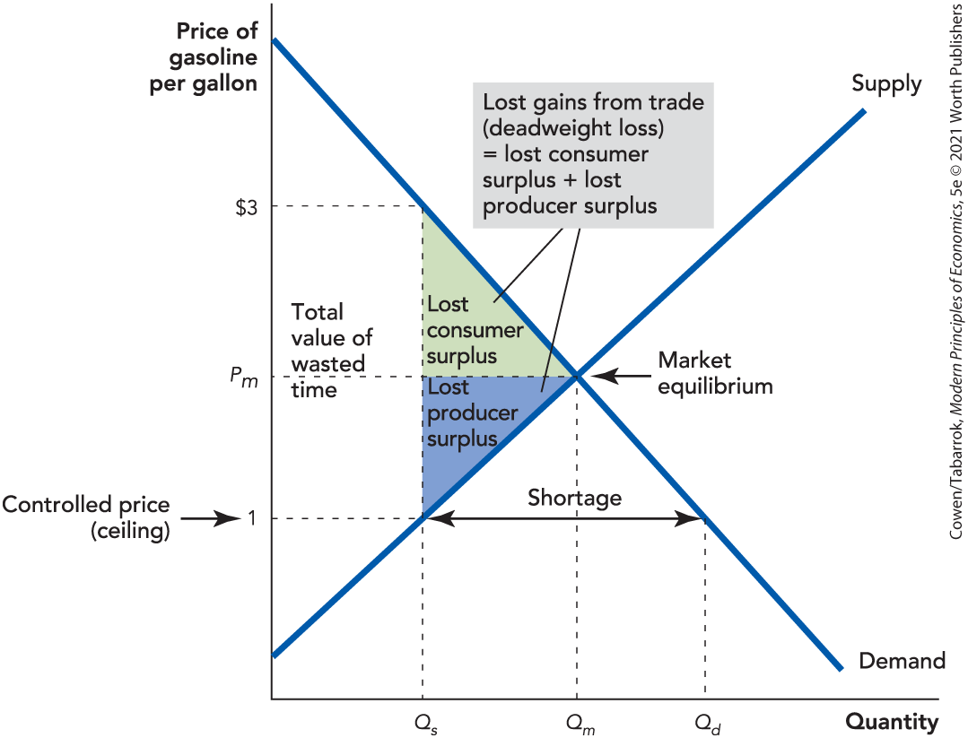
Price Ceilings (9 of 11)
Lost consumer surplus
Lost producer surplus
A + B = Total lost gains from trade
Notes:
Figure 5-3 (8-3): A Price Ceiling Reduces the Gains from Trade

Slide 17
Price Ceilings (10 of 11)
Misallocation of Resources
When prices are controlled, resources do not flow to their highest-valued uses.
Example: A cold winter increases the demand for heating oil.
The demanders of heating oil are prevented from bidding up the price of oil.
There is no signal and no incentive to ship oil to where it is needed most.

Slide 18
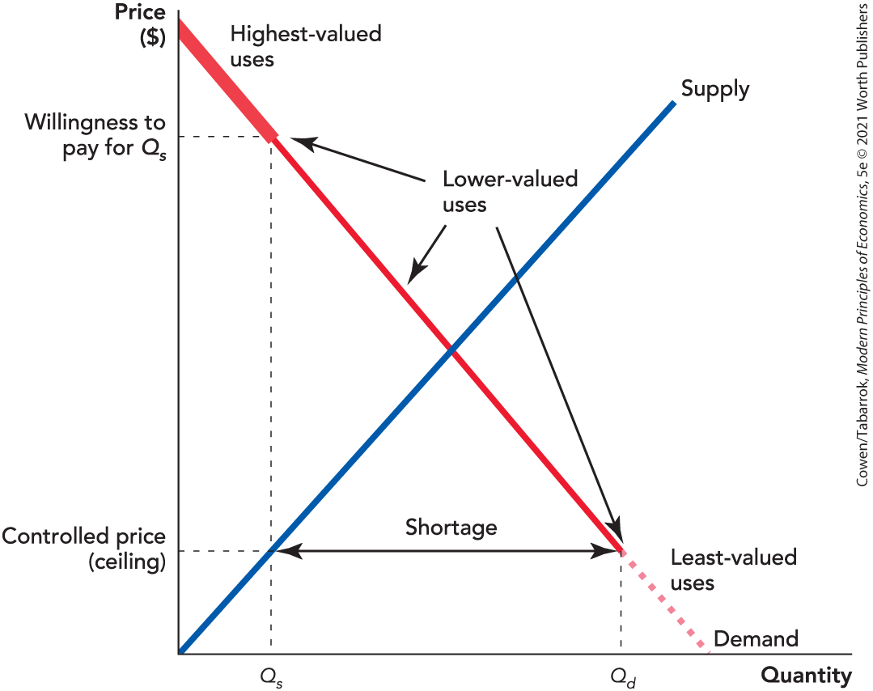
Price Ceilings (11 of 11)
Notes:
Figure 5-5 (8-5): When Prices Are Controlled, Resources Do Not Flow to Their Highest-Valued Uses

Slide 19
Self-Check (2 of 5)
Under a price ceiling, resources are misallocated because:
price can’t signal that there is a shortage.
quantity can’t respond to changing prices.
neither price nor quantity can increase or decrease.

Slide 20
Self-Check (2 of 5) (Answer)
Under a price ceiling, resources are misallocated because:
price can’t signal that there is a shortage.
quantity can’t respond to changing prices.
neither price nor quantity can increase or decrease.
Answer:
The price is not allowed to increase, which would signal that there is a shortage.

Slide 21
Advanced Material: The Loss from Random Allocation (1 of 2)
Under a price control, a good is not necessarily allocated to its highest-valued uses.
Consumer surplus will be less than under market allocation.
In the worst-case scenario, all the goods are allocated to the lower-valued uses.
More likely, goods are allocated randomly so that a high-valued use is as likely as a low-valued use.

Slide 22
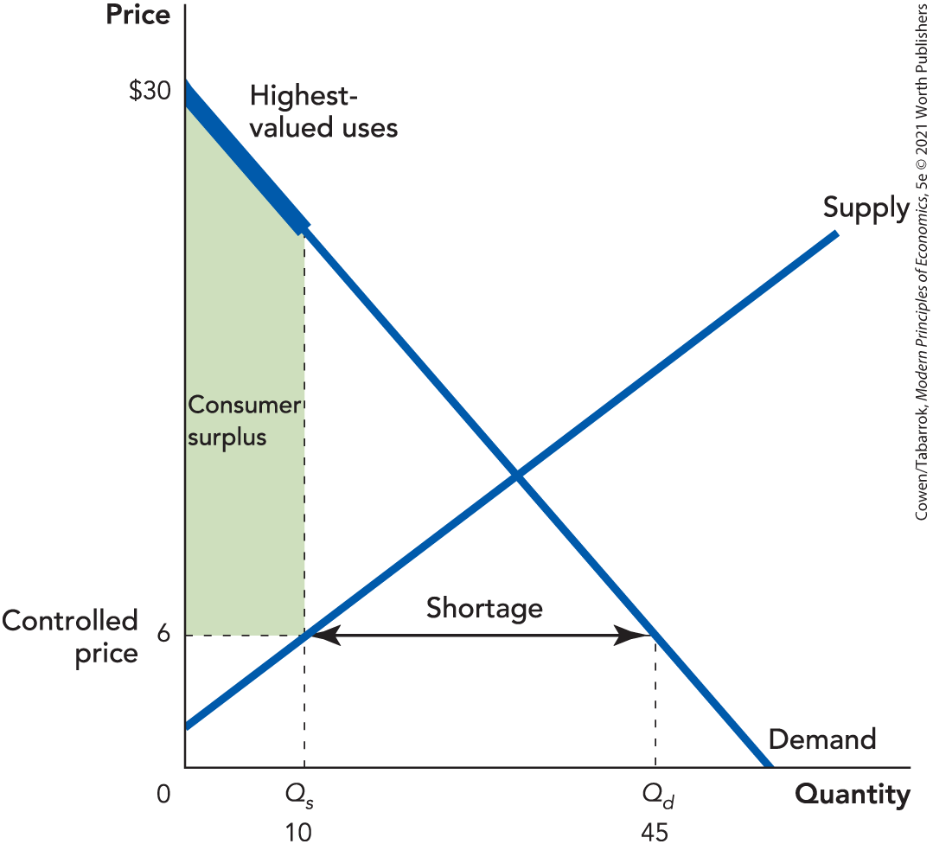
Best-Case Scenario
Best-case scenario: Goods go to the highest-valued uses; consumer surplus is the green area.
Notes:
Figure 5-6 (8-6): In a Free Market Goods Flow to Their Highest-Value Uses

Slide 23
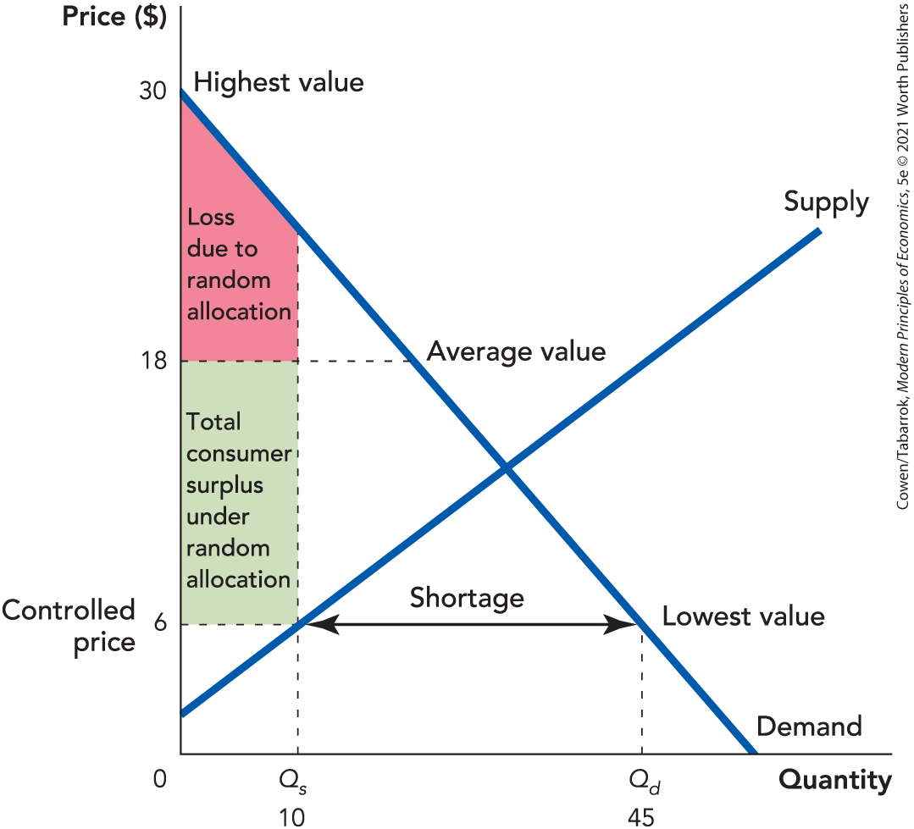
Advanced Material: The Loss from Random Allocation (2 of 2)
If goods are allocated randomly, average value will be $18.
Resources are misallocated, reducing consumer surplus to the green area.
Notes:
Figure 5-7 (8-7): Consumer Surplus Falls Under Random Allocation

Slide 24
Price Controls and Production
Shortages in one market create breakdowns and shortages in other markets.
The effects of price controls expand into markets without price controls.
In an economy with many price controls, shortages can appear at any time.
Shortages of steel drilling equipment made it difficult to expand oil production, even as the United States was undergoing the worst energy crisis in its history.

Slide 25
Self-Check (3 of 5)
The effects of price controls:
are restricted to one market.
disappear over time.
can spread to other markets without price controls.

Slide 26
Self-Check (3 of 5) (Answer)
The effects of price controls:
are restricted to one market.
disappear over time.
can spread to other markets without price controls.
Answer:
The effects of price controls can spread to markets without price controls.

Slide 27
Definition (3 of 4)
Rent control:
A price ceiling on rental housing.

Slide 28
Rent Controls (1 of 4)
Rent Controls
Usually begin with a rent freeze, prohibiting landlords from raising rents
As overall rents rise, controlled rents fall below the market equilibrium rent.
The short-run supply curve for apartments is inelastic.
Landlords have few options other than to absorb the lower price.

Slide 29
Rent Controls (2 of 4)
Rent Controls
The long-run supply curve is much more elastic than the short-run supply curve.
The shortage grows over time:
Fewer new apartment units are built.
Older units are turned into condominiums.
Units are torn down to make way for other uses.

Slide 30
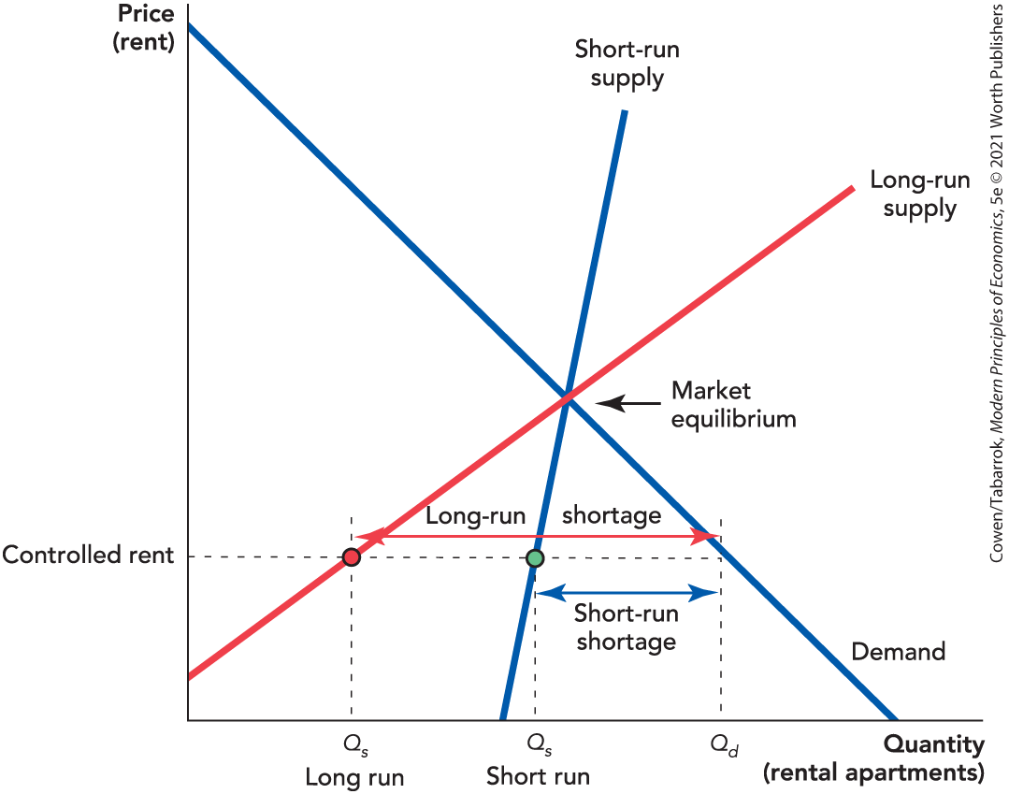
Rent Controls (3 of 4)
Notes:
Figure 5-8 (8-8): Rent Control Creates Larger Shortages in the Long Run Than in the Short Run

Slide 31
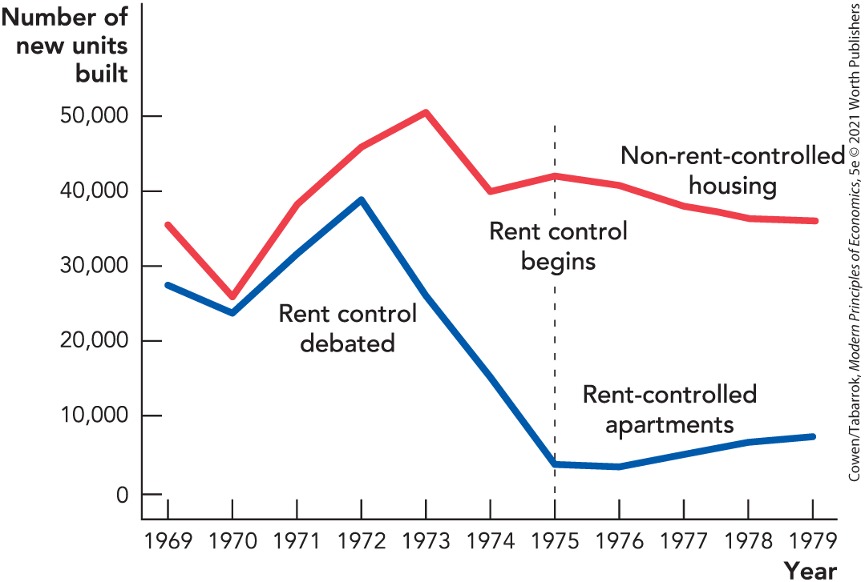
Rent Controls (4 of 4)
Rent control reduces the building of new apartments.
Notes:
Figure 5-9 (8-9): Rent Control Reduces the Building of New Apartments

Slide 32
Self-Check (4 of 5)
Shortages caused by rent controls:
become more severe over time.
become less severe over time.
remain constant over time.

Slide 33
Self-Check (4 of 5) (Answer)
Shortages caused by rent controls:
become more severe over time.
become less severe over time.
remain constant over time.
Answer:
Since long-run supply is more elastic than short-run supply, shortages caused by rent controls become more severe over time.

Slide 34
Reductions in Product Quality
Rent controls reduce housing quality.
Maintenance costs rise.
Owners respond by cutting costs.
When rent controls are strong:
Apartment buildings turn into slums.
Slums turn into abandoned and hollowed-out buildings.

Slide 35
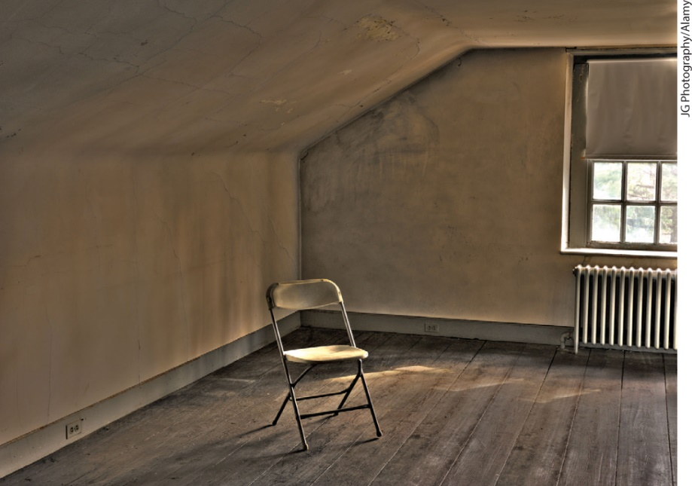
Wasteful Lines, Search Costs, Lost Gains
Finding an apartment often involves a costly search.
At controlled prices, landlords have more renters than apartments, so they can discriminate.
Bribes are illegal but can be disguised:
“Key money”
Renter charged for a “furnished” apartment
A rent-controlled apartment—supposedly furnished

Slide 36
Misallocation of Resources (1 of 2)
Apartments are not allocated to the renters who value them the most.
Some people with a high willingness to pay can’t buy as much housing as they want.
Others with a low willingness to pay consume more housing than they would purchase at the market rate.

Slide 37
Rent Regulation
In the 1990s, many American cities eliminated or eased rent controls.
Some changed their policies to “rent regulation.”
Limits are placed on the amount that rent can be increased—for example, 10% per year.
This usually allows landlords to pass along cost increases, so the incentive to cut back on maintenance is reduced.

Slide 38
Arguments for Price Controls
Rent controls help the poor.
Vouchers are a better way to help the poor:
Do not create a shortage
Can be targeted to the poor
The best case for price controls is to discipline monopolies.
Another reason may be that the public does not connect price controls with the consequences.

Slide 39
Definition (4 of 4)
Price floor:
A minimum price allowed by law.

Slide 40
Price Floors
Price floors create:
Surpluses
Lost gains from trade (deadweight loss)
Wasteful increases in quality
A misallocation of resources

Slide 41
Surpluses
An example of a price floor is a minimum wage.
A minimum wage above the market price creates a surplus.
The quantity of labor supplied exceeds the quantity demanded.
A surplus of labor is called unemployment.

Slide 42
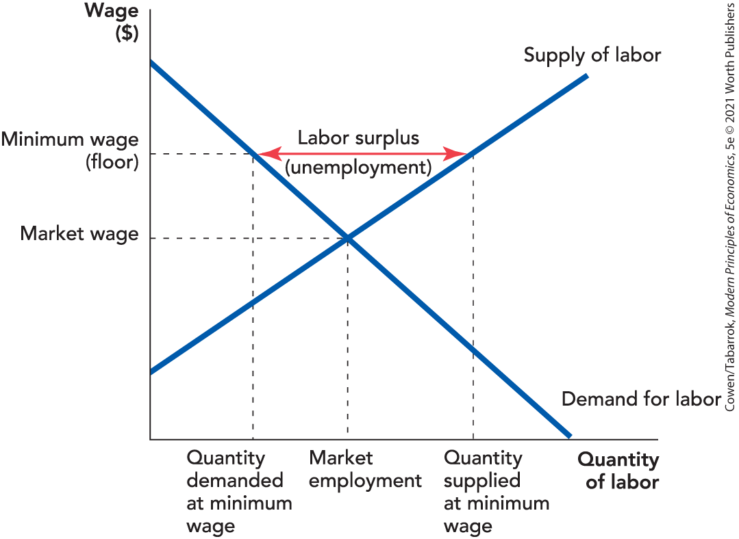
A Minimum Wage Creates a Surplus
Notes:
Figure 5-10 (8-10): A Price Floor Creates a Surplus (Minimum Wages Create Unemployment)

Slide 43
Self-Check (5 of 5)
Price floors result in:
higher prices in future.
a shortage.
a surplus.

Slide 44
Self-Check (5 of 5) (Answer)
Price floors result in:
higher prices in future.
a shortage.
a surplus.
Answer:
Price floors result in a surplus.

Slide 45
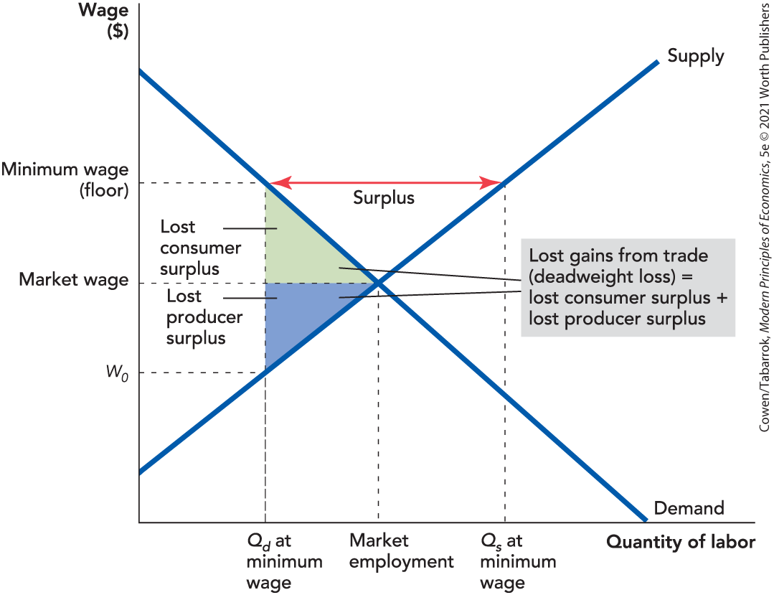
Lost Gains from Trade
Notes:
Figure 5-11 (8-11): A Price Floor Reduces the Gains from Trade

Slide 46
Wasteful Increases in Quality
U.S. airlines were extensively regulated from 1938 to 1978.
Unregulated fares were half the price of similar-length regulated flights.
The regulated prices were above the airlines’ willingness to sell.
Airlines couldn’t drop prices to compete for customers.
They competed by offering higher quality that buyers would otherwise not be willing to pay for.

Slide 47
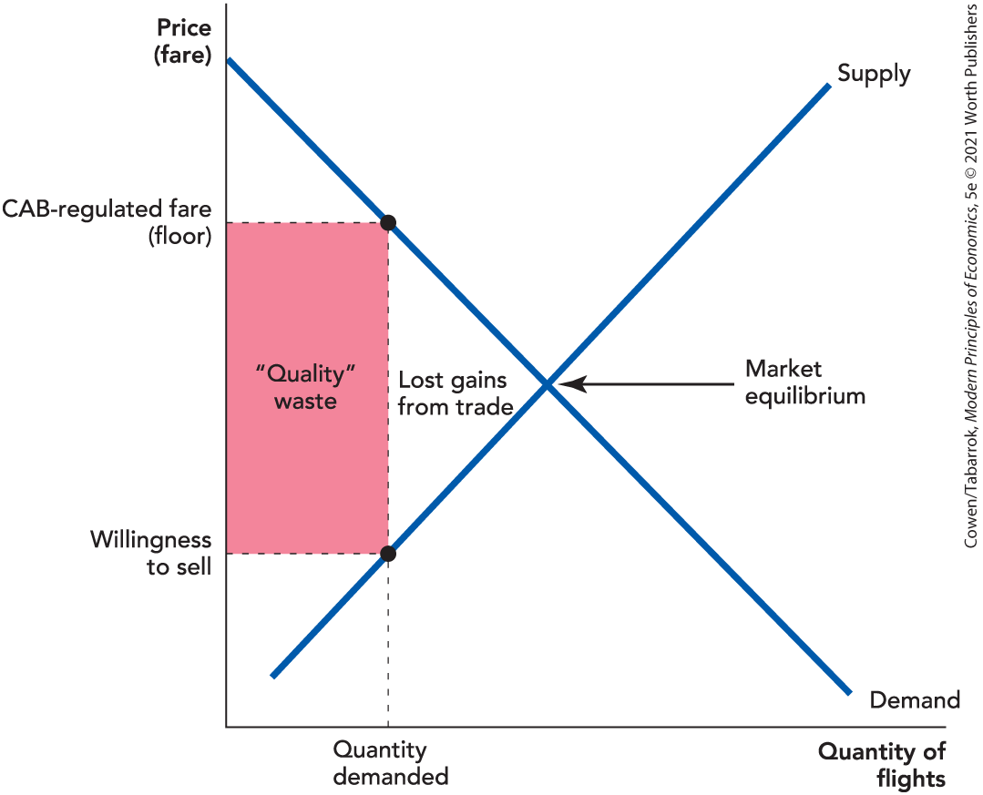
A Price Floor Creates Quality Waste
Notes:
Figure 5-12 (8-12): A Price Floor Creates Quality Waste

Slide 48
Misallocation of Resources (2 of 2)
Entry of new firms into the airline industry was also regulated.
Restrictions on entry misallocated resources because low-cost airlines were kept out of the industry.
This also kept out the innovations, new ideas, and experiments that are part of the market process.

Slide 49
Takeaway (1 of 2)
Price ceilings create:
Shortages
Reductions in quality
Wasteful lines and other search costs
A loss of gains from trade
A misallocation of resources
This affects not just the market with the price ceiling but potentially the whole economy.

Slide 50
Takeaway (2 of 2)
Price floors create:
Surpluses
A loss of gains from trade
Wasteful increases in quality
A misallocation of resources

