Slide 1

MODERN PRINCIPLES OF ECONOMICS
Fifth Edition
Chapter 12 Competition and the Invisible Hand
© 2021 Worth Publishers. All Rights Reserved.

Slide 2
Outline
Invisible Hand Property 1: The Minimization of Total Industry Costs of Production
Invisible Hand Property 2: The Balance of Industries
Creative Destruction
The Invisible Hand Works with Competitive Markets
Takeaway

Slide 3
Introduction
The conditions for profit maximization under competition lead entrepreneurs to produce outcomes that have desirable properties.
The P = MC condition balances production across firms in a way that minimizes total industry costs of production.
Entry and exit signals balance production across different industries in a way that maximizes the total value of production.

Slide 4
Minimization of Total Industry Costs
All firms in a perfectly competitive industry face the same market price.
To maximize profits each firm adjusts its output until P = MC.
Thus, in a competitive market with N firms:
P = MC₁ = MC₂ = … = MC_{N}
This results in minimizing total costs for the industry.

Slide 5
Minimization of Total Industry Costs of Production (1 of 5)
Example:
Assume you own two farms.
Each has a different MC curve.
You wish to produce a total of 200 bushels of wheat.
Do you choose to use one or both farms?

Slide 6
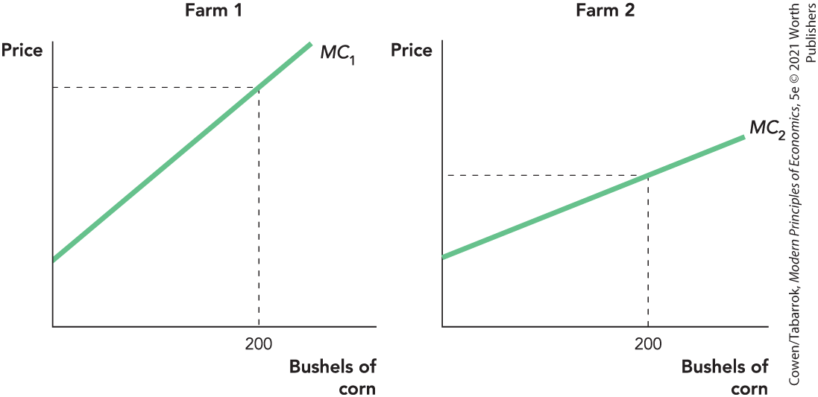
Minimization of Total Industry Costs of Production (2 of 5)
It might seem as if the lowest-cost way is to produce all 200 bushels on farm 2.

Slide 7
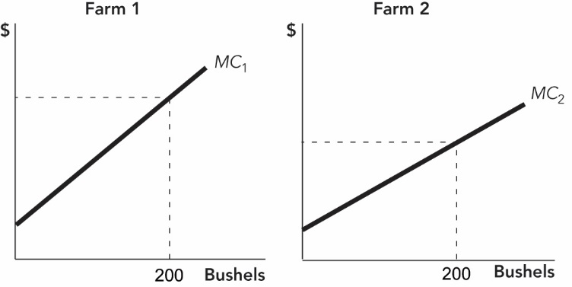
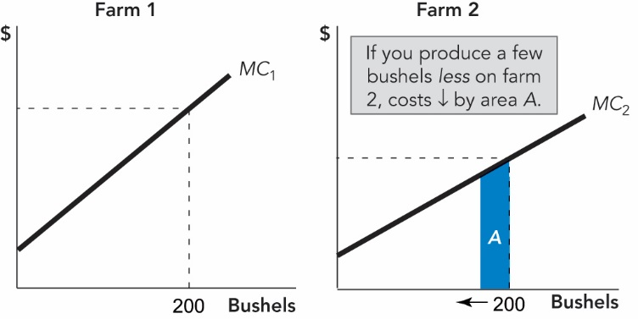
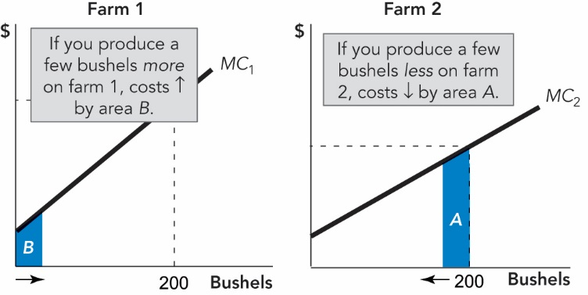
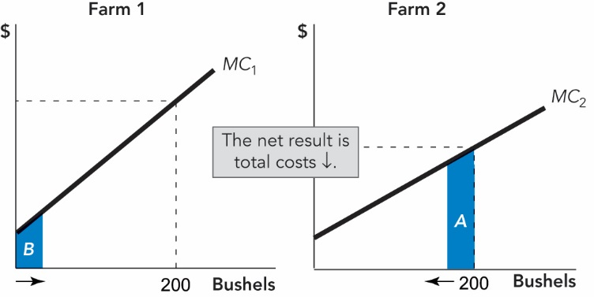
Minimization of Total Industry Costs of Production (3 of 5)
You can decrease overall costs by shifting some production from farm 2 to farm 1.

Slide 8
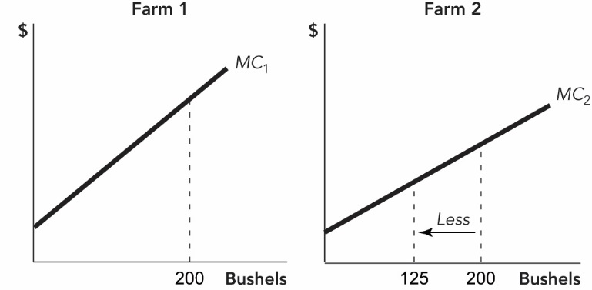
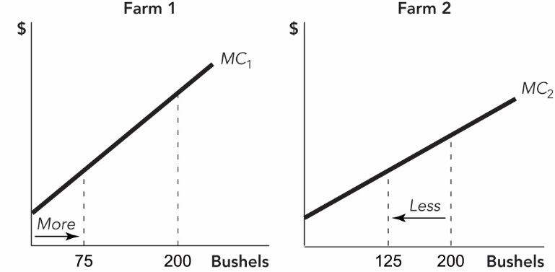
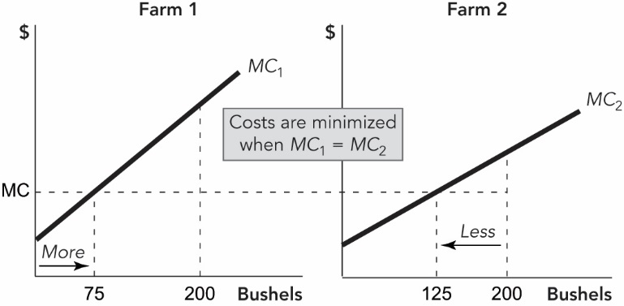
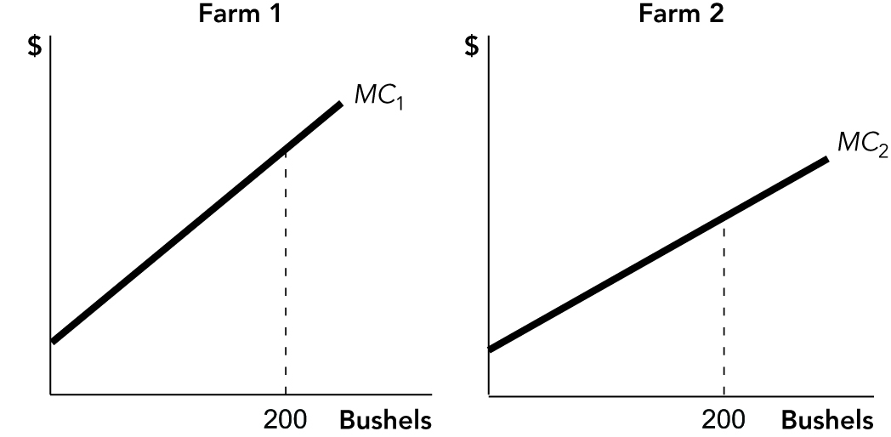
Minimization of Total Industry Costs of Production (4 of 5)
To minimize total production costs, set output on the two farms so that marginal costs are equal.

Slide 9
Minimization of Total Industry Costs of Production (5 of 5)
Market price allocates production across firms so that MC₁ = MC₂.
Each firm faces the same market price.
Each firm maximizes profits by producing where P = MC.
Therefore, P = MC₁ = MC₂ … = MC_{N}

Slide 10
Self-Check (1 of 2)
In a competitive market, total industry costs are minimized because each firm produces where:
Price = Total cost.
Price = Marginal cost.
Total revenue = Marginal revenue.

Slide 11
Self-Check (1 of 2) (Answer)
In a competitive market, total industry costs are minimized because each firm produces where:
Price = Total cost.
Price = Marginal cost.
Total revenue = Marginal revenue.
Answer:
Price = Marginal cost.

Slide 12
Balance of Industries (1 of 2)
Competitive markets ensure that the right amount of a good is produced.
Entrepreneurs seek profit and avoid losses.
Profit is a signal that labor and capital are being used productively in satisfying our wants.
Profit-seeking aligns with the social incentive to move labor and capital out of low-value industries and into high-value industries.

Slide 13
Balance of Industries (2 of 2)
Resources flow from low-profit industries to high-profit industries.
If P > AC, profits are above normal, causing capital and labor to enter the industry.
As firms enter, supply ↑ price ↓ → profits ↓.
If P < AC, profits are below normal, causing capital and labor to exit the industry.
As firms exit, supply ↓ price ↑ → profits ↑.
The profit rate in all competitive industries tends toward the same level.

Slide 14
Definition
Elimination principle:
Above-normal profits are eliminated by entry, and below-normal profits are eliminated by exit.

Slide 15
Creative Destruction (1 of 2)
Resources move toward an increase in the value of production.
Entrepreneurs move resources from unprofitable industries to profitable industries.
Implication of the elimination principle:
Above-normal profits are temporary.
To earn above-normal profits, entrepreneurs must innovate.

Slide 16
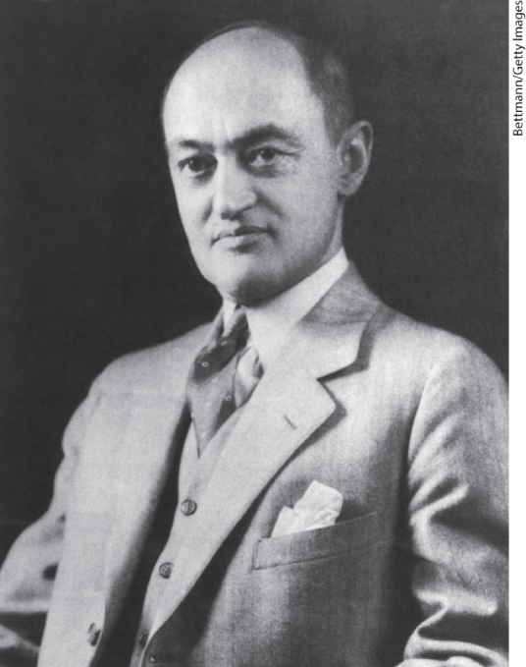
Creative Destruction (2 of 2)
Schumpeter believed innovation was far more important than price competition.
Innovation makes competitors obsolete.
“This process of creative destruction is the essential fact about capitalism.”
Joseph Schumpeter 1883–1950

Slide 17
Self-Check (2 of 2)
The idea that above-normal and below-normal profits are eliminated by firms entering and exiting an industry is called:
the elimination principle.
creative destruction.
profit maximization.

Slide 18
Self-Check (2 of 2) (Answer)
The idea that above-normal and below-normal profits are eliminated by firms entering and exiting an industry is called:
the elimination principle.
creative destruction.
profit maximization
Answer:
The elimination principle states that above- and below-normal profits are eliminated through entry and exit.

Slide 19
The Invisible Hand
The invisible hand will not work if:
Prices do not accurately signal costs and benefits.
There is no optimal balance between industries.
Markets are not competitive.
Monopolists and oligopolists produce less than the ideal amount.
Firms make above-normal profits, and entry is limited.
Commodities are public goods.
Self-interest does not align with social interest.

Slide 20
Takeaway (1 of 2)
Invisible Hand Property 1:
By producing where P = MC, the profit-seeking behavior of entrepreneurs minimizes the total industry costs of production.
Invisible Hand Property 2:
Entry and exit decisions eliminate profits.
Entry and exit also ensure that labor and capital move across industries to optimally balance production, so that the greatest use is made of limited resources.

Slide 21
Takeaway (2 of 2)
The elimination principle says that:
Above-normal profits are eliminated by entry and below-normal profits are eliminated by exit.
To earn above-normal profits, a firm must innovate.
Competitive markets align self-interest with the social interest.
Not all markets are competitive.

