Slide 1

MODERN PRINCIPLES OF ECONOMICS
Fifth Edition
Chapter 13 Monopoly
© 2021 Worth Publishers. All Rights Reserved.

Slide 2
Outline
Market Power
How a Firm Uses Market Power to Maximize Profit
The Costs of Monopoly: Deadweight Loss
The Costs of Monopoly: Corruption and Inefficiency
The Benefits of Monopoly: Incentives for Research and Development
Sources of Market Power
Regulating Monopoly
Takeaway

Slide 3

Introduction
Since 1981, AIDS has killed more than 36 million people.
In the United States, deaths from AIDS dropped 50% due to drugs like Combivir.
A Combivir pill costs $0.50 to produce, but sells for 25 times higher: $12.50.

Slide 4
Definition (1 of 4)
Market power:
The power to raise price above marginal cost without fear that other firms will enter the market.
Monopoly:
A firm with market power.

Slide 5
Market Power (1 of 2)
GlaxoSmithKline owns the patent on Combivir.
A patent gives exclusive rights to make, use, or sell the product.
GSK’s patent prevents competition.
This gives GSK market power.
India does not recognize the Combivir patent.
In India, an equivalent drug sells for $0.50, or the marginal cost.

Slide 6
Self-Check (1 of 4)
Market power allows a firm to raise price:
above average cost.
above marginal cost.
above marginal revenue.

Slide 7
Self-Check (1 of 4) (Answer)
Market power allows a firm to raise price:
above average cost.
above marginal cost.
above marginal revenue.
Answer:
Market power allows a firm to raise price above marginal cost without fear that other firms will enter the market.

Slide 8
Definition (2 of 4)
Marginal revenue (MR):
The change in total revenue from selling an additional unit.
Marginal cost (MC):
The change in total cost from selling an additional unit.
Notes:
These incremental measures were described in Chapter 11.

Slide 9
Market Power (2 of 2)
To maximize profit, firms produce at the level of output where:
MC = MR
A firm with market power must lower its price to sell an additional unit.
It faces a downward-sloping demand curve.
The additional revenue per unit < current price, or:
MR < P
Notes:
P and MR differ because when the price is lowered to sell an additional unit, the price must be lowered to all buyers, including those who had purchased the good at the previous, higher price.

Slide 10
Marginal Revenue (1 of 2)
When price ↓ from $16 to $14, quantity ↑ from 2 to 3 units.
Total revenue ↑ from $32 to $42.
MR, or the change in total revenue, is $10.
P | Q | TR (P × Q) | MR (Change in TR)
18 | 1 | 18
16 | 2 | 32 | 14
14 | 3 | 42 | 10
12 | 4 | 48 | 6
10 | 5 | 50 | 2
8 | 6 | 48 | -2
Notes:
Figure 13-1: Marginal Revenue

Slide 11
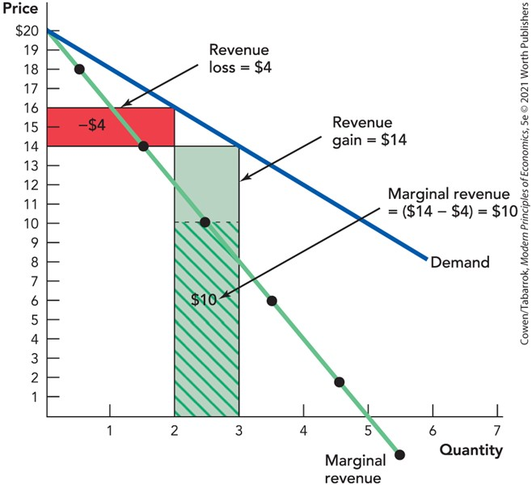
Marginal Revenue (2 of 2)
Notes:
Figure 13-1 (13-1): Marginal Revenue.

Slide 12
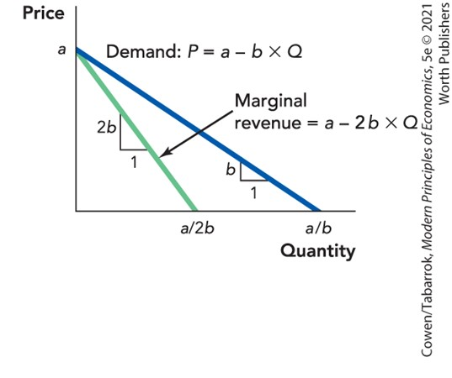
Shortcut for Finding MR
MR begins at same point on the vertical axis as demand.
MR has twice the slope.
Notes:
Figure 13-2: The MR Shortcut

Slide 13
Self-Check (2 of 4)
For a firm with market power, marginal revenue is:
higher than price.
equal to price.
lower than price.

Slide 14
Self-Check (2 of 4) (Answer)
For a firm with market power, marginal revenue is:
higher than price.
equal to price.
lower than price.
Answer:
A firm with market power must drop its price to sell more units, so the marginal (additional) revenue is lower than price.

Slide 15
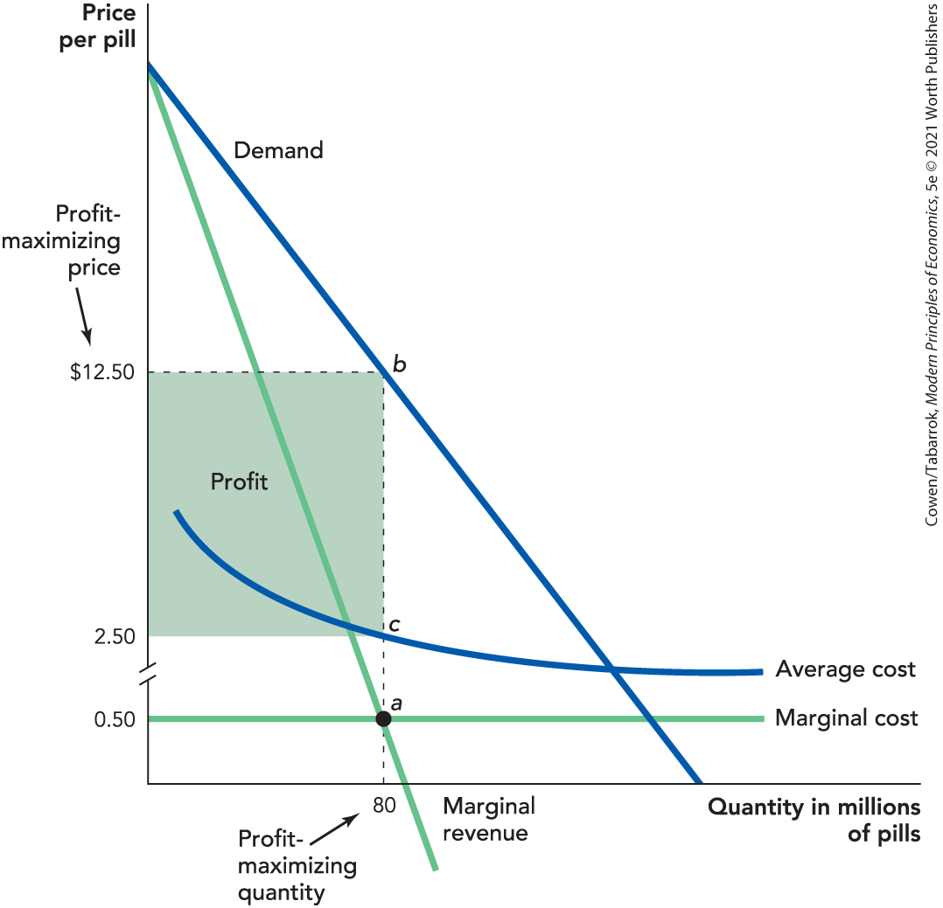
How a Monopolist Maximizes Profit
Profit-maximizing output: MR = MC at 80 million pills
Profit-maximizing price = $12.50
Profit per pill = $10.00
Total profit = $10 × 80 = $800 million
Notes:
Figure 13-3 (13-3): How a Monopolist Maximizes Profit.

Slide 16
Elasticity of Demand and Monopoly Markup
Two effects make demand for pharmaceuticals inelastic:
The “you can’t take it with you” effect:
People with serious illnesses are relatively insensitive to the price of life-saving drugs.
The “other people’s money” effect:
If third parties are paying for the medicine, people are less sensitive to price.
The more inelastic the demand curve, the more a monopolist will raise price above MC.

Slide 17
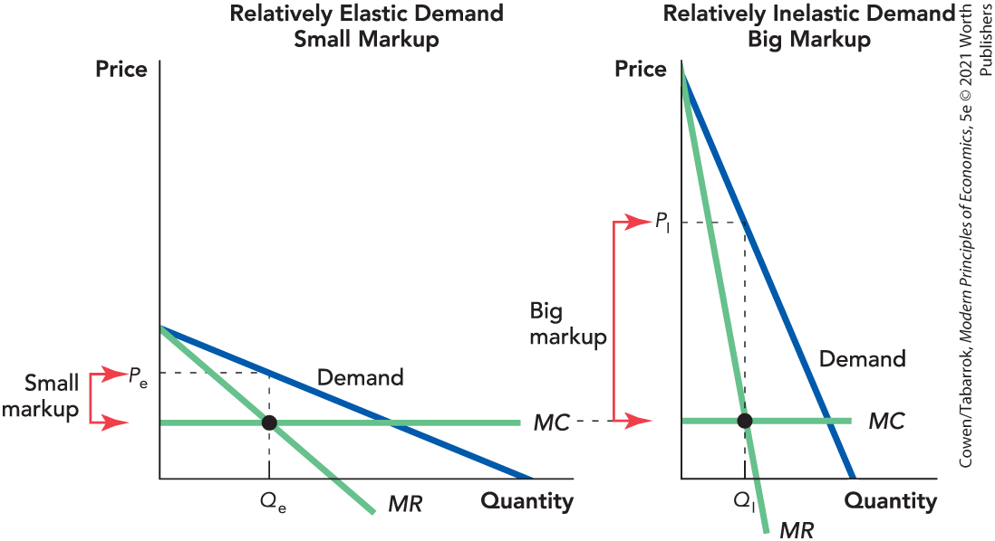
Elasticity of Demand and Markup

Slide 18
Costs of Monopoly: Deadweight Loss (1 of 2)
Monopolies charge a higher price and produce less than competitive firms.
Monopolies reduce total surplus (consumer surplus + producer surplus).
This implies a deadweight loss: sales that do not occur because the monopoly price is above the competitive price.

Slide 19
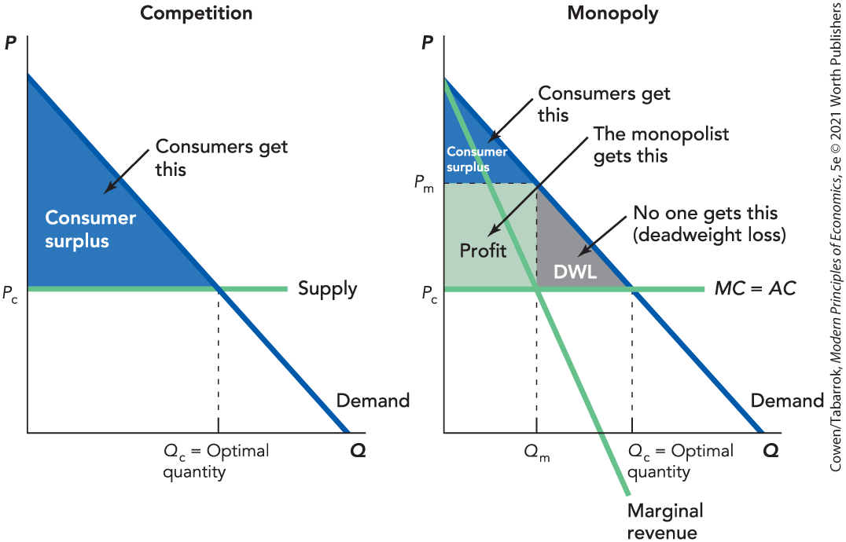
Costs of Monopoly: Deadweight Loss (2 of 2)

Slide 20
Self-Check (3 of 4)
A monopolist’s price is:
lower than a competitive firm’s.
higher than a competitive firm’s.
the same as a competitive firm’s.

Slide 21
Self-Check (3 of 4) (Answer)
A monopolist’s price is:
lower than a competitive firm’s.
higher than a competitive firm’s.
the same as a competitive firm’s.
Answer:
A monopolist’s price is higher than a competitive firm’s.

Slide 22
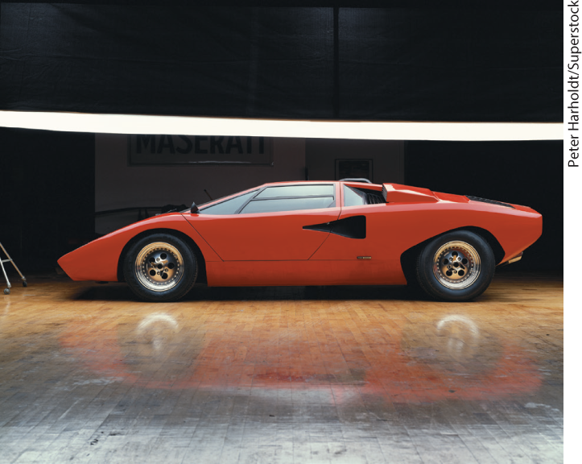
Costs of Monopoly: Corruption and Inefficiency (1 of 2)
Many monopolies are the result of government corruption.
Tommy Suharto, the Indonesian president’s son, was given the clove monopoly.
He bought the Lamborghini company with the monopoly profits.

Slide 23
Costs of Monopoly: Corruption and Inefficiency (2 of 2)
Monopolies are especially harmful if they control a good that is used to produce other goods.
In Algeria, a dozen or so army generals each control a key good.
People refer to these men as General Wheat, General Tire, ….
Each general tries to get a larger share of the economic pie.
The result is greater deadweight loss, and the “pie” shrinks.

Slide 24
Benefits of Monopoly: Incentives for R&D (1 of 2)
Drug prices are lower in India and Canada.
India does not offer strong patent protection.
Canada’s government controls drug prices.
It costs $1 billion to develop a new drug.
Patents are one way of rewarding research and development (R&D).
Without patents, firms would not spend on R&D, and fewer new drugs would be developed.

Slide 25
Benefits of Monopoly: Incentives for R&D (2 of 2)
Prizes can reward R&D without creating monopolies.
Patent buyouts are another alternative.
Buyouts reduce price without reducing R&D.
Government must raise taxes to pay for the patent.
It may be difficult to determine a price.

Slide 26
Sources of Monopoly Power (1 of 2)
Economies of scale
Barriers to entry
Network effects
Innovation

Slide 27
Definition (3 of 4)
Economies of scale:
The advantages of large-scale production that reduce average cost as quantity increases.
Natural monopoly:
When a single firm can supply the entire market at a lower cost than two or more firms can.

Slide 28
Natural Monopoly (1 of 2)
Monopolies can arise naturally when economies of scale allow a single firm to produce at a lower cost than can many small firms.
Utilities such as water, natural gas, and cable television are often natural monopolies.
If economies of scale are large enough, price can be lower under a natural monopoly than under competition.

Slide 29
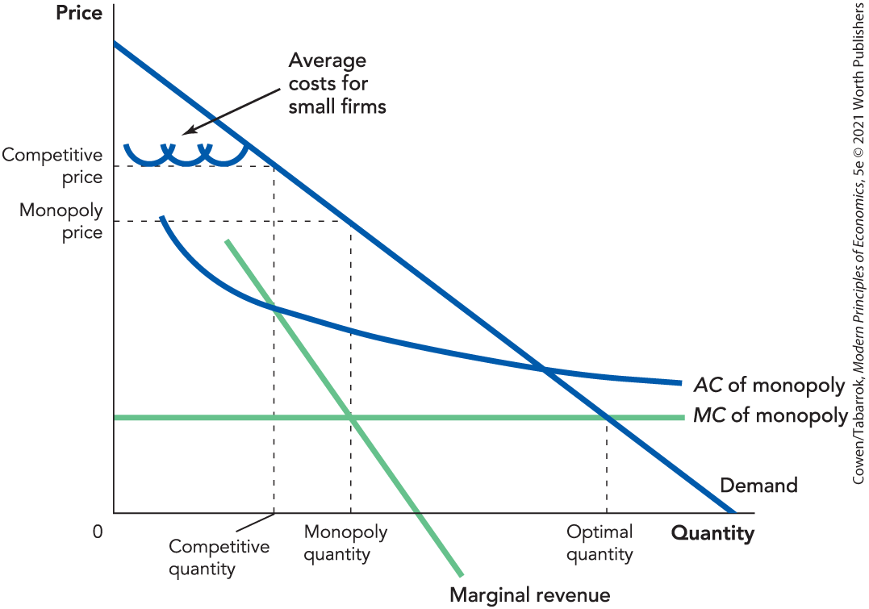
Natural Monopoly (2 of 2)

Slide 30
Self-Check (4 of 4)
Which of the following is most likely to be a natural monopoly?
a home builder
a restaurant
a railroad company

Slide 31
Self-Check (4 of 4) (Answer)
Which of the following is most likely to be a natural monopoly?
a home builder
a restaurant
a railroad company
Answer:
A railroad company is most likely to be a natural monopoly, due to economies of scale and the high cost of duplicating tracks.

Slide 32
Definition (4 of 4)
Barriers to entry:
Factors that increase the cost to new firms of entering an industry.

Slide 33
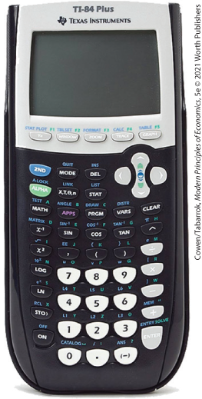
Barriers to Entry
Potential barriers to entry:
Ownership of an input that is difficult to duplicate
Brands and trademarks
Development of a relationship with the market (for example, the TI-84 graphing calculator)

Slide 34
Network Effects
Network effects make a product or service more valuable as the number of users increases.
Facebook has few competitors because everybody wants to use the same site that their friends use.
There are only a few credit card companies.
Customers want cards that are widely accepted.
Firms want to accept cards that are widely used.

Slide 35
Innovation
Innovation can lead to products that other firms can’t immediately duplicate.
It involves a trade-off:
iPhones are priced higher than if there were stronger competitors.
But Apple would have less incentive to innovate if it didn’t expect monopoly profits.

Slide 36
Sources of Monopoly Power (2 of 2)
Some Sources of Market Power
Sources of Market Power | Example
Patents | GSK’s patent on Combivir
Laws preventing entry of competitors | Indonesian clove monopoly, Algerian wheat monopoly, U.S. Postal Service
Economies of scale | Subways, cable TV, electricity transmission, major highways
Hard-to-duplicate inputs | Oil, diamonds, Rolex watches
Innovation | Apple’s iPhone, Wolfram’s Mathematica software, eBay
Copyright | Novels, movies, musical compositions, computer software
Network effects | Facebook, eBay, credit cards
Notes:
Table 13-1: Some Sources of Market Power

Slide 37
Regulating Monopoly
The government has many tools to regulate monopolies:
Price controls
Government ownership
Antitrust law

Slide 38
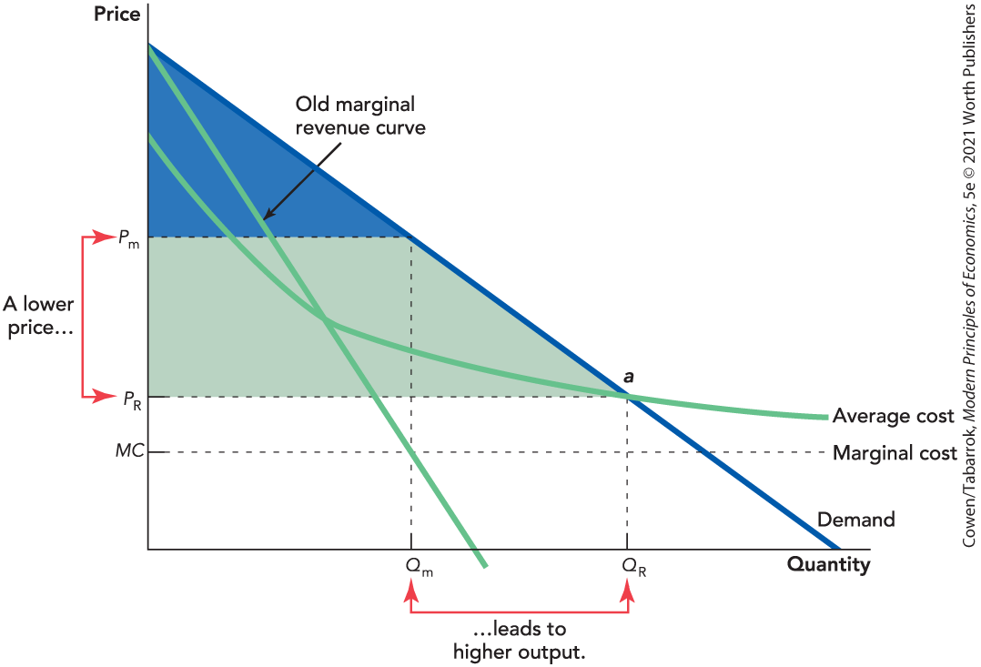
Price Controls (1 of 2)
A price control on a monopoly can increase output.

Slide 39
Price Controls (2 of 2)
Reducing monopoly prices:
Increases output and consumer surplus
Decreases the incentive to innovate

Slide 40
Government Ownership
Government ownership and regulation of electricity provided the United States with cheap power for decades.
There are some 3,000 electric utilities, two-thirds of which are government-owned (the remainder are heavily regulated).
Without competition or a profit motive, there is a tendency to become inefficient.
Without regulation, providers can exploit market power, as occurred in California in 2000.

Slide 41
Antitrust Law (1 of 2)
Antitrust laws are antimonopoly laws.
Two important U.S. antitrust laws are the Sherman Act (1890) and the Clayton Act (1914).
The laws give the federal government legal authority to prosecute monopolies or firms’ attempts to monopolize.
Can break up a monopoly
Can prohibit a merger
Can prevent acts that reduce competition

Slide 42
Antitrust Law (2 of 2)
Mergers
Prices, technology, and market conditions are constantly changing.
Firms grow, shrink, split, and merge.
Mergers lead to efficiencies of scale but more market power.
Authorities must try to balance lower costs with higher prices.

Slide 43
Takeaway (1 of 2)
For a monopolist, marginal revenue is less than market price (MR < P).
Monopolies:
Charge a higher price than competitive firms
Reduce total surplus
Create a deadweight loss
Use market power to earn above-normal profits
The more inelastic the demand, the larger markup of price over marginal cost.

Slide 44
Takeaway (2 of 2)
Patent monopolies involve a trade-off between deadweight loss and innovation.
Natural monopolies involve a trade-off between deadweight loss and economies of scale.
The practice of regulation is much more complicated than the theory.
Antitrust laws give the government authority to prosecute monopolies or attempts to monopolize.
Many monopolies are created to transfer wealth to politically powerful elites.

