Slide 1
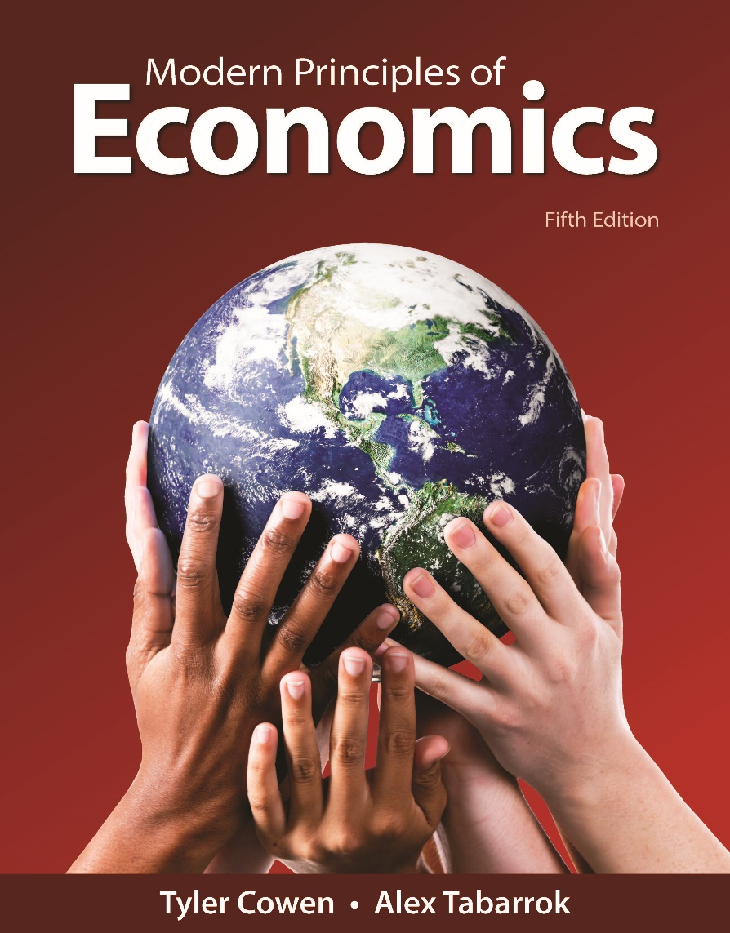
MODERN PRINCIPLES OF ECONOMICS
Fifth Edition
Chapter 14 Price Discrimination and Pricing Strategy
© 2021 Worth Publishers. All Rights Reserved.

Slide 2
Outline (1 of 2)
Price Discrimination
Price Discrimination Is Common
Is Price Discrimination Bad?
Tying and Bundling
Takeaway

Slide 3
Outline (2 of 2)
The anti-AIDS drug Combivir sells for $0.50/pill in Africa and $12.50/pill in Europe.
Demand in Africa is lower and more elastic because people, on average, are poorer.
GlaxoSmithKline can increase its profit by selling the same product at different prices to different customers.

Slide 4
Definition (1 of 5)
Price discrimination:
Selling the same product at different prices to different customers.

Slide 5
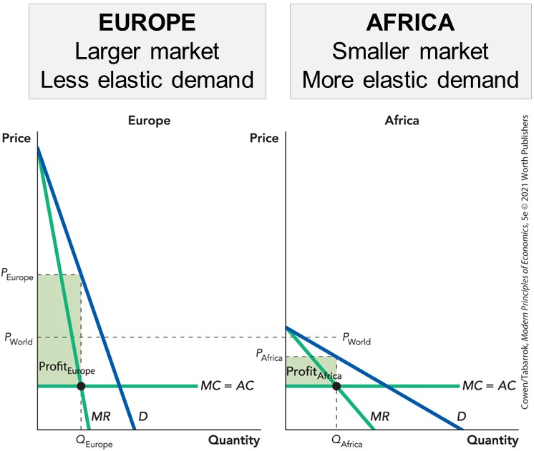
Price Discrimination

Slide 6
Self-Check (1 of 4)
A firm with market power can use price discrimination to:
decrease costs.
decrease output.
increase profits.

Slide 7
Self-Check (1 of 4) (Answer)
A firm with market power can use price discrimination to:
decrease costs.
decrease output.
increase profits.
Answer:
A firm with market power can use price discrimination to increase profits.

Slide 8
Definition (2 of 5)
The principles of price discrimination:
1a. If the demand curves are different, it is more profitable to set different prices in different markets than a single price that covers all markets.
1b. To maximize profit, the firm should set a higher price in markets with more inelastic demand.
2. Arbitrage makes it difficult for a firm to set different prices in different markets.

Slide 9
Definition (3 of 5)
Arbitrage:
Taking advantage of price differences for the same good in different markets by buying low in one market and selling high in another market.

Slide 10
Preventing Arbitrage
Rohm and Haas produced a plastic (MM) used in industry and in dentistry.
MM for industrial uses sold at $0.85 per pound; a slightly different version for dentures sold at $22 per pound.
To reduce arbitrage, Rohm and Haas spread a rumor that industrial MM was laced with arsenic.

Slide 11
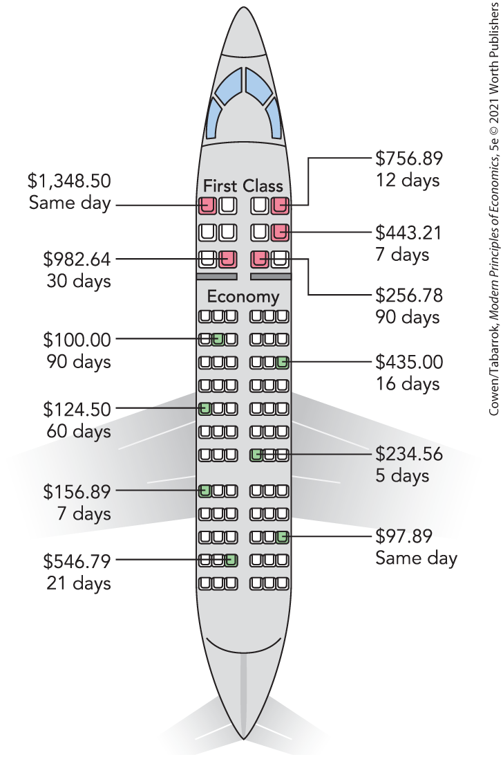
Price Discrimination Is Common
Movie theaters often charge seniors less.
Businesses often pay more for software than students do.
Airlines set different prices according to characteristics that are correlated with willingness to pay.
Notes:
Figure 14-3: Different Prices for the Same Flight

Slide 12
Definition (4 of 5)
Perfect price discrimination:
Each customer is charged his or her maximum willingness to pay.

Slide 13
Perfect Price Discrimination (1 of 3)
Price Discrimination at Williams College, 2016
Income Quintile | Family Income | Average Net Price
Low | $0–$30,000 | $3,127
Lower Middle | $30,001–$48,000 | $4,971
Middle | $48,001–$75,000 | $7,419
Upper Middle | $75,001–$110,000 | $16,899
High | $1,100,011 | $38,936
Note: Students who did not apply for financial aid—about half the student body—paid $64,090.
Data from: CollegeCalc.org, using data from the U.S. Department of Education.
Williams College uses detailed information about its customers to set many different prices.
Notes:
Table 14-1 (14-1): Price Discrimination at Williams College, 2001–2002

Slide 14
Perfect Price Discrimination (2 of 3)
A perfectly price-discriminating (PPD) monopolist charges each consumer his or her maximum willingness to pay.
Consumers end up with zero consumer surplus.
All of the gains from trade go to the monopolist.
The PPD monopolist has an incentive to maximize the gains from trade, which means no deadweight loss.

Slide 15
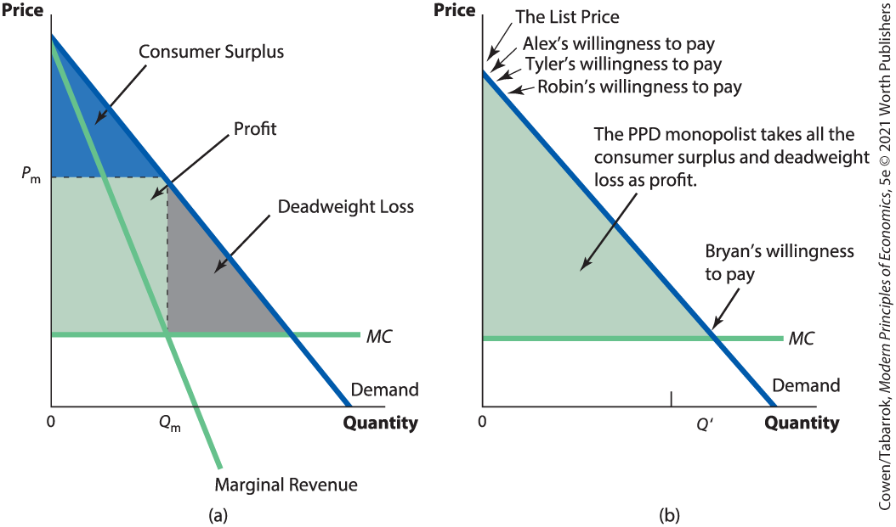
Perfect Price Discrimination (3 of 3)

Slide 16
Self-Check (2 of 4)
Perfect price discrimination means charging each customer:
the same amount.
their maximum willingness to pay.
their maximum ability to pay.

Slide 17
Self-Check (2 of 4) (Answer)
Perfect price discrimination means charging each customer:
the same amount.
their maximum willingness to pay.
their maximum ability to pay.
Answer:
Perfect price discrimination means charging each customer their maximum willingness to pay.

Slide 18
Is Price Discrimination Bad? (1 of 2)
Price discrimination could be better or worse than single pricing.
It is bad if the total output with price discrimination falls or stays the same.
If output increases under price discrimination, then total surplus will usually increase.

Slide 19
Is Price Discrimination Bad? (2 of 2)
Price discrimination helps cover fixed costs.
Fixed costs remain the same, while profits increase with market size.
More profit encourages more research and development.
This creates incentives to increase output.

Slide 20
Self-Check (3 of 4)
Price discrimination is better than single pricing if:
total surplus increases.
total surplus decreases.
output remains the same.

Slide 21
Self-Check (3 of 4) (Answer)
Price discrimination is better than single pricing if:
total surplus increases.
total surplus decreases.
output remains the same.
Answer:
Price discrimination is better if it increases total surplus.

Slide 22
Definition (5 of 5)
Tying:
To use one good, a consumer must use a second good that is sold only by the same firm.
Bundling:
Requiring that products be bought together in a bundle or package.

Slide 23
Tying (1 of 2)
Hewlett-Packard sells printers below cost and ink far above cost.
The printer will only work with HP ink cartridges.
Those with a high willingness to pay probably want to print a lot of photos.
Tying causes high-volume users to pay more per photo than low-volume users.

Slide 24
Tying (2 of 2)
Tying illustrates the benefits and costs of price discrimination.
May increase output by lowering price for low-volume users
Spreads the fixed cost of R&D over more users, encouraging innovation
Extra money is spent to keep competitors out of the ink business

Slide 25
Bundling (1 of 3)
Many goods must be bought as a package.
Toyota doesn’t sell engines, steering columns, and wheels; it sells a bundle called a car.
It would be difficult for most consumers to assemble the parts themselves.
Microsoft bundles Word, Excel, Outlook, Access, and PowerPoint into Microsoft Office.
It would not be difficult for consumers to buy the products individually and assemble them.

Slide 26
Bundling (2 of 3)
Maximum Willingness to Pay for Word and Excel
 | Amanda | Yvonne
Word | $100 | $40
Excel | $20 | $90
Consumers have very different values for the separate items but similar values for the package.
This enables price discrimination.
Notes:
Table 14-2: Maximum Willingness to Pay for Word and Excel

Slide 27
Bundling (3 of 3)
Maximum Willingness to Pay for Office
 | Amanda | Yvonne
Word | $100 | $40
Excel | $20 | $90
Office=Word + Excel | $120 | $130
Suppose Microsoft charges $120 for Office.
Amanda pays $100 for Word and $20 for Excel.
Yvonne pays $40 for Word and $80 for Excel.
Notes:
Table 14-3: Maximum Willingness to Pay for Office

Slide 28
Self-Check (4 of 4)
Requiring goods to be bought together in a single package is called:
tying.
bundling.
single-package pricing.

Slide 29
Self-Check (4 of 4) (Answer)
Requiring goods to be bought together in a single package is called:
tying.
bundling.
single-package pricing.
Answer:
Requiring goods to be bought together is called bundling.

Slide 30
Takeaway (1 of 2)
Price discrimination is common.
Firms often price goods based on characteristics correlated with willingness to pay.
Student and senior discounts
Setting prices depending on how far in advance a flight is booked
Firms must prevent arbitrage to successfully price discriminate.

Slide 31
Takeaway (2 of 2)
The more a firm knows about its customers, the better it can price discriminate.
Perfect price discrimination means charging each customer their maximum willingness to pay.
Tying and bundling are different forms of price discrimination.
By increasing profits, price discrimination increases the incentive to engage in R&D.

