Slide 1

MODERN PRINCIPLES OF ECONOMICS
Fifth Edition
Chapter 10 Externalities: When the Price Is Not Right
© 2021 Worth Publishers. All Rights Reserved.

Slide 2
Outline
External costs, external benefits, and efficiency
Private solutions to externality problems
Government solutions to externality problems
Takeaway

Slide 3
Introduction (1 of 2)
Antibiotics are overused.
Users get all the benefits but do not bear all of the costs.
Each use of an antibiotic
Creates an increase in bacterial resistance
Pollutes the environment with more resistant and stronger bacteria
Non-users pay these external costs.

Slide 4
Introduction (2 of 2)
Since the price of antibiotics does not include all the costs, the price signal is imperfect.
The price is too low, and antibiotics are overused.

Slide 5
Externalities and Efficiency (1 of 2)
For some products, some of the costs or benefits fall on bystanders.
External costs are called negative externalities.
External benefits are called positive externalities.
When we evaluate markets with externalities, we look at social surplus.

Slide 6
Definition (1 of 11)
Externalities:
External costs or benefits that fall on bystanders.
External cost:
A cost paid by people other than the consumer or the producer.

Slide 7
Definition (2 of 11)
Private cost:
A cost paid by the consumer or the producer.
Social cost:
The cost to everyone; private cost plus external cost.

Slide 8
Self-Check (1 of 5)
You pay $50 for a new jacket. This is an example of a(n):
external cost.
social cost.
private cost.

Slide 9
Self-Check (1 of 5) (Answer)
You pay $50 for a new jacket. This is an example of a(n):
external cost.
social cost.
private cost.
Answer:
This is a private cost because it is paid by you, the consumer.

Slide 10
Definition (3 of 11)
Social surplus:
Consumer surplus plus producer surplus plus everyone else’s surplus.

Slide 11
Externalities and Efficiency (2 of 2)
A market equilibrium maximizes consumer surplus plus producer surplus (gains from trade).
A market with externalities does not maximize social surplus (consumer + producer + everybody else’s surplus).
A market with externalities is therefore inefficient.

Slide 12
Definition (4 of 11)
Efficient equilibrium:
The price and quantity that maximize social surplus.

Slide 13
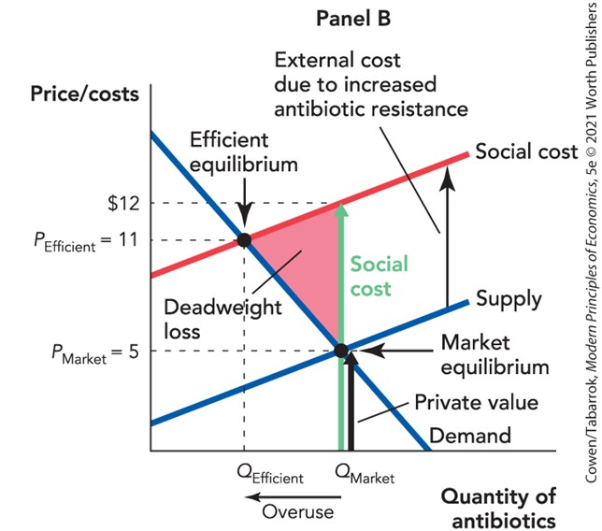
External Costs (1 of 2)

Slide 14
Definition (5 of 11)
Efficient quantity:
The quantity that maximizes social surplus. Who bears the cost is irrelevant for efficient quantity.

Slide 15
External Costs (2 of 2)
A tax on an ordinary good increases deadweight loss.
A tax on a good with an external cost reduces deadweight loss and raises revenue.
Economist Arthur C. Pigou first focused attention on externalities and how they might be corrected with taxes.

Slide 16
Definition (6 of 11)
Pigouvian tax:
A tax on a good with external costs.

Slide 17
Self-Check (2 of 5)
When a tax is imposed on a good with significant external costs, deadweight loss is:
increased.
reduced.
unchanged.

Slide 18
Self-Check (2 of 5) (Answer)
When a tax is imposed on a good with significant external costs, deadweight loss is:
increased.
reduced.
unchanged.
Answer:
A tax on a good with an external cost reduces deadweight loss.

Slide 19
Definition (7 of 11)
External benefit:
A benefit received by people other than the consumers or producers trading in the market.

Slide 20
External Benefits (1 of 4)
Vaccines benefit the person who is vaccinated, but they also create an external benefit.
People who have been vaccinated are less likely to spread the disease.
The person getting the shot bears all the costs: time, money, fever, and aches.
But the person being vaccinated doesn’t receive all the benefits.
As a result, fewer people get flu shots than is efficient.

Slide 21
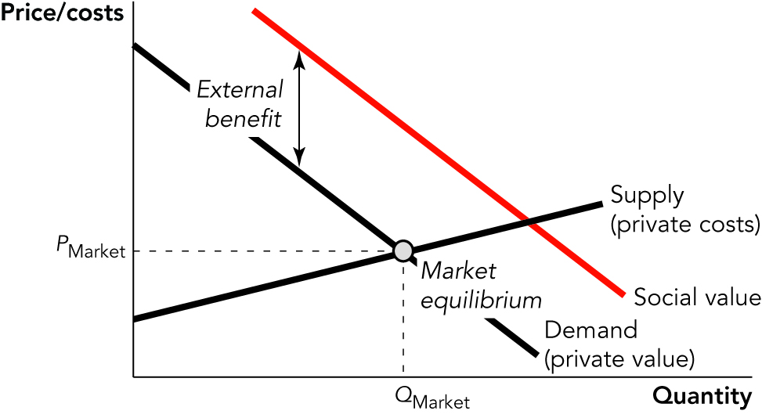
External Benefits (2 of 4)

Slide 22
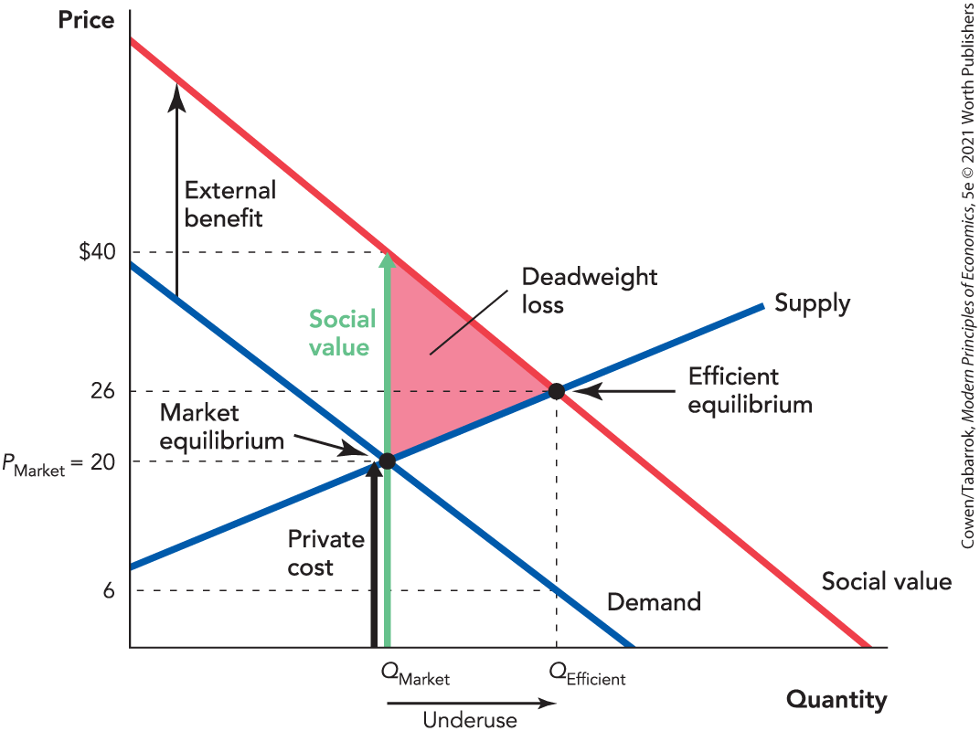
External Benefits (3 of 4)

Slide 23
External Benefits (4 of 4)
When there are external benefits, market output is too low.
A subsidy equal to the external benefit:
Shifts the demand curve up
Makes market equilibrium = efficient equilibrium
A Pigouvian subsidy therefore:
Reduces deadweight loss
Increases social surplus

Slide 24
Definition (8 of 11)
Pigouvian subsidy:
A subsidy on a good with external benefits.

Slide 25
Self-Check (3 of 5)
When there are external benefits, market output is:
too low.
too high.
socially efficient.

Slide 26
Self-Check (3 of 5) (Answer)
When there are external benefits, market output is:
too low.
too high.
socially efficient.
Answer:
In a market with external benefits, output is too low.

Slide 27
Definition (9 of 11)
Internalizing an externality:
Adjusting incentives so that decision makers take into account all the costs and benefits of their actions, both private and social.

Slide 28
Private Solutions to Externality Problems (1 of 2)
Market equilibrium can be efficient even when there are externalities if there is systematic trading in those externalities.
The market can handle externalities when:
Transaction costs are low.
Property rights are clearly defined.
These conditions are often not met.
Markets alone will not solve all externality problems.

Slide 29
Definition (10 of 11)
Transaction costs:
All the costs necessary to reach an agreement. The costs of identifying and bringing buyers and sellers together, the bargaining, and the drawing up of a contract are all transaction costs.

Slide 30
Definition (11 of 11)
Coase theorem:
If transaction costs are low and property rights are clearly defined, private bargains will ensure that the market equilibrium is efficient even when there are externalities.

Slide 31
Private Solutions to Externality Problems (2 of 2)
Conditions of the Coase theorem are often unlikely to be met.
Transaction costs for many externalities are high.
Property rights are often not clearly defined.
If property rights can be clearly defined and transaction costs reduced, then a new market for externalities might develop.

Slide 32
Government Solutions to Externality Problems (1 of 3)
Command and control
When external costs are significant, Q_{Market} > Q_{Efficient}.
One method to reduce external costs is for the government to order firms to use (or make) less.
Used to eliminate smallpox and to address the COVID-19 pandemic
The government may not have enough information to choose the least costly method of achieving the goal.
Taxes and subsidies are more flexible.

Slide 33
Self-Check (4 of 5)
Under the command and control method, the government:
pays firms to produce less.
orders firms to produce less.
lets the market force firms to produce less.

Slide 34
Self-Check (4 of 5) (Answer)
Under the command and control method, the government:
pays firms to produce less.
orders firms to produce less.
lets the market force firms to produce less.
Answer:
Under command and control, the government orders firms to use (or make) less.

Slide 35
Government Solutions to Externality Problems (2 of 3)
Tradable allowances
Under the Clean Air Act of 1990, the EPA distributes pollution allowances to generators of electricity.
Congress sets the total amount of allowances.
The EPA monitors emissions so firms can’t pollute beyond their allowances.
Firms can trade or bank allowances for future use.

Slide 36
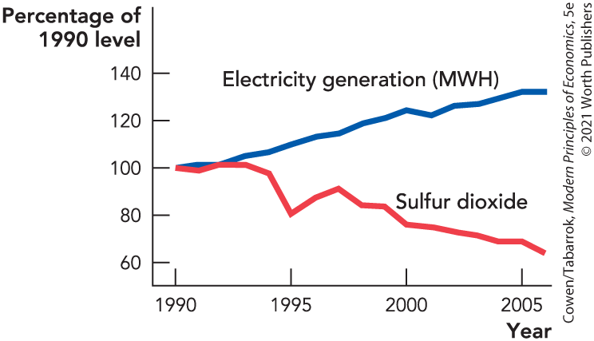
Government Solutions to Externality Problems (3 of 3)
Tradable allowances
The program has been very successful:
Emissions have been reduced.
Air quality has improved.
Illness has been reduced.
Electricity generation has increased.
Notes:
Figure 10-4: Since the 1990 Clean Air Act Was Enacted, Electricity Generation Has Increased and Sulfur Dioxide Emissions Have Decreased.

Slide 37
Self-Check (5 of 5)
Under tradable allowances, producers of electricity have:
reduced both output and emissions.
increased both output and emissions.
reduced emissions and increased output.

Slide 38
Self-Check (5 of 5) (Answer)
Under tradable allowances, producers of electricity have:
reduced both output and emissions.
increased both output and emissions.
reduced emissions and increased output.
Answer:
Reduced emissions and increased output.

Slide 39
Comparing Carbon Taxes and Tradable Allowances (1 of 3)
Carbon taxes and trading allowances are equivalent if:
The tax = the level of the external cost
The number of allowances = the efficient quantity
Carbon taxes and trading allowances are different if:
There is uncertainty.
There are political preferences for one or the other.

Slide 40
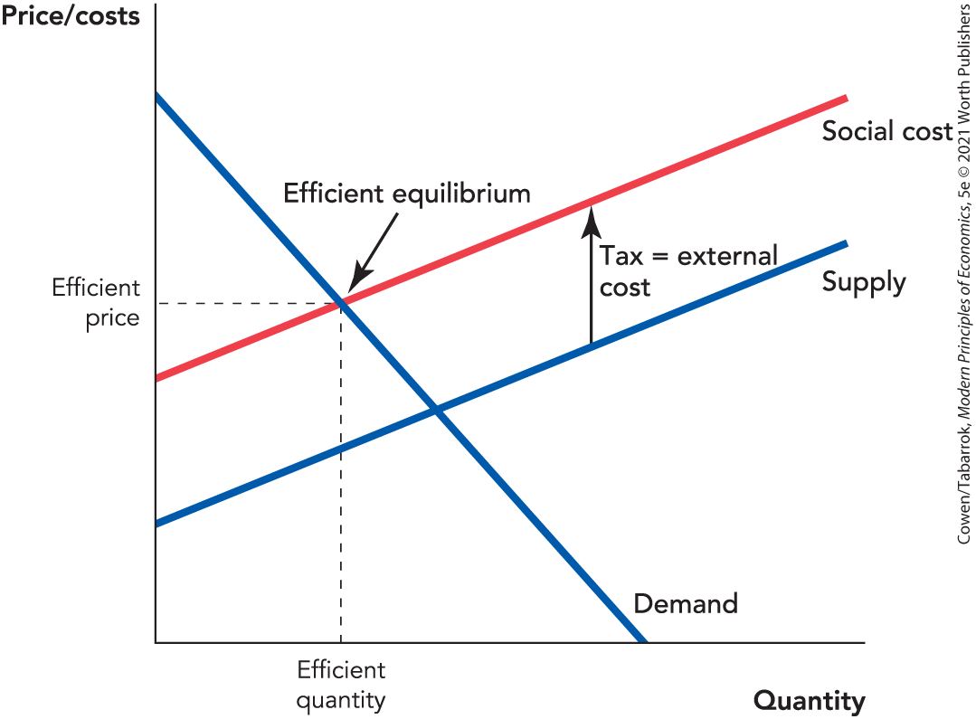
Comparing Carbon Taxes and Tradable Allowances (2 of 3)
If we knew the exact positions of the supply and demand curves, then we could always use tradable allowances to hit the efficient quantity or a tax to hit the efficient price and the equilibrium would be identical.
Notes:
Figure 10-5: Comparing Tradable Allowances and Pigouvian Taxes

Slide 41
Comparing Carbon Taxes and Tradable Allowances (3 of 3)
Firms that are given tradable allowances get a big benefit compared with having to pay taxes.
Critics say that pollution allowances equal corrective taxes plus corporate welfare.
Allowances can be auctioned off, generating government revenue.
The use of allowances is more likely to gain cooperation from large firms than taxes.

Slide 42
Takeaway (1 of 2)
In a free market equilibrium, quantity maximizes consumer surplus + producer surplus.
With externalities, the market quantity is not the efficient quantity.
There are three types of government solutions to externality problems:
Taxes and subsidies
Command and control
Tradable allowances

Slide 43
Takeaway (2 of 2)
Market prices do not correctly signal true costs and benefits when there are externalities.
Taxes and subsidies can adjust prices so that they do send the correct signals.
Command and control solutions can work but often carry a high cost and are inflexible.
If property rights are clearly defined and transaction costs are low, then markets in the externality will solve the problem.

