Slide 1

MODERN PRINCIPLES OF ECONOMICS
Fourth Edition
Chapter 24 Asymmetric Information: Moral Hazard and Adverse Selection
© 2021 Worth Publishers. All Rights Reserved.

Slide 2
Outline
Moral Hazard
Adverse Selection
Signaling as a Response to Asymmetric Information
Takeaway

Slide 3
Introduction (1 of 2)
A study tracked cab rides from an airport to a hotel.
Half the passengers were taken on detours that lengthened the ride by about 10%.
Detouring was not random: Passengers who appeared to be from out of town were detoured more often.
Taxi drivers took the longest detours when their information advantage appeared to be the greatest.

Slide 4
Definition (1 of 7)
Asymmetric information:
When one party to an exchange has more or better information than the other party.

Slide 5
Introduction (2 of 2)
Markets work best when traders know exactly what is being traded.
When one party has more or better information, the less-informed party may withdraw because trade is too risky.
Market institutions and regulations have evolved to deal with problems of asymmetric information.

Slide 6
Definition (2 of 7)
Principal–agent problem:
How can a principal incentivize an agent to work in the principal’s interest even when the agent has information that the principal does not?

Slide 7
Self-Check (1 of 4)
When one party to a transaction has more information than the other party, it is called:
incentives.
a principal–agent problem.
asymmetric information.

Slide 8
Self-Check (1 of 4) (Answer)
When one party to a transaction has more information than the other party, it is called:
incentives.
a principal–agent problem.
asymmetric information.
Answer:
asymmetric information. For example, the seller of a used bike has more information about its quality compared to the potential buyer of the bike.

Slide 9
Definition (3 of 7)
Moral hazard:
When an agent tries to exploit an information advantage in a dishonest or undesirable way.

Slide 10
Moral Hazard
The problem of moral hazard runs deeper than a transfer of wealth from buyer to seller.
Unnecessary work is a waste of time and resources.
Buyers who are aware of the moral hazard may decide not to buy.
The possibility of mutual gain is lost.
The problem is more serious when decisions are more expensive, longer-lasting, and difficult to reverse.

Slide 11
Overcoming Moral Hazard (1 of 5)
Providing more information
The Internet has made it easier for buyers to pool their knowledge.
Reviews:
Make it easier to avoid shady businesses
Raise the cost of exploiting an information advantage
The Internet has increased the value of having a good reputation.

Slide 12
Overcoming Moral Hazard (2 of 5)
Providing more information
The more important a rating is, the greater the incentive to fake or manipulate it is.
Third-party organizations can sometimes be trusted to provide independent advice.
Many forms of information are a public good, meaning it is difficult to exclude nonpayers from obtaining the information.
This makes it hard to sell the information.

Slide 13
Definition (4 of 7)
Free rider:
One who consumes but does not pay.

Slide 14
Overcoming Moral Hazard (3 of 5)
Creating better incentives
Splitting the selling of a service from the diagnosis of how much service is needed can help reduce moral hazard.
Most house buyers will hire a house inspector.
The inspector has no incentive to under-report bad news.
It’s illegal for house inspectors to profit from the repairs, so there is no incentive to over-report bad news.

Slide 15
Overcoming Moral Hazard (4 of 5)
Creating better incentives
Another method is to better align the buyer’s and the seller’s incentives.
Plaintiffs often pay their lawyers with a contingent fee—the lawyer is paid only if the case is won.
Real estate agents are paid only if the house sells.

Slide 16
Overcoming Moral Hazard (5 of 5)
Creating better incentives
Moral hazard is not limited to markets.
Politicians and bureaucrats typically have more information than voters do.
Competitive elections, checks and balances, and a free and independent press all limit moral hazard in politics.

Slide 17
Self-Check (2 of 4)
Which of the following illustrates moral hazard?
A clerk who steals office supplies for home use
An auto mechanic who recommends unnecessary work
A boss who micromanages her employees

Slide 18
Self-Check (2 of 4) (Answer)
Which of the following illustrates moral hazard?
A clerk who steals office supplies for home use
An auto mechanic who recommends unnecessary work
A boss who micromanages her employees
Answer:
The auto mechanic is exploiting an information advantage; this is an example of moral hazard.

Slide 19
Adverse Selection (1 of 5)
Sick people are more likely to want health insurance than those who are well.
The offer to buy health insurance implies that the buyer is likely to have above-average health care costs.

Slide 20
Definition (5 of 7)
Adverse selection:
Occurs when an offer contains negative information about the product being offered.

Slide 21
Definition (6 of 7)
Credible promise:
A promise that the promisor has an incentive to keep.

Slide 22
Adverse Selection (2 of 5)
Type of car | Lemons (low quality) | Plums (high quality)
Value | $8,000 | $12,000
A key assumption is that only sellers know the true quality of the product.
If there are equal numbers of lemons and plums, the probability is ½ for each.
Buyers would be willing to pay the expected or average value: (½ × $8,000) + (½ × $12,000) = $10,000.

Slide 23
Adverse Selection (3 of 5)
Type of car | Lemons (low quality) | Plums (high quality)
Value | $8,000 | $12,000
Buyers are willing to pay only $10,000.
A seller with a high-quality car worth $12,000 is not willing to sell at that price.
If a car is offered for sale, it’s probably a lemon.
High-quality used cars don’t trade, leading to market failure.

Slide 24
Adverse Selection (4 of 5)
Adverse selection also occurs in health insurance.
Without preventive measures in place, sicker people would be attracted to health insurance in greater numbers than are healthy people.
If this happens, insurance companies would not be able to stay in business without huge increases insurance premiums.
Some market features can be used to address the problem:
Inspections and checkups: Gather information for the insurance company.
Group rates: Reduce chances of only unhealthy people signing up for insurance.
Conscientiousness: Some value health insurance more than others, potentially leading to propitious selection.

Slide 25
Adverse Selection (5 of 5)
Market institutions, laws, and regulations have evolved to deal with adverse selection.
Techniques such as car or home inspections help overcome information asymmetry and increase trade.
Warranties reduce consumer fears about getting an inferior product.
Some sellers will sell regardless of price; this keeps the price high enough for sellers to be willing to sell high-quality products.

Slide 26
Self-Check (3 of 4)
The fear of getting an inferior product can be reduced through:
warranties.
markets.
adverse selection.

Slide 27
Self-Check (3 of 4) (Answer)
The fear of getting an inferior product can be reduced through:
warranties.
markets.
adverse selection.
Answer:
Warranties are one way to reduce the fear of getting an inferior product.

Slide 28
Definition (7 of 7)
Signal:
An expensive action that is taken to reveal information.

Slide 29
Signaling (1 of 4)
When Hyundai entered the U.S. market, its cars were seen as low quality and as having a poor repair record.
Hyundai invested in new, advanced factories, worker training, and quality control.
It also introduced “America’s Best Warranty”: 10 years/100,000 miles on the powertrain and 5 years/60,000 miles on everything else.
Over the next year, sales jumped 82%.

Slide 30
Signaling (2 of 4)
Hyundai’s warranty served two purposes:
If something does go wrong, the warranty has value as insurance.
The warranty signaled that Hyundai was serious about quality.
The signal was credible because the only way it would be profitable for the company was if its cars did not break down.

Slide 31
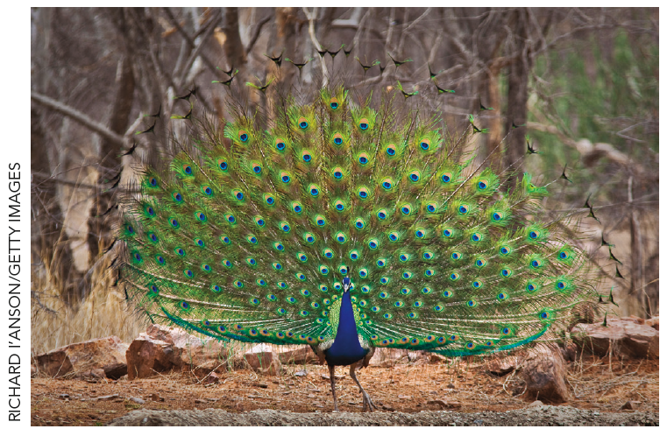
Signaling (3 of 4)
Where else may we observe signaling?
In the job market, offering to work for low pay sends a signal that you might be a low-quality worker.
In the animal kingdom, the peacock’s spread tail signals to peahens that the peacock is healthy, has good genes, and would make a good partner for procreation.

Slide 32
Signaling (4 of 4)
Signaling pervades our lives.
A university degree signals to employers that you are likely to have the kinds of qualities they want.
An expensive engagement ring is a signal because expensive rings are cheaper in the long run if you truly expect to remain married.
However, there is some inefficiency in most signaling models.
Signaling eases some problems of asymmetric information but may create others.

Slide 33
Self-Check (4 of 4)
An expensive action taken to reveal information is called:
adverse selection.
signaling.
a credible promise.

Slide 34
Self-Check (4 of 4) (Answer)
An expensive action taken to reveal information is called:
adverse selection.
signaling.
a credible promise.
Answer:
An action taken to reveal information is called signaling.

Slide 35
Takeaway (1 of 2)
When one party to an exchange has more or better information than the other party, we get problems of asymmetric information.
Moral hazard occurs when an agent tries to exploit an information advantage in a dishonest or undesirable way.
Adverse selection occurs when an offer conveys negative information about the product being offered.

Slide 36
Takeaway (2 of 2)
Market institutions, laws, and regulations have evolved to deal with these problems.
Ratings, reviews, and inspections generate information and reduce asymmetry.
Reputation and certification, second opinions, and contingent fees align buyers’ and sellers’ interests.
Information can be signaled by an investment in something else.

