Slide 1
Market Experiment
Double Auction

Slide 2
Double Auction
Buyers submit bids, sellers submit asks in any order
Buyer only knows his/her own the values (v)
Seller only knows his/her own the costs (c)
bids tend to increase as in an English auction (e.g. for antiques), and at the same time, offers tend to decrease.
bid-ask spread will narrow until one of the bids or offers is accepted.
Trade happens when bid >= ask
Payoff:
If trade happens, Payoff (buyer) = value - price, Profit (seller) = price - cost ;
Otherwise, Payoff (buyer) = Profit (seller) =0

Slide 3
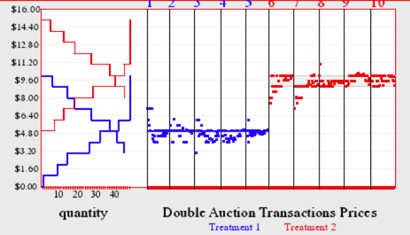
Double Auction

Slide 4
Experiment Design
3 buyers and 3 sellers, fixed role
2 parts, Market structure are different between two parts
Buyers’ values or sellers’ costs are different between two parts
Performance in the second part determines who can get bonus points
3 rounds/part
Every buyer or seller can trade at most 2 items in each round
Buyer must buy his/her first item before second item
Seller must sell his/her first item before second item

Slide 5
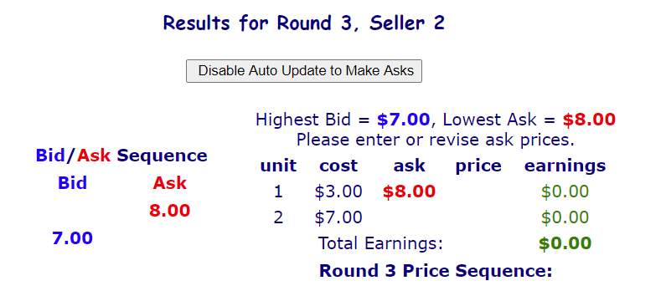
Notification
Click ”Disable Auto update to make bids/asks”
Trade will happen when new bid >= Lowest Ask, and price = Lowest Ask
Trade will happen when new ask <= Highest Bid, and price = Highest Bid
Highest bid and lowest ask will be cleared when one item is traded

Slide 6
Notification
Question : Suppose that the first buyer bids $7.00 and a seller decides to accept by entering an ask of $7.00. Before this seller can enter the ask, however, a second buyer bids $7.50. The seller, not knowing this, enters the ask of $7.00, after the bid of $7.50 is confirmed. The seller, of course, would be willing to sell at this higher bid price. What will the unit sell for? (a) $7.50 (b) $7.00
A seller who accepts a bid will receive the best (highest) bid price at the time the seller's acceptance is received. Similarly, a buyer who accepts an offer will receive the best (lowest) available ask price at the time the buyer's acceptance is received.

Slide 7
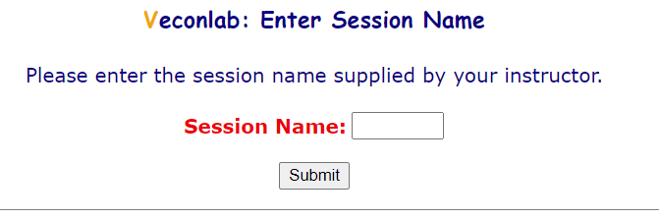
Log in
http://veconlab.econ.virginia.edu/login1.php
Session name: sgui26
Use your real name so that I can identify you

Slide 8
Market Environment
Part I (Practice)
Values are draw between 4 and 10.
Costs are draw between 0 and 6.
Part II (Bonus Points!)
Increased Demand: Values are draw between 6 and 12.
Increased Supply: Costs are draw between 2 and 8.

