Slide 1
Public Good Experiment
Voluntary Contribution

Slide 2
Public Goods
Definition
Non rivalrous: Increasing the number of consumers does not diminish the consumption of anyone else
Non excludable: It is impossible (or prohibitively expensive) to exclude anyone from consuming it.
Example - Asteroid deflection is a public good:
Nonexcludable: Nonpayers can’t be excluded from enjoying the benefits.
Nonrival: Many people can enjoy the benefits of the same asteroid deflection.
Problem
Free rider: Someone who enjoys the benefits of a public good without paying a share of the costs.

Slide 3
Public Good Game Experiment
4 participants in a group. Fixed Group in 8 rounds.
Start with 25 tokens in each round.
Allocate 25 tokens between private consumption and public investment.
Every token invested by your group earns group $0.2. (Group Return)
Every token invested by your group earns you $0.05 = 0.2/4. (External Return)
Every token you keep earns you $ 0.1. (Internal return)
In the first 5 rounds, you can get the feedback on your group investment.
In the last 3 rounds, you can conduct costly punishment to each of your partner after receiving the feedback.

Slide 4
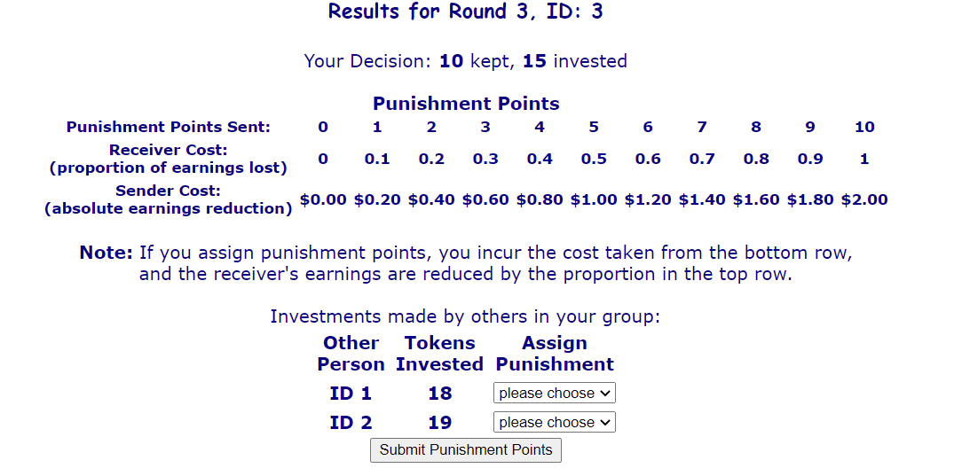
Punishment
Allocate up to 10 punishment points among your group members except yourself.
4 punishment points to your partner with ID 1, his external return will be 0.05*(1-0.4) = 0.03
3 punishment points to your partner with ID 2, his external return will be 0.05*(1-0.3) = 0.035
Cost for you = $1.4

Slide 5
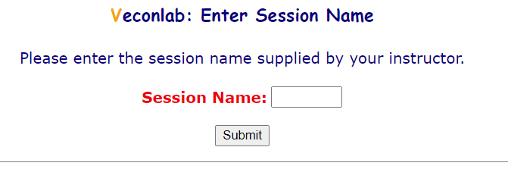
Log in
http://veconlab.econ.virginia.edu/login1.php
Session name: sgui28
Use your real name so that I can identify you

