Slide 1

SurveyCTO 101

Slide 2
Agenda
Introduction: Survey Data
Practice: SurveyCTO Overview
Survey Writing: Good Survey Questions
Survey Coding
Introduction to the Survey Design Form
Understanding the Spreadsheet Form

Slide 3
Introduction
Survey Data

Slide 4
Why surveys matter?
Social Science Research: data sources
Administrative Data
Observational Data
Survey Data
Survey characteristics
Information gathered primarily by asking people questions
Information collected from a sample of the population rather than all

Slide 5
Why SurveyCTO matters?
Electronic survey tool
Easy to administer
Design forms for better answers
Minimize errors
Data in a ready-to-analyze form
Online connectivity
Data safety
Data accessibility
Interactive survey features (pull previous answers)

Slide 6
Why good surveying matters?
Collecting and analyzing data comes with many possible errors that we want to minimize. Good surveying can minimize or eliminate many of those (in red)
Real Data
What we want to measure (construct) | Who we target (population)
Validity Does the question correctly cover the concept? | Coverage error Does our reachable list correctly map the target?
Measurement error Incorrect responses (lie, memory, …) | Sampling error Statistical stuff
Processing error Edit responses after collection (missing, etc.) | Nonresponse error Item (question) or survey (respondents)
 | Adjustment error Statistical stuff
Survey Statistic

Slide 7
Major steps of good surveying
Project codebook and previous surveys
Questions writing
Survey coding
Field testing before deployment
Enumerators training
High Frequency Checks during collection
Feedback at each step

Slide 8
Major steps of good surveying
Project codebook and previous surveys
Questions writing
Survey coding
Field testing before deployment
Enumerators training
High Frequency Checks during collection
Feedback at each step

Slide 9
Practice
SurveyCTO overview

Slide 10
SurveyCTO interface: take a survey!
On the tablet
Go to the SurveyCTO Collect App
On the computer
Go to http://gui2de.surveycto.com
Login with the following ID
User/email: gui2de-ra
Pwd: @training20

Slide 11
SurveyCTO interface: take a survey!
Tablet collection
Get Blank Form: Training – Nairobi Version
Get Selected
Fill Blank Form: Training – Nairobi Version
Mark Form as Finalized
Send Finalized Form: select and send
PC collection
Tab Collect: Training – Nairobi Version
Fill out

Slide 12
SurveyCTO Back End : Data
Monitor
or
Export
Data output: dataset like the ones you have been using in Stata

Slide 13
Survey Writing
How to write good survey questions

Slide 14
Survey Feedback
From the survey you just took:
What does the form try to measure?
Are questions accurately covering concepts?
Is incorrect response limited?
Is non-response limited?
Potential sources of errors and issues
Notes:
Check the duplicate

Slide 15
Principles of survey writing
Validity
Does the question accurately match your construct (what you’re trying to measure)
Reliability
Do questions give the same answer everytime (over time, across people)
Can people actually answer your question (memory, etc.)
Are errors minimized

Slide 16
Good practices
Specific
Short
Forced-choice instead of agree-disagree
Closed-ended, except when
we don’t know about a subject (exploration)
the topic is taboo/sensitive
Careful about:
Wording
Order

Slide 17
Good practices
Specific wording (use definitions)
Use reference points (eg, time periods)
Ask about one thing at a time only
Avoid asking about the future or too much into the past (more than 6mo)
Avoid math
About the “Don’t know” option

Slide 18
Specific questions: evaluations
Limit number of options (7 +/- 2)
Agree/disagree
May be problematic
Ratings
Unipolar (not at all interesting to extremely interesting)
Bipolar (extremely boring to extremely interesting with a midpoint)
Use words or numbers

Slide 19
Survey Coding
Design Form Overview

Slide 20
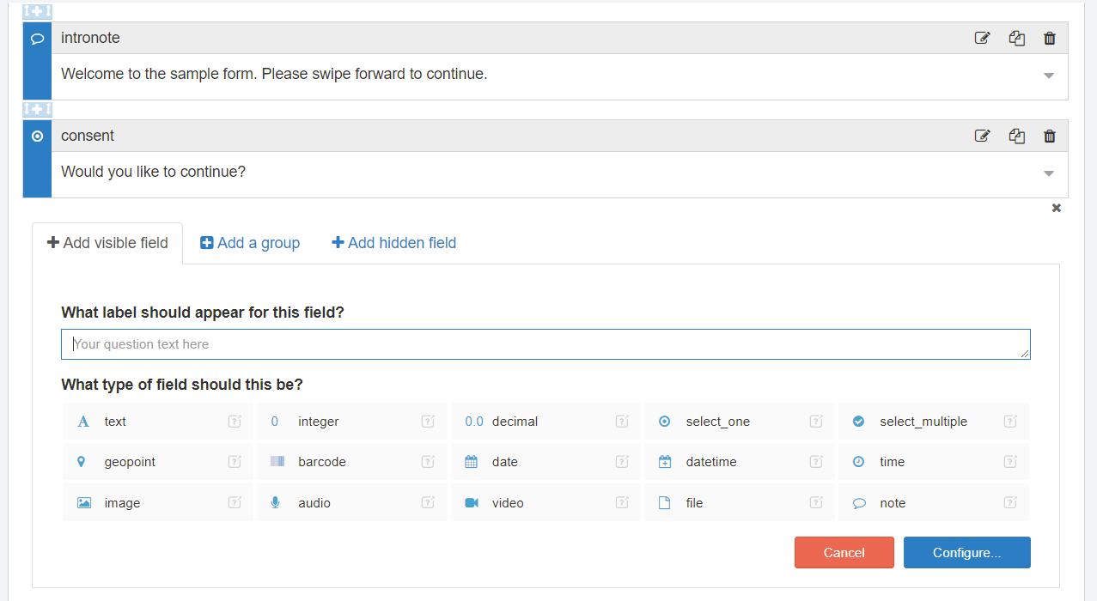
Design Form

Slide 21
Survey Coding
Spreadsheet Form Overview

Slide 22
Creating and editing a SCTO form in Excel or Google Sheets
TAB: SETTINGS
Change form title and ID
Version control (default)
Default language (for forms in several languages)
TAB: SURVEY
Understand default variables
Defining a new question
Variable type
Label
Relevance
Constraints
TAB: CHOICES For the select_one and select_multiple var types

Slide 23
Default variables
Those variables automatically appear at the beginning of the Excel form definition and shouldn’t be deleted. They won’t show up to enumerators (hidden field) but will be useful for data collection monitoring.
All forms also come with three HELP TABS (one for each tab) describing in details each variable type, syntax, operations, etc.
start | starttime | record the date and time the survey was started
end | endtime | record the date and time the survey was ended
deviceid | deviceid | record the unique ID of the device used to fill out the survey
subscriberid | subscriberid | record the subscriber ID associated with the device's SIM card, if any
simserial | simid | record the serial number associated with the device's SIM card, if any
phonenumber | devicephonenum | record the phone number associated with the device's SIM card, if any
username | username | record the username of the user filling out the form
caseid | caseid | record the unique ID of the case for which the form was filled out

Slide 24
Main variable types
note
text
integer, decimal
select_one, select_multiple
datetime, date, time
image (also: audio, video, file) – incl. pictures (‘new’) and signatures
barcode
calculate

Slide 25
Constraint, relevance, and other options
Constraints to limit the possible range of answers
Tailor constraint error message
Relevance conditions to establish skip patterns
Can be combined with groups
Other options
Hint to give more explanations about the question (italic, subtitle)
“Required”
Appearance
Media to add files

Slide 26
Operations and expressions
Details are in the help-survey tab of the form.
Arithmetic: + | - | * | div | mod | = | != | > | >= | < | <=
Logic: and | or | not()
Functions (not exhaustive): pulldata() | string-length() | concat() | min() | substr() | round() | regex() | if() | int() | date() | once(random())
${var} to refer to the question var in this form (can be replaced by . if we’re in that same line)
NB resource to debug regex: https://regex101.com/

Slide 27
Filtering drop-down menus
TAB: CHOICES
List the choices for select_one and select_multiple questions
Filtering choices
Survey tab: filter=${filtering_var}
Choices tab: corresponding values of the filtering var in the filter column, for the choices of the second var

Slide 28
Group and repeat groups
Group questions for
Skipping patterns (relevance condition on the group)
Appearance options (several questions on the same screen)
Nested groups are OK: they follow the following structure →
Repeat groups
When a set of question is repeated a n number of times, but n is not known in advance (depends on a survey answer), e.g. household roster
Calculate fields specific to repeat groups
position(..)
indexed-repeat(repeatedfield, repeatgroup, index)
AVOID nested repeat groups

Slide 29
Calculate fields
Hidden fields to the enumerator
Proper variables in the survey (like survey questions)
Used most often when
Creating intermediate variables for complex constraints, relevance conditions
Pulling data from other datasets
Generating random numbers
Using automatic random audits

Slide 30
Survey Coding
Advanced

Slide 31
Survey coding: best practices
In the spreadsheet /!\ start by changing the survey ID in the Settings tab /!\
Use help (help tabs from Excel spreadsheet, online help https://gui2de.surveycto.com/help.html, online support if needed – reach out to Béatrice to ask a question)
TEST your surveys
You can upload as DRAFT, without deploying
Coding involves testing, and iterations
Do not deliver something with bugs (to the field, or anyone else) unless you are explicit about the bugs during delivery
Add a “notes” tab in the spreadsheet that tracks changes
Tips:
Var names should start and end w a letter, only contain letters, numbers, underscore (_), reverse english order
Avoid repeat groups (and esp. nested ones) when you can

Slide 32
Publish data to server datasets
Use SurveyCTO console and Spreadsheet definition
To create interactive forms
Can pull data from previously submitted answers (from the same form or from another form)
Requires connectivity
Requires to update forms on the tablet

Slide 33
More features of SCTO
Use the help of SurveyCTO to explore the various options. For specific support requests, contact Béatrice who can write to the Support Center directly (very responsive for troubleshooting and debugging).
Translating surveys in multiple languages
GPS coordinates
Default entries or selections
Audio audits
Text audits (metadata, speed violations)
End-to-end encryption
Live visualizing and monitoring tools
…

Slide 34
Assignemnt
Introduction: Survey Data
Practice: SurveyCTO Overview
Survey Writing: Good Survey Questions
Survey Coding
Introduction to the Survey Design Form
Understanding the Spreadsheet Form

Slide 35
Assignment
Go to http://gui2de.surveycto.com
Login with the following ID
User/email: gui2de@georgetown.edu
Pwd: @coding20
Recreate the sample form and upload it into the Training & Testing group. Create it as a Google Sheets form and share the Sheet with bl517@georgetown.edu
Due by Wednesday 6/10 COB

Slide 36

www.gui2de.org

