Slide 1
Power and Sample Size
Part II
Elizabeth Garrett-Mayer, PhD
Assistant Professor of Oncology & Biostatistics

Slide 2
Sample Size and Power
The most common reason statisticians get contacted
Sample size is contingent on design, analysis plan, and outcome
With the wrong sample size, you will either
  Not be able to make conclusions because the study is “underpowered”
  Waste time and money because your study is larger than it needed to be to answer the question of interest
And, with wrong sample size, you might have problems interpreting your result:
  Did I not find a significant result because the treatment does not work, or because my sample size is too small?
  Did the treatment REALLY work, or is the effect I saw too small to warrant further consideration of this treatment?
  This is an issue of CLINICAL versus STATISTICAL significance

Slide 3
Sample Size and Power
Sample size ALWAYS requires the investigator to make some assumptions
  How much better do you expect the experimental therapy group to perform than the standard therapy groups?
  How much variability do we expect in measurements?
  What would be a clinically relevant improvement?
The statistician CANNOT tell you what these numbers should be (unless you provide data)
It is the responsibility of the clinical investigator to define these parameters

Slide 4
Sample Size and Power
Review of power
  Power = The probability of concluding that the new treatment is effective if it truly is effective
  Type I error = The probability of concluding that the new treatment is effective if it truly is NOT effective
  (Type I error = alpha level of the test)
  (Type II error = 1 – power)
When your study is too small, it is hard to conclude that your treatment is effective

Slide 5
Three common settings
Binary outcome: e.g., response vs. no response, disease vs. no disease
Continuous outcome: e.g., number of units of blood transfused, CD4 cell counts
Time-to-event outcome: e.g., time to progression, time to death.

Slide 6
Continuous outcomes
Easiest to discuss
Sample size depends on
  Δ: difference under the null hypothesis
  α: type 1 error
  β type 2 error
  σ: standard deviation
  r: ratio of number of patients in the two groups (usually r = 1)

Slide 7
Continuous Outcomes
We usually
  find sample size
  OR
  find power
  OR
  find Δ
But for Phase III cancer trials, most typical to solve for N.

Slide 8
Example: sample size in EACA study in spine surgery patients
The primary goal of this study is to determine whether epsilon aminocaproic acid (EACA) is an effective strategy to reduce the morbidity and costs associated with allogeneic blood transfusion in adult patients undergoing spine surgery. (Berenholtz)
Comparative study with EACA arm and placebo arm.
Primary endpoint: number of allogeneic blood units transfused per patient through day 8 post-operation.
Average number of units transfused without EACA is expected to be 7
Investigators would be interested in regularly using EACA if it could reduce the number of units transfused by 30% (to 5 units or less).

Slide 9
Example: sample size in EACA study in spine surgery patients
H₀: μ₁ – μ₂ = 0
H₁: μ₁ – μ₂ ≠ 0
We want to know what sample size we need to have large power and small type I error.
  If the treatment DOES work, then we want to have a high probability of concluding that H₁ is “true.”
  If the treatment DOES NOT work, then we want a low probability of concluding that H₁ is “true.”

Slide 10
Two-sample t-test approach
Assume that the standard deviation of units transfused is 4
Assume that difference we are interested in detecting is μ₁ – μ₂ = 2
Assume that N is large enough for CLT
Choose two-sided alpha of 0.05

Slide 11
Two-sample t-test approach

Slide 12
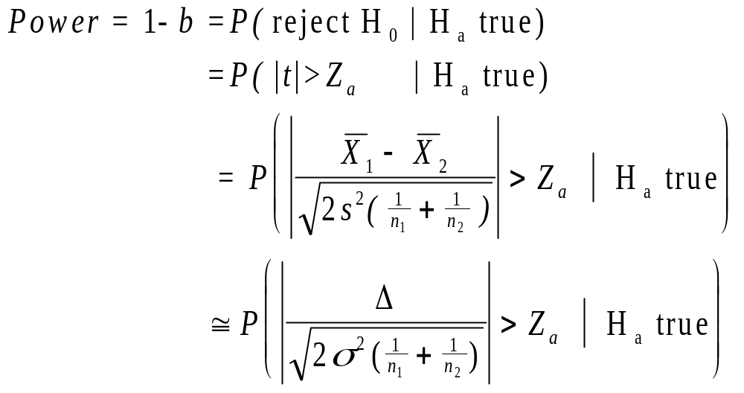
Two-sample t-test approach

Slide 13
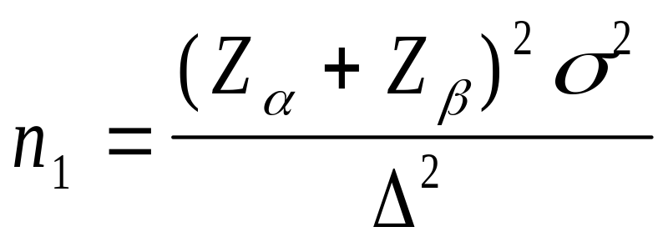
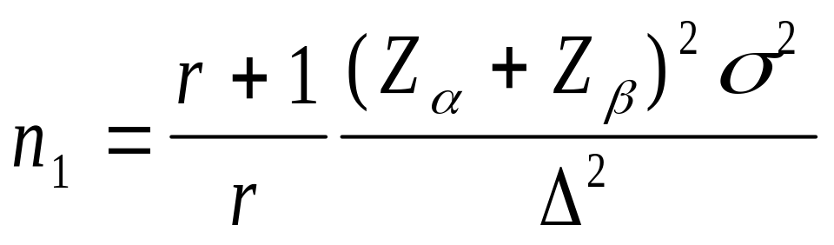
Two-sample t-test approach
For testing the difference in two means, with equal allocation to each arm:
With UNequal allocation to each arm, where n₂ = rn₁

Slide 14
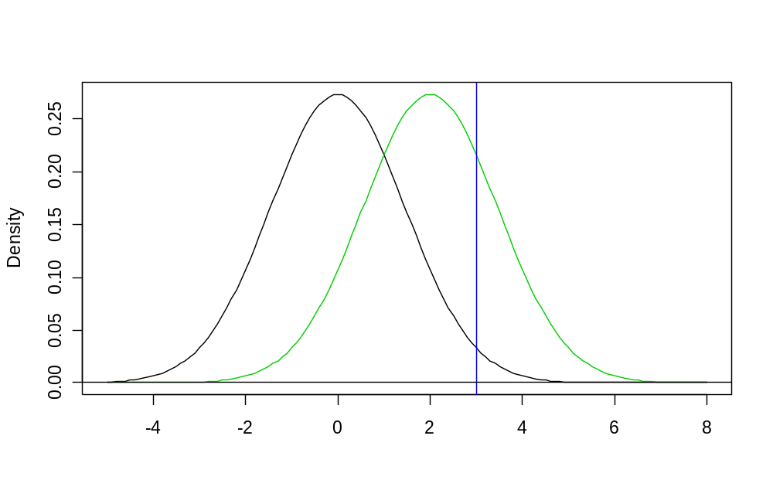
Sample size = 30,Power = 26%
Sampling distn under H₁: μ₁ - μ₂ = 0
Sampling distn under H₁: μ₁ - μ₂ = 2
Vertical line
defines
rejection region
μ₁ - μ₂

Slide 15
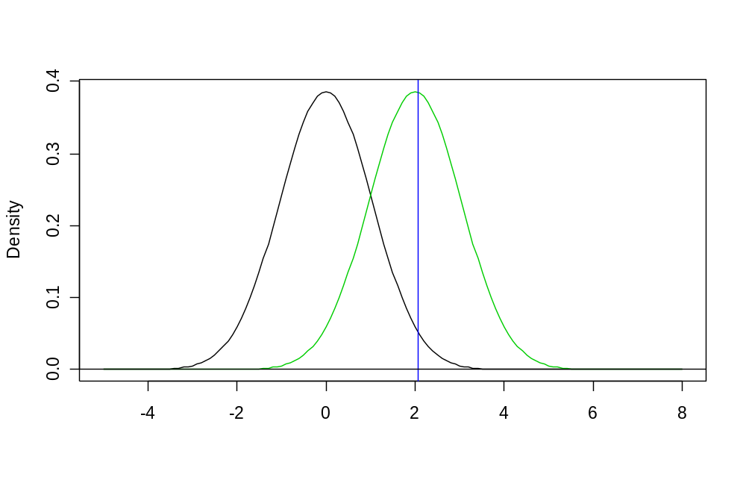
Sample size = 60,Power = 48%
Sampling distn under H₁: μ₁ - μ₂ = 0
Sampling distn under H₁: μ₁ - μ₂ = 2
Vertical line
defines
rejection region
μ₁ - μ₂

Slide 16
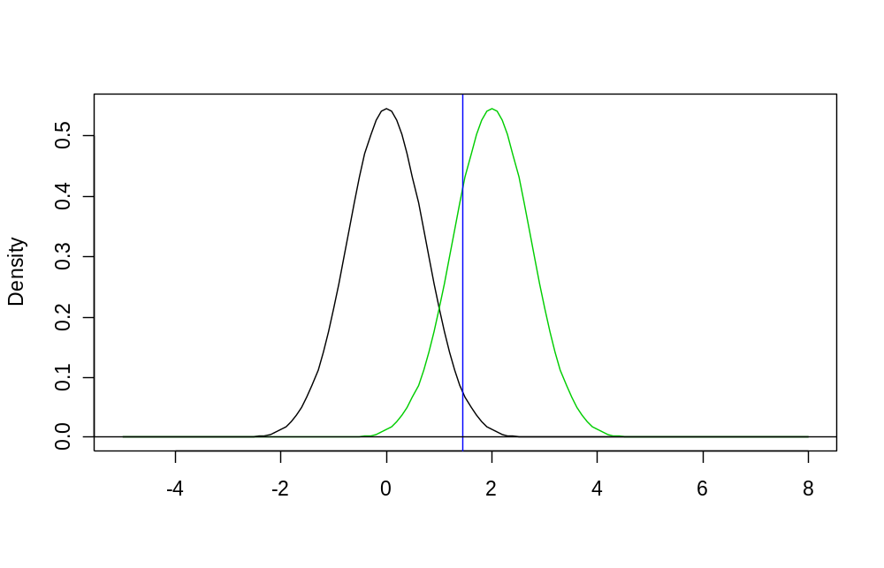
Sample size = 120,Power = 78%
Sampling distn under H₁: μ₁ - μ₂ = 0
Sampling distn under H₁: μ₁ - μ₂ = 2
Vertical line
defines
rejection region
μ₁ - μ₂

Slide 17
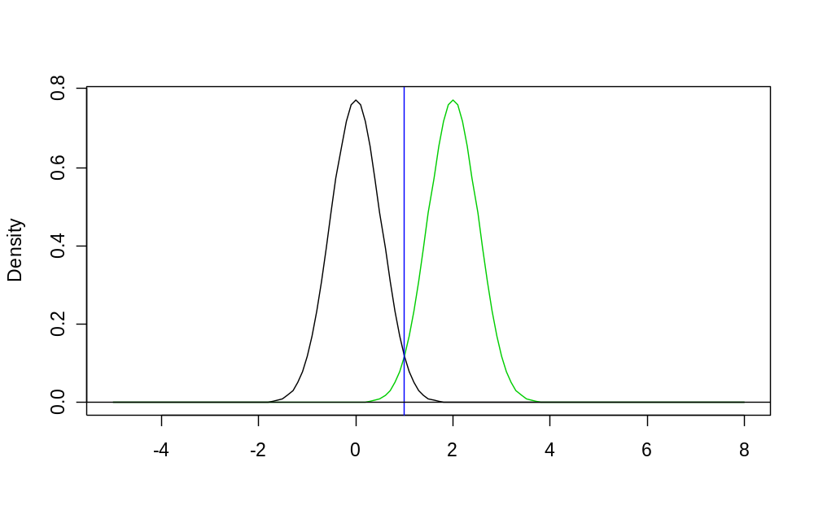
Sample size = 240, Power = 97%
Sampling distn under H₁: μ₁ - μ₂ = 0
Sampling distn under H₁: μ₁ - μ₂ = 2
Vertical line
defines
rejection region
μ₁ - μ₂

Slide 18
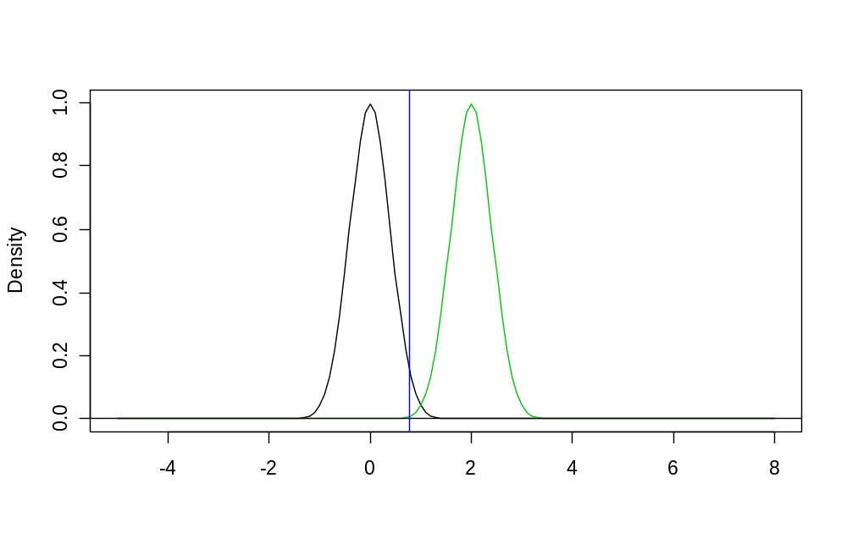
Sample size = 400, Power > 99%
Sampling distn under H₁: μ₁ - μ₂ = 0
Sampling distn under H₁: μ₁ - μ₂ = 2
Vertical line
defines
rejection region
μ₁ - μ₂

Slide 19
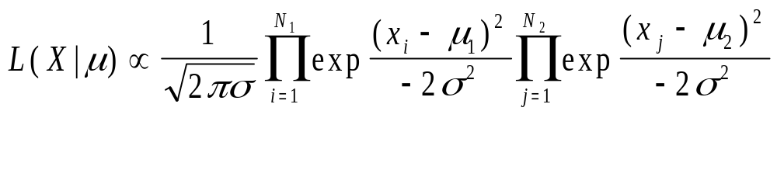
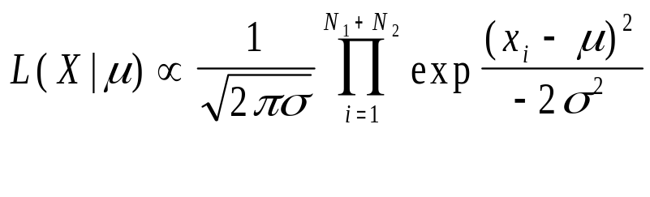
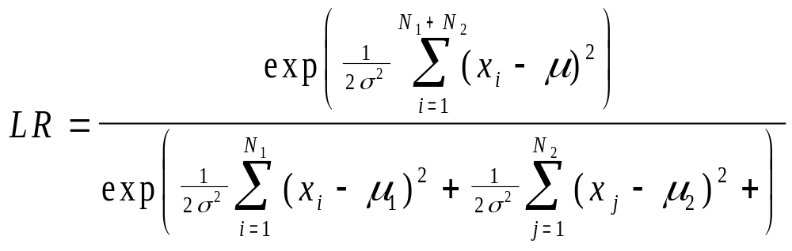
Likelihood Approach
Not as common, but very logical
Resulting sample size equation is the same, but the paradigm is different.
Create likelihood ratio comparing likelihood assuming different means vs. common mean:

Slide 20
Other outcomes
Binary:
  use of exact tests often necessary when study will be small
  more complex equations than continuous
  Why?
    Because mean and variance both depend on p
    Exact tests are often appropriate
    If using continuity correction with χ² test, then no closed form solution
Time-to-event
  similar to continuous
  parametric vs. non-parametric
  assumptions can be harder to achieve for parametric

Slide 21
Other issues in comparative trials
Unbalanced design
  why? might help accrual; might have more interest in new treatment; one treatment may be very expensive
  as ratio of allocation deviates from 1, the overall sample size increases (or power decreases)
Accrual rate in time-to-event studies
  Length of follow-up per person affects power
  Need to account for accrual rate and length of study

Slide 22
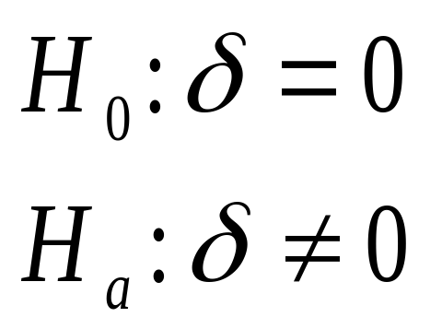
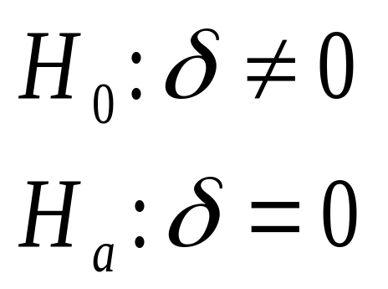
Equivalence and Non-inferiority trials
When using frequentist approach, usually switch H₀ and H_{a}
“Superiority” trial
“Non-inferiority” trial

Slide 23
Equivalence and Non-inferiority trials
Slightly more complex
To calculate power, usually define:
  H₀: δ > d
  H_{a}: δ < d
Usually one-sided
Choosing β and α now a little trickier: need to think about what the consequences of Type I and II errors will be.
Calculation for sample size is the same, but usually want small δ.
Sample size is usually much bigger for equivalence trials than for standard comparative trials.

Slide 24
Equivalence and Non-inferiority trials
Confidence intervals more natural to some
  Want CI for difference to exclude tolerance level
  E.g. 95% CI = (-0.2,1.3) and would be willing to declare equivalent if δ = 2
  Problems with CIs:
    Hard-fast cutoffs (same problem as HTs with fixed α)
    Ends of CI don’t mean the same as the middle of CI
Likelihood approach probably best (still have hard-fast rule, though).

Slide 25
Phase IV studies
Expanded Safety studies
LARGE trials
Looking for adverse events
These are generally quite rare
Rare events → use Poisson distribution
Can use frequentist of likelihood approach

Slide 26
Other considerations: cluster randomization
Example: Prayer-based intervention in women with breast cancer
  To implement, identified churches in S.E. Baltimore
  Women within churches are in same ‘group’ therapy sessions
Consequence: women from same churches has correlated outcomes
  Group dynamic will affect outcome
  Likely that, in general, women within churches are more similar (spiritually and otherwise) than those from different churches
Power and sample size?
  Lack of independence → need larger sample size to detect same effect
  Straightforward calculations with correction for correlation
  Hardest part: getting good prior estimate of correlation!

Slide 27
Other Considerations: Non-adherence
Example: side effects of treatment are unpleasant enough to ‘encourage’ drop-out or non-adherence
Effect? Need to increase sample size to detect same difference
Especially common in time-to-event studies when we need to follow individuals for a long time to see event.
Adjusted sample size equations available (instead of just increasing N by some percentage)

Slide 28
Helpful Hint: Use computer!
For common situations, software is available
Good software available for purchase
  Stata (binomial and continuous outcomes)
  NQuery
  PASS
  Power and Precision
  Etc…..
FREE STUFF ALSO WORKS!!!!
  Steve P’s software http://www.cancerbiostats.onc.jhmi.edu/software.cfm
  Cancer Research and Biostatistics (non-profit, related to SWOG) http://www.crab.org/Statistools.asp

Slide 29
Practical Considerations
We don’t always have the luxury of finding N
Often, N fixed by feasibility
We can then ‘vary’ power or δ
But sometimes, even that is difficult.
We don’t always have good guesses for all of the parameters we need to know…

Slide 30
Not always so easy
More complex designs require more complex calculations
Usually also require more assumptions
Examples:
  Longitudinal studies
  Cross-over studies
  Correlation of outcomes
Often, “simulations” are required to get a sample size estimate.

Slide 31
(1) Odds ratio between cases and controls for a one standard deviation change in marker | (2) SD(a)/SD(marker) | (3) Matching | (4) Power for X₁ as simulated | (5) Power for X₁ replaced with median from respective quintile
1.12 | 0.25 0.5 1 | 1:1 1:2 1:1 1:2 1:1 1:2 | 0.52 0.70 0.50 0.59 0.29 0.38 | 0.48 0.65 0.44 0.53 0.26 0.36
1.16 | 0.25 0.5 1 | 1:1 1:2 1:1 1:2 1:1 1:2 | 0.76 0.88 0.70 0.81 0.50 0.64 | 0.72 0.87 0.66 0.74 0.44 0.56
1.22 | 0.25 0.5 1 | 1:1 1:2 1:1 1:2 1:1 1:2 | 0.94 0.98 0.92 0.97 0.79 0.92 | 0.92 0.97 0.89 0.95 0.71 0.89
1.28 | 0.25 0.5 1 | 1:1 1:2 1:1 1:2 1:1 1:2 | > 0.99 >0.99 0.99 >0.99 0.95 0.99 | 0.98 >0.99 0.98 >0.99 0.91 0.97
(1) Odds ratio between cases and controls for a one standard deviation change in marker (in units of standard deviations of the controls) |  | (2) SD(a)/SD(marker in controls) | (3) Matching | (4) Power for X₁ as simulated | (5) Power for X₁ replaced with median from respective quintile
 | 1.16 | 0.25 0.5 1 | 1:1 1:2 1:1 1:2 1:1 1:2 | 0.55 0.75 0.51 0.65 0.32 0.50 | 0.54 0.70 0.50 0.59 0.31 0.43
 | 1.22 | 0.25 0.5 1 | 1:1 1:2 1:1 1:2 1:1 1:2 | 0.77 0.88 0.75 0.87 0.64 0.78 | 0.73 0.84 0.73 0.82 0.57 0.72
 | 1.28 | 0.25 0.5 1 | 1:1 1:2 1:1 1:2 1:1 1:2 | 0.92 0.98 0.89 0.97 0.84 0.94 | 0.91 0.97 0.88 0.95 0.82 0.88

Slide 32
Helpful Hint: Use computer!
For common situations, software is available
Good software available for purchase
  Stata (binomial and continuous outcomes)
  NQuery
  PASS
  Power and Precision
  Etc…..
FREE STUFF ALSO WORKS!!!!
  Steve P’s software http://www.cancerbiostats.onc.jhmi.edu/software.cfm
  Cancer Research and Biostatistics (non-profit, related to SWOG) http://www.crab.org/Statistools.asp

