Slide 1
Sample Size Determination
Janice Weinberg, ScD
Professor of Biostatistics
Boston University School of Public Health

Slide 2
Outline
Why does this matter? Scientific and ethical implications
Statistical definitions and notation
Questions that need to be answered prior to determining sample size
Study design issues affecting sample size
Some basic sample size formulas

Slide 3
Scientific And Ethical Implications
From a scientific perspective:
Can’t be sure we’ve made right decision regarding the effect of the intervention
However, we want enough subjects enrolled to adequately address study question to feel comfortable that we’ve reached correct conclusion

Slide 4
From an ethical perspective:
Too few subjects:
Cannot adequately address study question. The time, discomfort and risk to subjects have served no purpose.
May conclude no effect of an intervention that is beneficial. Current and future subjects may not benefit from new intervention based on current (inconclusive) study.

Slide 5
Too many subjects:
Too many subjects unnecessarily exposed to risk. Should enroll only enough patients to answer study question, to minimize the discomfort and risk subjects may be exposed to.

Slide 6
Definitions and Notation
Null hypothesis (H₀): No difference between groups
H₀: p₁ = p₂ H₀: μ₁ = μ₂
Alternative hypothesis (H_{A}): There is a difference between groups
H_{A}: p₁ ≠ p₂ H_{A} : μ₁ ≠ μ₂
P-Value: Chance of obtaining observed result or one more extreme when groups are equal (under H₀)
  Test of significance of H₀
  Based on distribution of a test statistic assuming H₀ is true
  It is NOT the probability that H₀ is true

Slide 7
Definitions and Notation
Δ: Measure of true population difference must be estimated. Difference of medical importance
Δ= |p₁ - p₂| Δ= |μ₁ - μ₂|
n: Sample size per arm
N: Total sample size (N=2n for 2 groups with equal allocation)

Slide 8
Type I error: Rejecting H₀ when H₀ is true
α: The type I error rate. Maximum p-value considered statistically significant
Type II error: Failing to reject H₀ when H₀ is false
β: The type II error rate
Power (1 - β): Probability of detecting group effect given the size of the effect (Δ) and the sample size of the trial (N)

Slide 9
 | Truth
Decision Based on the Data |  | Treatments are equal (H_{O} true) | Treatments differ (H_{A} true)
 | Do Not Reject H_{O} | O.K. | Type II error β
 | Reject H_{O} | Type I error α | O.K.

Slide 10
The quantities α, β, Δ and N are all interrelated.
Holding all other values constant, what happens to the power of the study if
Δ increases? Power ↑
α decreases? Power ↓
N increases? Power ↑
variability increases? Power ↓
Note: Typical error rates are α = .05 and β = .1 or .2 (80 or 90% power). Why is α often smaller than β?

Slide 11
SAMPLE SIZE:
How many subjects are needed to assure a given probability of detecting a statistically significant effect of a given magnitude if one truly exists?
POWER:
If a limited pool of subjects is available, what is the likelihood of finding a statistically significant effect of a given magnitude if one truly exists?

Slide 12
Before We Can Determine Sample Size We Need To Answer The Following:
1. What is the main purpose of the study?
2. What is the primary outcome measure?
Is it a continuous or dichotomous outcome?
3. How will the data be analyzed to detect a group difference?
4. How small a difference is clinically important to detect?

Slide 13
5. How much variability is in our population?
6. What is the desired α and β?
7. What is the sample size allocation ratio?
8. What is the anticipated drop out rate?

Slide 14
Example 1: Does the ingestion of large doses of vitamin A in tablet form prevent breast cancer?
Suppose we know from Connecticut tumor-registry data that incidence rate of breast cancer over a 1-year period for women aged 45 – 49 is 150 cases per 100,000
Women randomized to Vitamin A vs. placebo

Slide 15
Example 1 continued
Group 1: Control group given placebo pills by mail. Expected to have same disease rate as registry (150 cases per 100,000)
Group 2: Intervention group given vitamin A tablets by mail. Expected to have 20% reduction in risk (120 cases per 100,000)
Want to compare incidence of breast cancer over 1-year
Planned statistical analysis: Chi-square test to compare two proportions from independent samples
H₀: p₁ = p₂ vs. H_{A}: p₁ ≠ p₂

Slide 16
Example 2: Does a special diet help to reduce cholesterol levels?
Suppose an investigator wishes to determine sample size to detect a 10 mg/dl difference in cholesterol level in a diet intervention group compared to a control (no diet) group
Subjects with baseline total cholesterol of at least 300 mg/dl randomized

Slide 17
Example 2 continued
Group 1: A six week diet intervention
Group 2: No changes in diet
Investigator wants to compare total cholesterol at the end of the six week study
Planned statistical analysis: two sample t-test (for independent samples)
H₀: μ₁ = μ₂ vs. H_{A}: μ₁ ≠ μ₂

Slide 18
Some Basic Sample Size Formulas
To Compare Two Proportions From Independent Samples: H₀: p₁=p₂
1. α level
2. β level (1 – power)
3. Expected population proportions (p₁, p₂)

Slide 19
Some Basic Sample Size Formulas
To Compare Two Means From Independent Samples: H₀: μ₁ = μ₂
1. α level
2. β level (1 – power)
3. Expected population difference (Δ= |μ₁ - μ₂|)
4. Expected population standard deviation (σ₁ , σ₂)

Slide 20
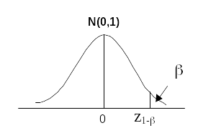
The Standard Normal Distribution
N(0,1) refers to standard normal (mean 0 and variance 1)

Slide 21
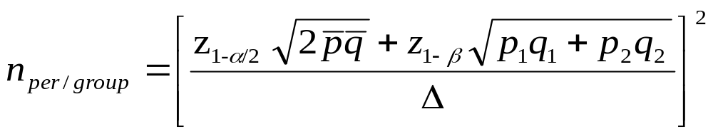
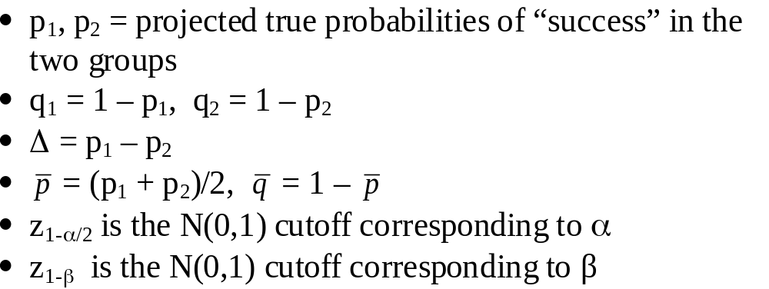
Dichotomous Outcome (2 Independent Samples)
Test H₀: p₁ = p₂ vs. H_{A}: p₁ ≠ p₂
Assuming two-sided alternative and equal allocation
***Always Round Up To Nearest Integer!

Slide 22
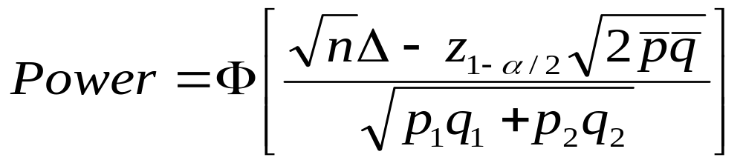
Dichotomous Outcome
(2 Independent Samples)
where Φ is the probability from a standard normal distribution

Slide 23

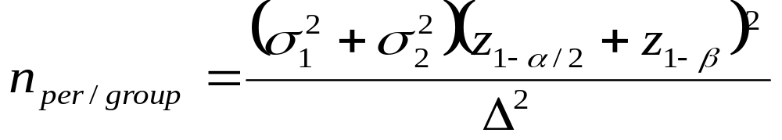
Continuous Outcome
(2 Independent Samples)
Test H₀: μ₁ = μ₂ vs. H_{A}: μ₁ ≠ μ₂
Two-sided alternative and equal allocation
Assume outcome normally distributed with:

Slide 24
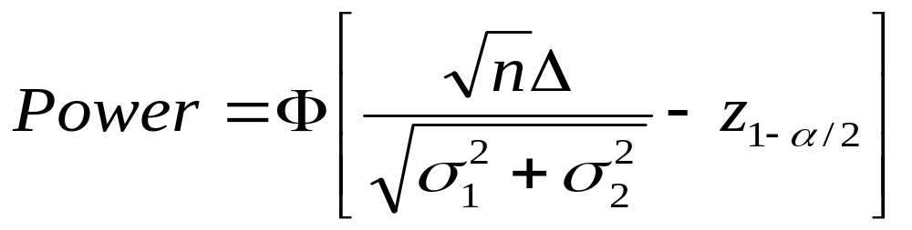
Continuous Outcome
(2 Independent Samples)
where Φ is the probability from a standard normal distribution

Slide 25
Example 1: Does ingestion of large doses of vitamin A prevent breast cancer?
Test H₀: p₁ = p₂ vs. H_{A} p₁ ≠ p₂
Assume 2-sided test with α=0.05 and 80% power
p₁ = 150 per 100,000 = .0015
p₂ = 120 per 100,000 = .0012 (20% rate reduction)
Δ = p₁ – p₂ = .0003
z_{1-α/2} = 1.96 z_{1-β} = .84
n per group = 234,882
Too many to recruit in one year!

Slide 26
Example 2: Does a special diet help to reduce cholesterol levels?
Test H₀: μ₁=μ₂ vs. H_{A} : μ₁≠μ₂
Assume 2-sided test with α=0.05 and 90% power
Δ = μ₁ - μ₂ = 10 mg/dl
σ₁= σ₂ = (50 mg/dl)
z_{1-α/2} = 1.96 z_{1-β} = 1.28
n per group = 525
Suppose 10% loss to follow-up expected,
adjust n = 525 / 0.9 = 584 per group

Slide 27
These two basic formulas address common settings but are often inappropriate
Other types of outcomes/study designs require different approaches including:
-Survival or time to event outcomes
-Cross-over trials
-Equivalency trials
-Repeated measures designs
-Clustered randomization

Slide 28
Sample Size Summary
Sample size very sensitive to values of Δ
Large N required for high power to detect small differences
Consider current knowledge and feasibility
Examine a range of values, i.e.:
-for several Δ, power find required sample size
-for several n, Δ find power
Often increase sample size to account for loss to follow-up
Note: Only the basics of sample size are covered here. It’s always a good idea to consult a statistician

