Slide 1
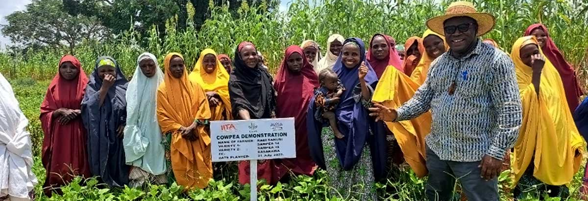

It Takes More Than Seeds
Knowledge, Capital, and Women’s Agency in Nigeria
Arishka Nayak, Grace Huang, Yubing Han, and Abhinav Dutt

Slide 2
Background & Country Context
Nigeria’s agricultrual sector:
Gender divide within agricultural sector in Nigeria
The World Bank estimates that female plot managers in Nigeria produce roughly 30% less per hectare than male farmers and generate 25% less output per hectare after controlling for observable household characteristics
The aggregate cost of this difference is estimated at $2.3 billion annually, or about 0.6 percent of Nigeria’s GDP, with broader spillover gains of up to 2 percent of GDP if the productivity gap were closed (World Bank, 2023).
Nigeria’s unique context within the African continent
The gender gap in agricultural labor productivity in Nigeria is large relative to other sub-Saharan African contexts (Palacios-López, 2015) and it cannot be explained fully by observable differences in endowments (Mukasa, 2015).
Female-managed plots in N. Nigeria are 42% smaller than male-managed plots.
Women rely more heavily on female household labor per hectare and the gender productivity gap is wider in the north than in the south (Oseni, 2015).
24% of GDP
80% are smallholder farmers
80% of HHs in north 50% of HHs in south
36.2% Women

Slide 3
Motivation for Intervention
What is our focus?
THE PROBLEM
THE CONSEQUENCE
THE NUANCE
Unexplained gap
Reinforcement of gap
Participation != bargaining power
77% of the productivity difference between male and female farmers is attributable to unexplained structural factors rather than to differences in endowments (Mukasa, 2015).
interventions that target only the observable aspects of the gap, such as inputs or credit, are unlikely to generate durable gains if the underlying institutional and social mechanisms remain unchanged.
Productive resources such as land, credit, inputs, and knowledge are more often directed toward men than toward women, reinforcing the perception that men are the farm’s legitimate economic agents while women are dependents rather than contributors (Oseni, 2015).
The identity of the resource recipient shapes productive outcomes in ways that aggregate quantities of inputs alone cannot capture.
Women’s increased participation in agricultural value chains does not necessarily improve their control over the resulting income, and male household members may capture commercially successful female managed activities (Swaans, 2015).
A primary reason many interventions fail is their exclusive focus on visible outputs rather than the structural drivers that sustain them (Farnworth, 2015).
We study whether directing agricultural extension services AND microcredit exclusively to women increases women’s decision-making authority and control over farm resources, and whether these shifts alter their perceived role as productive contributors within the household.

Slide 4
Intervention Logic
Theory of Change
THE PROBLEM
THE MECHANISM
THE INTERVENTION
Resources flow to men
Institutional Signaling
T1 + T2
Extension, credit, and inputs go to male household heads — even when women do most of the farm labor.
77% of Nigeria's productivity gap cannot be explained by observable differences alone (Mukasa & Salami, 2015).
When institutions name women as recipients of knowledge and capital, they shift the household perception of women as legitimate economic actors — not dependents.
T1 Women-only extension T2 Extension + microcredit Both arms make women the publicly named recipient of resources.
→
→
Notes:
Intervention Logic (Grace)
The gender productivity gap in Nigerian agriculture is well-documented, but what's striking is that 77% of it can't be explained by observable differences — women don't just have fewer inputs, they're structurally excluded from being seen as legitimate economic actors. Extension contacts, credit, land titles — these all flow to male household heads by default, and that signal matters. It tells the household, and the community, that men are the farmers and women are dependents.
Our theory of change centers on institutional signaling. If we deliberately route productive resources — knowledge and capital — to women as the named recipients, we hypothesize that this shifts intra-household authority. That's the mechanism. So we designed two treatment arms: T1 delivers women-only agricultural extension, and T2 adds microcredit on top of that, with the woman as the named borrower of record. In both cases, the woman is publicly visible as the one receiving the resource.

Slide 5
What We're Testing
Three-Arm RCT · Village-level randomization
CONTROL
TREATMENT 1
TREATMENT 2
Status Quo
Women-Only Extension
Extension + Microcredit
No study-provided services.
Counterfactual: what happens without gender-targeted resources?
6 modules over one growing season. Female facilitators. Woman is the named recipient of knowledge.
All of T1 plus women are the sole eligible borrowers, disbursed in the woman's name via mobile money.
T1 vs Control → effect of knowledge alone T2 vs Control → joint effect of knowledge + capital T2 vs T1 → marginal effect of credit
Primary Outcomes
↑ Women's decision-making authority ↑ Control over farm revenue ↑ Perceived productive role
Notes:
What We're Testing (Grace)
This is a village-level RCT with three arms. Control villages continue under the status quo — no study-provided services — which gives us our counterfactual. Treatment 1 villages receive six modules of women-only extension over one growing season, delivered by female facilitators where possible. Treatment 2 adds microcredit eligibility, phased in after the initial extension period so women build financial literacy before accessing capital, and disbursed directly into the woman's own mobile money account.
The three arms give us three comparisons: T1 versus control isolates the effect of knowledge alone; T2 versus control captures the joint effect; and T2 versus T1 tests whether adding capital makes a difference beyond knowledge. Our primary outcomes are women's decision-making authority, control over farm revenue, and perceived productive role — measured through a pro-WEAI adapted instrument.

Slide 6
Study Design: Sample
Randomization at the village level:
Mechanism operates through community-level visibility
Minimizes risk of contamination between groups as extension knowledge diffuses across households
Stratified Sampling by Region:
Rural farming villages selected from northern and southern states
To capture gender norm intensity: northen Nigeria is predominantly Muslim and Hausa-Fulani households where Purdah is followed. We use this as proxy for norm-intensity where social restrictions on women are strongest.
Eligible households: at least one adult woman (aged 15 or more) engaged in agricultural production
Village-level baseline FLFP in agriculture used to identify villages
Sample size:
135 Total Villages
45 villages per treatment arm
~20 eligible women per villages (GHS median cluster size)

Slide 7
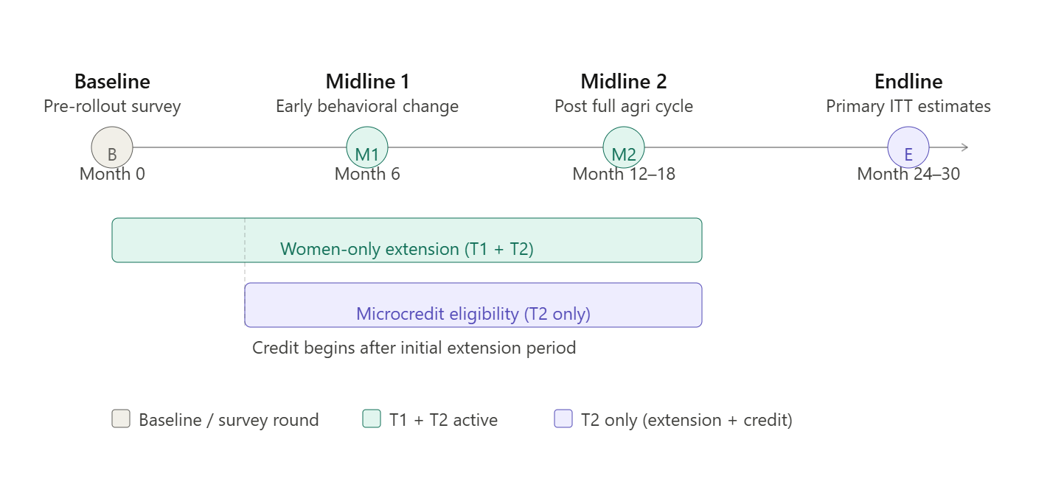
Study Design: Extension Details and Timeline
10 sessions over a growing season
Two sessions per curriculum module
2 hours per session
Bi-weekly: 20 weeks (one full growing season)
Modules covered:
Crop Planning and Seasonal Decision-Making
Input Use
Basic Record-keeping
Post-harvest handling and Storage
Market-oriented decision-making
Negotiation skills

Slide 8
Two Data Sources
Data Collection & Outcome
GHS 2018-19
Our Panel Survey
Existing national survey
Used for baseline parameters
(participation rate, ICC)
Original data collection
4 rounds: Baseline, Midline 1 (~6mo),
Midline 2 (post-harvest), Endline (24-30mo)
Tracks intervention effects over time
Survey Instrument: 4 Modules
Primary Outcomes
Female LFPR
M1
Identification
M2
Demographics
Women who worked in past 7 days (D1a)
÷ total adult women in household (B2b) × 100
ILO standard, 7-day recall
Cascading lookup,
consent, hidden
treatment arm
Age, education,
land, HH roster
(denominator)
M3
Agri Labor
M4
Outcomes
% Women in Agriculture
Days worked,
income, credit + consistency checks
LFPR, agri share,
decision-making
(pro-WEAI)
Women who worked on farm last season
÷ total adult women in household (B2b) × 100
Full-season recall
Bulleted Text Style Title— Helvetica Neue 20pt Bold

Slide 9
Baseline & Power Analysis
From GHS 2018-19 | N = 5,394 | 304 EAs | Rural adult women, age 15+
32.8%
0.228
45.8 vs 25.1%
Participation
ICC
South vs North
past 7 days
2x literature avg
20.7pp gap
Simulation: 1,000 replications, clustered SEs
J/arm | Villages | HHs | T1 vs C (10pp) | T2 vs C (15pp) | T2 vs T1 (5pp)
15 | 45 | 900 | .245 | .433 | .091
35 | 105 | 2,100 | .432 | .742 | .156
45 | 135 | 2,700 | .486 | .819 | .152
80 | 240 | 4,800 | .712 | .965 | .241
100 | 300 | 6,000 | .827 | .992 | .292
Recommended: 45 villages/arm (2,700 HHs). T2 vs C: 82% power. T1 vs C: underpowered. T2 vs T1: not feasible.
Bulleted Text Style Title— Helvetica Neue 20pt Bold

Slide 10
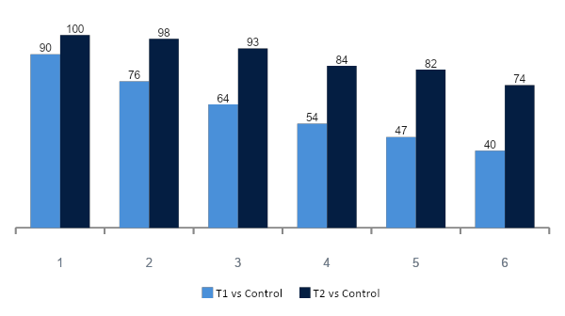
Sensitivity & Robustness
Other findings
Power is highly sensitive to ICC (% at J=45)
Attrition (20%)
T2 vs C power drops only from 81.4% to 80.0%. Robust to moderate dropout.
MDE threshold
At 45 villages/arm, we can reliably detect effects of 15pp or larger.
Regional heterogeneity
Cannot distinguish N vs S reatment effects at this sample. Exploratory only.
Bulleted Text Style Title— Helvetica Neue 20pt Bold

Slide 11
What We Cannot Answer
Microcredit marginal effect
The expected difference between extension+microcredit and extension-only is about 5 percentage points. At our ICC, this requires hundreds of villages per arm. Our study can assess the full intervention vs. status quo, but cannot isolate the credit component.
Regional heterogeneity
We pre-specify a test of whether treatment effects differ between North and South. However, at 45 villages per arm, the study has limited power for this comparison. This analysis will be treated as exploratory, not confirmatory.
Baseline parameters are conservative
The 7-day recall window may underestimate full-season participation (32.8% vs. potentially higher). ICC of 0.228 is above typical literature values (0.05-0.15). Both will be updated after the baseline survey. Final sample size may be adjusted.
Bulleted Text Style Title— Helvetica Neue 20pt Bold

Slide 12
Thank You!

