Slide 1
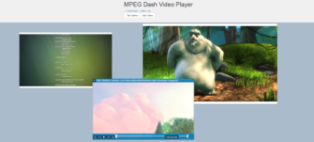
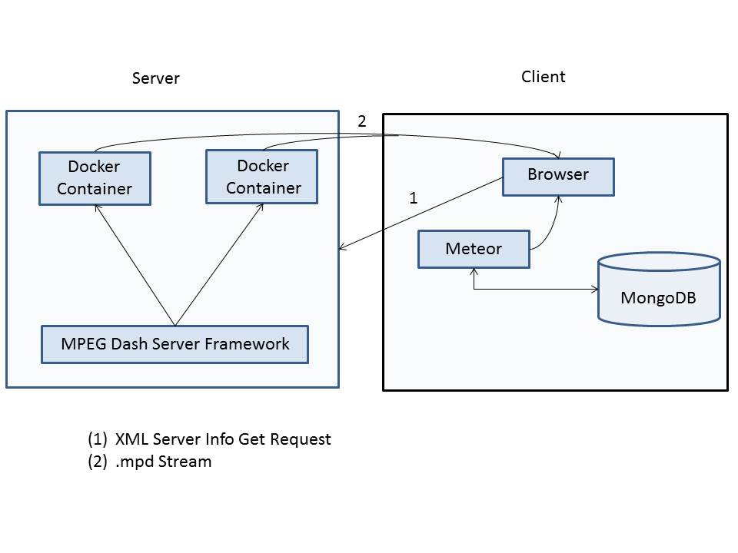
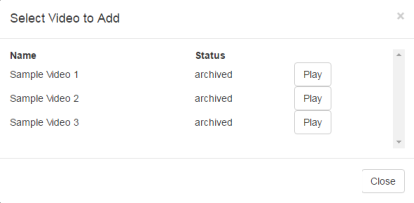
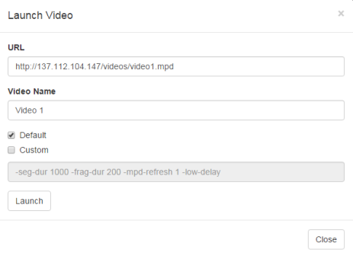
MPEG-Dash Service
Orry Jarvis, Jordan Lashomb, Brandon Tom, Andrew Yuk
Server
Client
MPEG-Dash (Dynamic Adaptive Streaming over HTTP) is an emerging streaming technique that works by breaking the content into a sequence of small file segments containing a short interval of playback time. Segments are encoded at a variety of bit rates so that while a segment is being played, the quality of the next segment can be downloaded based on current network conditions.
Viewing
Video Feed/mp4
Server Host
Server launches Docker container with given mp4/feed.
Videos are draggable, resizable, and tilable. Snapshots of each video can be taken.
Docker Container
Playing
DashCast encodes the video in MPEG Dash, while nodejs launches a simple web server to host the video.
gpac DashCast
Stores all videos on the server. Simply select to play.
Launching
The encoded .mpd and each segment are hosted by the web server
Nodejs Web Server
Our service launches docker containers that take both mp4 files and live streams and encodes them in MPEG-Dash using gpac. The containers then host the videos using nodejs. The videos can then be played by our client.
The client’s UI is capable of dynamically adding new servers, editing existing ones, shutting down existing video feeds, and uploading videos to be encoded into MPEG-Dash format.
Client
Client can also launch videos to be hosted.

