Slide 1
The Sequels
Data Analysis and Infrastructure
DA24STO - Hyper Island

Slide 2


From sheets to tables
Migrate a spreadsheet data set to a database
Review the data
Design the tables
Clean the data
Connect the data
Populate the database
Notes:
We have been tasked with transitioning a spreadsheet based data set to a relational database.
For that, we used the MSSQL server we had already running.
The steps included reviewing the data, designing the tables and thinking about the best way of relating them, cleaning the data, connecting the data and populating the database.

Slide 3

The data
Three given spreadsheets:
Classlist
StudentPerformance
MovieChoice
One created:
Address
There's no obvious connection to MovieChoice, so we created a backstory: During admission, all students were asked what their favourite movie was.
Notes:
We were provided with 3 spreadsheets, which we renamed to Classlist, StudentPerformance and MovieChoice.
We were also asked to include an extra table on the database with the addresses of everyone on Classlist, so we started with a spreadsheet.
Connecting Classlist, StudentPerformance and Address was trivial, but there was no obvious connection to MovieChoice.

Slide 4
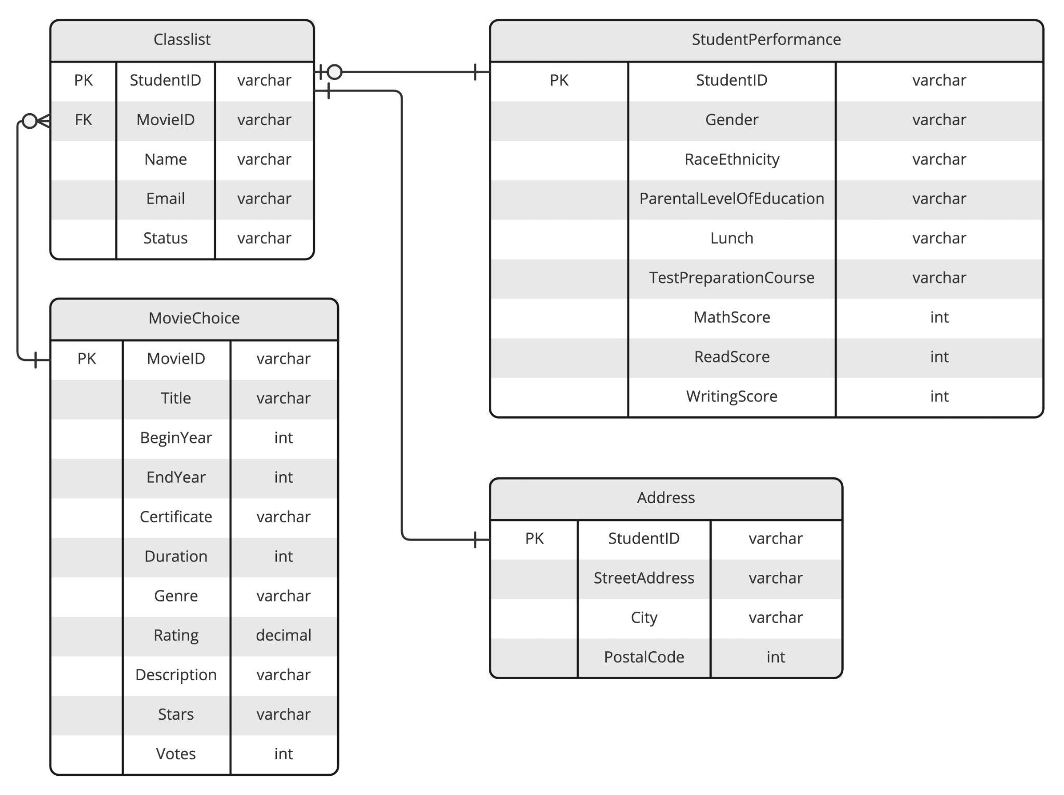

The design
Database schema (entity relationship diagram)
Notes:
The design came as follow.
Classlist, StudentPerformance and Address all share the same StudentID as primary key.
MovieChoice has MovieID as primary key to identify the movies, which is also a foreign key in Classlist that represents the favourite movie chosen by each student.
Note that there is a relationship of one-or-zero to one between Classlist and StudentPerformance, which means that one student on Classlist must be equal to one in StudentPerformance, but one student on StudentPerformance can be equal to one or none on Classlist.
Similarly, one movie chosen on Classlist must be equal to one on MovieChoice, but one movie on MovieChoice can be associated with multiple students on Classlist or none.
Finally, the relationship between Classlist and Address is always one to one.

Slide 5
Cleaning (aka Excel Magic)
Classlist and StudentPerformance were clean.
MovieChoice was a mess:
Missing data
Numbers stored as strings
Duration and Year had additional data
But no movie title was missing, so no line was excluded.
Notes:
And then we started cleaning the data.
Classlist and StudentPerformance were clean. There was just one email address that needed to be fixed.
But MovieChoice was a mess. There was missing data. Basically, all the numbers were stored as strings. And Duration and Year had additional, non-conforming data. But as no movie title was missing, which was what mattered to our case, then no line was excluded.

Slide 6
Cleaning (aka Excel Magic)
Year, Duration, Rating and Votes were cleaned with good old Find/Replace.
Year was split in two columns, BeginYear and EndYear, with these formulae:
=NUMBERVALUE(LEFT(C2, 4))
=IF(ISNUMBER(NUMBERVALUE(RIGHT(C2, 4))), NUMBERVALUE(RIGHT(C2, 4)), "")
And then:
=IF(L2=0, "", L2)
=IF(M2=0, "", M2)
Notes:
And we did all the cleaning on Excel. There was no good reason for loading everything to the database and cleaning it afterwards. That would be way harder.
For Duration, just removing "min" made Excel convert it to numbers. The same for Votes, after we removed the commas. Rating was a little tricky because it already had dots instead of commas, but they were strings. Changing dots to commas did the trick, maybe because Excel was not set to American English.
Anyway, Year needed real cleaning to remove parenthesis and extra text before we could split it into BeginYear and EndYear.
The first two formulas selected BeginYear and EndYear, respectively, if there was any, and the last two were necessary because when the cell had no value, it returned zero, and we wanted it to remain null.

Slide 7
Connecting
The tables need a matching ID.
The same GUID (StudentID) as primary key:
Classlist
StudentPerformance
Address
Another GUID (MovieID) to identify the movies:
MovieChoice (primary key)
Classlist (foreign key)
Notes:
Ok, then we needed IDs.
Classlist, StudentPerformance and Address shared the same StudentID as primary key.
And we created MovieID as a primary key for MovieChoice and as a foreing key to Classlist.
But we didn't use numbers as IDs. We used GUIDs or Global Unique IDs, also known as UUID or Universal Unique IDs.

Slide 8
Connecting
Why use a GUID? (a5bd8458-c730-4f1e-831b-8d20281e89f2; 128-bit in size, 32 digits long, 2¹²⁸ possibilities)
The nature and potential size of the tables.
Numerical IDs make sense when order and continuity needs to be maintained.
A GUID or UUID is unlikely to be repeated.
It can be uniquely created with NEWID() on MSSQL and UUID() on MySQL.
Notes:
Was that overkill? Yes and no.
If we think about the task, yes. But if we stretch that to a real life scenario, StudentPerformance could be a table for high school performance across Sweden, for example. It would be updated by many thousands every year.
The same for MovieChoice.
And Classlist would be a new different table every year. It's good that there's no matching StudentIDs among the years.
And if you had to remove a student, it wouldn't break the continuity of the numbers, because there's none, it doesn't matter.

Slide 9
Creating/Populating tables
Create CSV files.
When Excel runs out of magic:
CSV files with semicolons, instead of commas
Weird results when importing comma-separated numbers (used anywhere aside from the USA)
Just open the spreadsheets on Google Sheets and export them to CSV files.
Import into a clean database on MSSQL using the Import Wizard.
Watch out for the data types and primary keys.
Notes:
Finally, we had to put that data into tables.
As we're using MSSQL, the easiest way is to import CSV files. And that's when Excel fails.
For reasons unknown to men, Excel doesn't follow the standard and uses semicolons instead of commas. It's annoying. We just opened the Excel files on Google Sheets and exported them to standard CSV files.
We could also have used an online service to do that.
After creating a clean database, importing the CSV files created a table for each one.
We had to select the primary key during the process and double-check the data types because the Import Wizard not always choose the right size or check for the nulls.

Slide 10
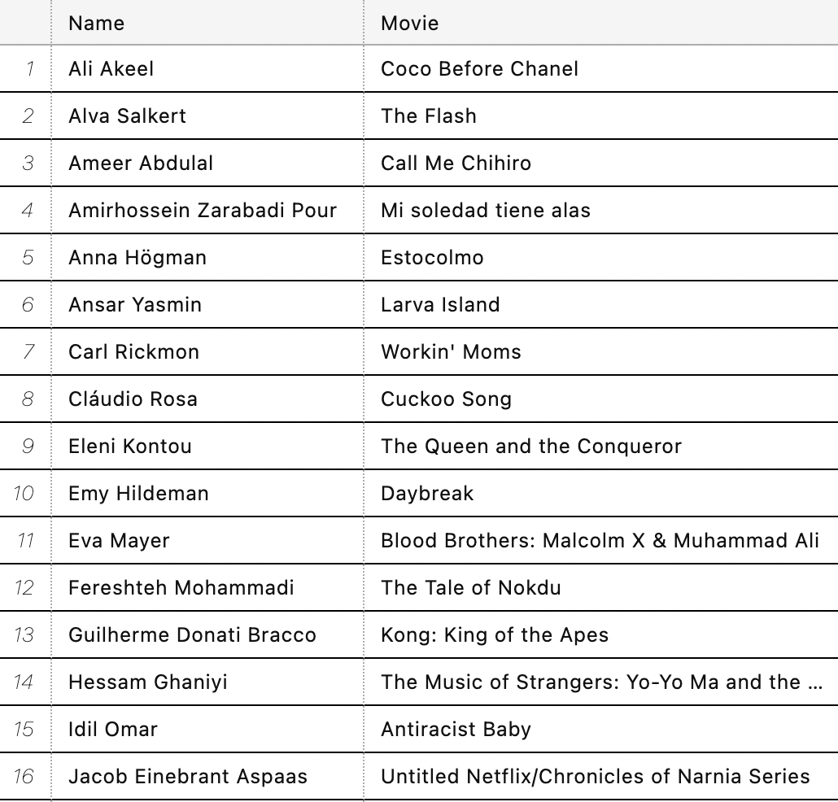
Queries
-- Their favourite movies?
USE TheSequels
SELECT Name, Title AS Movie
FROM Classlist
INNER JOIN MovieChoice
ON Classlist.MovieID
= MovieChoice.MovieID
ORDER BY Name;

Slide 11
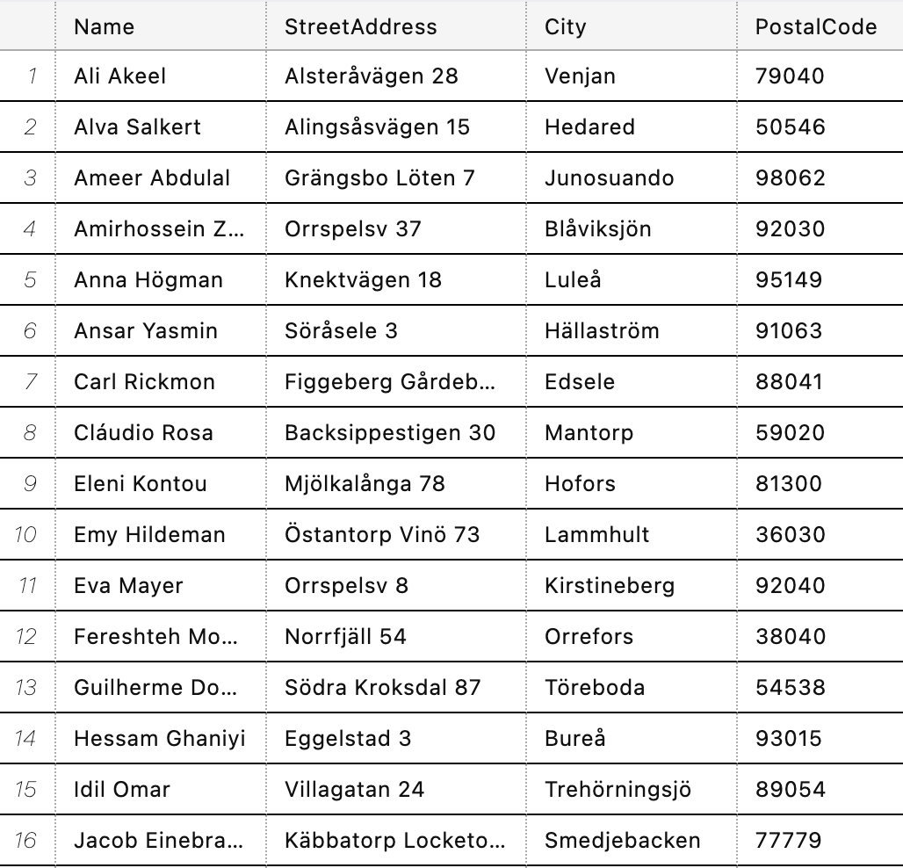
Queries
-- Where they live?
USE TheSequels
SELECT Name,
StreetAddress,
City,
PostalCode
FROM Classlist
INNER JOIN Address
ON Classlist.StudentID
= Address.StudentID
ORDER BY Name;

Slide 12
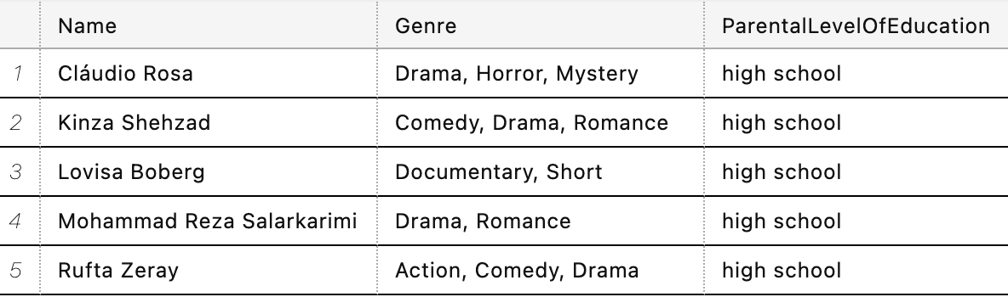
Queries
-- Genre of the movie chosen by the students whose parents only finished high school.
SELECT Name, Genre, ParentalLevelOfEducation
FROM Classlist, MovieChoice, StudentPerformance
WHERE Classlist.StudentID = StudentPerformance.StudentID
AND Classlist.MovieID = MovieChoice.MovieID
AND ParentalLevelOfEducation = 'high school'
ORDER BY Name;

Slide 13
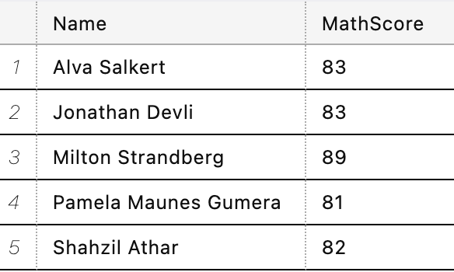
Queries
-- Which students have a score of 80 or more in Math?
USE TheSequels
SELECT Name, MathScore
FROM Classlist
INNER JOIN StudentPerformance
ON Classlist.StudentID
= StudentPerformance.StudentID
AND MathScore > 80
ORDER BY Name;

Slide 14
EOF
Thanks!

