Slide 1
Query Optimization for
Stream Databases
Presented by: Guillermo Cabrera
Fall 2008

Slide 2
Agenda
Scope
Core Problem
Eddy
  Motivation
  Challenges
  Example
Eddy usage in CACQ
Final Remarks

Slide 3
Scope
Query Optimization
  Rate-based
  Resource based
  QoS
  Query Adaptivity

Slide 4
Core Problem
Traditional DMBS
  Static query processing
  Cost-based optimization
Cost of query plan changes
  Processing time of operator
  Selectivity of predicate
  Arrival rate of a stream
Traditional optimizers unable to adapt to new environment
Notes:
In Stream Databases (As Swati mentioned)

Slide 5



Light Sensor Selectivity

Slide 6
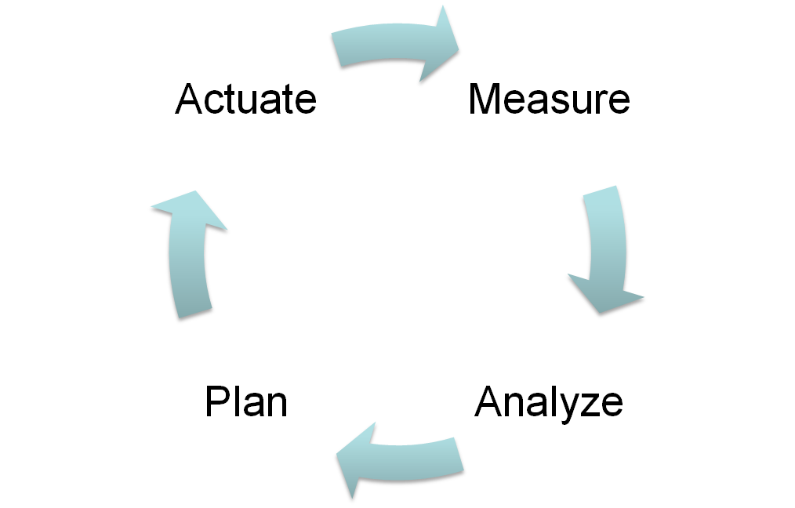
Adaptive Query Processing
Adaptivity loop
Notes:
Regular query execution is supplemented with a control system for monitoring query processing and adapting it. Adaptive control systems are typically componentized into a four-part loop that the controller repeatedly executes (either in line or in parallel with normal tuple processing,

Slide 7
Eddy Motivation
Need query plan to be re-optimized regularly
Reorder operators while in flight

Slide 8




What is an Eddy
Continuously reorders operators in query plan on tuple-by-tuple basis
Output
B |X| C
AB |X| C
Eddy
A
B
Output
A |X| B
C
C
A
B
A |X| B
Notes:
Inputs: tuples from sources and operators
Executes query by routing source tuples through operators
Buffer of tuples (priority queue)
Starvation, Eddies does not get clogged
Modules (query operators)
Each module in independent thread
Tuple associated with tuple descriptor
Ready bits: Where to go next
Done bits: What has been done

Slide 9
Challenges
How to reorder operators?
  Synchronization barriers
  Moments of Symmetry
How to route tuples?
  Routing policies

Slide 10
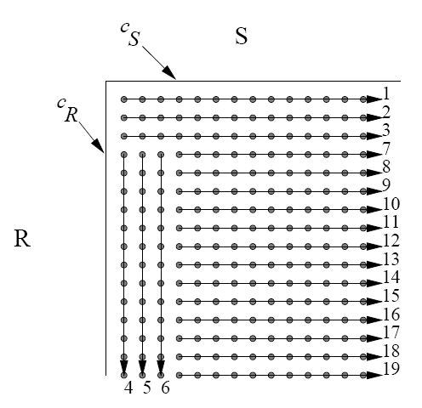
Join Review
R S
S
…
R
…
R
S
Basic NLJ
Grid view
S R

Slide 11
Reorder Operators
Synchronization Barriers
  One task waits for another to finish
Moments of Symmetry
  Stage for reordering
Goal
  Frequent moments of symmetry, non-existent barriers and minimal ordering constraints
Ripple Joins
Notes:
Example: Merge join
One table-scan must wait until the other table-scan produce a value larger than any seen before
Moments of Symetry: End of a scheduling dependency between its two input relations
Ordering constraints = merge join
Ripple join = non-blocking (output while concurrently reading)
Adaptive without sacrificing much performance
Very frequent moments of symmetry

Slide 12
Route Tuples
Tuple descriptor
  Ready bits: Where to go next
  Done bits: What has been done
Naïve
  Slower operators receive less tuples
Lottery
  Eddy holds lottery before sending tuple
Window
  Forget history to some extent
Notes:
Routing Determines efficiency of system

Slide 13


Eddy Example
SELECT * from A, B, C
WHERE A.x = B.x AND B.x = C.x
A |X| B
A
Eddy
B
Output
C
B |X| C
a:
Attribute | … | Ready | Done
Value | … | 10 | 00
b:
Attribute | … | Ready | Done
Value | … | 11 | 00
c:
Attribute | … | Ready | Done
Value | … | 01 | 00
Notes:
Eddy ships tuple to operators that have ready bits on
Done bit set when operator finished with tuple
If all Done bits set, send to output
Else, send to another operator
Tuples can’t be arbitrarily routed to any operator
Use ready bits to prevent access to an operator

Slide 14
Eddy Example
SELECT * from A, B, C
WHERE A.x = B.x AND B.x = C.x
A |X| B
a
Eddy
A
B
b
Output
C
c
B |X| C
a:
Attribute | … | Ready | Done
Value | … | 10 | 00
b:
Attribute | … | Ready | Done
Value | … | 11 | 00
c:
Attribute | … | Ready | Done
Value | … | 01 | 00
Notes:
Eddy ships tuple to operators that have ready bits on
Done bit set when operator finished with tuple
If all Done bits set, send to output
Else, send to another operator
Tuples can’t be arbitrarily routed to any operator
Use ready bits to prevent access to an operator

Slide 15
Eddy Example
SELECT * from A, B, C
WHERE A.x = B.x AND B.x = C.x
a
A |X| B
A
Eddy
B
Output
C
c
B |X| C
a:
Attribute | … | Ready | Done
Value | … | 10 | 00
b
Options:
(A B) C
A (B C)
b:
Attribute | … | Ready | Done
Value | … | 11 | 00
c:
Attribute | … | Ready | Done
Value | … | 01 | 00
Notes:
Eddy ships tuple to operators that have ready bits on
Done bit set when operator finished with tuple
If all Done bits set, send to output
Else, send to another operator
Tuples can’t be arbitrarily routed to any operator
Use ready bits to prevent access to an operator

Slide 16
Eddy Example
SELECT * from A, B, C
WHERE A.x = B.x AND B.x = C.x
A |X| B
a
A
Eddy
B
Output
C
c
B |X| C
b
a:
Attribute | … | Ready | Done
Value | … | 10 | 00
b:
Attribute | … | Ready | Done
Value | … | 11 | 00
c:
Attribute | … | Ready | Done
Value | … | 01 | 00
Notes:
Eddy ships tuple to operators that have ready bits on
Done bit set when operator finished with tuple
If all Done bits set, send to output
Else, send to another operator
Tuples can’t be arbitrarily routed to any operator
Use ready bits to prevent access to an operator

Slide 17
Eddy Example
SELECT * from A, B, C
WHERE A.x = B.x AND B.x = C.x
A |X| B
a
A
Eddy
B
Output
C
bc
B |X| C
a:
Attribute | … | Ready | Done
Value | … | 10 | 00
b:
Attribute | … | Ready | Done
Value | … | 10 | 01
c:
Attribute | … | Ready | Done
Value | … | 01 | 00
Notes:
Eddy ships tuple to operators that have ready bits on
Done bit set when operator finished with tuple
If all Done bits set, send to output
Else, send to another operator
Tuples can’t be arbitrarily routed to any operator
Use ready bits to prevent access to an operator

Slide 18
Eddy Example
SELECT * from A, B, C
WHERE A.x = B.x AND B.x = C.x
bc
A |X| B
Eddy
abc
A
B
Output
C
B |X| C
a:
Attribute | … | Ready | Done
Value | … | 10 | 00
b:
Attribute | … | Ready | Done
Value | … | 00 | 11
c:
Attribute | … | Ready | Done
Value | … | 01 | 00
Notes:
Eddy ships tuple to operators that have ready bits on
Done bit set when operator finished with tuple
If all Done bits set, send to output
Else, send to another operator
Tuples can’t be arbitrarily routed to any operator
Use ready bits to prevent access to an operator

Slide 19
Eddy Example
SELECT * from A, B, C
WHERE A.x = B.x AND B.x = C.x
A |X| B
A
Eddy
B
Output
abc
C
B |X| C
a:
Attribute | … | Ready | Done
Value | … | 10 | 00
b:
Attribute | … | Ready | Done
Value | … | 00 | 11
c:
Attribute | … | Ready | Done
Value | … | 01 | 00
Notes:
Eddy ships tuple to operators that have ready bits on
Done bit set when operator finished with tuple
If all Done bits set, send to output
Else, send to another operator
Tuples can’t be arbitrarily routed to any operator
Use ready bits to prevent access to an operator

Slide 20
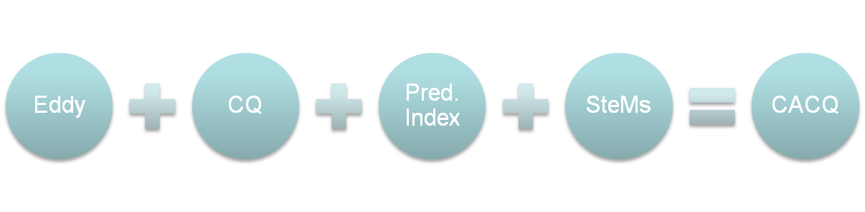
CACQ Project
Continuously Adaptive Continuous Queries
CQ lives long enough for changes to occur
Motivation
  Streams of data from sensor networks

Slide 21
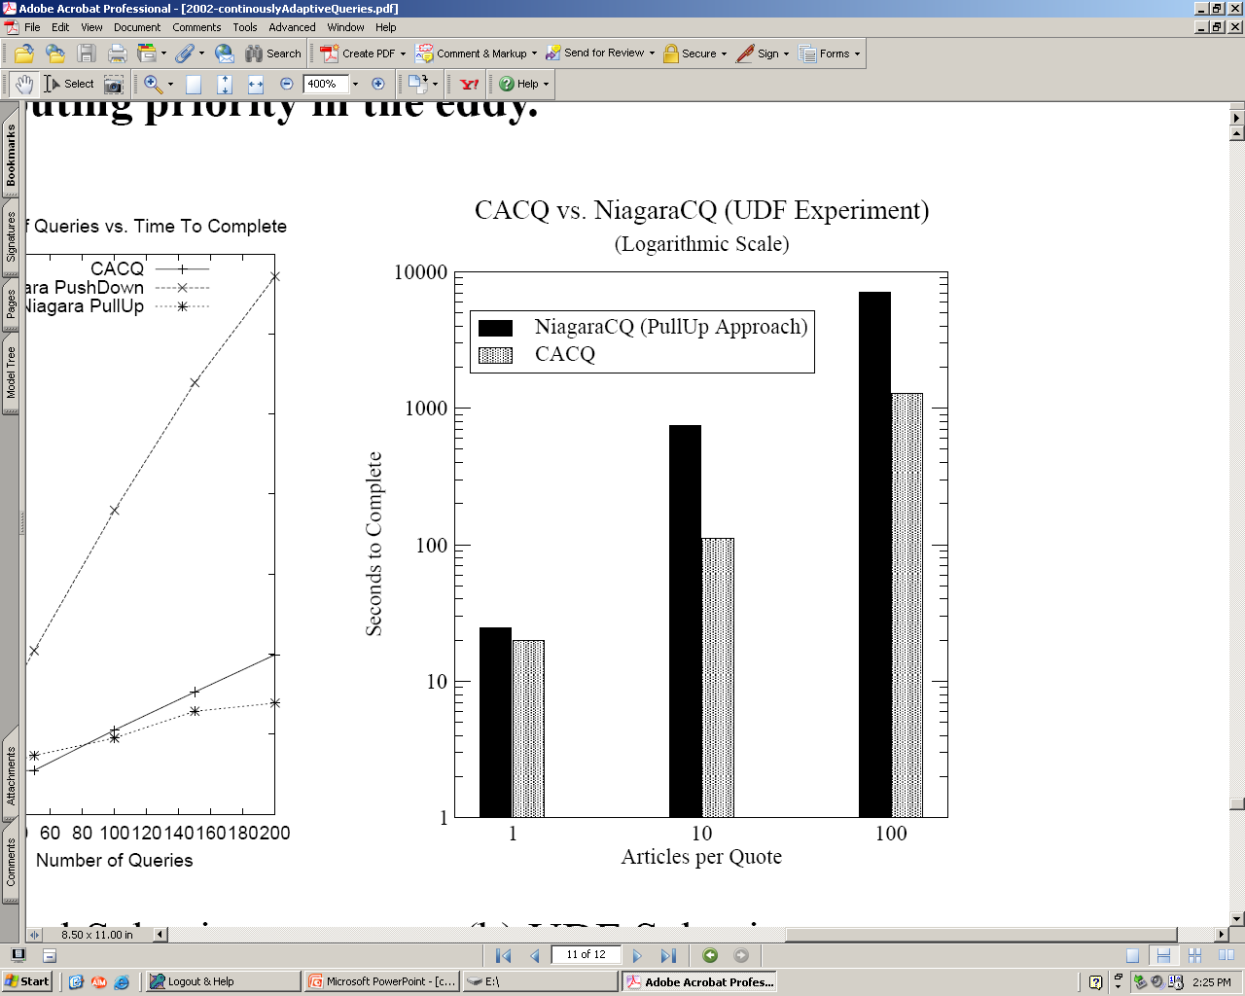
CACQ Performance
NiagaraCQ uses static plan

Slide 22
Final Remarks
Stream databases in constant change
Need to efficiently react to changes
Tradeoff between adaptivity and overhead required to route tuples separately
Routing policies very important
  Not much work so far
Other optimization schemes
Notes:
*Eddy ideal for executing continuous queries over data streams
*Queries computed over sliding windows
*Lottery routing does not work well with joins

Slide 23
References
[AH00] R. Avnur, J. M. Hellerstein: Eddies: Continuously Adaptive Query Processing SIGMOD Conference 2000
[M02] S. Madden, et.al: Continuously Adaptive Continuous Queries over Streams. SIGMOD Conference 2002

