Slide 1


Guillermo Cabrera – CSSRD 2008

Slide 2
Agenda
Who I am
Why you are here
What is CSSRD
Research
  Areas in Computing
  Database Area
  Industries
Cool Projects
Startups
Exposure
Closing Remarks

Slide 3
Who is Guillermo?
Why is he giving this talk?

Slide 4

Who is Guillermo?
Why is he giving this talk?

Slide 5
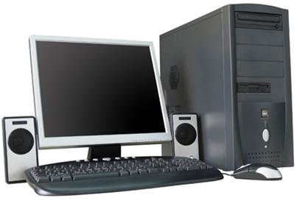
Who is Guillermo?
Why is he giving this talk?

Slide 6

Who is Guillermo?
Why is he giving this talk?

Slide 7

Who is Guillermo?
Why is he giving this talk?

Slide 8

Who is Guillermo?
Why is he giving this talk?

Slide 9
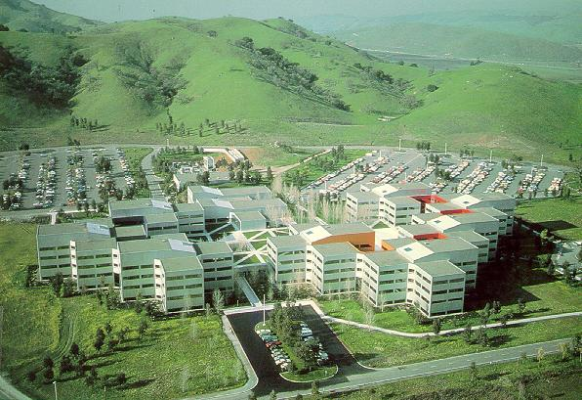
Who is Guillermo?
Why is he giving this talk?

Slide 10
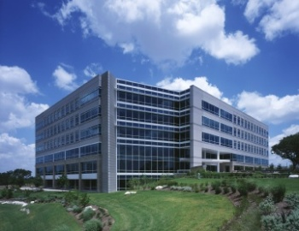
Who is Guillermo?
Why is he giving this talk?

Slide 11

Who is Guillermo?
Why is he giving this talk?

Slide 12

Who is Guillermo?
Why is he giving this talk?

Slide 13
Why are you here today?
Explore Computer Science field.
Learn about projects in CS department.
Network with students and faculty.

Slide 14
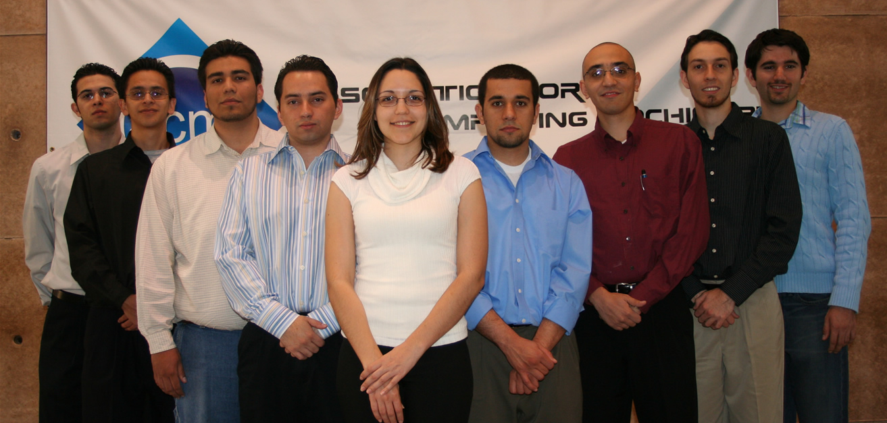
What is CSSRD?
Computer Science?
Conference to promote student work and research.
Idea originated in 2005.

Slide 15
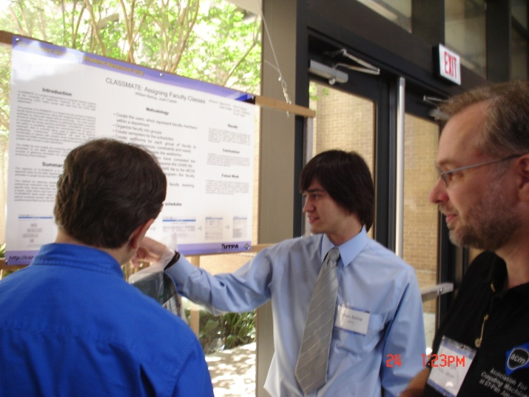
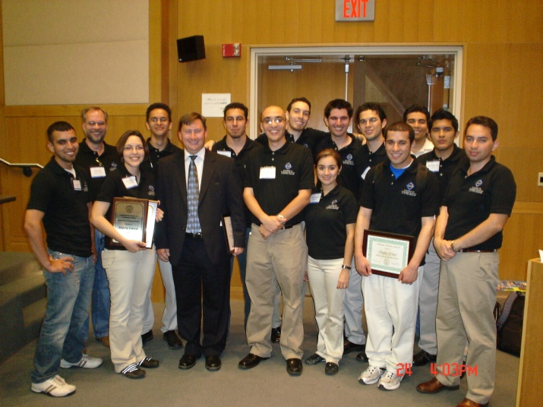
CSSRD
Promote CS student research that is being done in the Rio Grande Valley and surrounding areas.
Problem
  Lack of exposure from students undergoing research activity.
Goals
  Provide forum for CS students to present their work.
  Attract entering freshman and HS students to pursue a CS career.
  Collaboration of CS students/faculty with other fields.

Slide 16
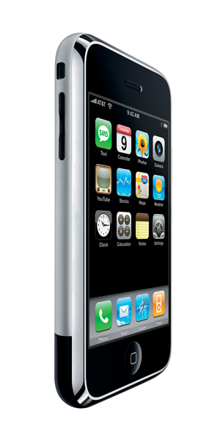
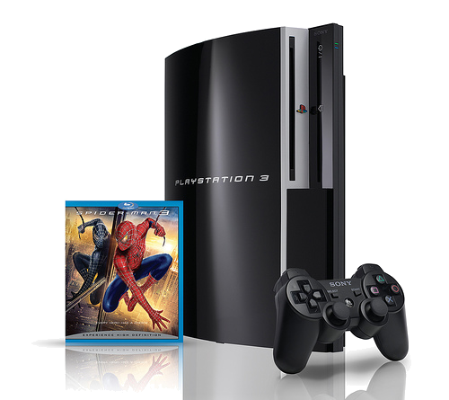


Research
Intellectual activity to discover new things.
Mean annual wage $96,440 for CS researcher.
  Top paying industry $131,640 (Communication).
Why is it important?

Slide 17
Research Areas in Computing
Artificial Intelligence
Computational Biology
Communications & Networking
Computer Architecture & Engineering
Control, Intelligent Systems, and Robotics
Database Management Systems
Education
Energy
Graphics and Human-Computer Interaction
Integrated Circuits
Operating Systems & Networking
Programming Systems
Scientific Computing
Security
Signal Processing
Theory

Slide 18
Research Areas in Computing
Artificial Intelligence
Computational Biology
Communications & Networking
Computer Architecture & Engineering
Control, Intelligent Systems, and Robotics
Database Management Systems
Education
Energy
Graphics and Human-Computer Interaction
Integrated Circuits
Operating Systems & Networking
Programming Systems
Scientific Computing
Security
Signal Processing
Theory

Slide 19
Computational Biology
Modern biology is increasingly reliant on CS.
Growth in the size and scope of biological data sets.
Bioinformatics
  Comparative genomics. Genetic analysis. Phylogenetics. Molecular evolutionary modeling. Gene regulatory networks.
Neural systems
  Sensory motor control. Vision. Audition. Biomimetics. Brain-machine interfaces. Computational neuroscience.

Slide 20
Computer-Human Interaction
Interaction in future computing environments including the office, home, mobile and medical.
Visualization:
  Scientific and information visualization. Virtual environments, tele-immersive environments.
Context-aware computing:
  Activity analysis, Smart Spaces, Location-aware systems, Privacy technologies.

Slide 21
Database Management
Computers are used less for computing per se than for the management, distribution and analysis of information.
Data Management for Wireless Sensor Networks and RFID.
Hybrid databases, the deep Web, data mining, digital libraries, information integration.

Slide 22
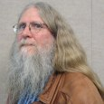

Why I like DBMS
Presentation at Almaden Research Center by Dr. Bruce Lindsay (ACM & IBM Fellow).
VISA processed average of 3700 TPS in 2002.

Slide 23

Why I like DBMS
1

Slide 24
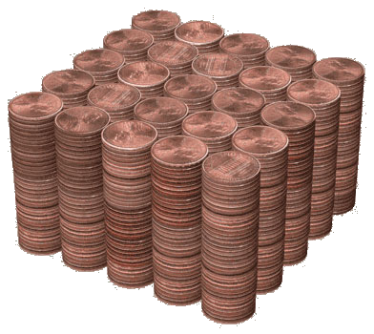
Why I like DBMS
1
1 Thousand

Slide 25
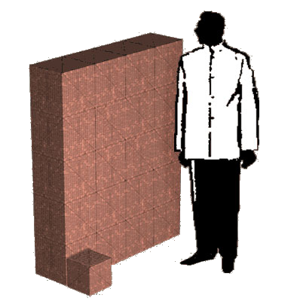
Why I like DBMS
1
1 Thousand
1 Million

Slide 26
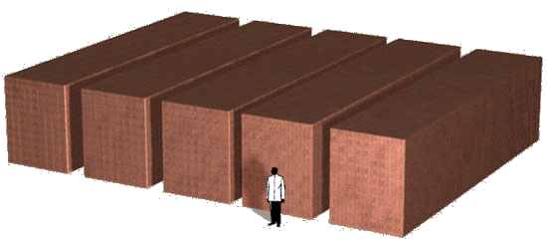
Why I like DBMS
1
1 Thousand
1 Million
1 Billion

Slide 27
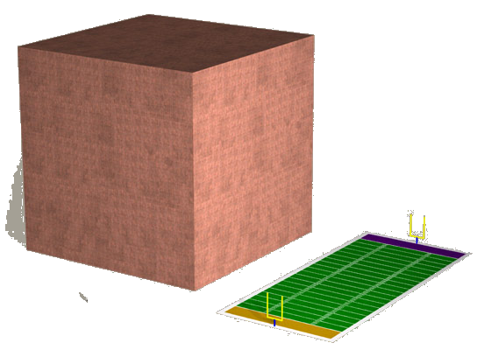
Why I like DBMS
1
1 Thousand
1 Million
1 Billion
1 Trillion

Slide 28
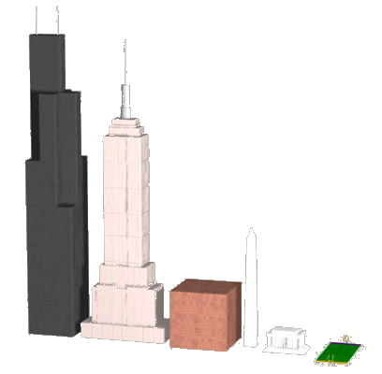
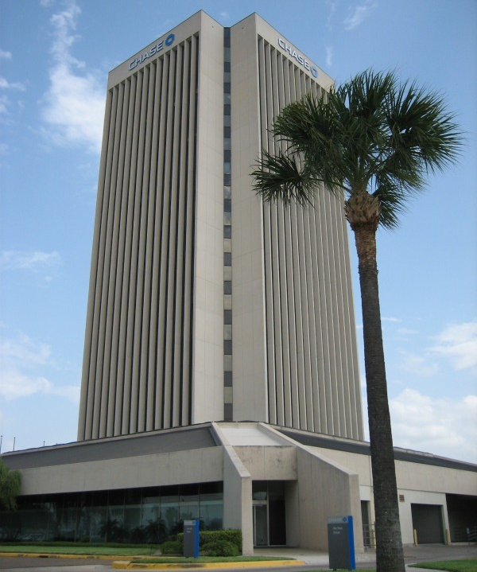
1 Trillion
CHASE Tower
McAllen, TX

Slide 29
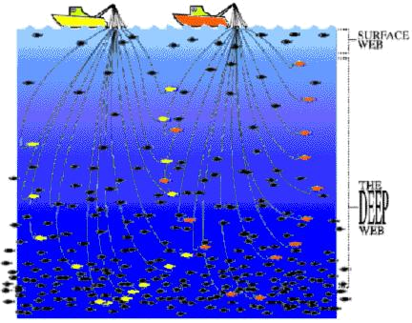
About DBMS
Topics of Study:
  The Deep Web
    500 times larger than surface web according to study at U. of Michigan in 2001

Slide 30


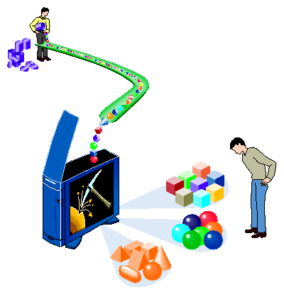

About DBMS
  Data Mining
    Terrorism
    Business

Slide 31
Industries
Aerospace and defense
Automotive
Banking
Consumer products
Education
Electronics
Financial markets
Government
Healthcare & life sciences
Industrial products
Insurance
Media & entertainment
Telecommunications
Travel & transportation

Slide 32
Industries - Biology
Bill Gates (Microsoft CEO) on role of software.
Amount of data has gotten Huge (Biology).
“We know less about our brain than anything that humans know about” Professor Jeff Lichtman (Harvard University)
Human brain needs hard drive of 1 million petabytes.
  1 petabyte = 1000 terabytes
  1 terabyte = 1000 gigabytes
Visualizations, databases, data mining, machine learning, parallel computing, image processing.

Slide 33
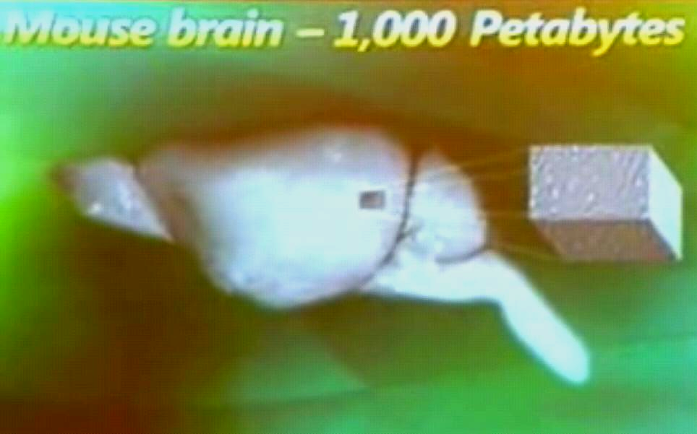
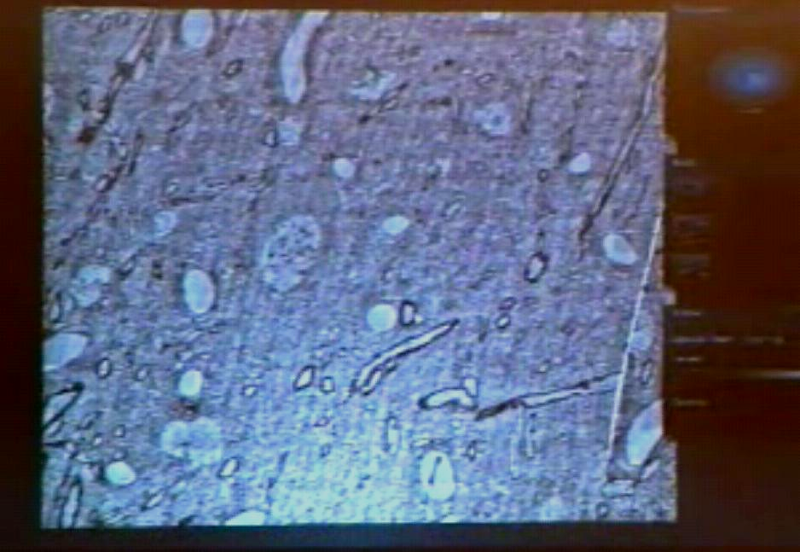
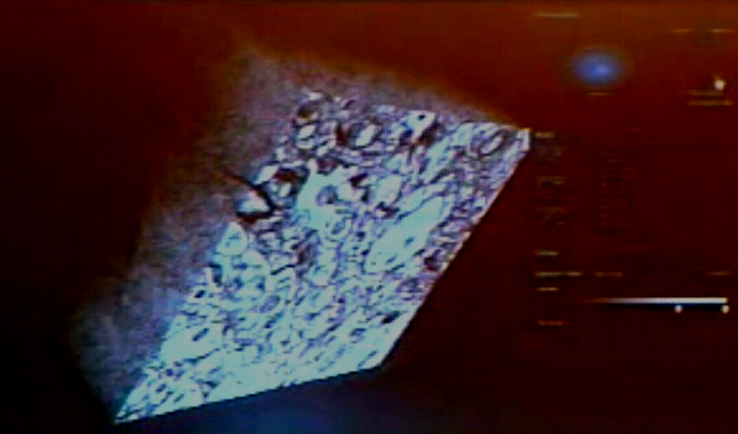
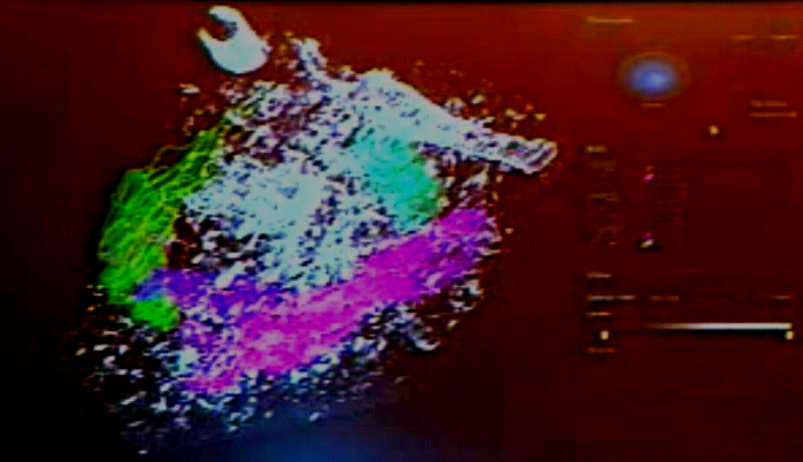
Industries

Slide 34
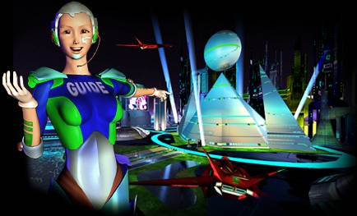


Cool Projects
Virtual Worlds
  Cybertown: popular in late 1990s with PIII procesor.
  Le 2ème Monde: sponsored by Canal+ (France).
  Second Life

Slide 35
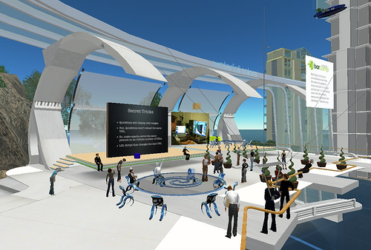


Cool Projects
Web interaction, collaboration, advertising.

Slide 36
Startups
Youtube
  Initially critiqued for unlimited video uploads.
  Videos take up an estimated 45 terabytes of storage (2006).
  Bought by Google for 1.65 billion dollars in 2006.
Google
  PageRank Algorithm
  Brin & Page – two youngest billionaires by Forbes
Facebook
  6 degrees of separation
  Sociology, anthropology, sociolinguistics, geography
Started as research projects (except Facebook)
Who does not use any of these 3 services?

Slide 37
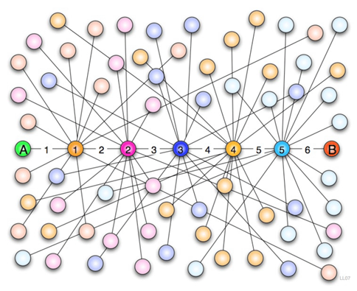
6 Degrees of Separation

Slide 38
Exposure
Be aware of what’s happening in the world for your field. (read publications, attend conferences, etc).
Resources at UTPA
  Internships (IBM, Xerox, Microsoft, TI, etc.)
  Research work with excellent faculty.
  Rapid Response Manufacturing Center.
  New computer engineering program.
Networking with other individuals in the field.
  ACM President from Morocco (YouTube).
  IBM Fellow Donald Chamberlin (Interest in Spanish).

Slide 39
Closing Remarks
Computer Science is a diverse field, take time to explore it.
Talk to CS students, ask many questions.
  Why they like what they do.
  What drew them to CS.
  Specifics of projects.
Learning process for both presenters and visitors.

Slide 40
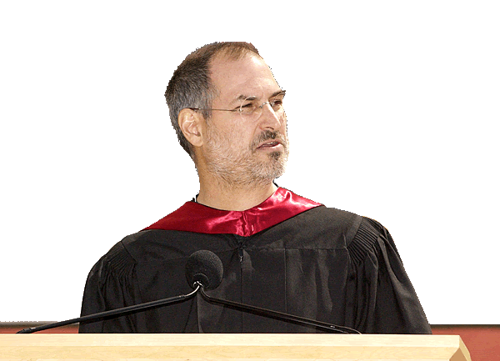
Steve Job’s Advice
“You've got to find what you love”
“Your work is going to fill a large part of your life…”
“If you haven't found it yet, keep looking. Don't settle.”

Slide 41


