Slide 1
Scalable Semantic Web Data Management Using Vertical Partitioning
Abadi, Marcus, Madden, Hollenbach VLDB 2007
Presented by: {Gui}llermo Cabrera

Slide 2
Agenda
Problem
Storage Goal
RDBMS use
RDF Physical Organization
Column store vs. Row Store
Materialized Path Expressions
Experiment & Results
Discussion

Slide 3
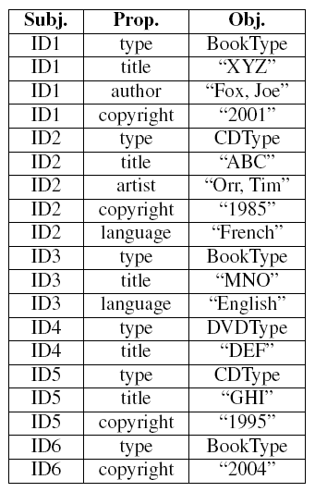
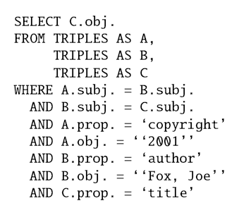
Problem
Performance: Self-joins
Many triples
Notes:
RDF as series of triples SPO
Performance: Self-joins, Low speed (# triples > memory)
Need to manage large number of triples
Billion Triple Challenge (semanticweb.org)

Slide 4
Goal
Achieve scalability & performance in triple storage
Survey approaches in RDBMS
Benefits of vertical partition and column store

Slide 5
Use RDBMS
1 table with 3 indexed columns?
Multi layer architecture
Translate -> Optimize -> Execute
Mapping tables for long URI and literals
Jena, Oracle, Sesame, 3store (Hyunjun), Hexastore (Donghyuk)
Notes:
Self joins become PROBLEMATIC when the LESS selective the predicates.
Mapping table – 1 clustered (identifiers) and 1 unclsutered index

Slide 6
RDF Physical Organization
Property tables
Clustered property table
Denormalize RDF (wider tables)
Clustering algorithm
NULL values
Notes:
Jena2 were first to propose
Basic idea is to cluster properties that tend to be DEFINED together (type title and copyrithg date).
Also, LEFT OVER Triples
Why fewer joins? Self joins on the subject column can be eliminated.
Tradeoff – narrow tables = less sparse = more tables used;
wide table = more space = less joins.

Slide 7
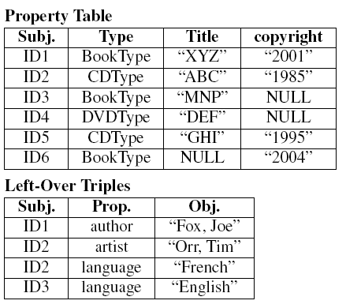
Clustered Property Tables

Slide 8
RDF Physical Organization
Property tables
Property-Class Tables
Exploit the type property
Properties may exist in multiple tables
Notes:
Property may exist in MLTIPLE property class tables
Good for reified statements.

Slide 9
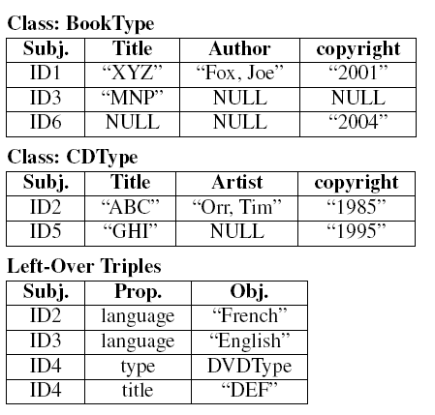
Property-Class Tables
Notes:
Exploit Type property
Reified statements

Slide 10
RDF Physical Organization
Advantage:
Fewer joins
Disadvantage:
NULL values
Multivalued attributes are complicated
Notes:
Object Relational – Bag structure

Slide 11
RDF Physical Organization
Vertical Partition
n two-column tables, n = # of unique properties
Table sorted by subject
Merge join
Notes:
Tuple header dominates size of actual data resulting in table

Slide 12
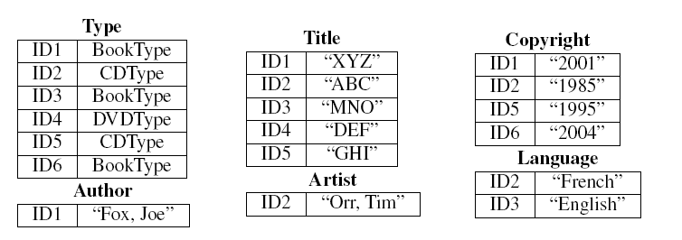
Vertical Partition
Notes:
Multi-valued subjects as multiple rows
No clustering algorithm

Slide 13
RDF Physical Organization
Advantage
Multi valued attributes supported
No clustering algorithm (Property tables)
Only accessed properties are read
Disadvantage
Use of multiple properties (table joins)
Inserts expensive

Slide 14
Implementation
Triple Store
Property Table
Vertical Partition (Row Store)
Vertical Partition Store (Column Store)
Notes:
Postgres has 27 byte tuple header, compare 8 byes to 35 bytes
Merge join uses prefetching to avoid seeks between columns.

Slide 15
Row Store vs. Column Store
Why?
Projection is free
Tuple headers (metadata on row)
35 bytes in Postgres vs. 8 bytes in C-Store
Column oriented compression
Run-length encoding (ex. 1,1,1,2,2 → 1x3, 2x2)
Optimized merge join
Prefetching
Notes:
Why? Row store to much overhead on vertical partition

Slide 16
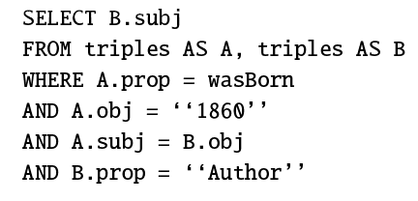
Materialized Path Expression
<BookID1, Author, http://preamble/FoxJoe>
<http://preamble/FoxJoe,wasBorn, “1860”>
Find all books whose authors were born in 1860

Slide 17
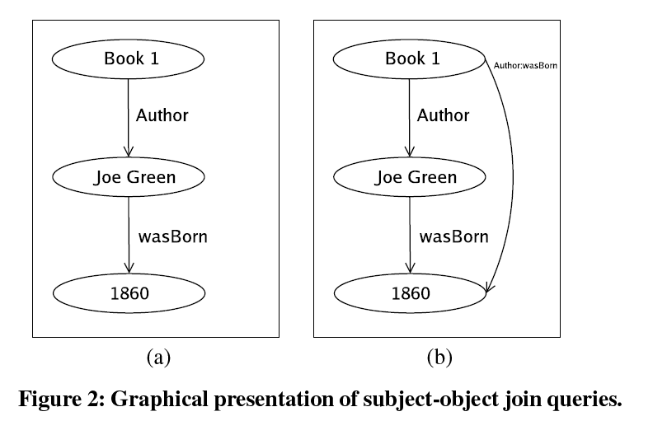
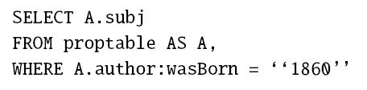
Materialized Path Expression
Notes:
For VP not merge joins.
PRECALCULATe these expressions, as 2-column table
Good: inference queries (of form x party of y, y part of z, then x part of z)
Bad: many tables

Slide 18
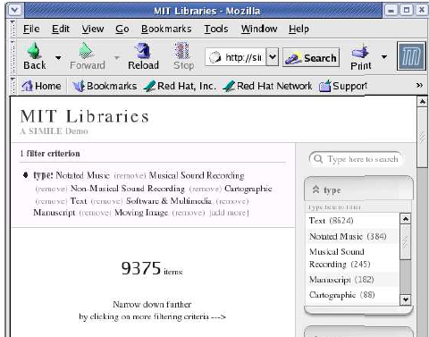
Experiment
Barton Libraries Dataset
Longwell Queries
Calculating counts
Filtering
Inference
Notes:
Convert from RDF/XML to triples using REDLAND
50 million triples, 221 unique properties, multivalued

Slide 19
Results - Space
8.3 GB – Triple Store (Postgres)
14 GB – Property Table (Postgres)
5.2 GB – Vertically Partitioned (Postgres)
2.7 GB – Vertically Partitioned (C-store)
Including indices and mapping table

Slide 20
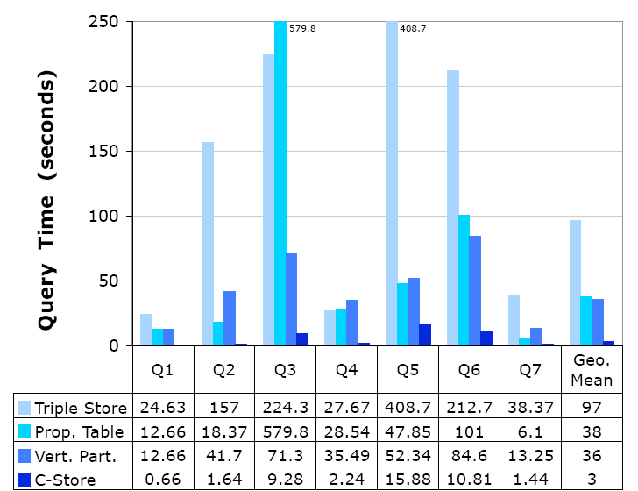
Results - Performance
Notes:
Average of 3 runs of the queries.
VP and PT factor of 2-3 faster than triple store.
C-store is 32 times faster than triple store
Q1: PT and VP identical because use of idealized property tables.
Q2: Avoids subject-subject joins
Q3: multiple sequential scans.
Q4: High selectivity

Slide 21
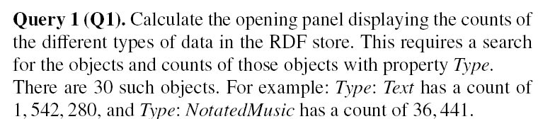
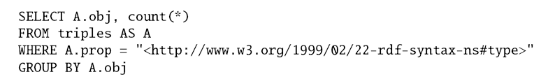
Query 1
Notes:
Involves all triples of property TYPE and count of object values
No join for Triple store
PT and VP have same schema. {Type: subject, object}

Slide 22
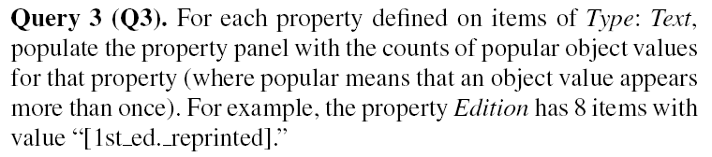
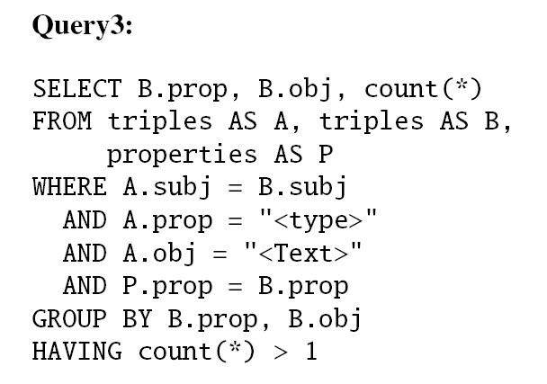
Query 3
Notes:
Display list of PROPERTIES defined for resources of "Type -> Text"
Multiple sequential scans

Slide 23
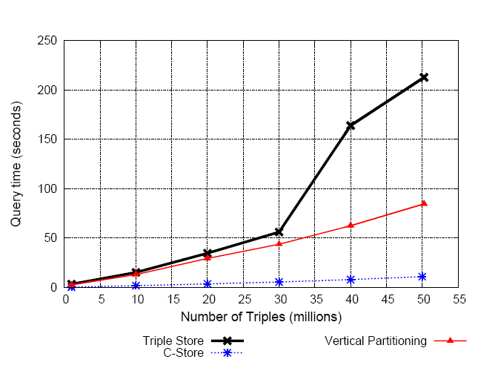
Results - Scalability
Notes:
1 million to 50 million, run only query 6. linearly except triple store
all joins for this query are linear for vertical partitioning
triple-store sorts the intermediate results after performing the three selections and before performing the merge join

Slide 24
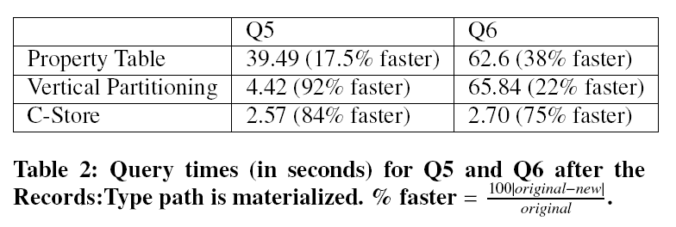
Results - Materialized Path Expression
Replace
subject-object joins → subject-subject joins
Notes:
For PT, add new column with MPE
For VP, add add table containing, subject column and a Records:Type object column.

Slide 25
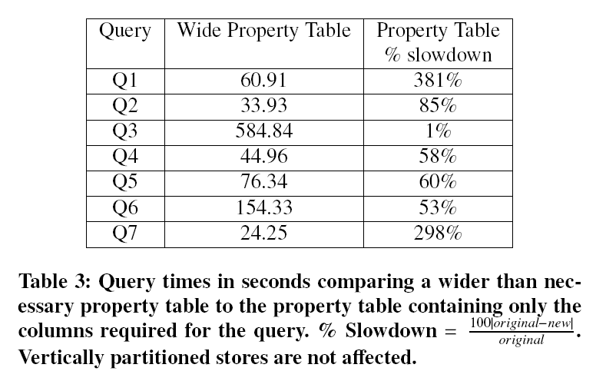
Results - Widening Effect
Add 60 integer valued columns
7 GB increase in size
Notes:
What is purpose of test???

Slide 26
Discussion
Great for reads, writes not considered
What about load times?
Using another benchmark (ex. LUBM)?
Native XML databases for RDF/XML?
Test triple store in Sesame
Notes:
LUBM, universities, departments, students etc.
15 MILLION triples

Slide 27
Questions

