Slide 1
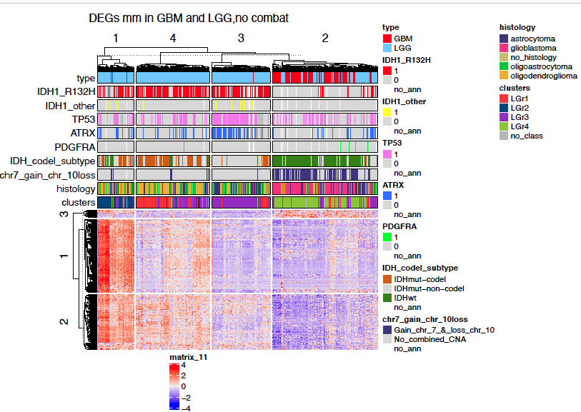
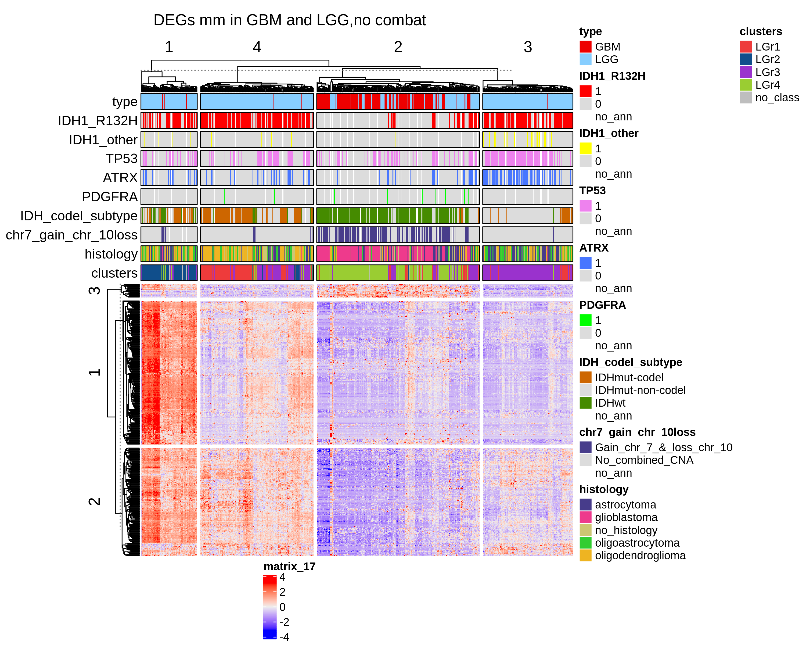
Differentially express genes between C1 vs C2 (q.value 0.01 – 2) + 2 filtering
GBM + LGG
N.Genes = 373
Adi, look the folder, you will find the pdf and excel file with numbers.

Slide 2
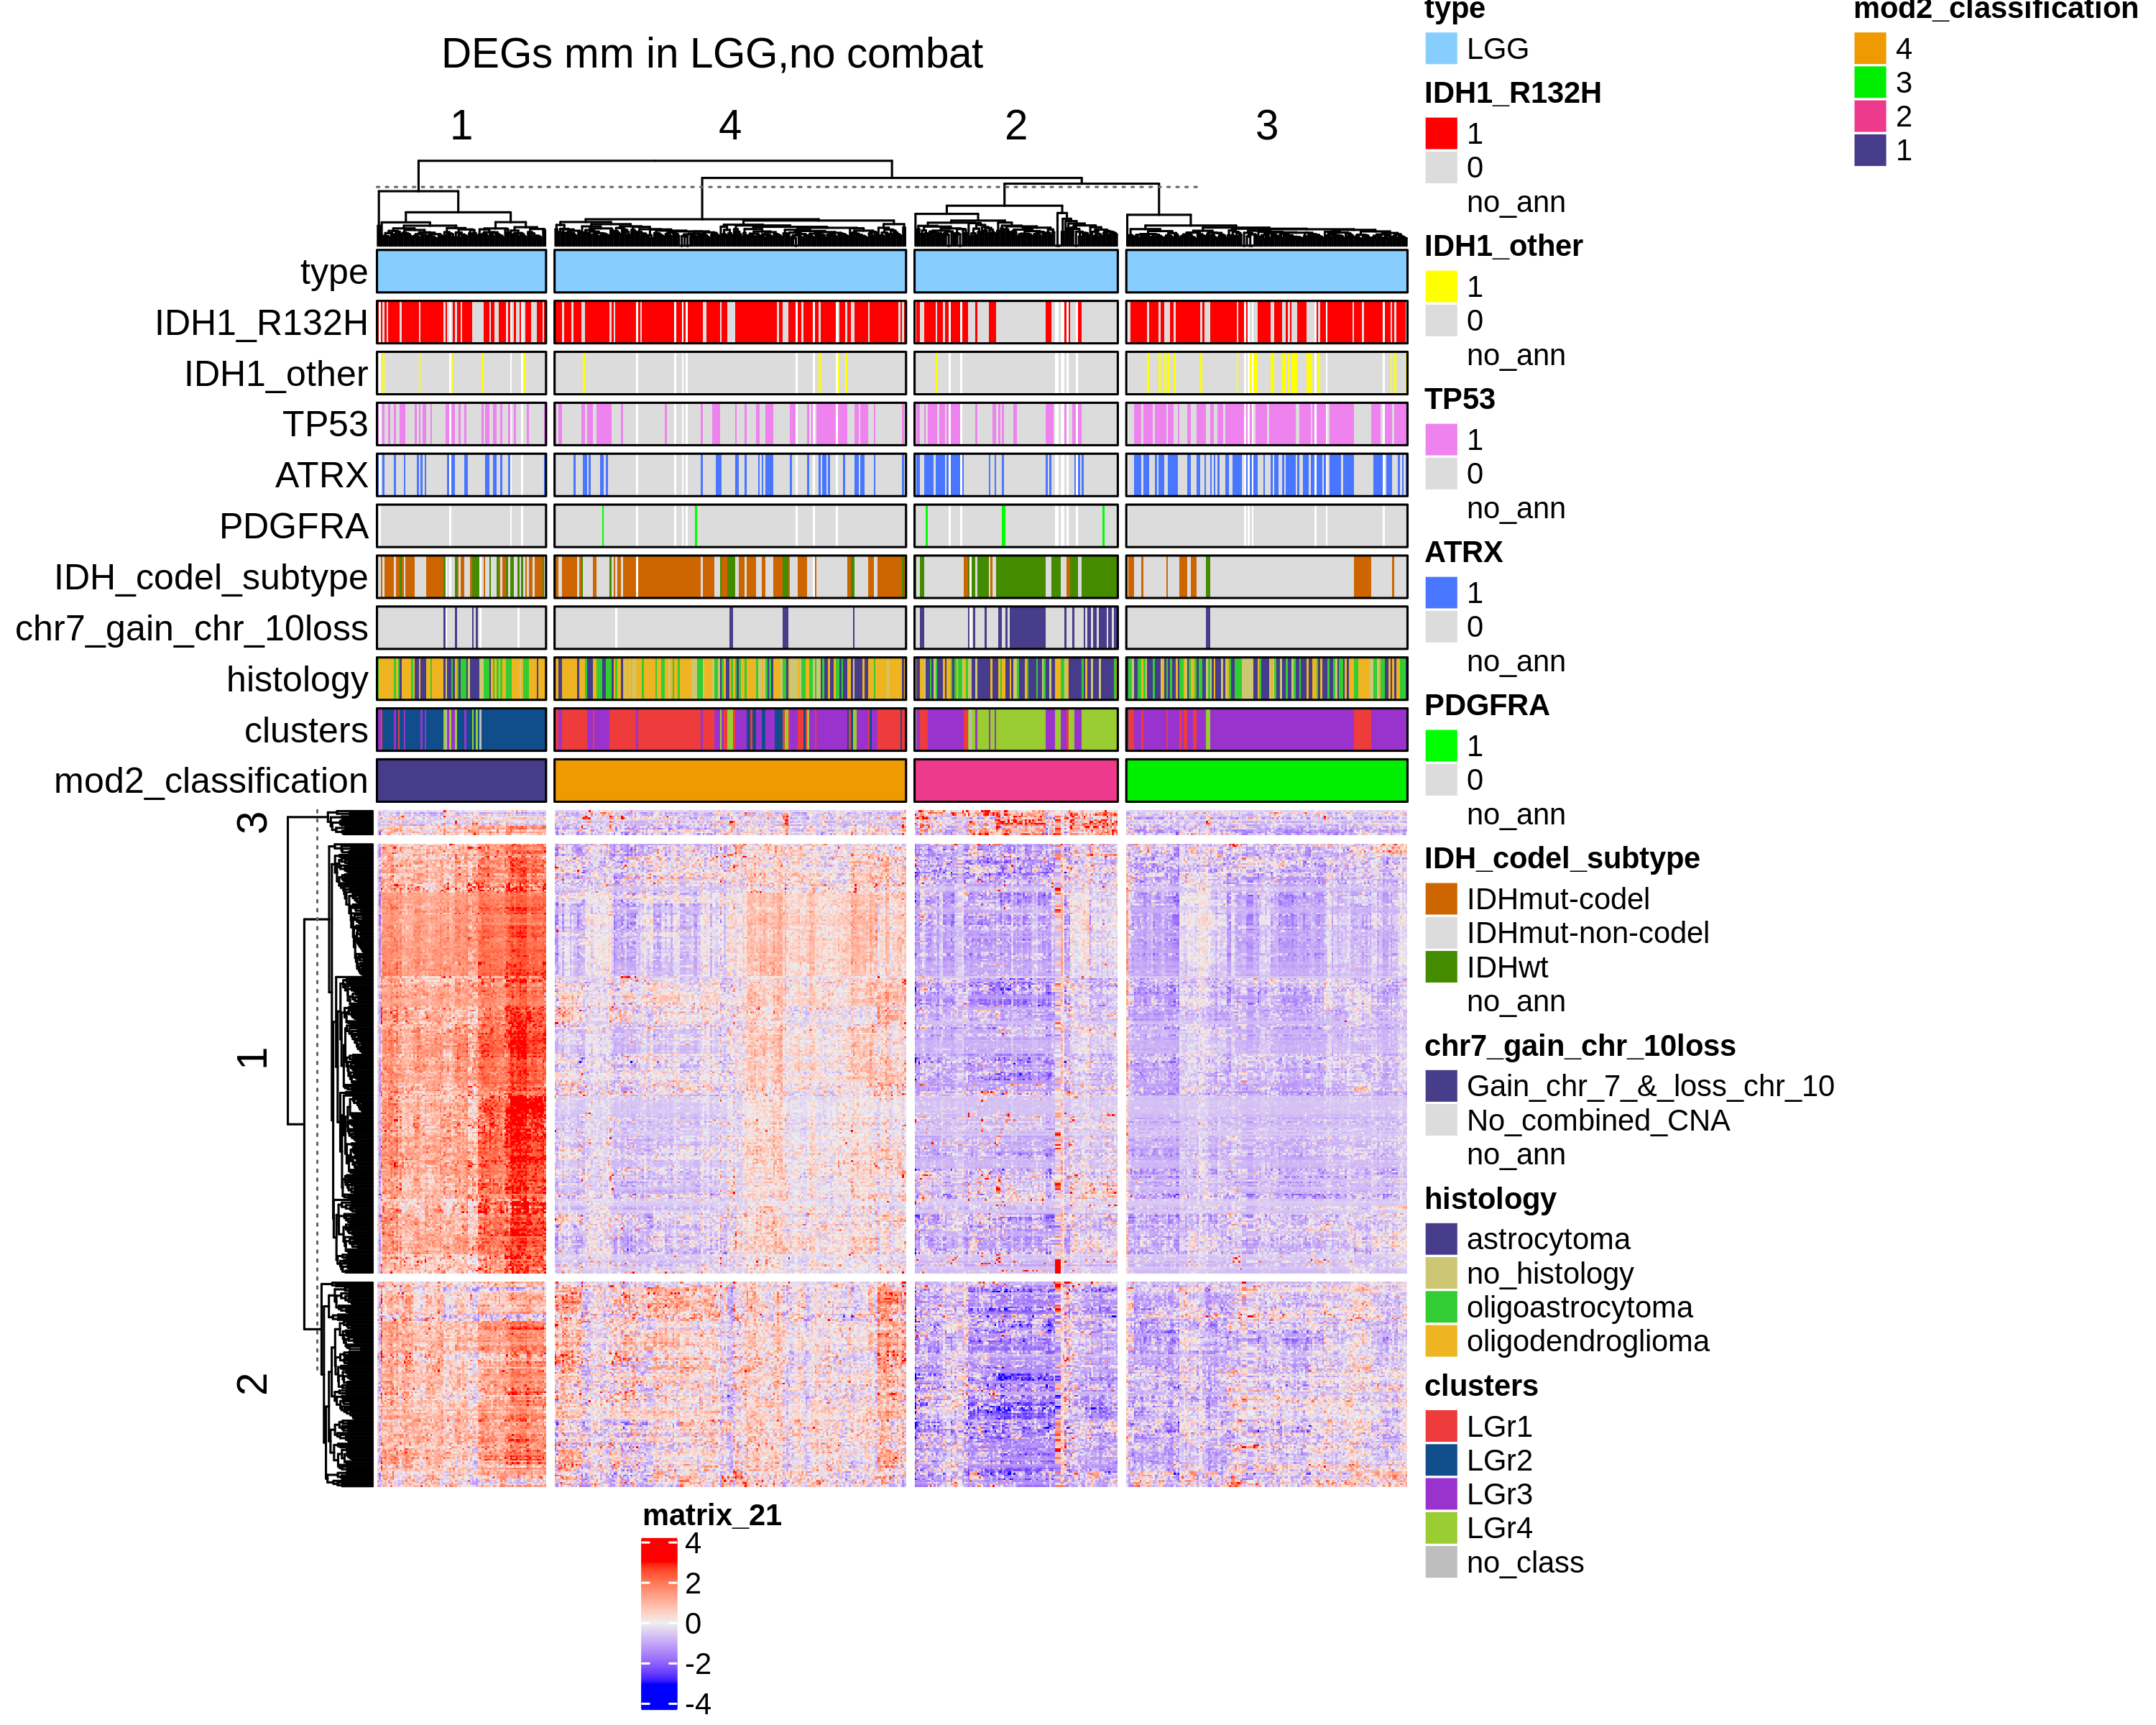
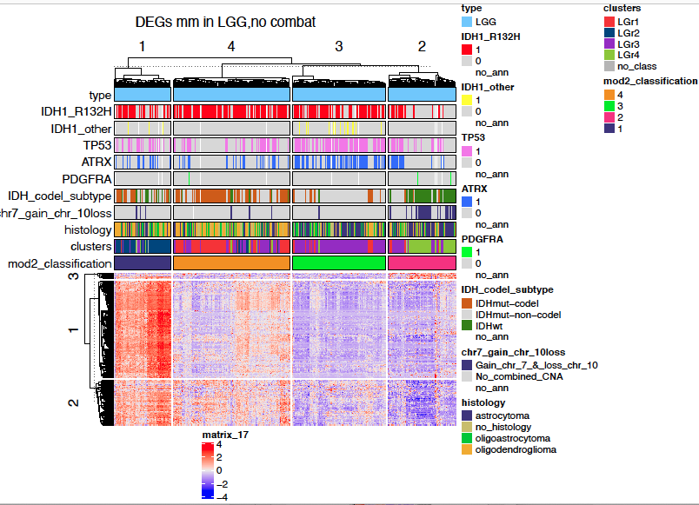
Differentially express genes between C1 vs C2 (q.value 0.01 – 2) + 2 filtering
LGG
N.Genes = 373
Adi, look the folder, you will find the pdf and excel file with numbers.

