Slide 1
cbioportal lgggbm merged version
Guidantonio
Ray
1
160
3
Triple mutants
Specifics samples Guidantonio:
TCGA-DU-5851 - R132H – IDH2 (WT) – ATRX ( L563Yfs*11) – TP53 (R273C)
Specifics samples Ray:
TCGA-HT-7476 - This samples does not contain a mutation in IDH1 but in IDH2
TCGA-DU-A7TA - This samples does not contain a mutation in IDH1 but in IDH2
TCGA-DU-7309 - This samples does not contain a mutation in IDH1 but in IDH2
These samples were classified as “MUT3”
Use as IDH1 samples

Slide 2
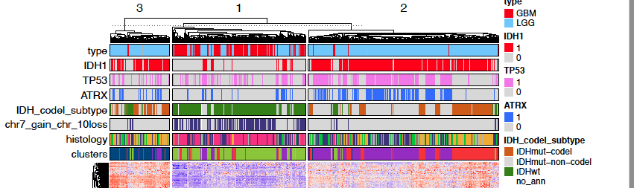
Triple mut - > genes -> scoring-> groups
IDHmut-non-codel -> genes -> scoring-> groups

Slide 3
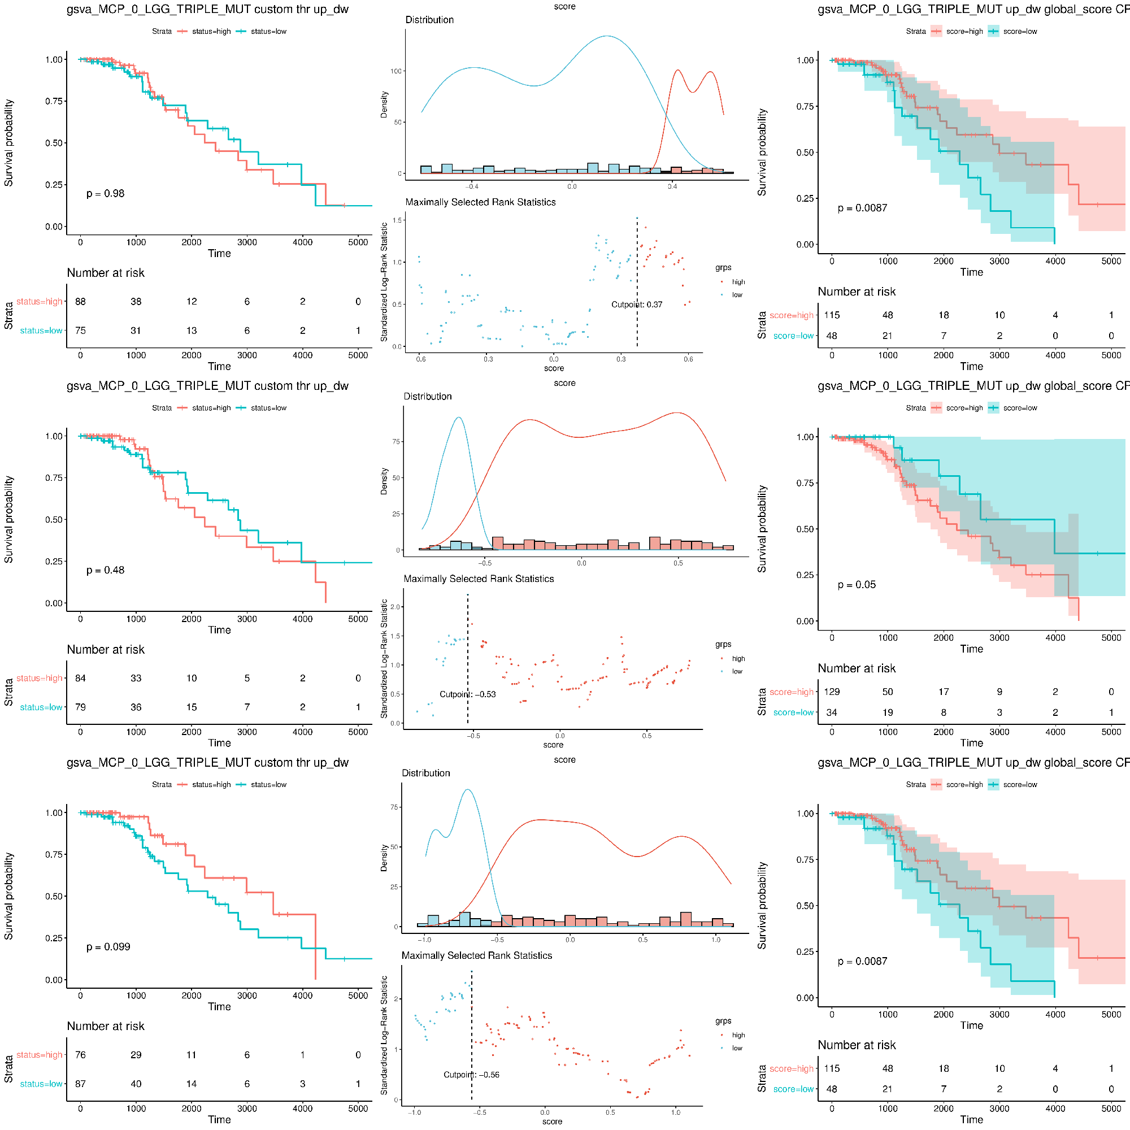
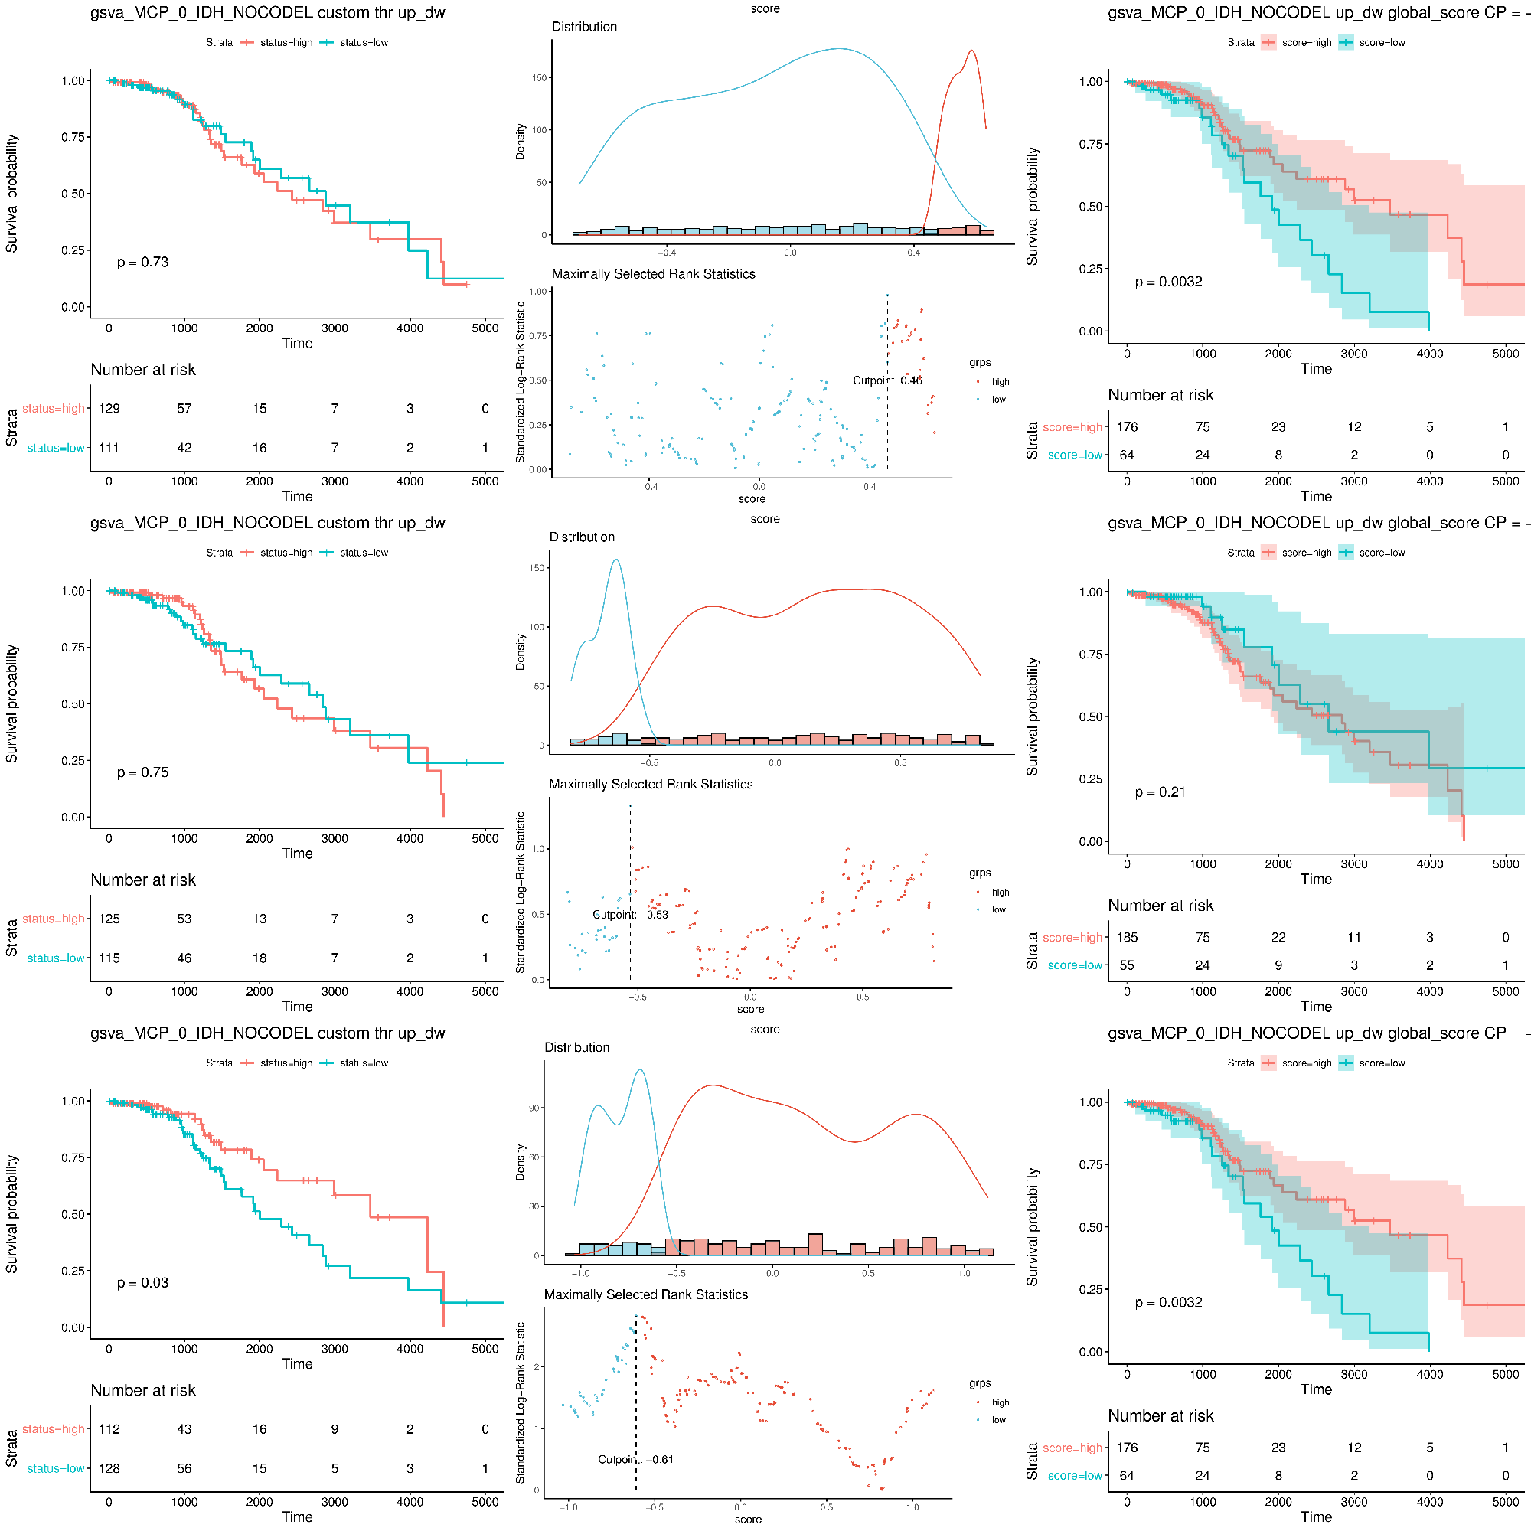
TRIPLE MUT
Send to Maria
IDH-NOCODEL

