Slide 1
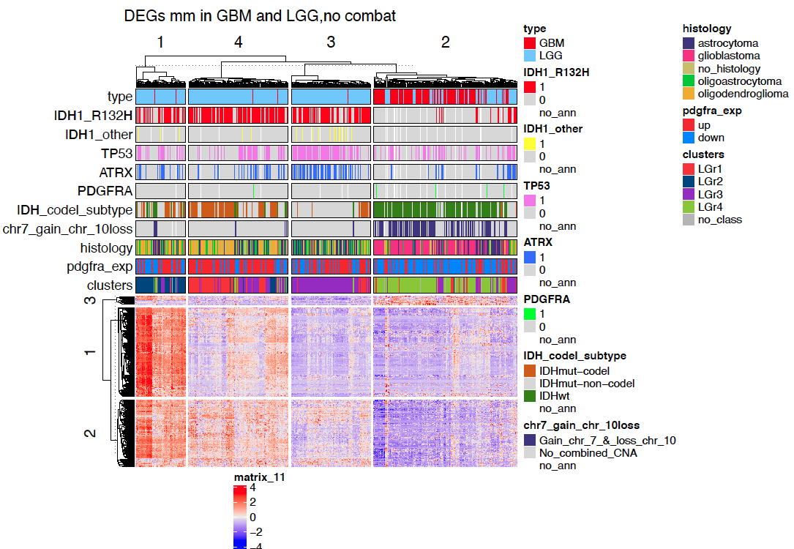
Differentially express genes between C1 vs C2 (q.value 0.01 – 2) + 2 filtering
GBM + LGG
N.Genes = 373

Slide 2
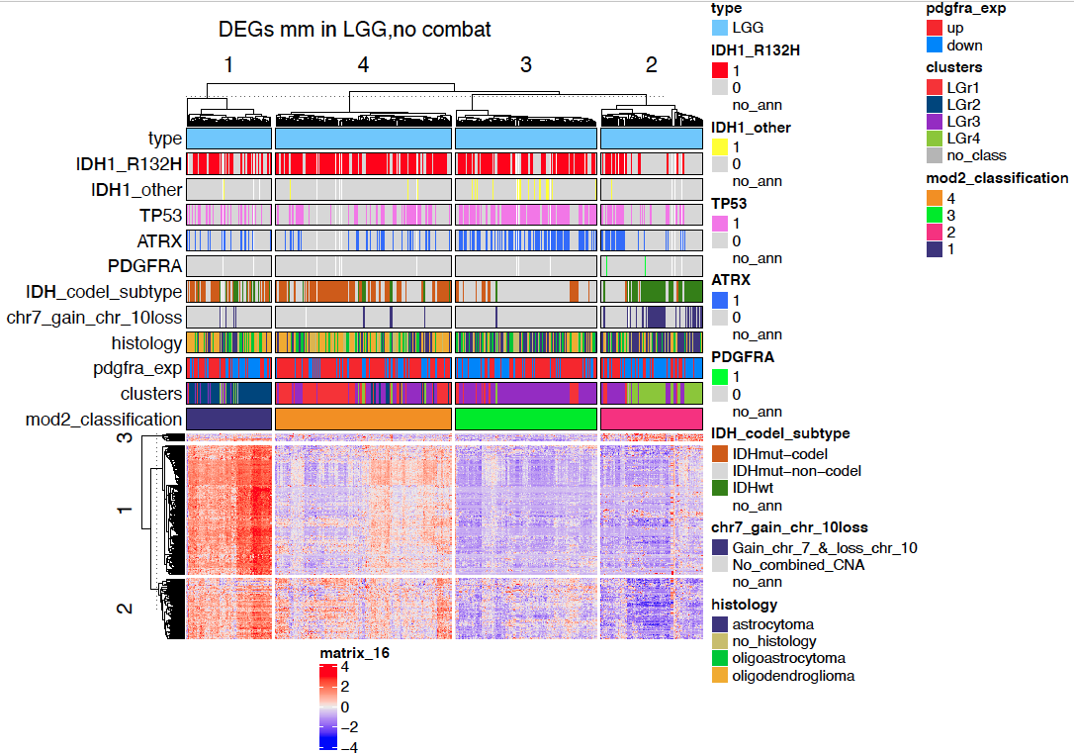
Differentially express genes between C1 vs C2 (q.value 0.01 – 2) + 2 filtering
LGG
N.Genes = 373

Slide 3
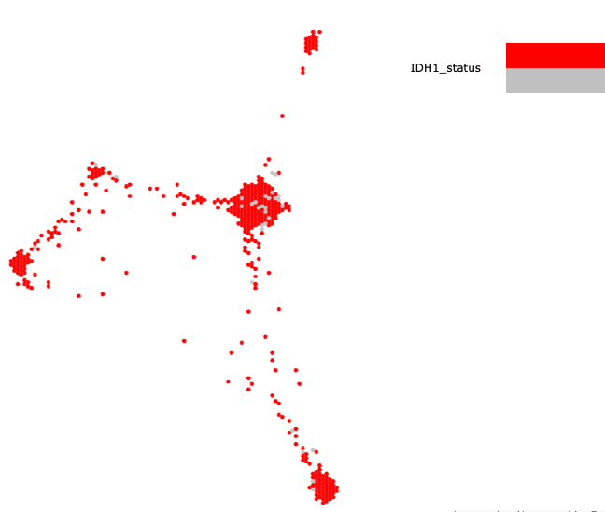
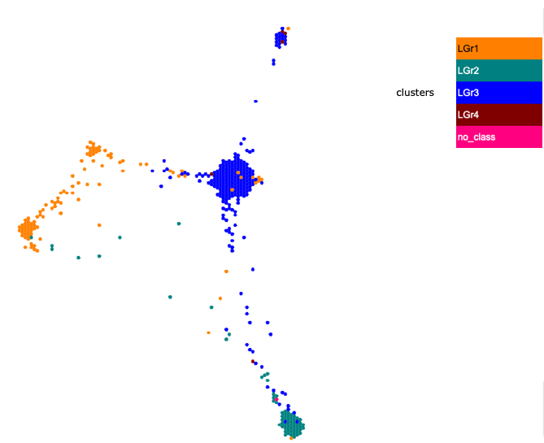
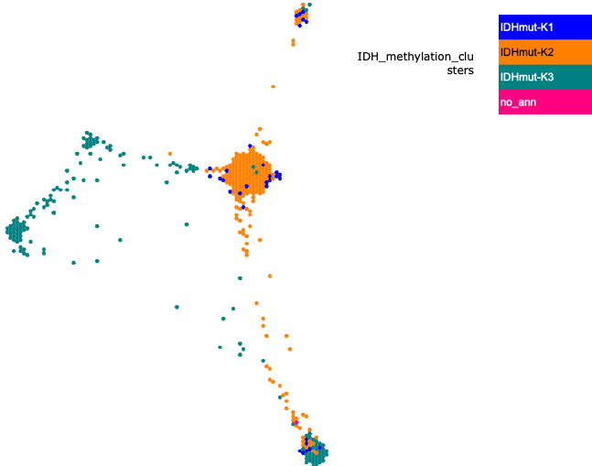
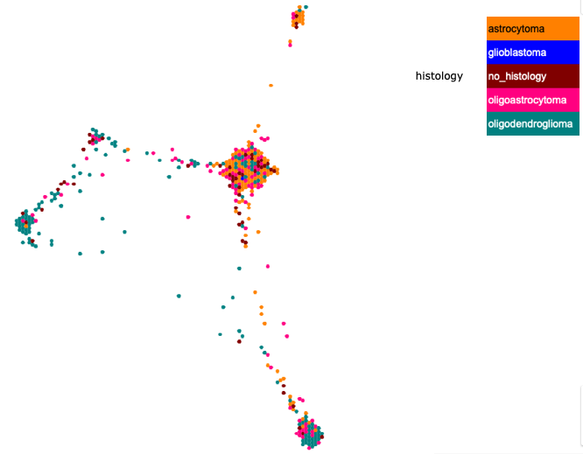
GBM + LGG (samples with MUT IDH)
IDH status
Transcriptome
Methylome
Histology
https://tumormap.ucsc.edu/?bookmark=da47e2ed926e5644bebd204eb8c838e361c05e1fa4fa6366806f667fdfd156dd

Slide 4
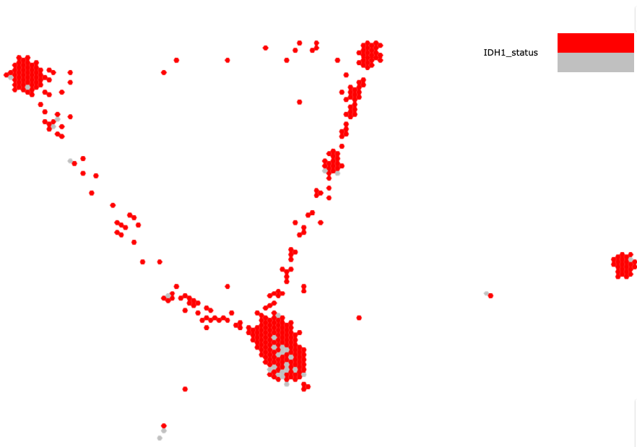
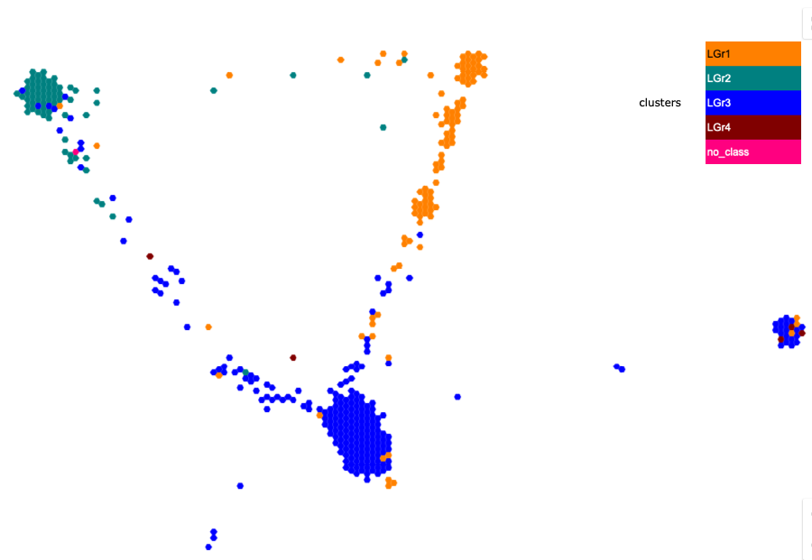
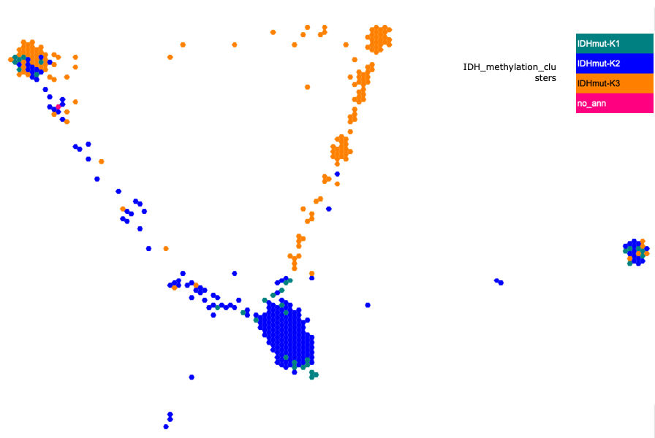
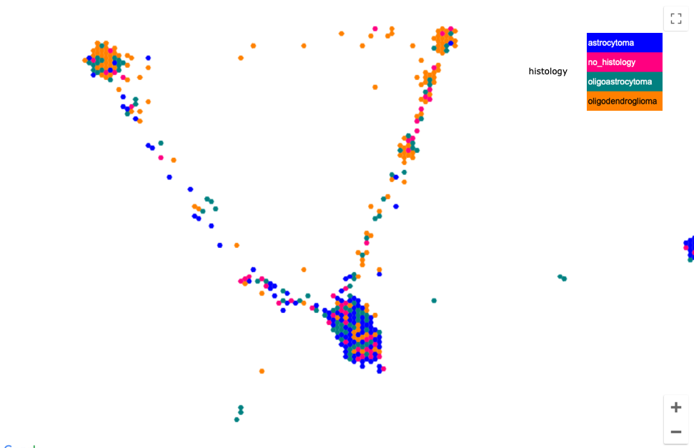
LGG (samples with MUT IDH)
IDH status
Transcriptome
Methylome
Histology

Slide 5
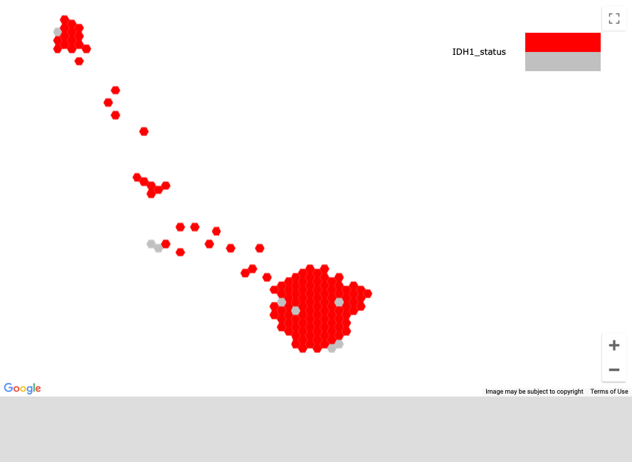
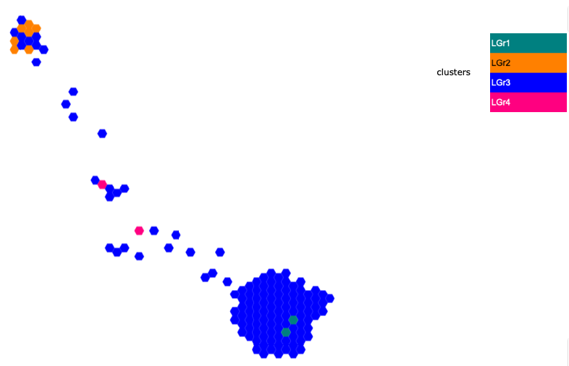
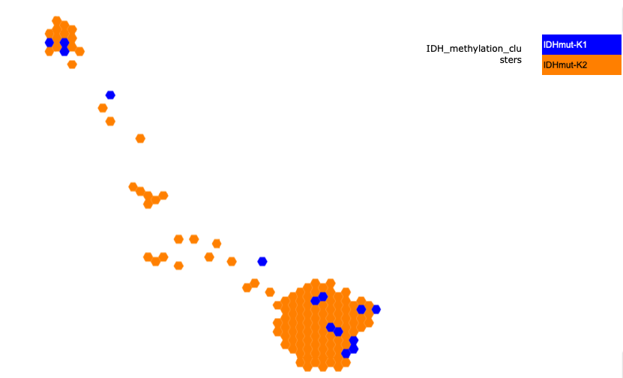
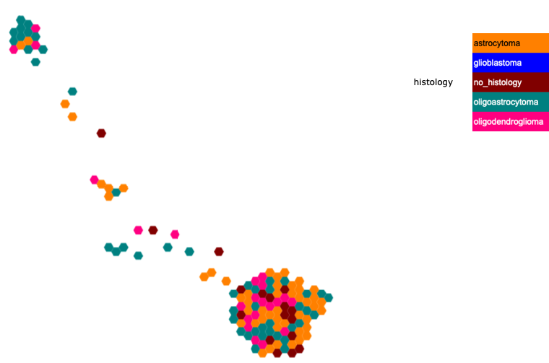
GBM + LGG (TRIPLE MUT)
IDH status
Transcriptome
Methylome
Histology
https://tumormap.ucsc.edu/?bookmark=dfc1b7aa2507a9ec6e5ea2527c65d8a0516f2916c88041e95bfdcdbecee56e8d

