Slide 1
J2EE
Web Application Development
Rubén Peredo Valderrama
ESCOM – IPN, México
rperedo@ipn.mx

Slide 2
J2EE
J2EE short for Java 2 Platform Enterprise Edition.

Slide 3
J2EE
J2EE is a platform independent.

Slide 4
J2EE
The Java 2 Platform, Java 2 Enterprise Edition (J2EE) defines the standard for developing multitier enterprise applications.

Slide 5
J2EE
J2EE is a Java environment from Sun Microsystems (Oracle) for developing, building and deploying Web based enterprise applications online.

Slide 6
J2EE
The J2EE platform simplifies enterprise applications.

Slide 7
J2EE
Providing a complete set of services to those components, and by handling many details of application behavior automatically, without complex programming.

Slide 8
J2EE
The J2EE platform takes advantage of many features of the Java 2 Platform, Standard Edition (J2SE), such as "Write Once, Run Anywhere" portability, JDBC API for database access.

Slide 9
J2EE
Today's enterprises gain competitive advantage by quickly developing and deploying applications that provide unique business services.

Slide 10
J2EE
The J2EE platform is a set of services, APIs, and protocols that provide the functionality for developing multitiered, Web based applications.

Slide 11
J2EE
At the client tier, J2EE supports pure HTML.

Slide 12
J2EE
At the client tier, J2EE supports Java applets/Applications.

Slide 13
J2EE
Java Server Pages and Servlet create HTML or other formatted data for the client.

Slide 14
J2EE
Enterprise Java Beans (EJBs) provide another layer where the platform's logic is stored.

Slide 15
J2EE
Java Data Base Connectivity (JDBC) is the standard interface for Java databases.

Slide 16
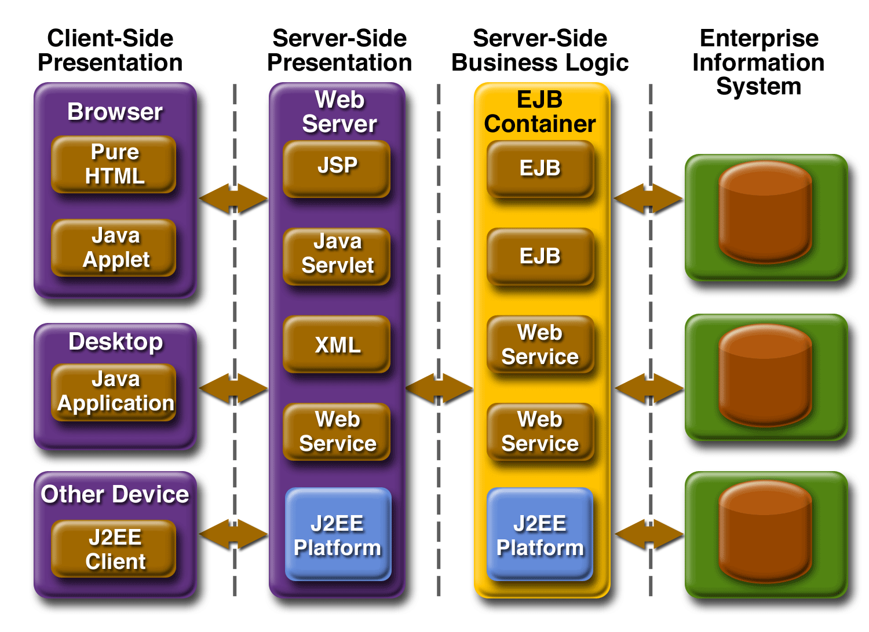
J2EE - Enterprise Application Model [1]

Slide 17
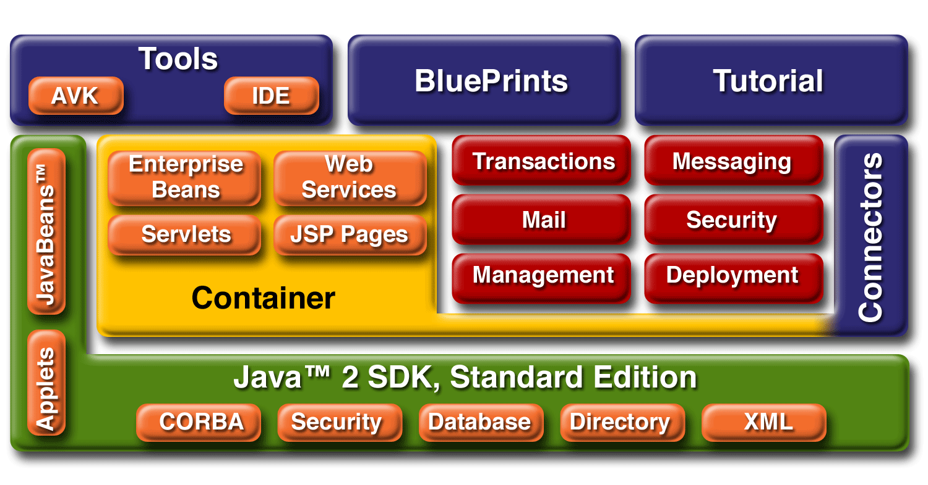
J2EE - Platform Services [1]

Slide 18
J2EE
References
[1]http://enterprise.sourceforge.net/java_2_enterprise_edition.htm.

