Slide 1
UNIT 1
Introduction to Web Applications
1.1.1 Multilayer architectures
Rubén Peredo Valderrama
ESCOM – IPN, México
rperedo@ipn.mx

Slide 2
Multilayer architectures
Layers vs. Tiers
“The term layer to refer to a component type and uses the term tier to refer to physical distribution patterns.“ [1]

Slide 3
Multilayer architectures
Layers vs. Tiers
In other words, layers are logical and tiers are physical (two-tier, three-tier, N-tier). [1]

Slide 4
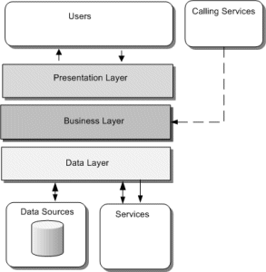
Multilayer architectures [1]

Slide 5
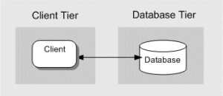
Multilayer architectures [1]
Two-Tier

Slide 6

Multilayer architectures [1]
Three-Tier

Slide 7

Multilayer architectures [1]
N-Tier

Slide 8
Multilayer architectures
The J2EE platform is a layered set of system services that are consistently available to J2EE applications across implementations. [2].

Slide 9
Multilayer architectures
The J2EE platform and Application have layers.

Slide 10
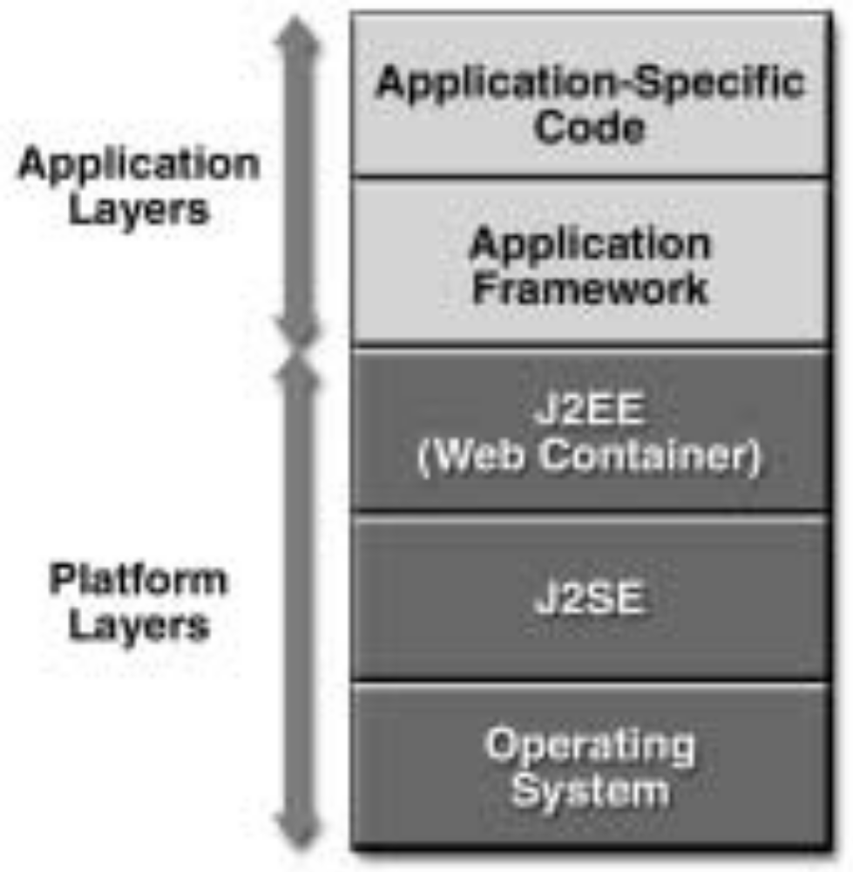
Multilayer architectures [2]

Slide 11
Multilayer architectures
A multitier architecture (n-tier architecture) is a Client/Server architecture in which presentation, application processing, and data management functions are physically separated. [3]

Slide 12
Multilayer architectures
The most common multitier architecture is the three tier architecture.

Slide 13
Multilayer architectures [1]
Three-Tier

Slide 14
Multilayer architectures
The Applications with multitier architecture provide a model to create flexible and reusable applications.

Slide 15
Multilayer architectures
Separating an application into tiers, developers have the option of modifying/adding a specific layer, instead of remake the complete application.

Slide 16
Multilayer architectures
The three tier architecture is normally composed with: presentation, business/data access, and a data tier.

Slide 17
Multilayer architectures
A tier is a physical structuring mechanism for the system infrastructure.

Slide 18
Multilayer architectures
Three tier architecture is a Client/Server architecture, it was developed by John J. Donovan in Open Environment Corporation (OEC), a tools company in Cambridge, Massachusetts. [3]

Slide 19
Multilayer architectures
Three tier architecture is planned to allow to the tiers to be upgraded or replaced independently in response to changes.

Slide 20
Multilayer architectures
Three tier architecture
The presentation tier displays information related to the services.

Slide 21
Multilayer architectures
Three tier architecture
The logical tier controls an application’s functionality by performing detailed processing.

Slide 22
Multilayer architectures
Three tier architecture
The Data tier consists of database servers, where information is stored and retrieved.

Slide 23
Multilayer architectures
Three-tier is a Architecture Style and MVC pattern is a Design Pattern.

Slide 24
Multilayer architectures
The Three-tier main goal is separation of business logic from client and database, providing: multiple client protocols, scalability, etc. The MVC main goal is that implementation changes in one part do not require changes to another.

Slide 25
Multilayer architectures
References
[1] http://blogs.msdn.com/b/jmeier/archive/2008/09/06/layers-and-tiers.aspx
[2] Designing Enterprise Applications with the J2EETM Platform, Second Edition
[3] http://en.wikipedia.org/wiki/Multitier_architecture

