Slide 1
UNIT 1
Introduction to Web Applications
1.2.2 Tomcat Application Server
Rubén Peredo Valderrama
ESCOM – IPN, México
rperedo@ipn.mx

Slide 2
Tomcat Application Server
Apache Tomcat™ is an open source software implementation of the Java Servlet and Java Server Pages technologies.Tomcat is written in Java.

Slide 3
Tomcat Application Server
The Java Servlet and Java Server Pages specifications are developed under the Java Community Process.

Slide 4
Tomcat Application Server
Tomcat was created by James Duncan Davidson (then an employee at Sun).

Slide 5

Tomcat Application Server
“Furthermore, I wanted the animal to be something that was self-sufficient. Able to take care of itself, even if neglected, etc. Tomcat came out of that thought.”.

Slide 6
Tomcat Application Server
Tomcat is a standalone combination Web server and servlet container.

Slide 7
Tomcat Application Server
Tomcat is a Java Web server, which is the servlet container that allows you to run Servlet/JSP.

Slide 8
Tomcat Application Server
Many corporations are using Tomcat in production environments because it has proven to be quite stable.

Slide 9
Tomcat Application Server
Tomcat is used in the real world to run everything.

Slide 10
Tomcat Application Server
Despite Tomcat’s popularity, it suffers from a common shortcoming among open source projects: lack of complete documentation..

Slide 11
Tomcat Application Server
Partial J2EE Implementation
Apache Tomcat

Slide 12
Tomcat Application Server
Apache Software Foundation (ASF) is a nonprofit organization that was created to facilitate the development of open source software projects.

Slide 13
Tomcat Application Server
Tomcat is developed with support of the ASF.

Slide 14
Tomcat Application Server
The Tomcat project has its origins in the Java’s Servlet technology. Servlets are a type of Java application that plug into special Web servers, called Servlet containers (Servlet engines).

Slide 15
Tomcat Application Server
In 1999, Sun donated its Servlet container code (Java Web Server) to the ASF, to create the Tomcat server.

Slide 16
Tomcat Application Server
The first version of Tomcat was the 3.x series, and it implemented the Servlet 2.2 and JSP 1.1 specifications.

Slide 17
Tomcat Application Server
Tomcat is open source software, and, as such, is free and freely distributable.

Slide 18
Tomcat Application Server
Tomcat started as a subproject of the Jakarta project, but now is independent of it.

Slide 19
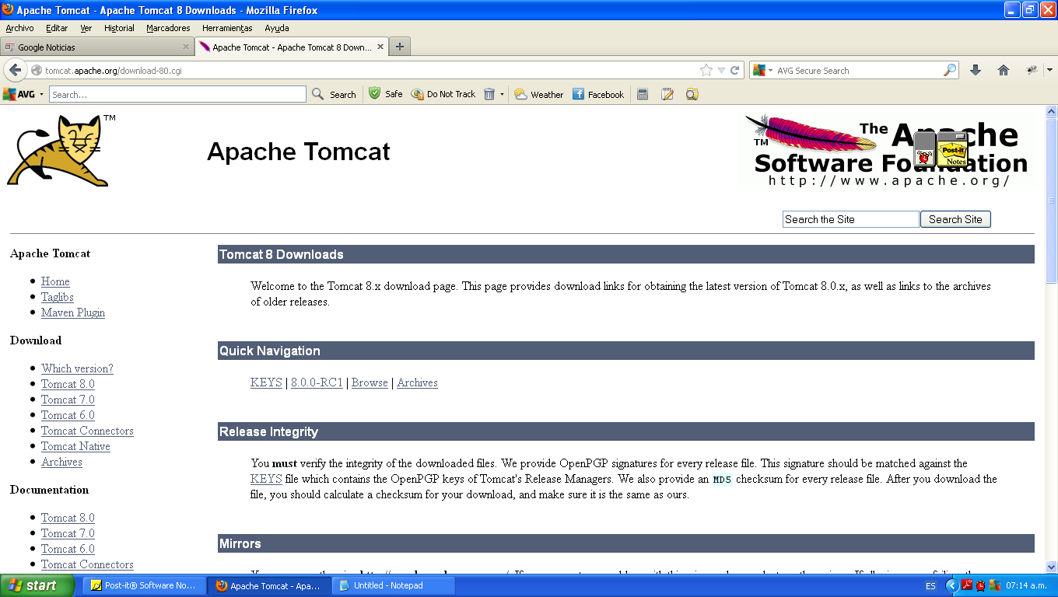
Tomcat Application Server
Tomcat Web site: http://tomcat.apache.org/

Slide 20
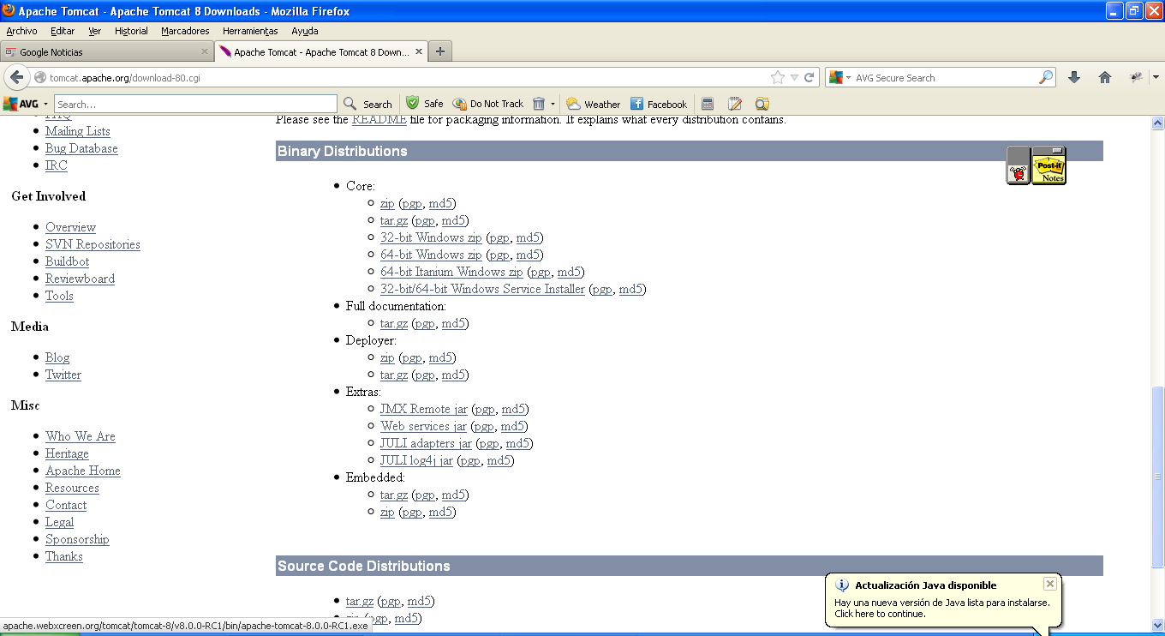
Tomcat Application Server
Tomcat Distributions

Slide 21
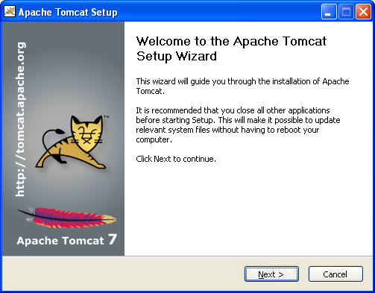
Tomcat Application Server
Tomcat installation

Slide 22
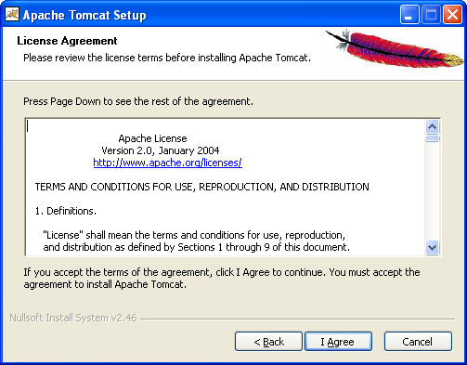
Tomcat Application Server
Tomcat installation

Slide 23
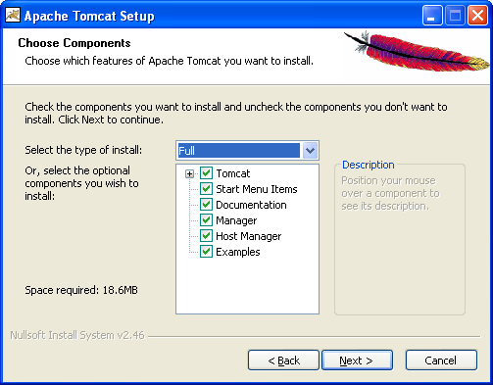
Tomcat Application Server
Tomcat installation

Slide 24
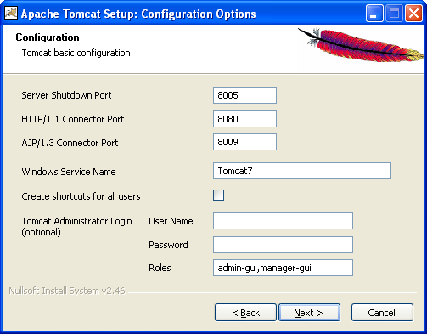
Tomcat Application Server
Tomcat installation

Slide 25
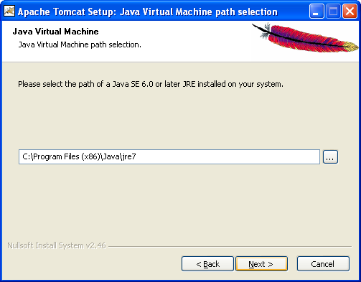
Tomcat Application Server
Tomcat installation

Slide 26
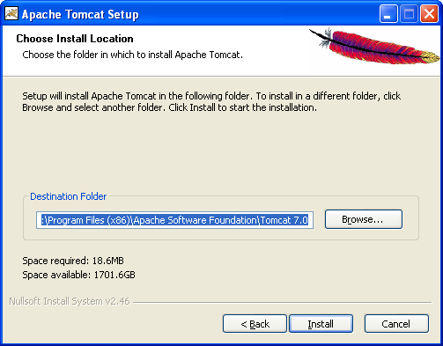
Tomcat Application Server
Tomcat installation

Slide 27
Tomcat Application Server
Testing Tomcat
http://localhost:8080
http://localhost

Slide 28
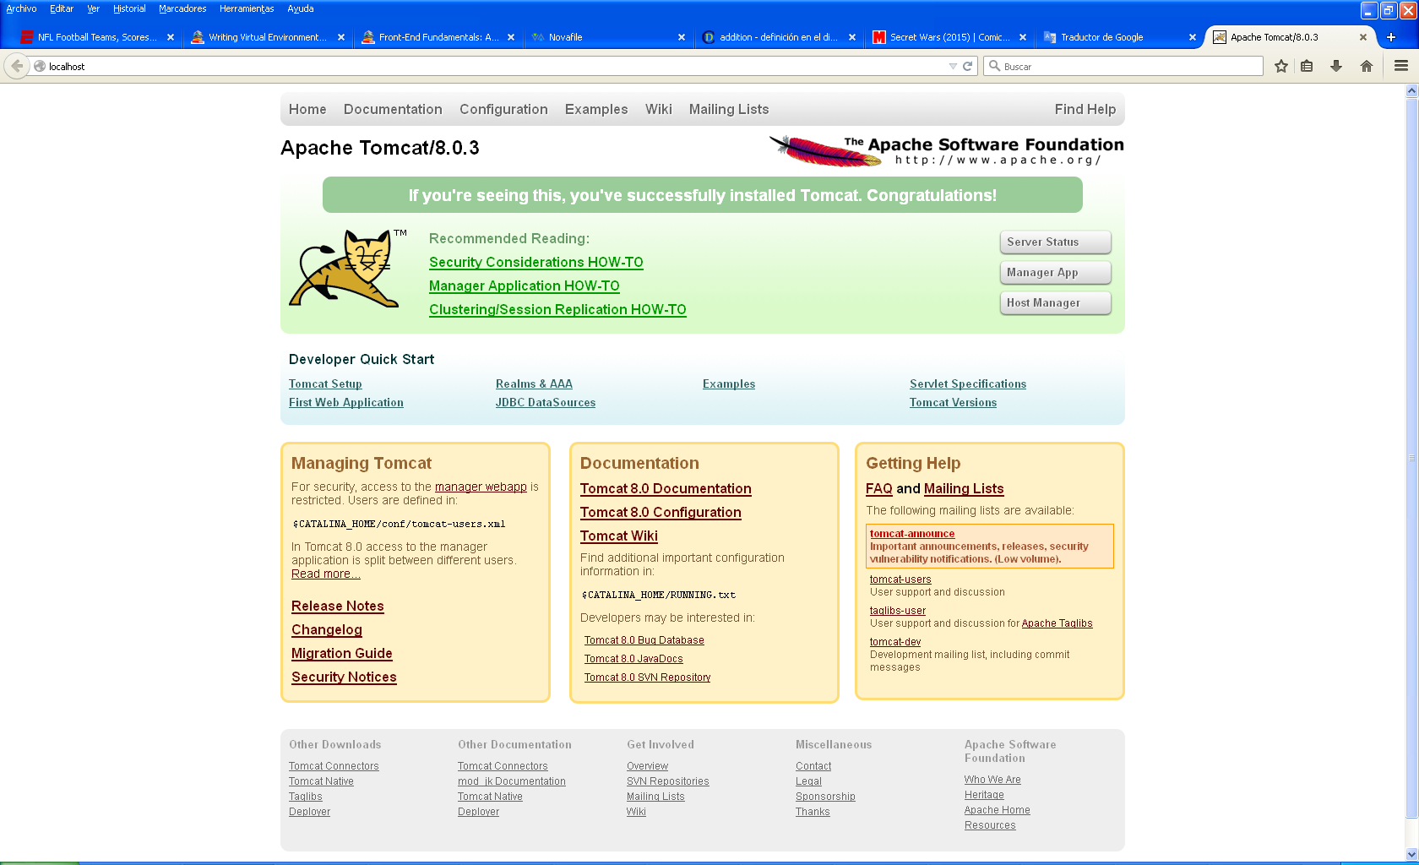
Tomcat Application Server

Slide 29
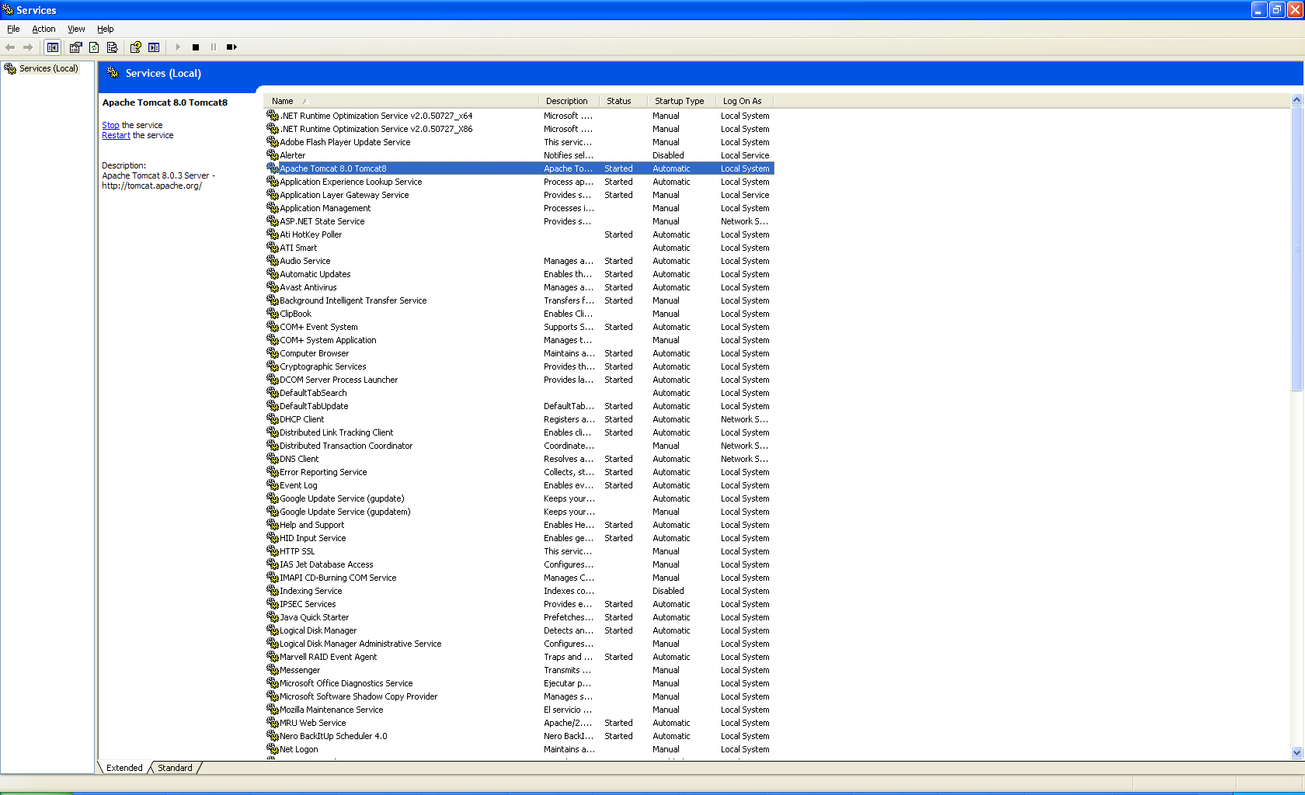
Tomcat Application Server

