Slide 1
UNIT 1
Introduction to Web Applications
1.3.2 Configuration Files
Rubén Peredo Valderrama
ESCOM – IPN, México
rperedo@ipn.mx

Slide 2
Configuration Files
You need to customize its configuration, once you have Tomcat running,

Slide 3
Configuration Files
Configuring Tomcat is done by editing files and restarting Tomcat.

Slide 4
Configuration Files
The following are the main files for configuration:

Slide 5
Configuration Files
server.xml
web.xml
tomcat-users.xml
catalina.policy
context.xml

Slide 6
Configuration Files
server.xml is the main Tomcat configuration file.

Slide 7
Configuration Files
web.xml is a configuration file for servlets and other settings.

Slide 8
Configuration Files
tomcat-users.xml is the default list of roles, users, and passwords used by Tomcat for authentication.

Slide 9
Configuration Files
catalina.policy is the file for the Java security for Tomcat.

Slide 10
Configuration Files
context.xml is the default context settings that are applied to all deployed contexts.

Slide 11
Configuration Files
The web.xml file is known as a deployment descriptor, which contains configuration for the Web application.

Slide 12
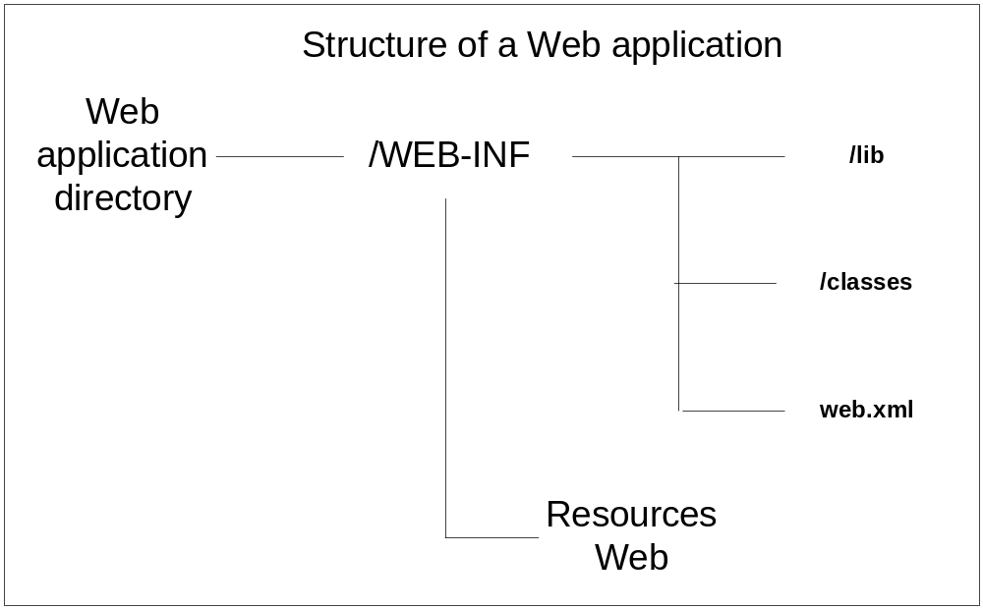
Configuration Files

Slide 13
Configuration Files
The deployment descriptor (web.xml) allows customizations, compared with the way other web servers.

Slide 14
Configuration Files
The web.xml makes it easier for maintenance and also makes it easy to package up the files from one site to move them to another server.

Slide 15
Configuration Files
The web.xml file format is defined in the Java Servlet Specification.

Slide 16
Configuration Files
The root element of deployment descriptor (web.xml) is web-app.

Slide 17
Configuration Files
The <servlet> element lets you assign a name to a servlet/JSP that can be used in servlet-mapping and other elements that refer to a servlet.

Slide 18
Configuration Files
To name a servlet allows to give it a local name.

Slide 19
Configuration Files
<servlet>
<servlet-name>Servlet1</servlet-name>
<servlet-class>paquete.Servlet1</servlet-class>
</servlet>

Slide 20
Configuration Files
Then, other elements in the web.xml file may refer to the servlet simply using Servlet1.

Slide 21
Configuration Files
It is desirable to use a URI alias for a servlet, which hidden the actual Java class name.

Slide 22
Configuration Files
The <servlet-mapping> element lets you assign a name to a servlet/JSP that can be used in servlet-mapping and other elements that refer to a servlet.
.

Slide 23
Configuration Files
The mapping can be accomplished using a servlet-mapping element in the servlet application’s web.xml file.

Slide 24
Configuration Files
<servlet-mapping>
<servlet-name>Servlet1</servlet-name>
<url-pattern>/ServletXXX</url-pattern>
</servlet-mapping>

Slide 25
Configuration Files
The servlet is then accessible under the new name called an alias or servlet alias.

Slide 26
Configuration Files
The url-pattern is a specific URI being mapped to the servlet.

