Slide 1
UNIT 1
Introduction to Web Applications
1.3 Structure of a Web Application
Rubén Peredo Valderrama
ESCOM – IPN, México
rperedo@ipn.mx

Slide 2
Structure of a Web Application
Tomcat has an implementation for servlet and JSP specifications.

Slide 3
Structure of a Web Application
Your Web Applications must follow certain conventions, such as the directory layout for storing web pages, configuration files, and so on.

Slide 4
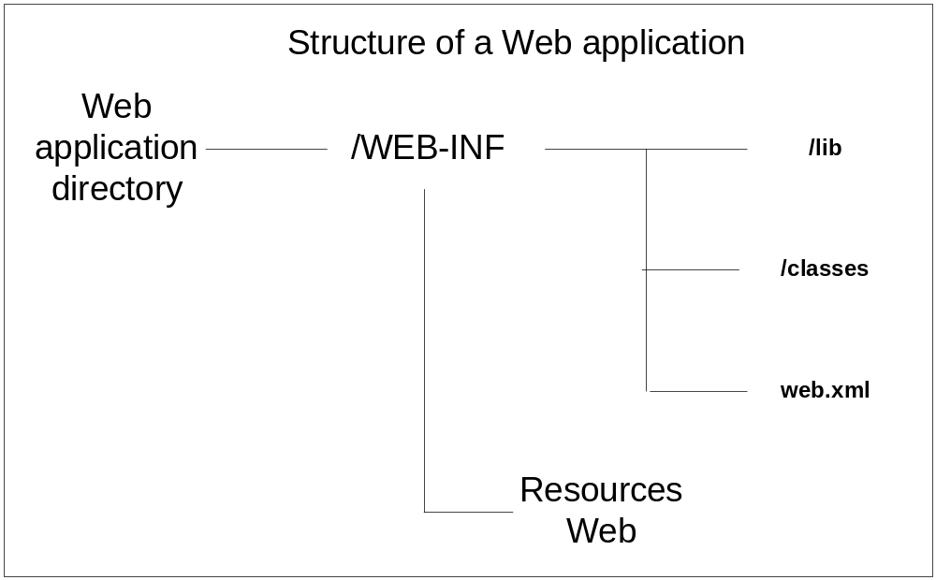
Structure of a Web application
Figure 1 Structure of a Web application

Slide 5
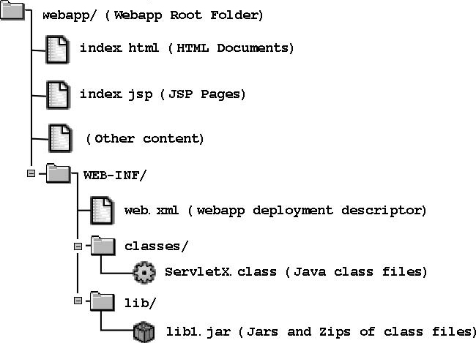
Structure of a Web Application

Slide 6
Structure of a Web Application
The Web pages (static HTML, dynamic JSP, etc.) can go in the root of a Web application directory or in almost any subdirectory that you like, except the WEB-INF.

Slide 7
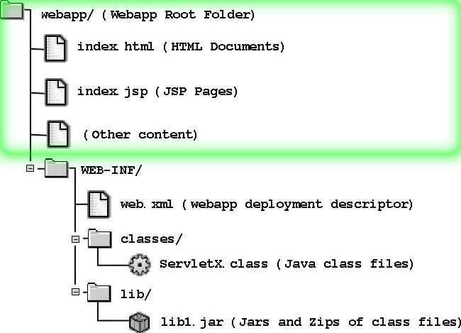
Structure of a Web Application

Slide 8
Structure of a Web Application
The WEB-INF directory has several sections.

Slide 9
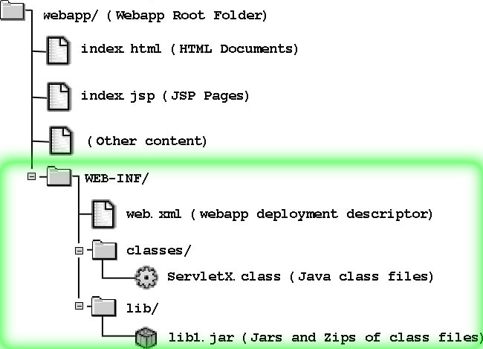
Structure of a Web Application

Slide 10
Structure of a Web Application
The classes directory is where you place any Java class files.

Slide 11
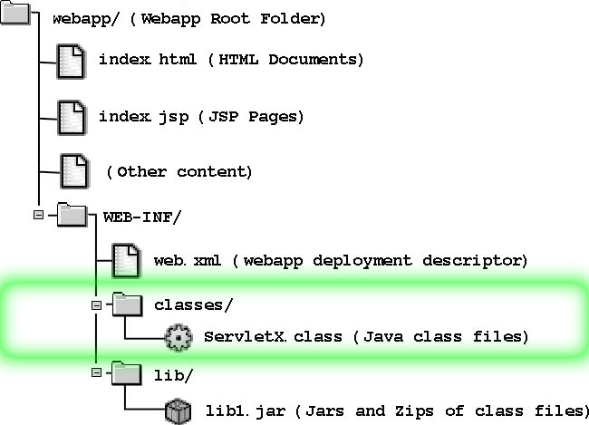
Structure of a Web Application

Slide 12
Structure of a Web Application
The lib directory is where you put any JAR files containing packages of classes (frameworks).

Slide 13
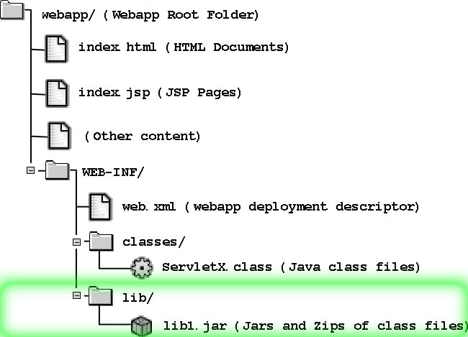
Structure of a Web Application

Slide 14
Structure of a Web Application
The web.xml file is known as a deployment descriptor, which contains configuration for the web application, a description of the Web Application.

Slide 15
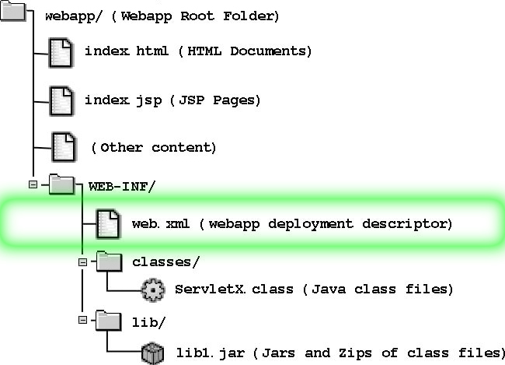
Structure of a Web Application

Slide 16
Structure of a Web Application
The contents of the WEB-INF directory is automatically protected from access by client web browsers, so this configuration information is safe from client view.

