Slide 1
UNIT 2
Java Servlets
2.2 Life Cycle and the Servlet API
Rubén Peredo Valderrama
ESCOM – IPN, México
rperedo@ipn.mx

Slide 2
Life Cycle and the Servlet API
The life cycle governs the environment that Servlets run and provides understanding to some of the mechanisms available to a developer for sharing server side resources.

Slide 3
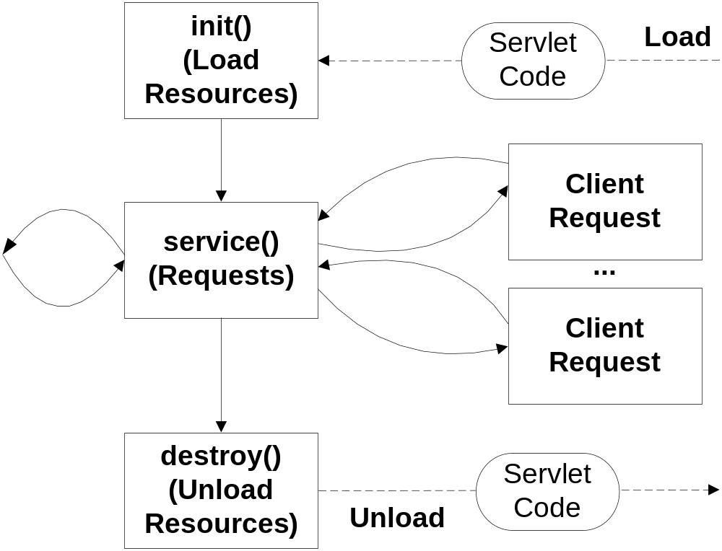
Life Cycle and the Servlet API

Slide 4

Life Cycle and the Servlet API

Slide 5

Life Cycle and the Servlet API

Slide 6

Life Cycle and the Servlet API

Slide 7
Life Cycle and the Servlet API
A servlet engine may execute servlets in a single Java Virtual Machine (JVM).

Slide 8
Life Cycle and the Servlet API
A servlet engine must conform to the following life cycle contract:

Slide 9
Life Cycle and the Servlet API
1. Create and initialize the servlet, init() method.
2. Handle requests from clients, service() method.
3. Destroy the servlet, destroy() method.

Slide 10
Life Cycle and the Servlet API
The servlets persist between requests as object instances.

Slide 11
Life Cycle and the Servlet API
When the servlet is loaded, the server creates a single class instance. The single instance handles every request.

Slide 12
Life Cycle and the Servlet API
The init() method is guaranteed to be called before the servlet handles its first request.

Slide 13
Life Cycle and the Servlet API
The init() method is used to perform servlet initialization - creating or loading objects that are used by the servlet.

Slide 14
Life Cycle and the Servlet API
public void init()
throws ServletException
{
// Initialization code.
}

Slide 15
Life Cycle and the Servlet API
The service() method is our main method to perform the actual request.

Slide 16
Life Cycle and the Servlet API
The service() method handles requests coming from the client (browser) and responses to the client (browser).

Slide 17
Life Cycle and the Servlet API
The service() method checks the HTTP request type (GET, POST, PUT, DELETE, etc.) and calls doGet, doPost, doPut, doDelete, etc. methods appropriate.

Slide 18
Life Cycle and the Servlet API
The doGet() and doPost() are most normally used methods on each request.

Slide 19
Life Cycle and the Servlet API
public void service(ServletRequest request,
ServletResponse response)
throws ServletException, IOException
{
//Handles requests coming from the client (browser)
}

Slide 20
Life Cycle and the Servlet API
The destroy() method is called only once at the end of the life cycle of a servlet.

Slide 21
Life Cycle and the Servlet API
This method gives to the servlet the opportunity to close database connections.

Slide 22
Life Cycle and the Servlet API
public void destroy()
{
// Finalization code.
}.

