Slide 1

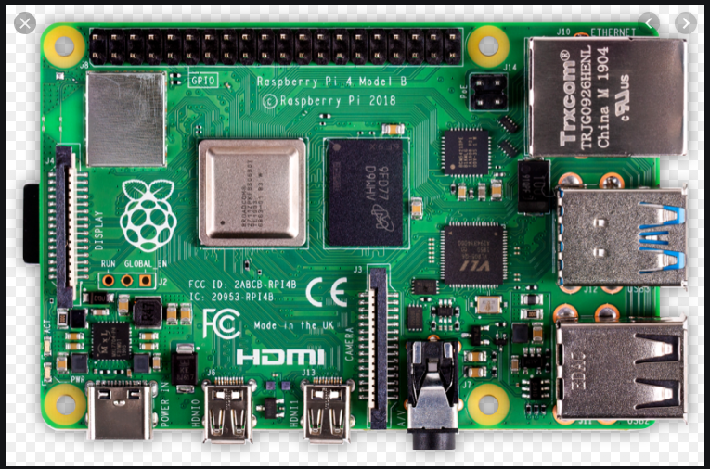
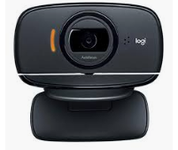
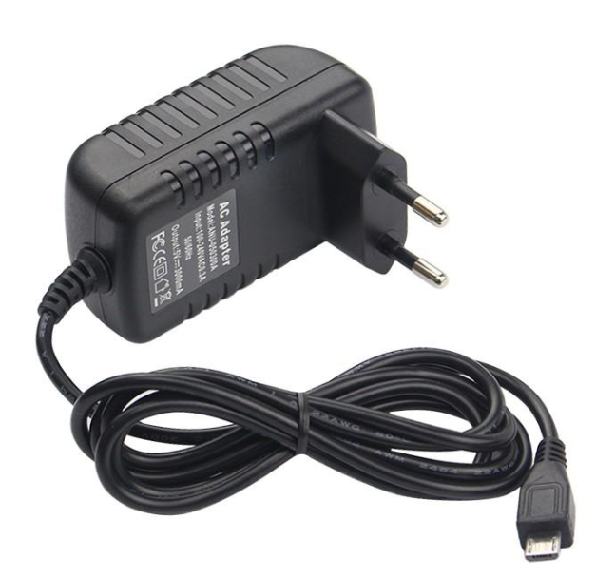
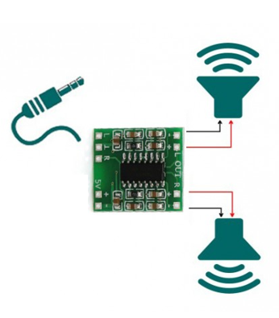
LED driver
Infrared LED
WIFI
GPIO
Raspberry PI 4 (or 3)
192.168.1.63:8092
192.168.1.63:8090
192.168.50.1: 80
Python Web Server (Flask)
Infrared transmitter (LIRC)
UV4L Web RTC audio - video streaming
USB
WIFI Access Point
Logitech C525
autofocus USB camera
with integrated microphone
5V 3A
PAM 8403 class D audio amplifier
3W
3W

