Slide 1

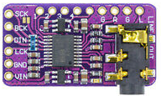
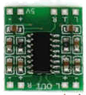
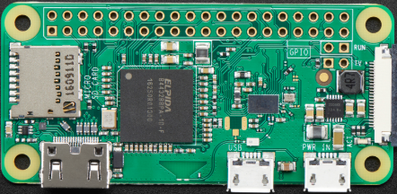
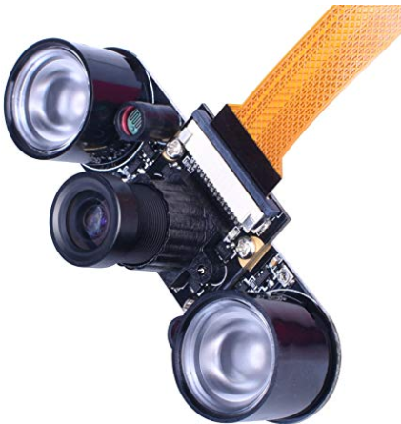

3W
RPI pins | PCM5102
6 (GND) | SCK
12 | BCK
40 | DIN
35 | LCK
6 (GND) | GND
2 (+5V) | VIN
PCM5102 I2S DAC
PCM5102 |  | PAM8403
ROUT | 270 ohm | L
AGND | Wire | GND
LROUT | 270 ohm | L
GND |  | GND
VIN |  | + 5 Vcc
PAM 8403 class D audio amplifier
Janus Gaeway Server
Port 5010: RTP Audio
Port 5012: RTP Video
Wireless LAN
192.168.1.63:443
192.168.50.1: 80
Python Web Server (Flask)
gstreamer app to send audio/ video via RTP to a Janus server
WIFI Access Point
Raspberry PI Zero W
Raspberry PI Camera with infrared lights
5V 3A

Slide 2
