Slide 1
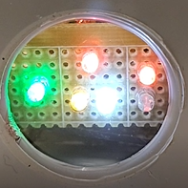
GSM field:
Blink every second: KO
Blink every 3 seconds: OK
Battery on charge
Output1 ON
Battery charged
Input1 ON
(contact closed)
Level1 below the threshold

