Slide 1
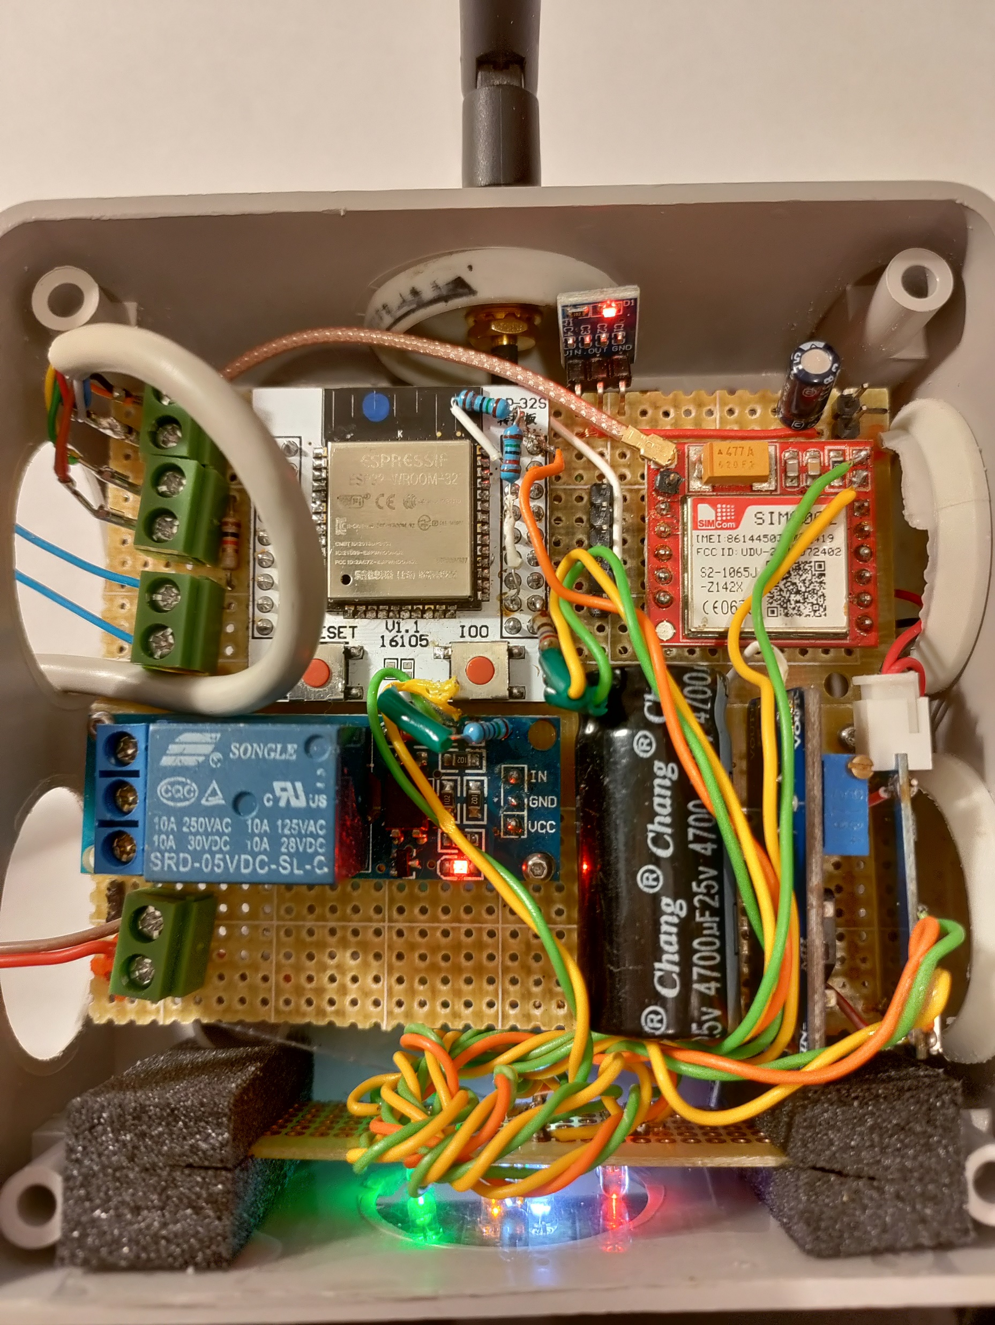
GSM Antenna
SIM800L
SIM slot
ESP32
AMS1117 low drop regulator 4.5 o 3.3 V
To the HC SR04 Ultrasonic meter
SIM800L
GSM module
4700uF filtering capacitor
Output relay
220V 10A
2 x 3.7 V 1100mAh battery connector
MT3608 battery charger
5V 2 A Power supply
3.7 – 4.2 STEP UP to 4.5 V
MT3608 battery charger

