Slide 1
CLUSTER ANALYSIS
AI For Communication and Marketing
Guido Apuzzo 504834

Slide 2
Context
Customer segmentation is crucial for targeted marketing, personalized recommendations, and enhancing user experience.
The primary analysis revolves around segmenting customers based on their search behaviors on the homepage of a Hotel Booking Company, Ypedia, potentially to tailor marketing strategies or improve service offerings.
The application of AI, particularly clustering algorithms, can help in dynamically segmenting customers based on various behavioral metrics. This can lead to more efficient marketing, better customer service, and optimized resource allocation.

Slide 3
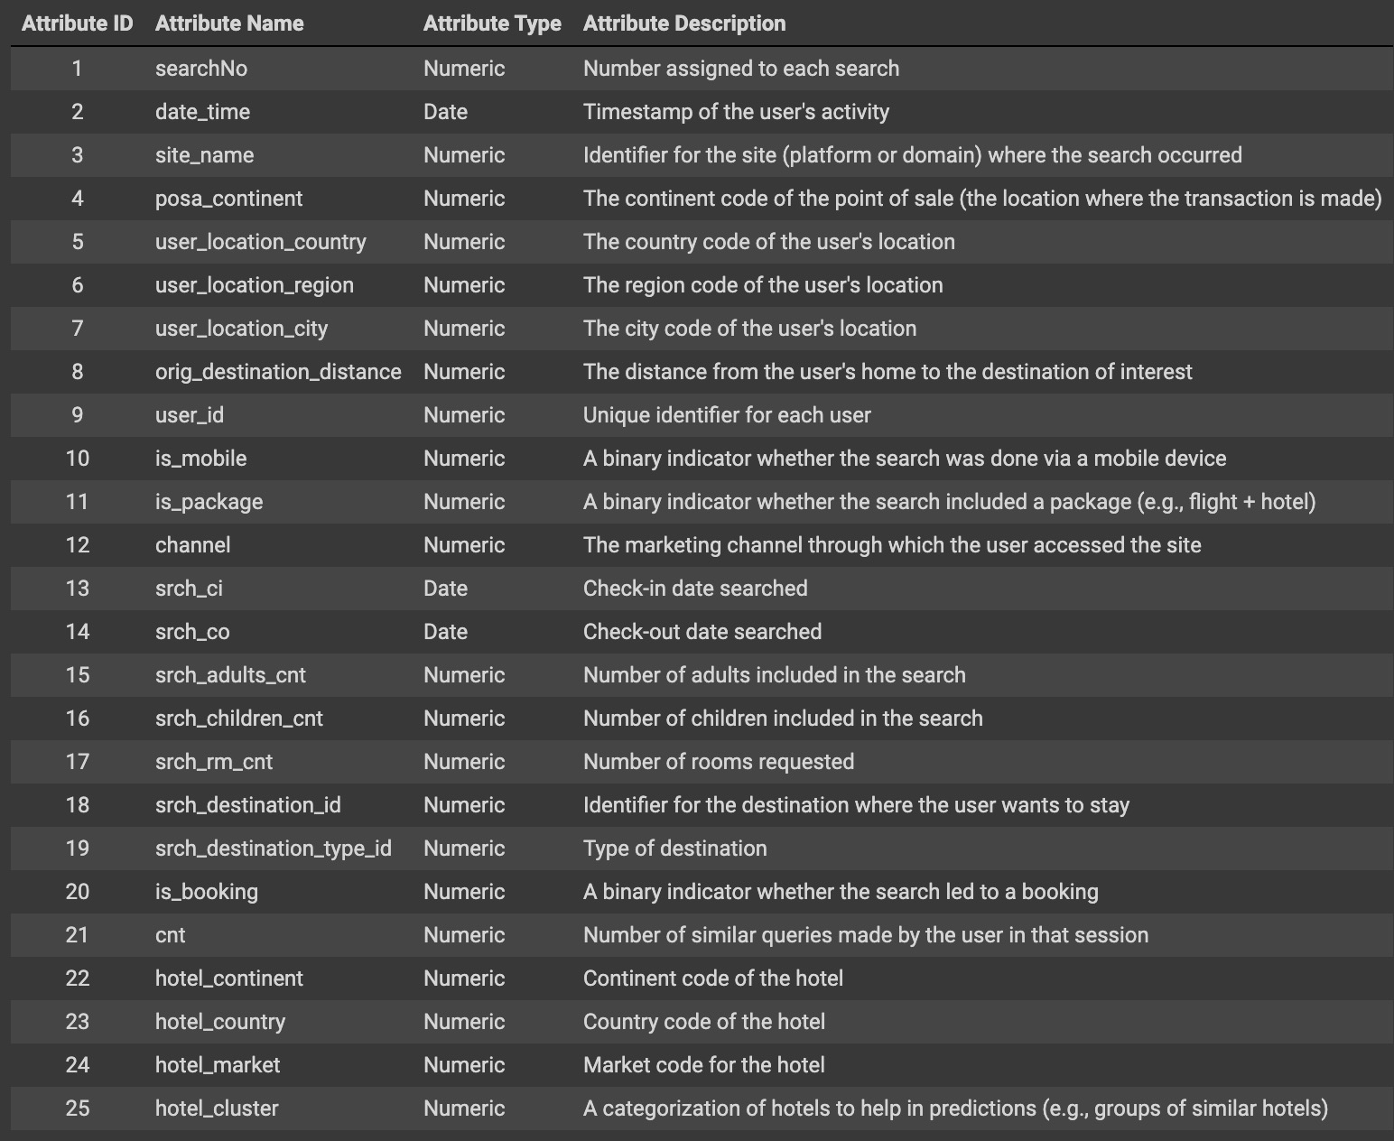
Dataset
The Dataset contains details from user searches on the Ypedia Homepage, comprising 25 features.
However, some of the features are not useful for our analysis.
The features set considered for this project is as follows:
User: user_id
Content: date_time, srch_ci, srch_co, srch_adults_cnt, srch_children_cnt, srch_room_cnt, orig_destination_distance
Method: is_mobile, is_package, is_booking, channel

Slide 4
Methodology
Data Cleaning: Initial steps involve dropping useless features, handling missing values and cleaning up the dataset for analysis.
Exploratory Data Analysis (EDA): This includes examining distributions of numerical columns, exploring date ranges, and identifying unique values. Significant correlations and patterns are then identified to understand user behaviors.
Cluster Segmentation: Using the Elbow Method and K-means algorithm, customers are segmented based on their search behaviors.
Feature Importance: A random forest model is used to identify which features are most predictive of the clustering outcomes, helping to understand what drives different customer behaviors.

Slide 5
Results
Cluster 0: We found out that the customers of this cluster travels an average distance of 1800 kms, books their rooms around 2 months in advance and stays 3 days in average. Also, the probabilities of adults, children and room counts with respect to booking were good. So it makes sense that these features contributes abut 95% variance. We can say Cluster 0 mainly consists of families who travels in groups, as can be seen from the number of adults, children and room counts. Possible actions might be the use family-oriented messaging that highlights benefits for groups traveling together, such as discounts on multiple room bookings or family packages or the offer of special promotions that cater to families, such as 'kids stay free' or group discounts for local attractions and meals.
Cluster 1: Cluster 1 consists mainly of individuals or couples who prefer short-duration trips, 2 days on average, typically planned about a month in advance. They tend to book their travel without packages, which suggests a preference for flexibility in arranging travel components. They travel on average 1540 kms. Duration, days in advance and distance from the origin, explain more than 95% of the variance. Possible actions might be last minute deals, create and market 2-3 day packages for quick getaways, offer incentives like free breakfast or parking for mid-week stays, romantic getaway promotions, create couples' packages with add-ons like spa treatments or dining experiences.
Cluster 2: Cluster 2 is characterized by the longest travel distances, about 2438 kms, planned around 89 days in advance on average, indicating that these travelers plan their trips well ahead, which is common for long travels. Also, the duration is the longest, with an average of about 5 days, aligning with the need for longer stays after traveling significant distances. This might indicate vacation travel or extended business trips. The highest usage of package deals among the clusters (64%), indicates a preference for convenience and perhaps all-inclusive offers that simplify planning and logistics for long trips. Possible actions might be significant discounts for bookings made 3-4 months in advance, incremental discounts for stays extending beyond 5 nights, collaborate with airlines or long-distance travel providers for joint marketing campaigns.

