Slide 1
R for the lazy researcher
¡Welcome!
First some rules and dynamics

Slide 2
R for the lazy researcher
Class Schedule:
Reading
+
Class (comment + script applying what we learnt)
+
Homework

Slide 3
R for the lazy researcher
Is HARD to learn everything about R
Is EASY to learn how to solve our everyday problems
We are going to take the easy way : )

Slide 4
Sessions
1. R throught Rstudio, the basis
2. Reading files
3. Working on our dataset
4. Plotting
5. T.test, ANOVA, Regression
6. (G) Linear Mixed Models

Slide 5



Resources

Slide 6
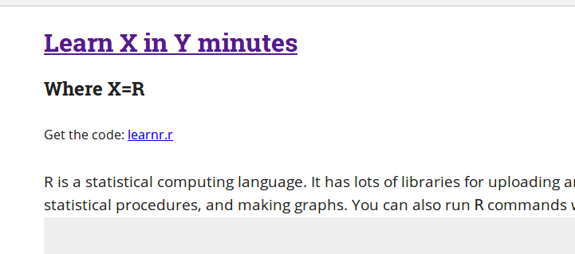
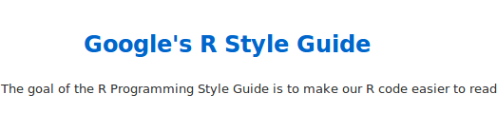
Resources
https://learnxinyminutes.com/docs/r/
https://google.github.io/styleguide/Rguide.xml

Slide 7
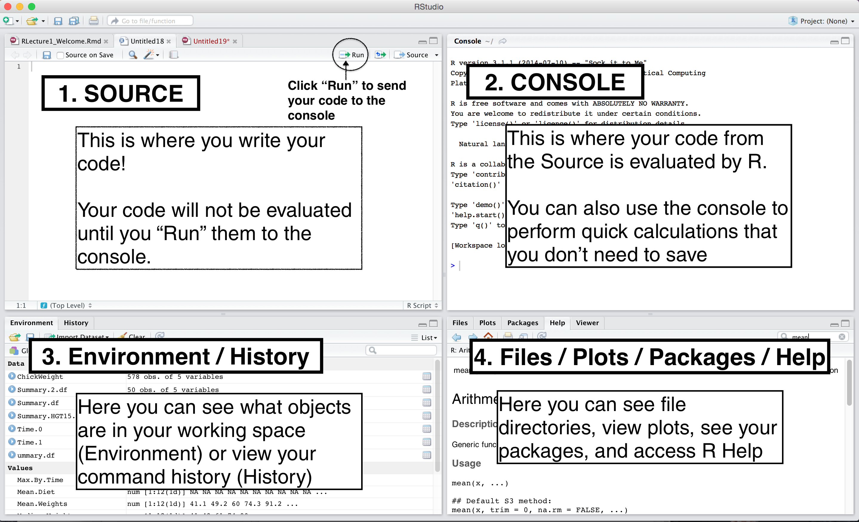
Starting with RStudio
Rstudio is a free platform.

Slide 8
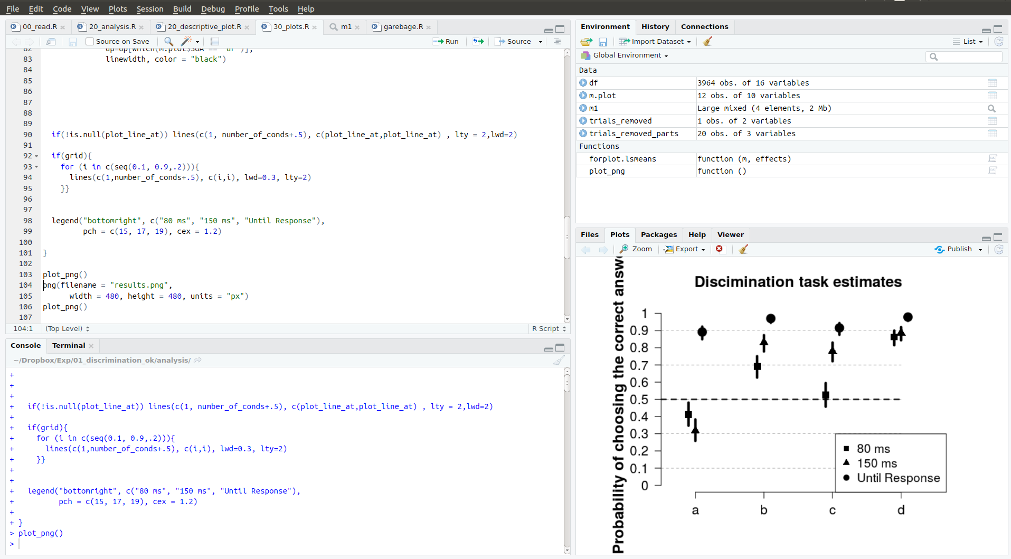
Starting with RStudio
Rstudio is a free platform.

Slide 9
Code + Console
What
Code: holds your code
- persistent (if you save it!)
Console: execute your code
- follow the orders (given by the > or by the script)

Slide 10
Code + Console
Use
Code: holds your code
- store everything you need, make it readable, repeat yourself as much as you can
Console: execute your code
- testing (mmh if I try this command what happens?), read the feedback, etc.

Slide 11
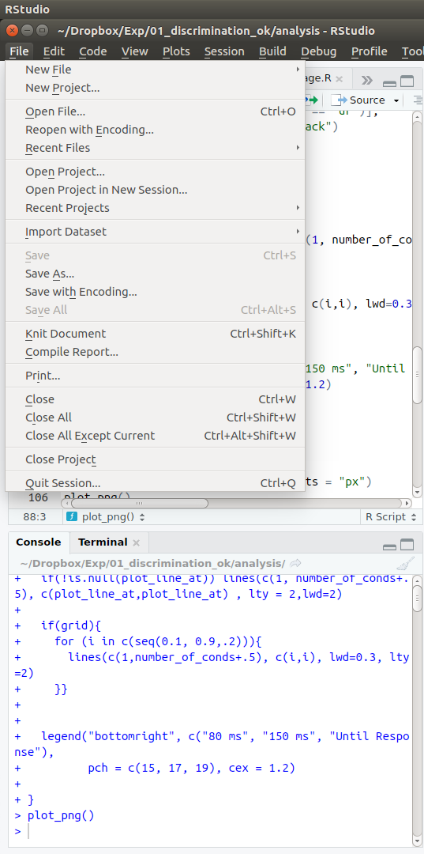
R Projects
The easiest way to work (and share) our analysis is the R projects.
Open our Rstudio
project (R_course.Rproj)
Do!

Slide 12
Our 2 cents of R
Everything that exists is an object.
Everything that happens is a function call.
This seems trivial. But in future it will be important

Slide 13
Our 2 cents of R
We use “<-” to assign
object <- “value”
Different types of objects: integers (1), text (“hi”), lists, functions (a < - function() {print(“hi”} ), data.frames, logicals (TRUE) , etc...
R is so silly that ONLY will follow your orders so cheack spellings (hello != Hello, heII0 != hellO]), etc.

Slide 14
Rules of engagement
Readable
80 characters length each line
Comments
Work for your future self (the dumb with no memory :P)
Be consistent
We will check the style guide : )

Slide 15
To the code!
Open the project
Open the 00_ script : )

