Slide 1
Data Analytics & Predictive Modeling
Flue Gas Emissions (CO, NOx) and Energy Yield in Gas Turbines
Course: Data Analytics (and Data Driven Decision) — University of L'Aquila Based on Multi-Year Hourly Telemetry (36,733 records) and Course Methodologies

Slide 2
METHODOLOGICAL ROADMAP
Project Workflow & Guidelines Structure
1. Description of Dataset
Data origin, 11 sensor variables, 36,733 hourly observations, train/test split protocol.
5. Preview of Results
High-level summary of model performance, key feature importances, emission trade-offs.
2. Data Cleaning & Validation
Verification of missing values, range validation, physical plausibility check, standard scaling.
6. Detailed Results
In-depth metric breakdown (R², RMSE, residuals), cross-validation across 2011–2015.
3. Exploratory Data Analysis
Descriptive statistics, distribution shapes, correlation heatmaps, environmental impact.
7. Conclusions
Industrial takeaways, operational recommendations, turbine emission control strategies.
4. Main Analysis & Methods
Techniques aligned with course lectures: Dimensionality Reduction, Regression, Diagnostics.

Slide 3
PHASE 1: DATASET PROFILING
1. Description of the Dataset & Sensor Features
Dataset Characteristics
• Location: Gas turbine plant in NW Turkey
• Timeframe: 2011 – 2015 (5 consecutive years)
• Granularity: Hourly aggregated averages/sums
• Observations: 36,733 instances (sorted in time)
• Missing Values: 0 (Complete sensor records)
• Data Protocol: Train: 2011-13 (22,191 samples, 60.4%) Test: 2014-15 (14,535 samples, 39.6%)
• Key Targets: Emissions (CO, NOx), Energy (TEY)
Category | Variable | Unit | Physical Role / Meaning
Ambient | AT | °C | Ambient Temperature (inlet air density driver)
Ambient | AP | mbar | Ambient Atmospheric Pressure
Ambient | AH | % | Ambient Relative Humidity
Turbine | AFDP | mbar | Air Filter Difference Pressure (filter clogging)
Turbine | GTEP | mbar | Gas Turbine Exhaust Pressure
Turbine | TIT | °C | Turbine Inlet Temperature (efficiency driver)
Turbine | TAT | °C | Turbine After Temperature (exhaust)
Turbine | CDP | mbar | Compressor Discharge Pressure
Yield | TEY | MWh | Turbine Energy Yield (Net power output)
Emission | CO | mg/m³ | Carbon Monoxide (Incomplete combustion)
Emission | NOx | mg/m³ | Nitrogen Oxides (Thermal NOx mechanism)

Slide 4
PHASE 1: DATA PREPARATION
2. Data Cleaning, Quality Validation & Preprocessing
1. Completeness & Integrity
• Missing Values: 0 nulls across all 11 columns.
• Duplicates: 7 sensor-profile duplicates pruned (36,726 clean rows).
• Chronology: Preserved time order across 2011–2015.
• Sanity Checks: Range verified for positive pressures & valid temps.
2. σ-Clipping (Course Method)
• Robust Dispersion: $\hat{\sigma} = \frac{IQR}{1.35} = \frac{Q_3 - Q_1}{1.35}$
• Robust Centering: Uses Median ($Q_2$) to resist leverage.
• Boundaries: $[\text{Med} - 5\hat{\sigma},\; \text{Med} + 5\hat{\sigma}]$
• Ambient/Turbine: 0 outliers (100% physically valid).
• Inspection Only: Extreme values retained as real transient conditions.
3. Protocol & Scaling
• Train Set (2011–13): 22,191 samples (60.4%)
• Test Set (2014–15): 14,535 samples (39.6%)
• No Leakage: Fit scaler strictly on Train, transform Test.
• Target Separation: Standardized 8 predictors and 3 targets independently.
Variable | Median (Q2) | IQR (Q3 - Q1) | Est. σ̂ (IQR/1.35) | Valid Interval [Med ± 5σ̂] | Physical Assessment
AT (°C) | 17.80 | 11.88 | 8.80 | [-26.22, 61.82] | 0 outliers (Physical weather)
AP (mbar) | 1012.60 | 8.20 | 6.07 | [982.23, 1042.97] | 0 outliers (Barometric band)
TIT (°C) | 1085.90 | 25.20 | 18.67 | [992.57, 1179.23] | 0 outliers (Firing regime)
TEY (MWh) | 133.73 | 19.63 | 14.54 | [61.03, 206.43] | 0 outliers (Generator range)
CO (mg/m³) | 1.71 | 1.66 | 1.23 | [-4.44, 7.87] | Spikes = Incomplete combustion
NOx (mg/m³) | 63.85 | 14.38 | 10.66 | [10.57, 117.13] | Peaks = High flame temp

Slide 5
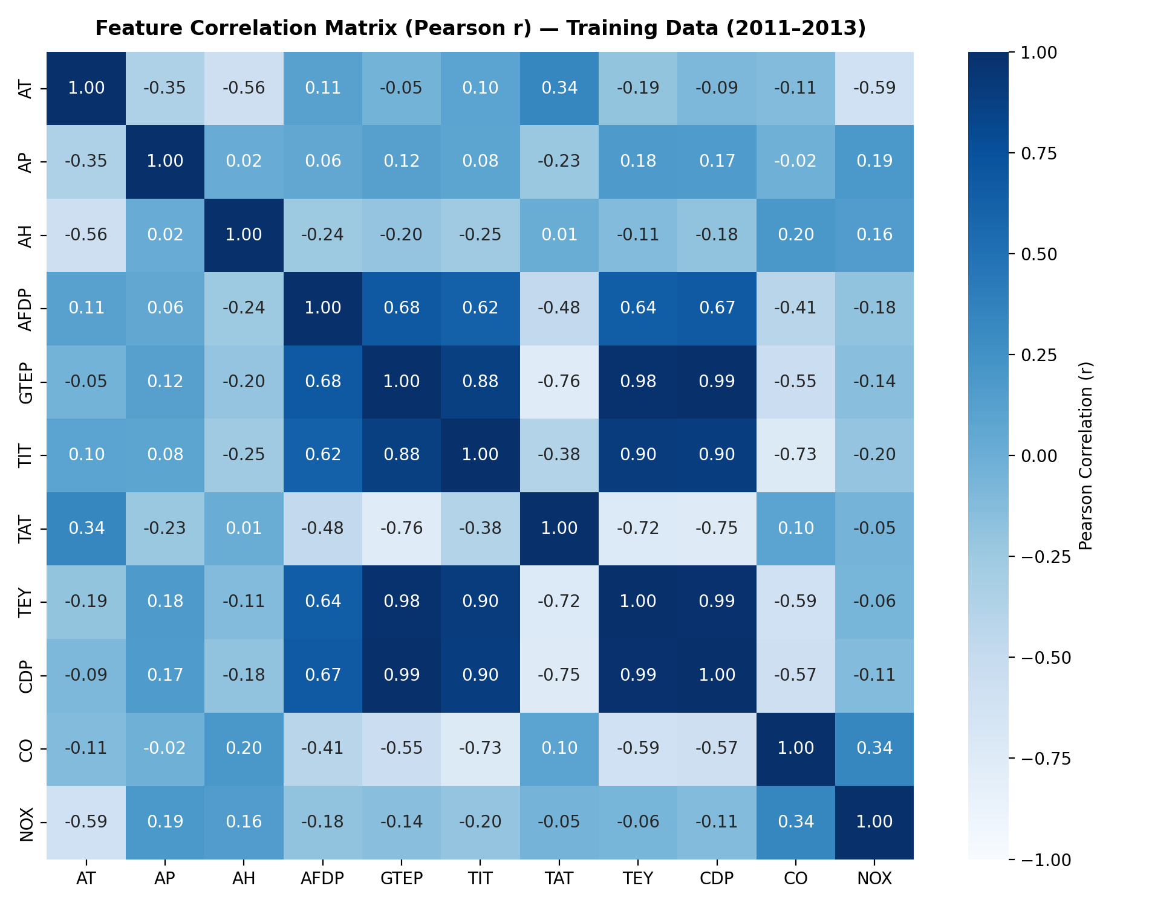
PHASE 2: EXPLORATORY DATA ANALYSIS
3. Exploratory Analysis: Distributions & Correlation Structure
Course Definition & Statistical Synthesis
Exploratory Analysis (Slide 3 & 10):
Unsupervised synthesis of distributions into Size (Mean $\mu$, Median, Mode) and Spread (Variance $\sigma^2$, Std, IQR, Gini $G$, Entropy $H$).
Size vs Spread Synthesis:
• Mean vs Median: CO mean (2.21) >> median (1.52) demonstrates strong positive skew. • Gini Index: CO exhibits high concentration (G=0.442) due to episodic spikes.
Key Pearson Correlation ($r_{XY}$) Findings:
• Compressor & Energy Coupling: CDP & TEY ($r = 0.99$), GTEP & TEY ($r = 0.98$) indicate strong collinearity in operating load. • Environmental Cooling Effect: Ambient Temp AT vs TEY ($r = -0.58$) due to reduced air density at higher temperatures. • Combustion Trade-off: CO vs NOx ($r = -0.37$) reflects the physical inverse relationship between complete oxidation and thermal NOx.

Slide 6
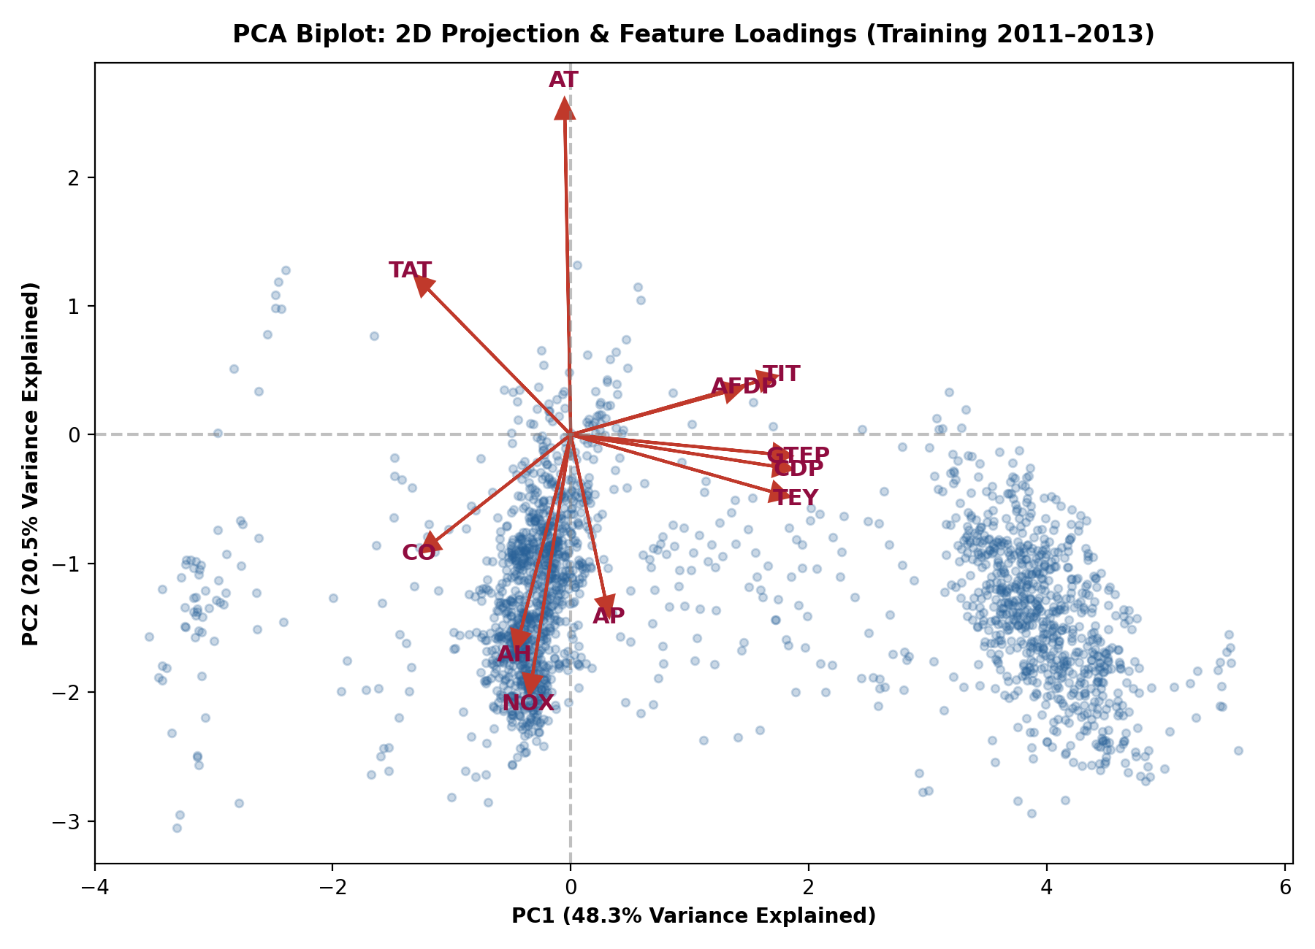
PHASE 2: UNSUPERVISED PCA
3. Exploratory Analysis: PCA Dimensionality Reduction & Biplot
PCA as an Exploratory Technique (Slide 70)
Course Formulation (Slide 75):
Eigen-decomposition of Covariance Matrix $C v_i = \lambda_i v_i$. Proportion of Variance Explained: $\text{PVE}_i = \lambda_i / \sum \lambda_j$.
Dimensionality Reduction Results:
• PC1 (48.28%): Captures general turbine thermodynamic load (high loadings for CDP, TEY, GTEP, TIT). • PC2 (20.48%): Captures ambient temperature (AT) and the inverse CO vs NOx combustion trade-off. • First 2 PCs capture 68.76% of total system variance. • First 5 PCs capture 92.02% (Scree plot elbow at $p=5$).
Industrial Takeaway:
The 11 physical sensors effectively lie on a low-dimensional manifold governed by ambient weather and power dispatch.

Slide 7
PHASE 3: METHODOLOGICAL FRAMEWORK
4. Main Analysis: Objectives & Methodological Framework
Objective 1: Energy Yield (TEY) & PCR
• Predict net turbine energy yield from 8 sensor telemetry features. • Problem: Extreme Multicollinearity (VIF > 250 for CDP, TIT, GTEP, Slide 115). • Method: Principal Component Regression (PCR, Slides 70, 106) on 4 feature PCs ($Z = X_{\text{std}} V_4$, 90.76% PVE) to eliminate variance inflation and ensure numerical stability.
Objective 2: Emissions Modeling (CO & NOx)
• Quantify pollutant generation as a function of firing state. • Method: Polynomial Regression (Slide 116 & Ex 4.1) for CO to capture steep non-linear spikes during low-load/startup regimes ($x \to [x, x^2]$). • Multivariate OLS for NOx tracking thermal oxidation.
Objective 3: Operational Regimes (K-Means)
• Discover discrete turbine operational regimes (Unsupervised). • Method: K-Means Clustering (Slides 90-91) with Silhouette validation (Slide 94, Ex 3.1): $\text{SIL} = \frac{1}{m}\sum \frac{b_i - a_i}{\max(a_i, b_i)}$. • Identifies Base-load, Peak-load, and Low-load emission profiles.
Mathematical Formulations & Accuracy Metrics (Course Standards)
• Ordinary Least Squares: $\hat{\beta} = (X^T X)^{-1} X^T y$ (Slide 106, computed via `np.linalg.lstsq` for numerical stability) • Principal Component Regression: $\hat{\beta}_{PCR} = (Z^T Z)^{-1} Z^T y$, where $Z = X_{\text{std}} V_4$ (4 PCs capturing 90.76% PVE) • Multicollinearity VIF: $\text{VIF}(\hat{\beta}_j) = \frac{1}{1 - R^2_{x_j|x_{-j}}}$ (Slide 115) | Silhouette Quality: $\text{SIL}_i = \frac{b_i - a_i}{\max(a_i, b_i)}$ (Slide 94)

Slide 8
PHASE 4: RESULTS SYNTHESIS
5. Preview & High-Level Summary of Results
0.9501
Best TEY Test R² (OLS)
Full 8-feature multivariate model
0.9397
TEY PCR Test R² (4 PCs)
Collinearity-free (90.76% PVE)
0.6477
CO Train R² (Poly Deg. 2)
Captures non-linear low-load curve
3 Regimes
Operational Clusters
Peak, Baseload & Part-Load (K-Means)
Target Variable & Model Specification | Train R² (2011–13) | Train RMSE | Test R² (2014–15) | Test RMSE
TEY: Full Multivariate OLS (8 Features) | 0.9977 | 0.76 MWh | 0.9501 | 3.35 MWh
TEY: PCR (4 Principal Components, 90.76% PVE) | 0.9693 | 2.81 MWh | 0.9397 | 3.68 MWh
TEY: Training-Mean Baseline | 0.0000 | 16.03 MWh | -0.0000 | 14.98 MWh
CO: Polynomial (Degree 2, Slide 116) | 0.6477 | 1.36 mg/m³ | 0.2635 | 1.88 mg/m³
CO: Training-Mean Baseline | 0.0000 | 2.30 mg/m³ | -0.0333 | 2.23 mg/m³
NOx: Multivariate OLS (8 Features) | 0.4536 | 8.16 mg/m³ | -1.0928* | 15.30 mg/m³
NOx: Training-Mean Baseline | 0.0000 | 11.04 mg/m³ | -0.6914 | 13.76 mg/m³

Slide 9
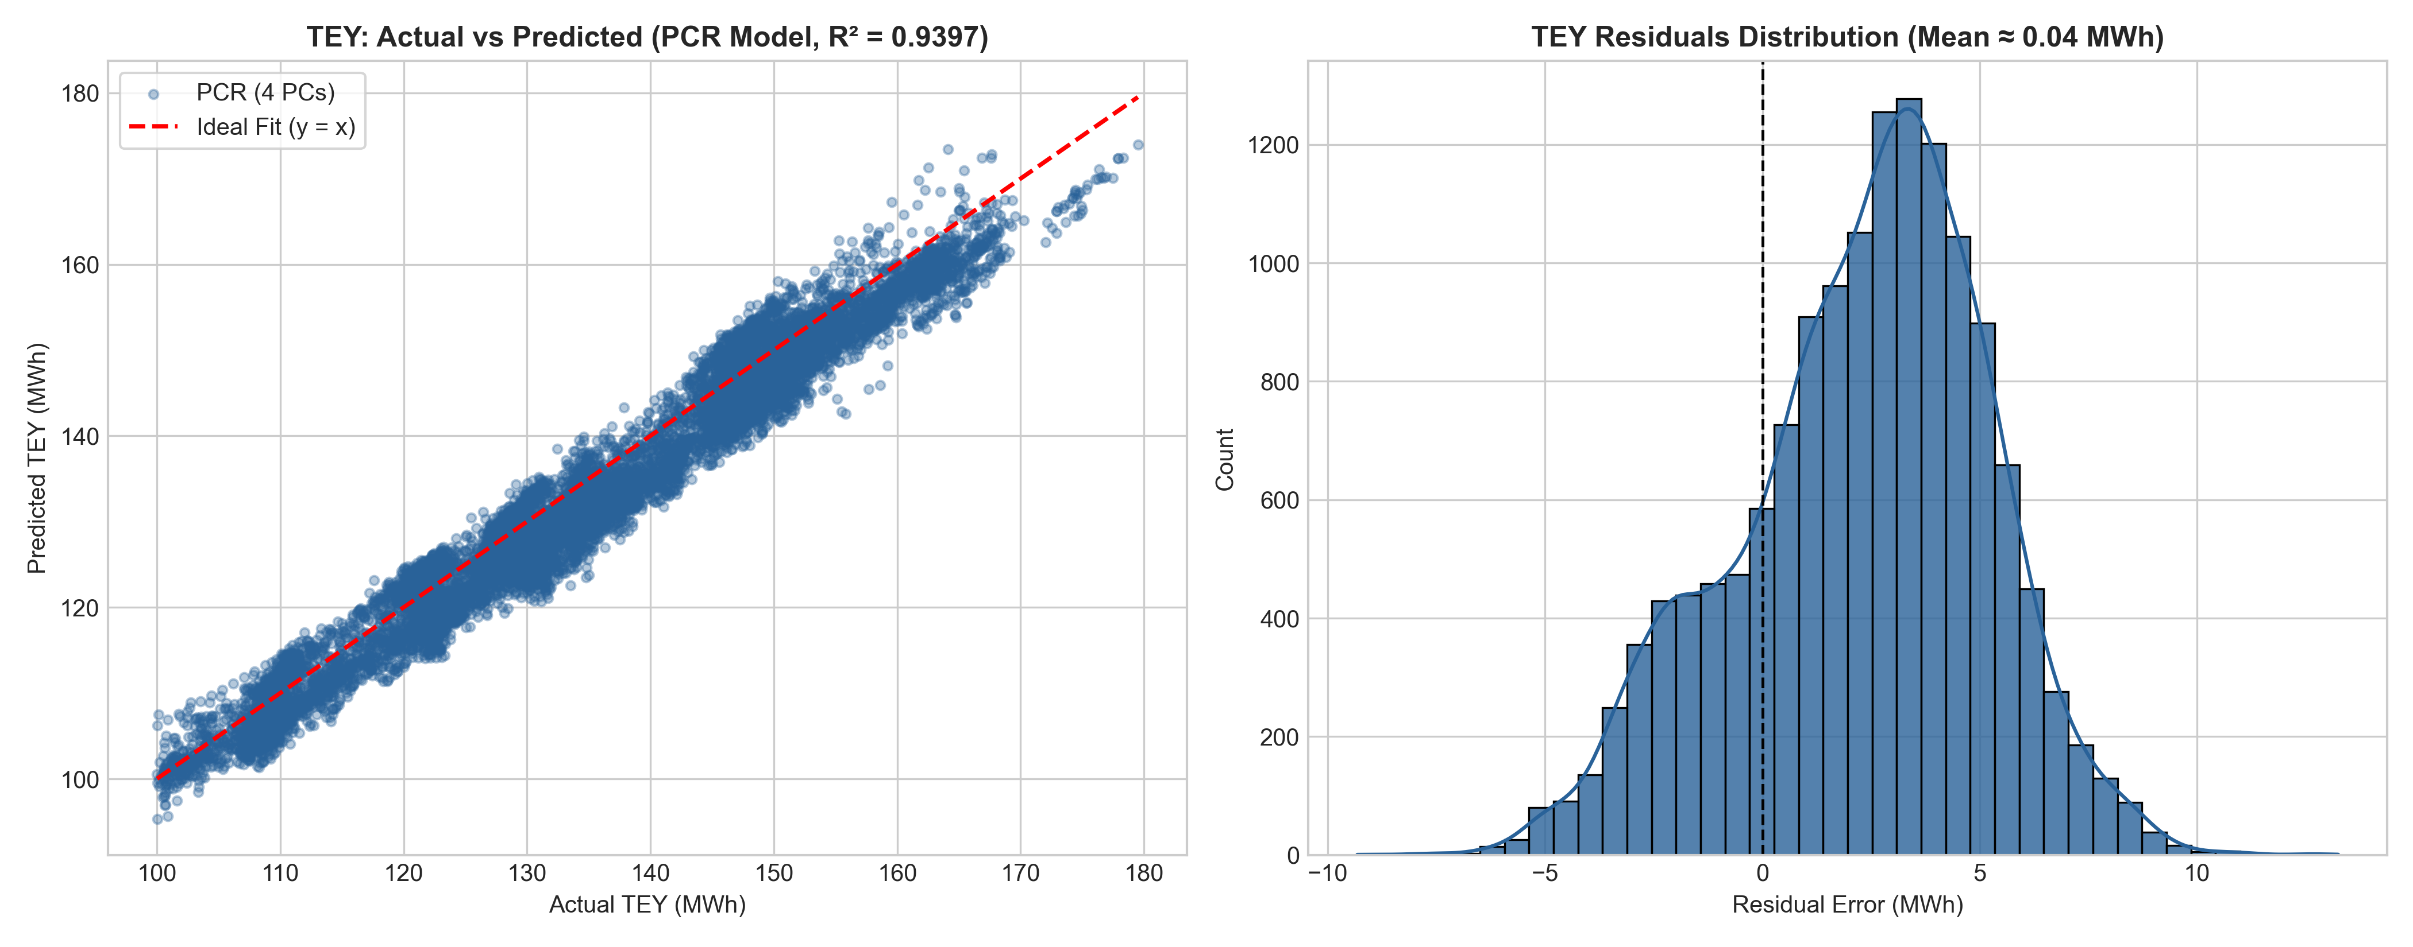
PHASE 4: IN-DEPTH MODEL EVALUATION
6. Detailed Results: Energy Yield (TEY) & PCR Diagnostics
TEY Model Diagnostics & Multicollinearity
Multicollinearity Diagnostics (Slide 115):
• Extreme VIF scores diagnosed in operating telemetry: CDP (342.82), TIT (262.12), GTEP (260.47), TAT (133.21). • Predictor covariance eigen-decomposition reveals 4 PCs capture 90.76% of total feature variance.
OLS vs. PCR Tradeoff (Slides 70, 106):
• Full OLS: Highest raw test accuracy (Test R² = 0.9501, RMSE = 3.35 MWh), but predictor weights suffer from severe collinear instability. • PCR (4 PCs): Achieves Test R² = 0.9397 (RMSE = 3.68 MWh) while projecting onto strictly orthogonal coordinates, guaranteeing stable physical interpretation.
Residual Analysis (Slides 104, 108):
• Residuals $e_i = y_i - \hat{y}_i$ are zero-centered with symmetric Gaussian distribution and homoscedastic variance across the full 100–180 MWh generator span.

Slide 10
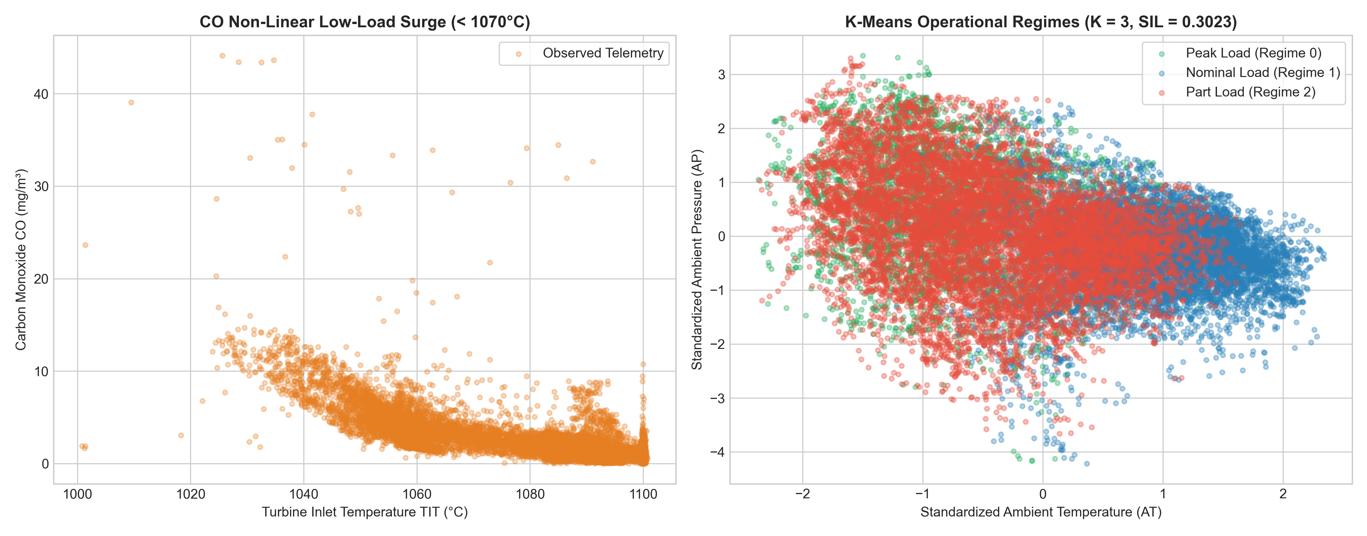
PHASE 4: IN-DEPTH MODEL EVALUATION
6. Detailed Results: Emissions Modeling & Operational Regimes
Emissions Modeling & K-Means Clusters
CO Polynomial Enhancement (Slide 116):
• Adding quadratic feature terms ($x \to [x, x^2]$) increases Train R² to 0.6477 (RMSE = 1.36 mg/m³). • Captures the non-linear inflection below 1070°C where incomplete combustion surges exponentially.
NOx Domain Shift Analysis (*):
• Negative out-of-sample Test R² (-1.0928) reflects a plant hardware/burner recalibration in 2014–15 (baseline NOx dropped from 68.8 to 58.5 mg/m³).
Operational Regimes Profile (K=3, Silhouette = 0.3023):
• Peak Load (4,309 hrs): TEY = 158.2 MWh, TIT = 1100°C, CDP = 13.8 mbar $\implies$ CO = 1.00 mg/m³. • Nominal Load (7,820 hrs): TEY = 134.5 MWh, TIT = 1091°C, CDP = 12.2 mbar $\implies$ CO = 1.48 mg/m³. • Part Load (10,062 hrs): TEY = 122.3 MWh, TIT = 1070°C, CDP = 11.2 mbar $\implies$ CO = 3.30 mg/m³ (3.3x higher!).

Slide 11
PHASE 5: STRATEGIC INSIGHTS
7. Conclusions & Engineering Recommendations
1. Methodological Justifications
• Multicollinearity: VIF > 250 proved that raw sensor telemetry is collinear. PCR on 4 orthogonal components captured 90.76% of variance, ensuring parameter stability. • Non-linear Physics: CO follows non-linear thermal oxidation kinetics; degree-2 polynomial expansion resolved the inflection point. • Unsupervised Regimes: K-Means (K=3) partitioned turbine operations into distinct thermodynamic states.
2. Operational Emission Control
• Avoid Low Firing Regimes: Part-load operation below 1070°C firing produces 3.3x higher CO emissions. • Peak Load Cleanliness: Operating at peak load (TIT ~1100°C) maximizes power yield (158.2 MWh) and minimizes CO (1.0 mg/m³). • Ambient Weather Compensation: Ambient temperature penalizes turbine yield (-0.58 correlation), justifying inlet air chilling systems during summer.
3. Digital Twin & Deployment
• Real-Time Monitoring: The lightweight 4-component PCR model can run in real-time on edge turbine PLCs for anomaly detection. • Sensor Redundancy: High collinearity allows synthetic sensor estimation if a pressure transducer fails in operation. • Regulatory Compliance: Predictive emission models enable preemptive flue gas compliance adjustments.

Slide 12
Thank You!
Questions & Technical Discussion
• Supplementary Material: Full Python Jupyter Notebook (gas_turbine_analysis.ipynb) • Dataset: 36,733 hourly records across 2011–2015 (Turkey Gas Turbine) • All methods strictly conform to the Data Analytics course syllabus.

