Slide 1
011144 Computer Networks
Exercise 2

Slide 2
1. Process A want to communicate with process B on a different host, how process A identifies process B with (c)
(a) IP address of process B’s host
(b) process B’s process ID (PID)
(c) IP address of process B’s host + port number that process B binds to
(d) the socket created by process B

Slide 3
2. Suppose with your Web browser you click a link to retrieve an HTML Web page that references eight very small objects on the same server. The RTT between Web server and local host is RTT₀. Neglecting transmission times, how much time elapses with
a. Non-persistent HTTP with no parallel TCP connections? 2×RTT₀+8×2×RTT₀
b. Non-persistent HTTP with the browser configured for 5 parallel connections? 2×RTT₀+2×2×RTT₀
c. Persistent HTTP? 2×RTT₀+RTT₀

Slide 4
3. Which one of the following statements is wrong (multiple choices) (a)(c)(d)
(a) SSL is at the transmission layer.
(b) HTTP/1.0 retrieves one object with one TCP connection.
(c) There is no server process and client process for P2P network architecture.
(d) Both HTTP and FTP protocols are stateless.

Slide 5
4. Suppose you issues a DNS query on the name “www.baidu.com” from USTC campus network, which of the following DNS servers are definitely not involved in the name resolution process? (c)
(a) Root DNS server
(b) “.com” TLD server
(c) Local DNS server of Baidu company
(d) Local DNS server of USTC
(e) Authoritative server of the “baidu.com” domain.

Slide 6
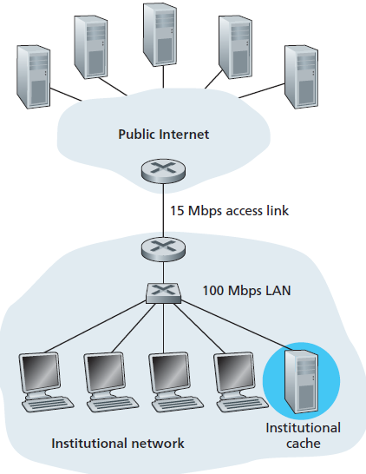
5. Consider the case of Web cache as in the figure. The institutional network users issue 16 requests per second, the averaged object size is 1.2M bits. What is the minimum cache hit ratio so that the access link’s utilization ratio is below 100%?
Ans: suppose hit ratio is p
16×1.2×(1-p) < 15 Mbps
p > 21.875%

