Slide 1
011144 Computer Networks
Exercise 4

Slide 2
1. Suppose a router has the following forwarding table, and it receives an IP datagram with the destination address as “200.23.17.4”, which interface the packet should be forwarded out?
Ans: 2
Prefix | Link interface
200.23.14.0/23 | 1
200.23.16.0/23 | 2
200.23.18.0/23 | 3
Otherwise | 0

Slide 3
Now suppose that the routing algorithm of the router inserts a new entry, and the forwarding table becomes
Which interface the IP datagram is forwarded out? What if the destination address of the IP datagram is “200.23.10.100”?
Ans: 5; 0.
Prefix | Link interface
200.23.14.0/23 | 1
200.23.16.0/23 | 2
200.23.17.0/24 | 5
200.23.18.0/23 | 3
Otherwise | 0

Slide 4
2. Suppose a host send out an IP datagram of a size 3200 bytes (20 bytes header and 3180 bytes of IP payload), suppose that the MTU of the link is 804 bytes, how many fragments are sent out? And what is the value of the Length, ID, and Offset fields of each IP fragments?
Ans:
Length | ID | Offset
804 | 1 | 0
804 | 1 | 98
804 | 1 | 196
804 | 1 | 294
64 | 0 | 392

Slide 5
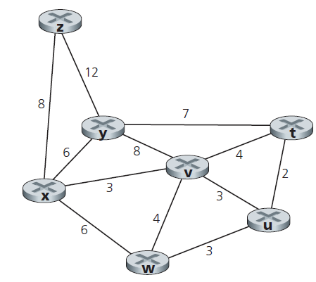
3. Consider the following network. With the indicated link costs, use Dijkstra’s shortest-path algorithm to compute the shortest path from x to all network nodes. Show how the algorithm works by filling the table.

Slide 6
Ans:
Step | N’ | D(t), p(t) | D(u), p(u) | D(v), p(v) | D(w), p(w) | D(y), p(y) | D(z), p(z)
0 | x | ∞ | ∞ | 3, x | 6, x | 6, x | 8, x
1 | xv | 7, v | 6, v | 3, x | 6, x | 6, x | 8, x
2 | xvu | 7, v | 6, v | 3, x | 6, x | 6, x | 8, x
3 | xvuw | 7, v | 6, v | 3, x | 6, x | 6, x | 8, x
4 | xvuwy | 7, v | 6, v | 3, x | 6, x | 6, x | 8, x
5 | xvuwyt | 7, v | 6, v | 3, x | 6, x | 6, x | 8, x
6 | xvuwytz | 7, v | 6, v | 3, x | 6, x | 6, x | 8, x

Slide 7
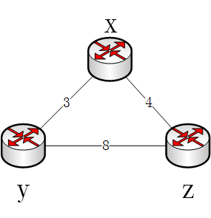
4. Consider the three-node topology, compute the distance tables after the initialization step and after each iteration of a synchronous version of the distance-vector algorithm.
Ans:
Round 1:
Node x
 | x | y | z
x | 0 | 3 | 4
y | ∞ | ∞ | ∞
z | ∞ | ∞ | ∞
Node y
Node z
 | x | y | z
x | ∞ | ∞ | ∞
y | 3 | 0 | 8
z | ∞ | ∞ | ∞
 | x | y | z
x | ∞ | ∞ | ∞
y | ∞ | ∞ | ∞
z | 4 | 8 | 0

Slide 8
 | x | y | z
x | 0 | 3 | 4
y | 3 | 0 | 8
z | 4 | 8 | 0
Round 2:
Round 3
Node x
Node y
Node z
 | x | y | z
x | 0 | 3 | 4
y | 3 | 0 | 7
z | 4 | 8 | 0
 | x | y | z
x | 0 | 3 | 4
y | 3 | 0 | 8
z | 4 | 7 | 0
Node x
 | x | y | z
x | 0 | 3 | 4
y | 3 | 0 | 7
z | 4 | 7 | 0
Node y
Node z
 | x | y | z
x | 0 | 3 | 4
y | 3 | 0 | 7
z | 4 | 7 | 0
 | x | y | z
x | 0 | 3 | 4
y | 3 | 0 | 7
z | 4 | 7 | 0

Slide 9
5. Which of the following are wrong? (multiple choices)
(a) IPv4’s checksum field is set up by the source host and remain unchanged along the forwarding path.
(b) Each subnet must have a DHCP server.
(c) Each CIDR address block in a forwarding table is a subnet.
(d) The IPsec protocol works on routers.
(e) IP fragments are resembled at intermediate routers.
Ans: (a)(b)(c)(d)(e)

Slide 10
6. Suppose a local network connects to wide area network using NAT. The NAT runs on an IP address of 210.45.123.201. If a local client at 10.0.0.4 use port 4433 to connect to a remote server at 202.38.64.10 80, fill in the following blacks the IP source and destination addresses and ports, and the NAT rule for allowing the connection.
Direction | LAN | WAN
LAN → WAN | src.: 10.0.0.4, 4433 dst.: 202.38.64.10, 80 | src.: _210.45.123.201_, 5001 dst.: _202.38.64.10, 80_
WAN → LAN | src.: _202.38.64.10, 80_ dst.: _10.0.0.4, 4433_ | src.: _202.38.64.10, 80_ dst.: _210.45.123.201, 5001_
NAT table
WAN side addr. | LAN side addr.
_210.45.123.201, 5001_ | _10.0.0.4, 4433_

