Slide 1
011144 Computer Networks
Exercise 5

Slide 2
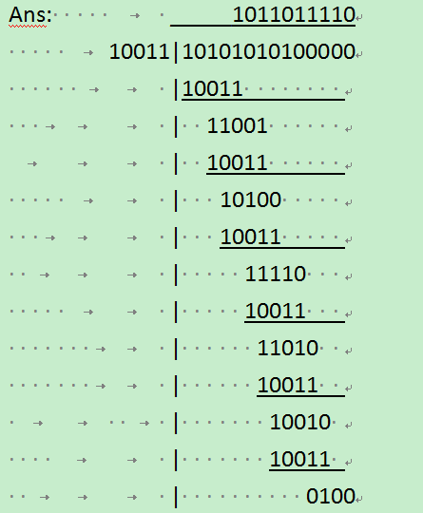
1. 1. Consider the 5-bit generator, G=10011, and suppose that D has the value 1010101010. What is the value of R?
Ans: R=0100

Slide 3
2. Consider the following network.

Slide 4
a. How many subnets are interconnected? List the hosts, switches and routers belonging to each subnet.
Ans.: three subnets. subnet1: A, B, S1, R1; subnet2: C, D, S2, R1, R2; subnet3: E, F, S3, R2.

Slide 5
b. Suppose host A sends an IP datagram to host F, for the three path segments from A to R1, R1 to R2, and R2 to F, list all the source/destination IP addresses and MAC addresses of the frames transmitting in each path segment.
Ans.:
 | Source IP | Destination IP | Source MAC | Destination MAC
A to R1 | 192.168.1.2 | 192.168.3.3 | 00-00-00-00-00-00 | 22-22-22-22-22-22
R1 to R2 | 192.168.1.2 | 192.168.3.3 | 33-33-33-33-33-33 | 66-66-66-66-66-66
R2 to F | 192.168.1.2 | 192.168.3.3 | 77-77-77-77-77-77 | 99-99-99-99-99-99

Slide 6
c. Suppose each pair of hosts have successfully pinged each other, list the switch forwarding table for each of the three switches (ignore the TTL).
Ans.:
S1:
S2:
S3:
Address | Interface
00-00-00-00-00-00 | 1
11-11-11-11-11-11 | 2
22-22-22-22-22-22 | 3
Address | Interface
33-33-33-33-33-33 | 1
44-44-44-44-44-44 | 2
55-55-55-55-55-55 | 3
66-66-66-66-66-66 | 4
Address | Interface
77-77-77-77-77-77 | 1
88-88-88-88-88-88 | 2
99-99-99-99-99-99 | 3

Slide 7
3. Consider the following network, and suppose each pair of hosts have successfully pinged each other, list the switch forwarding table for each of the three switches (ignore the TTL).
Ans.:

Slide 8
Ans.:
S1
S2
S3
Address | Interface
00-00-00-00-00-00 | 1
11-11-11-11-11-11 | 2
22-22-22-22-22-22 | 3
33-33-33-33-33-33 | 3
44-44-44-44-44-44 | 3
55-55-55-55-55-55 | 3
Address | Interface
00-00-00-00-00-00 | 1
11-11-11-11-11-11 | 1
22-22-22-22-22-22 | 2
33-33-33-33-33-33 | 3
44-44-44-44-44-44 | 4
55-55-55-55-55-55 | 4
Address | Interface
00-00-00-00-00-00 | 1
11-11-11-11-11-11 | 1
22-22-22-22-22-22 | 1
33-33-33-33-33-33 | 1
44-44-44-44-44-44 | 2
55-55-55-55-55-55 | 3

Slide 9
4. Let’s consider the operation of a learning switch in the context of a network in which 6 nodes labeled A through F are star connected into an Ethernet switch. Suppose that (i) B sends a frame to E, (ii) E replies with a frame to B, (iii) A sends a frame to B, (iv) B replies with a frame to A. The switch table is initially empty. Show the state of the switch forwarding table before and after each of these events. For each of these events, identify the link(s) on which the transmitted frame will be forwarded.

Slide 11
Ans.:
Event | Switch forwarding table | Forwarding link
B sends a frame to E | {B 2} | ACDEF
E replies with a frame to B | {B 2; E 5} | B
A sends a frame to B | {B 2; E 5; A 1} | B
B replies with a frame to A | {B 2; E 5; A 1} | A

Slide 12
5. Which of the following is wrong?
(a) FDM, TDM, and CDMA are channel partitioning MAC protocols.
(b) Both CSMA and CDMA are random access protocols.
(c) CSMA/CD doesn’t detect collusion as it is difficult in wireless LANs.
(d) In random access protocol, if there is only one node, it can only utilize R/N capacity (R is the total link capacity)
(e) CSMA can utilize 100% of the link bandwidth when there are many nodes sending data.
Ans.: (b)(c)(d)(e)

Slide 13
6. Explain why an Ethernet switch can “plug-and-play”. Why an IP router can not?
Ans.:
Switch: forwarding table subnet
Router: forwarding table for entire Internet, not scalable.

