Slide 1
011144 Computer Networks
Exercise 6

Slide 2
1. True or false
(a) Before an 802.11 station transmits a data frame, it must first send an RTS frame and receive a corresponding CTS frame.
(b) Using RTS and CTS can completely avoid collision.
(c) Using RTS and CTS can completely avoid collision in transmitting data frames.
(d) Ethernet and 802.11 use the same frame structure.
Ans.: F, F, T, F

Slide 3
2. Two users using CDMA to communicate, user A’s code = {1,-1,-1,1,-1,1}, user B’s code = {1, 1,-1,-1,1,1}. Suppose user A transmits 1, user B transmits -1, show the decoded data using A and B’s code to recover from the combined signal.
Ans.:
User A transmit 1 | 1 | -1 | -1 | 1 | -1 | 1
User B transmit -1 | -1 | -1 | 1 | 1 | -1 | -1
Combine | 0 | -2 | 0 | 2 | -2 | 0
Decode for A | <0,-2,0,2,-2,0>*<1,-1,-1,1,-1,1>= 6/6=1
Decode for B | <0,-2,0,2,-2,0>*<1,1,-1,-1,1,1>=-6/6=-1

Slide 4
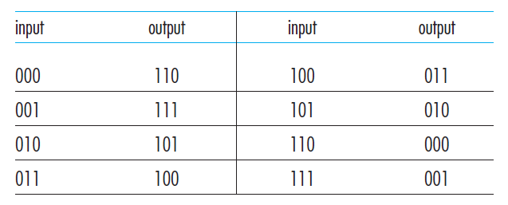
3. Using the following 3-bit block cipher to encrypt a bit string 100100100 (a) without cipher-block chaining (CBC); and (b) with cipher-block chaining (CBC) and IV=111.
Ans.:
(a) 011011011
(b) 100 XOR 111 = 011, K(011)=100; 100 XOR 100 = 000, K(000)=110; 100 XOR 110 = 010, K(010) = 101;
100110101

Slide 5
4. Suppose two mobile nodes communicate with mobile IP, as shown in the following graph, each has its permanent address and care-of-address, and the visited networks have dedicated mobile agents on the routers. On which paths the IP packets contains encapsulated headers, and give all the destination addresses of the IP headers (including the encapsulated headers) for the packets on each path.

Slide 7
Ans.:
Packets on path 2 and path 5 contains encapsulated headers.
Path 1: dst addr. = 128.119.40.18
Path 2: outer dst addr. = 79.129.13.2, innder dst addr. = 128.119.40.18
Path 3: dst addr. = 128.119.40.18
Path 4: dst addr. = 10.10.10.1
Path 5: outer dst addr. = 20.20.20.2, innder dst addr. = 10.10.10.1
Path 6: dst addr. = 10.10.10.1

Slide 8
5. Consider RSA with p = 5 and q = 11.
(a) What are n and z?
(b) Is e = 3, d = 27 acceptable? Why?
(c) Encrypt the message m = 8 using the key (n, e).
Ans.:
(a) n=55, z = 40
(b) Yes, e=3 is less than n and has no common factor with z; de-1 can be divided by z.
(c) (m^e) mod n = 17, c=17.

