Slide 1

Host: sends packets of data
host sending function:
takes application message
breaks into smaller chunks, known as packets, of length L bits
transmits packet into access network at transmission rate R
link transmission rate, aka link capacity, aka link bandwidth
two packets,
L bits each
2
1
R: link transmission rate
host
packet
transmission
delay
time needed to
transmit L-bit
packet into link
L (bits)
R (bits/sec)
=
=
数据包传输时延

Slide 2




Packet-switching: store-and-forward
L bits
per packet
source
3
2
1
R bps
R bps
destination
takes L/R seconds to transmit (push out) L-bit packet into link at R bps
store and forward: entire packet must arrive at router before it can be transmitted on next link
numerical example:
L = 7.5 Mbits
R = 1.5 Mbps
one-hop transmission delay = 5 sec
two-hop transmission delay = 10 sec
end-end delay = 2L/R (assuming zero propagation delay)
more on delay shortly …

Slide 3
Packet switching versus circuit switching
Packet switch
Good for bursty data
Simple, no call set up and management
Better use of bandwidth
Have congestion, delay and loss
Circuit switch
Guarantee bandwidth
Complex
May waste bandwith

Slide 4
Four sources of packet delay
transmission
A
propagation
B
nodal
processing
queueing
d_{nodal} = d_{proc} + d_{queue} + d_{trans} + d_{prop}
d_{trans}: transmission delay:
L: packet length (bits)
R: link bandwidth (bps)
d_{trans} = L/R
d_{prop}: propagation delay:
d: length of physical link
s: propagation speed (~2x10⁸ m/sec)
d_{prop} = d/s
d_{trans} and d_{prop}
very different
* Check out the online interactive exercises for more examples: http://gaia.cs.umass.edu/kurose_ross/interactive/
* Check out the Java applet for an interactive animation on trans vs. prop delay
Notes:
4

Slide 5
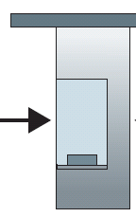
Caravan analogy
100 km
100 km
ten-car
caravan
toll
booth
toll
booth
cars “propagate” at 100 km/hr
toll booth takes 12 sec to service car (bit transmission time)
car ~ bit; caravan ~ packet
Q: How long until last car arrive 2nd toll booth?
time to “push” entire caravan through toll booth onto highway = 12*10 = 120 sec
time for last car to propagate from 1st to 2nd toll both: 100km/(100km/hr)= 1 hr
A: 62 minutes

Slide 6
Protocol layers
application
transport
network
link
physical
application
transport
network
link
physical
什么设备实现什么层的协议？
上层协议与下层协议的关系
同层协议栈之间的关系

Slide 7

















Client-server architecture
server:
always-on host
permanent IP address
data centers for scaling
clients:
communicate with server
may be intermittently connected
may have dynamic IP addresses
do not communicate directly with each other
client/server

Slide 8
P2P architecture
no always-on server
arbitrary end systems directly communicate
peers request service from other peers, provide service in return to other peers
self scalability – new peers bring new service capacity, as well as new service demands
peers are intermittently connected and change IP addresses
complex management
peer-peer

Slide 9
Processes communicating
process: program running within a host
within same host, two processes communicate using inter-process communication (defined by OS)
processes in different hosts communicate by exchanging messages
clients, servers
client process: process that initiates communication
server process: process that waits to be contacted
aside: applications with P2P architectures have client processes & server processes

Slide 10
Sockets
process sends/receives messages to/from its socket
socket analogous to door
sending process shoves message out door
sending process relies on transport infrastructure on other side of door to deliver message to socket at receiving process
also referred to as the Application Programming Interface (API) between the application and the network
application
socket
application
controlled by
app developer
process
process
transport
transport
network
network
controlled
by OS
link
Internet
link
physical
physical

Slide 11
Addressing processes
to receive messages, process must have identifier
host device has unique 32-bit IP address
Q: does IP address of host on which process runs suffice for identifying the process?
identifier includes both IP address and port numbers associated with process on host.
example port numbers:
HTTP server: 80
mail server: 25
to send HTTP message to gaia.cs.umass.edu web server:
IP address: 128.119.245.12
port number: 80
more shortly…
A: no, many processes can be running on same host

Slide 12
Internet transport protocols services
TCP service:
reliable transport between sending and receiving process
flow control: sender won’t overwhelm receiver
congestion control: throttle sender when network overloaded
does not provide: timing, minimum throughput guarantee, security
connection-oriented: setup required between client and server processes
UDP service:
unreliable data transfer between sending and receiving process
does not provide: reliability, flow control, congestion control, timing, throughput guarantee, security, or connection setup,
Q: why bother? Why is there a UDP?
SSL is at app layer
apps use SSL libraries, that “talk” to TCP

Slide 13
Non-persistent HTTP: response time
HTTP is “stateless”
RTT (definition): time for a small packet to travel from client to server and back
HTTP response time:
one RTT to initiate TCP connection
one RTT for HTTP request and first few bytes of HTTP response to return
file transmission time
non-persistent HTTP response time =
2RTT+ file transmission time
initiate TCP
connection
RTT
request
file
RTT
time to
transmit
file
file
received
time
time

Slide 14
Persistent HTTP
persistent HTTP:
server leaves connection open after sending response
subsequent HTTP messages between same client/server sent over open connection
client sends requests as soon as it encounters a referenced object
These requests for objects can be made back-to-back, without waiting for replies to pending requests (pipelining)
as little as one RTT for all the referenced objects
non-persistent HTTP issues:
requires 2 RTTs per object
N objects: N×2×RTT
OS overhead for each TCP connection
browsers often open parallel TCP connections to fetch referenced objects

Slide 15
Pipelining in persistent HTTP
Non-pipelining: request objects one by one over single TCP connection
One RTT to initiate TCP connection
One RTT for HTTP request and response to return for each object
N objects: RTT + N×RTT
Pipelining: request objects in parallel over single TCP connection
One RTT to initiate TCP connection
One RTT for HTTP requests and responses to return for all objects
N objects: RTT + RTT (ignore file transmission time)

Slide 16
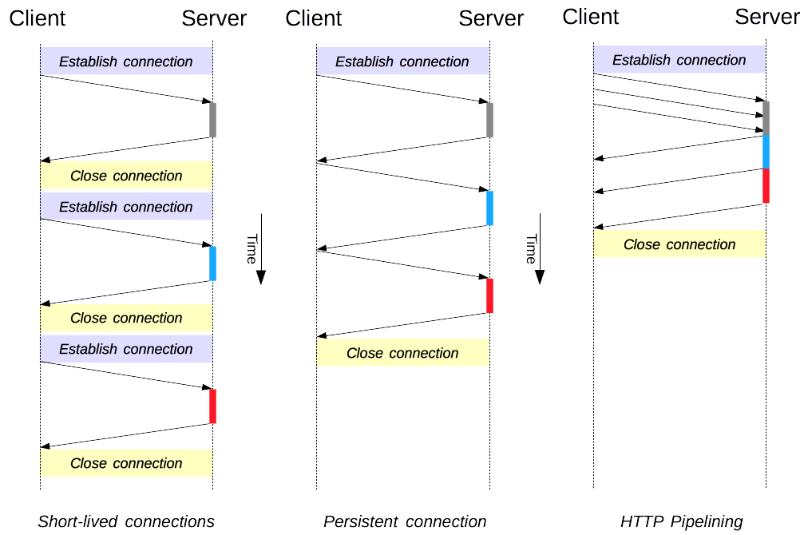
HTTP/1.0
2 RTT per object
HTTP/1.1
1 RTT for connection
1 RTT per object
HTTP/1.1
1 RTT for connection
1 RTT for all objects

Slide 17

Web caches (proxy server)
goal: satisfy client request without involving origin server
user sets browser: Web accesses via cache
browser sends all HTTP requests to cache
object in cache: cache returns object
else cache requests object from origin server, then returns object to client
proxy
server
HTTP request
HTTP request
client
origin
server
HTTP response
HTTP response
HTTP request
HTTP response
client
origin
server

Slide 18

Caching example: install local cache
Calculating access link utilization, delay with cache:
User request 15Mbps of data from Internet
suppose cache hit rate is 0.4
40% requests satisfied at cache, 60% requests satisfied at origin
origin
servers
public
Internet
access link utilization:
60% of requests use access link
data rate to browsers over access link
= 0.6*15 Mbps = 9 Mbps
utilization = 9/15 = 0.6
15 Mbps
access link
institutional
network
total delay
= 0.6 * (delay from origin servers) +0.4 * (delay when satisfied at cache)
= 0.6 (2.01) + 0.4 (~msecs) = ~ 1.2 secs
less than with 100 Mbps link (and cheaper too!)
100 Mbps LAN
local web
cache

Slide 19
FTP: separate control, data connections
TCP control connection,
server port 21
FTP client contacts FTP server at port 21, using TCP
client authorized over control connection
client browses remote directory, sends commands over control connection
when server receives file transfer command, server opens 2nd TCP data connection (for file) to client
after transferring one file, server closes data connection
FTP
client
TCP data connection,
server port 20
FTP
server
server opens another TCP data connection to transfer another file (port 20)
control connection: “out of band”
HTTP, “in band”
FTP server maintains “state”: current directory, earlier authentication
HTTP, stateless

Slide 20
Electronic mail
outgoing
message queue
user mailbox
Three major components:
user agents
mail servers
simple mail transfer protocol: SMTP
User Agent
a.k.a. “mail reader”
composing, editing, reading mail messages
e.g., Outlook, Thunderbird, iPhone mail client
outgoing, incoming messages stored on server
user
agent
mail
server
user
agent
SMTP
mail
server
user
agent
SMTP
SMTP
user
agent
mail
server
user
agent
user
agent

Slide 21
Electronic mail: mail servers
mail servers:
mailbox contains incoming messages for user
message queue of outgoing (to be sent) mail messages
SMTP protocol between mail servers to send email messages
client: sending mail server
“server”: receiving mail server
user
agent
mail
server
user
agent
SMTP
mail
server
user
agent
SMTP
SMTP
user
agent
mail
server
user
agent
user
agent

Slide 22


Mail access protocols
user
agent
mail access
protocol
user
agent
SMTP
SMTP
(e.g., POP,
IMAP)
sender’s mail
server
receiver’s mail
server
SMTP: delivery/storage to receiver’s server
Sender’s user agent also use SMTP to push the mail to sender’s mail server.
mail access protocol: retrieval from server
POP: Post Office Protocol [RFC 1939]: authorization, download, on TCP port 110.
IMAP: Internet Mail Access Protocol [RFC 1730]: more features, including manipulation of stored messages on server
HTTP: gmail, Hotmail, Yahoo! Mail, etc.

Slide 23
DNS: a distributed, hierarchical database
Root DNS Servers
…
…
com DNS servers
org DNS servers
edu DNS servers
yahoo.com
DNS servers
pbs.org
DNS servers
poly.edu
DNS servers
umass.edu
DNS servers
amazon.com
DNS servers
client wants IP for www.amazon.com; 1st approximation:
client queries root server to find com DNS server
client queries .com DNS server to get amazon.com DNS server
client queries amazon.com DNS server to get IP address for www.amazon.com

Slide 24
DNS name resolution example
root DNS server
host at cis.poly.edu wants IP address for gaia.cs.umass.edu
2
3
TLD DNS server for .edu
4
Query procedure:
contacted server replies with name of server to contact
“I don’t know this name, but ask this server”
5
local DNS server
dns.poly.edu
7
6
1
8
authoritative DNS server
dns.cs.umass.edu
requesting host
cis.poly.edu
Combination of iterative (迭代) and recursive (递归) query
Typically, the query from the requesting host to the local DNS server is recursive, and the remaining queries are iterative.
gaia.cs.umass.edu

Slide 25
Inserting records into DNS
example: new startup “Network Utopia”
register name networkuptopia.com at DNS registrar (e.g., Network Solutions)
provide names, IP addresses of authoritative name server (primary and secondary)
registrar inserts two RRs into .com TLD server: (networkutopia.com, dns1.networkutopia.com, NS)
(dns1.networkutopia.com, 212.212.212.1, A)
create authoritative server type A record for www.networkuptopia.com;
(www.networkutopia.com, 212.212.71.4, A)

Slide 26
Socket programming with UDP
UDP: no “connection” between client & server
no handshaking before sending data
sender explicitly attaches IP destination address and port # to each packet
receiver extracts sender IP address and port# from received packet
UDP: transmitted data may be lost or received out-of-order
Application viewpoint:
UDP provides unreliable transfer of groups of bytes (“datagrams”) between client and server

Slide 27
Socket programming with TCP
client must contact server
server process must first be running
server must have created socket (door) that welcomes client’s contact
client contacts server by:
Creating TCP socket, specifying IP address, port number of server process
when client creates socket: client TCP establishes connection to server TCP
when contacted by client, server TCP creates new socket for server process to communicate with that particular client
allows server to talk with multiple clients
source port numbers used to distinguish clients (more in Chap 3)
application viewpoint:
TCP provides reliable, in-order
byte-stream transfer (“pipe”)
between client and server

Slide 28
Connectionless demultiplexing
recall: when creating datagram to send into UDP socket, must specify
destination IP address
destination port #
recall: created socket has host-local port #:
sock.bind('localhost',10000);
clientSocket.sendto(message,(serverName, serverPort))
when host receives UDP segment:
checks destination port # in segment
directs UDP segment to socket with that port #
IP datagrams with same dest. port #, but different source IP addresses and/or source port numbers will be directed to same socket at dest

Slide 29
Connection-oriented demux
TCP socket identified by 4-tuple:
source IP address
source port number
dest IP address
dest port number
demux: receiver uses all four values to direct segment to appropriate socket
server host may support many simultaneous TCP sockets:
each socket identified by its own 4-tuple
May have same server port
web servers have different sockets for each connecting client
non-persistent HTTP will have different socket for each object request

Slide 30
Internet checksum: example
example: add two 16-bit integers
1 1 1 1 0 0 1 1 0 0 1 1 0 0 1 1 0
1 1 1 0 1 0 1 0 1 0 1 0 1 0 1 0 1
1 1 0 1 1 1 0 1 1 1 0 1 1 1 0 1 1
1 1 0 1 1 1 0 1 1 1 0 1 1 1 1 0 0
1 0 1 0 0 0 1 0 0 0 1 0 0 0 0 1 1
wraparound
sum
checksum
checksum+sum=全1
Note: when adding numbers, a carryout from the most significant bit needs to be added to the result
求和、取补
* Check out the online interactive exercises for more examples: http://gaia.cs.umass.edu/kurose_ross/interactive/
Notes:
Kurose and Ross forgot to say anything about wrapping the carry and adding it to low order bit

Slide 31
rdt3.0: stop-and-wait operation
sender
receiver
first packet bit transmitted, t = 0
last packet bit transmitted, t = L / R
first packet bit arrives
RTT
last packet bit arrives, send ACK
ACK arrives, send next
packet, t = RTT + L / R

Slide 32
Pipelining: increased utilization
sender
receiver
first packet bit transmitted, t = 0
last bit transmitted, t = L / R
first packet bit arrives
RTT
last packet bit arrives, send ACK
last bit of 2nd packet arrives, send ACK
last bit of 3rd packet arrives, send ACK
ACK arrives, send next
packet, t = RTT + L / R
3-packet pipelining increases
utilization by a factor of 3!

Slide 33
Pipelined protocols: overview
Go-back-N:
sender can have up to N unacked packets in pipeline
receiver only sends cumulative ack（累积确认）
doesn’t ack packet if there’s a gap
sender has timer for oldest unacked packet
when timer expires, retransmit all unacked packets
Selective Repeat:
sender can have up to N unack’ed packets in pipeline
rcvr sends individual ack（逐个确认） for each packet
sender maintains timer for each unacked packet
when timer expires, retransmit only that unacked packet

Slide 34
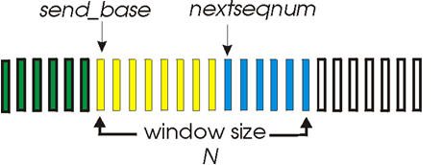
GBN: sender extended FSM
rdt_send(data)
if (nextseqnum < base+N) {
sndpkt[nextseqnum] = make_pkt(nextseqnum,data,chksum)
udt_send(sndpkt[nextseqnum])
if (base == nextseqnum)
start_timer
nextseqnum++
}
else
refuse_data(data)
Λ
base=1
nextseqnum=1
timeout
Wait
start_timer
udt_send(sndpkt[base])
udt_send(sndpkt[base+1])
…
udt_send(sndpkt[nextseqnum-1])
rdt_rcv(rcvpkt)
&& corrupt(rcvpkt)
rdt_rcv(rcvpkt) &&
notcorrupt(rcvpkt)
base = getacknum(rcvpkt)+1
If (base == nextseqnum)
stop_timer
else
start_timer

Slide 35
GBN: receiver extended FSM
default
udt_send(sndpkt)
rdt_rcv(rcvpkt)
&& notcurrupt(rcvpkt)
&& hasseqnum(rcvpkt,expectedseqnum)
Λ
Wait
extract(rcvpkt,data)
deliver_data(data)
sndpkt = make_pkt(expectedseqnum,ACK,chksum)
udt_send(sndpkt)
expectedseqnum++
expectedseqnum=1
sndpkt =
make_pkt(0,ACK,chksum)
ACK-only: always send ACK for correctly-received pkt with highest in-order seq #
may generate duplicate ACKs
need only remember expectedseqnum
out-of-order pkt:
discard (don’t buffer): no receiver buffering!
re-ACK pkt with highest in-order seq #

Slide 36
Selective repeat
sender
receiver
data from above:
if next available seq # in window, send pkt
timeout(n):
resend pkt n, restart timer
ACK(n) in [sendbase,sendbase+N]:
mark pkt n as received
if n is smallest unACKed pkt, advance window base to next unACKed seq #
pkt n in [rcvbase, rcvbase+N-1]
send ACK(n)
out-of-order: buffer
in-order: deliver (also deliver buffered, in-order pkts), advance window to next not-yet-received pkt
pkt n in [rcvbase-N,rcvbase-1]
ACK(n)
otherwise:
ignore

Slide 37
TCP seq. numbers, ACKs
outgoing segment from sender
sequence numbers:
byte stream “number” of first byte in segment’s data
acknowledgements:
seq # of next byte expected from other side
cumulative ACK
Q: how receiver handles out-of-order segments
A: TCP spec doesn’t say, - up to implementor
In practice: keep them and wait for the missing bytes (SR-like)
source port #
dest port #
sequence number
acknowledgement number
rwnd
checksum
urg pointer
window size
N
sender sequence number space
sent
ACKed
sent, not-yet ACKed
(“in-flight”)
usable
but not
yet sent
not
usable
incoming segment to sender
source port #
dest port #
sequence number
acknowledgement number
A
rwnd
checksum
urg pointer

Slide 38
TCP sender (simplified)
data received from application above
create segment, seq. #: NextSeqNum
pass segment to IP (i.e., “send”)
NextSeqNum = NextSeqNum + length(data)
if (timer currently not running)
start timer
Λ
NextSeqNum = InitialSeqNum
SendBase = InitialSeqNum
wait
for
event
timeout
retransmit not-yet-acked segment with smallest seq. #
start timer
ACK received, with ACK field value y
if (y > SendBase) {
SendBase = y
/* SendBase–1: last cumulatively ACKed byte */
if (there are currently not-yet-acked segments)
start timer
else stop timer
}

Slide 39
TCP flow control
to application process
receiver “advertises” free buffer space by including rwnd value in TCP header of receiver-to-sender segments
RcvBuffer size set via socket options (typical default is 4096 bytes)
many operating systems autoadjust RcvBuffer
sender limits amount of unacked (“in-flight”) data to receiver’s rwnd value
guarantees receive buffer will not overflow
RcvBuffer
buffered data
rwnd
free buffer space
TCP segment payloads
receiver-side buffering

Slide 40
TCP flow control
Receiver maintains
LastByteRead: last byte read by the application process
LastByteRcvd: last byte arrived in the receiver buffer
Sender maintains
LastByteSent
LastByteAcked
Ensure than
rwnd = RcvBuffer - [LastByteRead - LastByteRcvd]
LastByteSent – LastByteAcked ≤ rwnd

Slide 41

TCP 3-way handshake
client state
server state
LISTEN
LISTEN
choose init seq num, x
send TCP SYN msg
SYNSENT
SYNbit=1, Seq=x
choose init seq num, y
send TCP SYNACK
msg, acking SYN
SYN RCVD
SYNbit=1, Seq=y
ACKbit=1; ACKnum=x+1
received SYNACK(x)
indicates server is live;
send ACK for SYNACK;
this segment may contain
client-to-server data
ESTAB
ACKbit=1, ACKnum=y+1
received ACK(y)
indicates client is live
ESTAB

Slide 42
TCP: closing a connection
client state
server state
ESTAB
ESTAB
clientSocket.close()
FIN_WAIT_1
can no longer
send but can
receive data
FINbit=1, seq=x
CLOSE_WAIT
ACKbit=1; ACKnum=x+1
can still
send data
FIN_WAIT_2
wait for server
close
LAST_ACK
FINbit=1, seq=y
TIMED_WAIT
can no longer
send data
ACKbit=1; ACKnum=y+1
timed wait
for 2*max
segment lifetime
CLOSED
CLOSED

Slide 43
TCP congestion control: additive increase multiplicative decrease
approach: sender increases transmission rate (window size), probing for usable bandwidth, until loss occurs
additive increase: increase cwnd by 1 MSS every RTT until loss detected
multiplicative decrease: cut cwnd in half after loss
additively increase window size …
…. until loss occurs (then cut window in half)
AIMD saw tooth
behavior: probing
for bandwidth
cwnd: TCP sender
congestion window size
time

Slide 44
TCP Congestion Control: details
sender sequence number space
TCP sending rate:
roughly: send cwnd bytes, wait RTT for ACKS, then send more bytes (after increasing / decreasing cwnd)
cwnd
last byte
ACKed
last byte sent
sent, not-yet ACKed
(“in-flight”)
sender limits transmission:
cwnd is dynamic, function of perceived network congestion
LastByteSent-
LastByteAcked
cwnd
<
rate
cwnd
~
bytes/sec
~
RTT

Slide 45


Summary: TCP Congestion Control
New
ACK!
New
ACK!
.
duplicate ACK
new ACK
dupACKcount++
new ACK
cwnd = cwnd + MSS (MSS/cwnd)
dupACKcount = 0
transmit new segment(s), as allowed
cwnd = cwnd+MSS
dupACKcount = 0
transmit new segment(s), as allowed
Λ
cwnd = 1 MSS
ssthresh = 64 KB
dupACKcount = 0
cwnd > ssthresh
slow
start
Λ
congestion
avoidance
timeout
ssthresh = cwnd/2
cwnd = 1 MSS
dupACKcount = 0
retransmit missing segment
duplicate ACK
timeout
dupACKcount++
ssthresh = cwnd/2
cwnd = 1 MSS
dupACKcount = 0
retransmit missing segment
timeout
New
ACK!
ssthresh = cwnd/2
cwnd = 1
dupACKcount = 0
retransmit missing segment
New ACK
dupACKcount == 3
cwnd = ssthresh
dupACKcount = 0
dupACKcount == 3
ssthresh= cwnd/2
cwnd = ssthresh + 3
retransmit missing segment
ssthresh= cwnd/2
cwnd = ssthresh + 3
retransmit missing segment
fast
recovery
Reno FSM
duplicate ACK
cwnd = cwnd + MSS
transmit new segment(s), as allowed

Slide 46
TCP Congestion Control
Cwnd growth
Slow start: start at one MSS, double cwnd each RTT
Congestion avoidance: increase cwnd with one MSS each RTT
Packet loss
ssthresh=cwnd/2, cwnd=1
Tahoe and Reno
Receive 3 dup ACKs
Tahoe: ssthresh=cwnd/2, cwnd=1
Reno: ssthresh=cwnd/2, cwnd= ssthresh+3

Slide 47
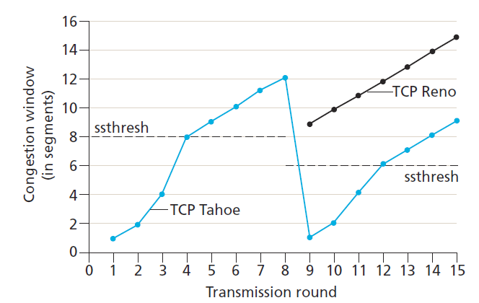
Initially, ssthresh=8 MSS
First 4 rounds, same for Tahoe and Reno
Lost detected at round 8 (3 dup Ack)
Set ssthresh=6 MSS (both Tahoe and Reno)
Tahoe: cwnd drop to 1 MSS
Reno: cwnd drop to 6 +3=9 MSS

