Slide 1




Building Economic Models and Measures of Search ACM SIGIR BEMMS 2019 Session 1 – Economics and Ranking Principles
by
Leif Azzopardi, Alistair Moffat, Paul Thomas and Guido Zuccon

Slide 2
Outline
Cost Benefit Analysis
Decision Theory & Expected Value
Ranking Principles
Probability Ranking Principle
Interactive Probability Ranking Principle
Generalized Interactive Probability Ranking Principle aka Card Model

Slide 3
COST BENEFIT ANALYSIS
A super efficient overview

Slide 4
Cost Benefit Analysis (CBA)
Aims to estimate and total up the value of the benefits and the costs associated with a particular decision/choice.
Provides the basis for the comparison of decision/choices.
Assumption: benefits and costs must be formulated in the same unit of measurement
However, we can perform a cost-effectiveness analysis if costs and benefits are in different measurements.

Slide 5
Applying CBA in CHI
List the alternative decisions/choices
List the stakeholders
For simplicity we will consider only one stakeholder e.g. the user
But we could consider other users/collaborators, advertisers, vendors, etc. too.
Select a measurement and measure all the cost/benefit elements
Apply discount rate (if appropriate)
Calculate the net present value.

Slide 6
Speak or Type
Alternatives:
(a) ask Siri,
(b) type in the question yourself
Unit of Measurement
Time Spent
Quality of Response (given the input)
Discount Rate:
Users prefer to receive a good response sooner (so each additional interaction means the benefit is discounted, by say 1/#interactions)

Slide 7
Type
Given the sequence of interactions:
We assume that the user receives some payoff for each document (payoff = benefit - cost)
Let’s say: Payoff(type) = -20, Payoff(Ans) =100
Discount the value
Compute NPV
(-20*1 +100*0.5) = 30
Type | Ans
-20 | 100
1 | 0.5
Notes:
NPV: net present value

Slide 8
Speak
Given the sequence of interactions when speaking:
We assume that the user receives some payoff for each document (payoff = benefit - cost)
Let’s say: Payoff(Ask) = -10, Payoff(Error)=-5, Payout(Ans)=100
Discount the value
Compute NPV
(-10*1 -5*0.5 -10*.33 + 100*.25) = 9.17
But if there is no error then the the NPV(speak) = 40
Ask | Error | Ask | Ans
-10 | -5 | -10 | 100
1 | 0.5 | 0.33 | 0.25

Slide 9
Cost Benefit Analysis
Compute the NPV of different methods to determine which alternative is preferable
But, there is no notion of uncertainty
What if there is some probability of an error
How good does the system need to be, before you would always speak to the agent?
We need to consider the uncertainty associated with payoffs.

Slide 10
DECISION THEORY
A super quick introduction

Slide 11
Decision Theory
Extending the idea of CBA
Decision Theory considers decision problems
where the goal is to select the best available/known alternative.
Often under uncertainty
Example: You have been given the choice between using Google or Yahoo!
Which one would you use to search the web?
Which one would you use to read the news?
Which one would you use for a joke?

Slide 12
Decision Theory
There are four basic elements:
Acts: the choices/decisions considered by the user
Events: occurrences taking place outside the control of the user
Outcomes: the result of the occurrence of acts and events
Usually have some probability of occurring
i.e. Uncertainty in the outcome
Payoff: the value the user places on the occurrences
Payoff = Benefit - Cost
It is often useful to represent the decision problem as a tree.

Slide 13
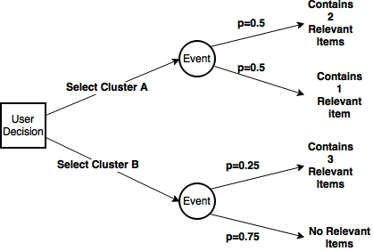

Browsing Clusters Example
Actions: User can select cluster A or B
Events: System responds with documents
Outcomes: With some probability different amounts of relevant items are returned
Payoffs: The benefit minus the cost for each outcome.

Slide 14
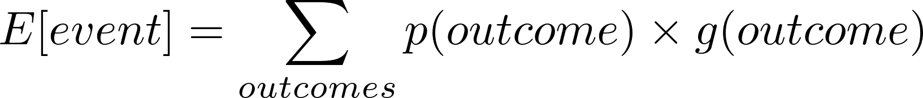
Expected Value
Expected Value (or often expected utility) of an Event is:
Where p is the probability and g is the gain.
Decisions:
Select Cluster A: Expected Payoff is: 0.5 * 2 + 0.5 * 1 =1.5
Select Cluster B: Expected Payoff is: 0.25 * 3 + 0.0 = 0.75
Since the expected payoff of A is greater than B, then the user should select A.
Notes:
note: payoff is minus cost: but we assume cost is constant, regardless of action/decision, so we ignore it

Slide 15
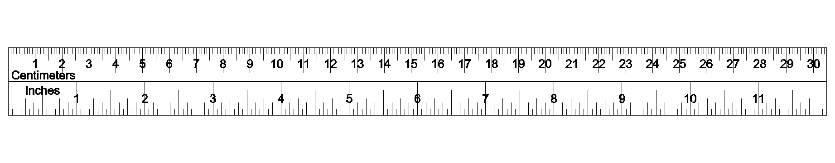
A Note on Costs and Benefits in IR
Lots of definitions/use of the terms: costs and benefits
Benefit: happiness, enjoyment, satisfaction, gain, utility, expected utility, usefulness
Cost: mental/cognitive, physical, financial, temporal
But often time is used as a proxy for cost
Generally the costs and benefits are considered to be common but abstracted unit
But not always.
Estimating costs and benefits is a major challenge.

Slide 16

Probability Ranking Principle

Slide 17
In Probability We Trust
Provides a theoretical justification for why documents should be ranked by the probability of relevance
The PRP ensures that retrieval is optimum and that retrieval costs are minimized.
Robertson, (1977)

Slide 18
Justification of the PRP
Expected cost of retrieving a document d_{i} is:
Where:
C_{r} : cost of retrieving a relevant document
C_{n} : cost of retrieving a non-relevant document
C_{r} < C_{n}
Robertson (1977)

Slide 19
Justification of the PRP
Then the Total Cost for Retrieval is:
Assuming the user examines k documents, and k is not known in advance
Robertson (1977)

Slide 20
Minimizing Expected Costs
The ranking function should minimize the total cost of retrieval by ordering documents by ascending expected cost.
Robertson (1977)

Slide 21
Minimizing Expected Costs
This holds true if:
Can be generalized to levels of relevance.
Robertson (1977)
Notes:
Recall that C_r < C_n and thus (C_r – C_n)<0

Slide 22
Insights from the PRP
Rank documents according to their decreasing probability of relevance.
Probabilistic retrieval is “guaranteed” to provide an optimal ranking
Given the information the decision is based upon!
The PRP is central to the development of many retrieval models.

Slide 23
Beyond the PRP
Similar justifications for optimality are put forward in:
Quantum Probability Ranking Principle
Accounts for lack of dependence
Interactive Probability Ranking Principle
Accounts for lack of interaction
The PRP assumes costs are fixed - new measures are starting to include document specific costs:
Time Biased Gain
U-Measure
Zuccon & Azzopardi (2010)
Fuhr (2008)
Smucker & Clarke (2012)
Sakai (2013)

Slide 24

Interactive Probability Ranking Principle

Slide 25
Problematic Assumptions
The Probability Ranking Principle assumes:
A fixed information need, fixed costs
Independence between documents
Limited/linear interaction
The Interactive PRP aims to:
Consider the complete interaction process
Allow for different costs and benefits of different activities
Allow for changes in the information need

Slide 26
iPRP Assumptions
Focuses on the choice level of interaction
Not usability
The system presents a list of choices to the user
i.e. set of results and interaction possibilities
Users evaluate choices in a linear order
Only positive decisions/choices are of benefit to a user
i.e. no benefit from non-relevant documents
Benefits and costs are in the same currency (usually time)

Slide 27
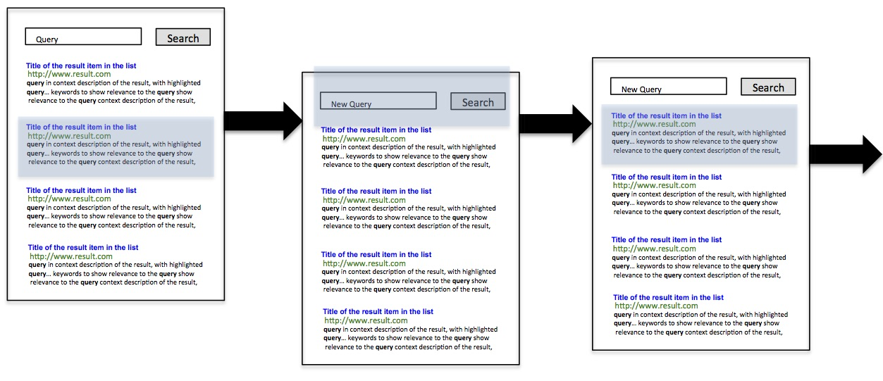
Intuition
A user moves from situation to situation
Discrete model of interaction
In each situation s the user is presented with a list of choices (e.g. a list of ranked documents)

Slide 28
Intuition
The user decides whether to examine a document (or not) in a sequential fashion
The first positive move puts the user in a new situation s’
When a negative move is made, the user backtracks (and incurs a cost)

Slide 29
Intuition
A user moves from situation to situation
Discrete model of interaction
In each situation s the user is presented with a list of choices (i.e. a list of ranked documents)
The user decides whether to examine a document or not in a sequential fashion
The first positive move puts the user in a new situation s’
When a negative move is made, the user backtracks (and incurs a cost)

Slide 30
Situations, Choices, Interactions
A situation is a number of choices
Choices could be:
Examine document i
Add expansion terms to the query
Take a query suggestion
View cluster
Etc.
After a user performs an interaction they move to a new situation
Notes:
Add expansion terms to the query
Look at the first results list entry
Immediately click on the first document
Look at the summary of top ranking documents

Slide 31
Expected Benefit of a Choice
Cost and Probabilities of Interactions:
pj : probability that the user will accept choice cj
qj : probability that the decision was positive
ej < 0 : effort for evaluating the choice cj
bj > 0 : benefit from a positive decision
gj <= 0 : cost of correcting for a negative decision
Expected Benefit of choice cj

Slide 32
Expect Benefit of List of Choices
Let:
The expected value of a list of choices:
(
)

Slide 33
Ranking of Choices
By considering two subsequent choices cj and cj+1, it is possible to determine the condition for the ranking to be optimal:
The ranking criteria: order cj according to:
Note that this is different from ranking according to expected benefit of each individual choice
In fact, we are interested in the expected benefit of the list of choices

Slide 34
Relationship b/w PRP and iPRP
The PRP assumes that:
Effort to examine documents is equal
i.e.
Benefit from each relevant document is equal
i.e.
Plugging this into the iPRP ranking criteria:

Slide 35
Ranking of Choices
Compute the Expected Value (EV) and Ranking Criteria (RC) for each choice:
Order w PRP | Order w iPRP | Pj | Aj | Ej | EV(cj) | RC(cj)
 |  | 0.5 | 10 | -1
 |  | 0.2 | 20 | -3
 |  | 0.2 | 20 | -2
 |  | 0.25 | 16 | -1

Slide 36
Ranking of Choices
Order w PRP | Order w iPRP | Pj | Aj | Ej | EV(cj) | RC(cj)
1 | 3 | 0.5 | 10 | -1 | 4 | 8
=3 | 4 | 0.2 | 20 | -3 | 1 | 5
=3 | 2 | 0.2 | 20 | -2 | 2 | 10
2 | 1 | 0.25 | 16 | -1 | 3 | 12
Thus, a risker option can be ranked before a less risker option
(This is similar to what the Optimal Search Theory will suggest)

Slide 37
Insights from the iPRP
Extends the PRP to interactive settings
Requires parameters to be estimated
Can be used to rank documents and other options
Rank choice by average benefit, cost and probability of relevance.
There is a trade-off between effort and benefit.

Slide 38
Challenges of using iPRP
Difficult to operationalize because of the many parameters
How to estimate efforts and benefits of choices?
iPRP models users as stochastic agents: probability of accepting choices
What models to use to determine these probabilities?
How do we apply it to inform how the user behaves in a particular situation?

Slide 39
Using the iprp

Slide 40
Applied to Topic Retrieval
Let’s consider the case when a user is searching for information about a topic
Where they issue a number of queries
And assess a number of documents per query
To simplify the application of the iPRP, we consider situations where the user has two choices:
Assess the next document (with probability p_{d})
Issue a new query and visit the first document (1-p_{d})

Slide 41
Effort of Choice
The effort of querying e_{q} is the time to query (t_{q}) plus the time to assess the first document,
e_{q} = -(t_{q} + t_{d})
The effort of assessing the next document e_{d} is :
e_{d} = -t_{d}
where t_{d} is the time to assess a document.

Slide 42
Approximating the Benefit
Let’s say that the gain at rank r is determined by:
g@r = k.r^-beta
Where essentially at each rank the user receives less and less gain
Note this is similar to DCG
The gain from issuing a query and visiting the first document then is equal to: g@1
g@1 = k

Slide 43
Approximating the Benefit
Since iPRP requires the benefit and effort to be in the same units,
We need to convert the gain to time.
i.e. how much time we save from the gain received
t = t_{q} + i.t_{d}
i = (t- t_{q})/t_{d}
Given g@i = k. ((t- t_{q})/t_{d} ) ^-beta
Then re-arranging for t:
t = ( [g@i/k]^beta).t_{d} + t_{q}

Slide 44
Benefit
By substituting in the g@1 and the g@i into the previous equation, we can arrive at the amount of time saved (i.e. benefit) for each choice.
Benefit of querying:
a_{q} = t_{q} + t_{d}
Benefit of assessing i:
a_{d} = t_{q} + t_{d}.i^(-beta^2)
g@i = k. ((t- t_{q})/t_{d} ) ^-beta

Slide 45
Decision Criteria
If the equality holds:
a_{q} + e_{q}/p_{q} > a_{d} + e_{d}/p_{d}
Then the principle predicts that the user will query next, if it doesn’t they will assess the next document
Substituting in an re-arranging terms we arrive at:
((p_{d}-1)(f-(p_{d}+1)/p_{d})> t_{q}/t_{d}
Where f = i^(-beta^2)

Slide 46
Probability of Accepting a Choice (pd)
Rho1 describes a more patient user, who is more willing to examine documents at lower depth.
Probability of accepting a choice
Rank Position

Slide 47
Inequality Plot
⬅ Assess Query ➔
Query when LHS is greater than RHS (tq/td).
A decrease in rho suggests users will query sooner.
LHS vs RHS
Rank Position
((p_{d}-1)(f-(p_{d}+1)/p_{d})> t_{q}/t_{d}

Slide 48
Using the iPRP
By manipulating the different variables it is possible to see how the behavior will change.
It is possible to frame other scenarios to evaluate what options a user “should” take according to the iPRP decisions criteria.
Requires estimates of effort and benefit in the same units along with the probability of taking a choice
This probability may be dependent on the user-system interactions and the position/placement of the choice!

Slide 49

Card Model

Slide 50
Overview
Search process as a collaborative game
Player 1: the user
Player 2: the system
Goal of the game: maximise the expected gain for the user while minimising the effort of the user
Zhang&Zhai (2015)

Slide 51
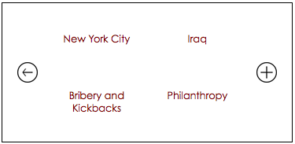
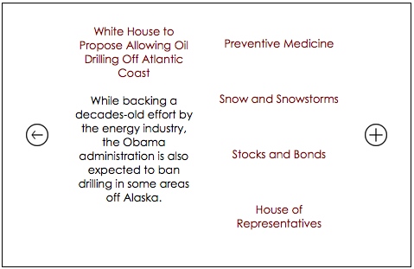
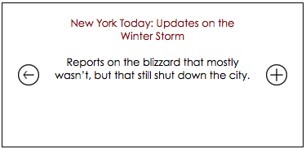
A principle for interactions
The card model aims to go beyond ranking documents
It considers how interfaces should be designed wrt user efforts, gains, costs, etc
click
VS.

Slide 52
The Search Process
User
System
action
enters a query
identify optimal interface
retrieves results and
presents snippets
action
clicks on a result
identify optimal interface
shows related results

Slide 53
Laps
User
System
action
enters a query
Produce optimal interface
lap t=1
retrieves results and
presents snippets
action
clicks on a result
lap t=2
Produce optimal interface
shows related results
Lap [t]: interaction unit between user and system in which user issues action and system reacts by producing optimised interface

Slide 54
Cards
User
System
action
card q¹
enters a query
Produce optimal interface
lap t=1
retrieves results and
presents snippets
action
clicks on a result
card q²
lap t=2
Produce optimal interface
shows related results
Card [q^{t}]: interface instance generated by the system in reaction to the user action in the lap – it is a generalisation for
result page
screen, …

Slide 55
Context
User
System
action
enters a query
card q¹
lap t=1
context c¹
action
context c²
clicks on a result
lap t=2
card q²
Context [c^{t}]: information the system has collected till the lap about the user to estimate next user’s choice. Includes prior info about user, interaction in prev laps

Slide 56
Constrains
User
System
f¹_{c}(q¹) <= 0
action
enters a query
card q¹
lap t=1
context c¹
action
context c²
clicks on a result
lap t=2
card q²
f²_{c}(q²) <= 0
Constrain [f^{t}_{c}(q^{t})]: set of restrictions a card needs to satisfy

Slide 57
Actions
User
System
action a¹
f¹_{c}(q¹) <= 0
action
enters a query
card q¹
lap t=1
action a²
context c¹
action
context c²
clicks on a result
lap t=2
card q²
f²_{c}(q²) <= 0
Action [a^{t+1} € A(q^{t})]: move the user chooses to take next from a set of possible moves which may depend on the current card

Slide 58
The Search Process
User
System
a¹
lap t=1
q¹, c¹, f¹_{c}(q¹)
a²
lap t=2
q², c², f²_{c}(q²)

Slide 59
Action Model
User
System
a¹
lap t=1
q¹, c¹, f¹_{c}(q¹)
a²
p(a² | c¹,q¹)
lap t=2
q², c², f²_{c}(q²)
p(a³ | c²,q²)
Action Model [p(a^{t+1} | c^{t},q^{t})]: the system predicts the probabilities over the next actions available to the user

Slide 60
Rewards
User
System
a¹
lap t=1
q¹, c¹, f¹_{c}(q¹)
a²
p(a² | c¹,q¹)
r(a² | c¹,q¹)
lap t=2
q², c², f²_{c}(q²)
p(a³ | c²,q²)
r(a³ | c²,q²)
Reward [r(a^{t+1} | c^{t},q^{t})]: the system estimates benefit of the next actions available to the user

Slide 61
Costs
User
System
a¹
s(a² | c¹,q¹)
lap t=1
q¹, c¹, f¹_{c}(q¹)
a²
p(a² | c¹,q¹)
r(a² | c¹,q¹)
lap t=2
q², c², f²_{c}(q²)
p(a³ | c²,q²)
r(a³ | c²,q²)
s(a³ | c²,q²)
Cost [s(a^{t+1} | c^{t},q^{t})]: the system estimates expected effort required to user to pursue the next action

Slide 62
Surplus
User
System
a¹
s(a² | c¹,q¹)
lap t=1
q¹, c¹, f¹_{c}(q¹)
a²
p(a² | c¹,q¹)
r(a² | c¹,q¹)
u(a² | c¹,q¹)
lap t=2
q², c², f²_{c}(q²)
p(a³ | c²,q²)
r(a³ | c²,q²)
s(a³ | c²,q²)
Surplus [u(a^{t+1} | c^{t},q^{t})]: difference b/w reward and cost
Surplus is the same as payoff
u(a² | c¹,q¹) = r(a² | c¹,q¹) - s(a² | c¹,q¹)

Slide 63
Interface Card Optimization
In each lap t, system should play card q^{t} that maximises expected surplus u^{t} (given current context & constraints)
max_{qt} E(u^{t} | c^{t},q^{t})
= Σ p(a^{t+1} | c^{t},q^{t}) u(a^{t+1} | c^{t},q^{t})
a^{t+1} € A(q^{t})
subject to f_{c}^{t}(q^{t}) <= 0

Slide 64
Card Model ~= iPRP
Card model is a generalisation of iPRP
To get to iPRP:
Plain card: each card is a choice e^{t} in a ranked list
Binary actions: only two actions allowed, accept e^{t} or reject e^{t}
Set rewards for rejecting and costs for accept and reject wrt e^{t}
Rank according to E(u^{t}|e^{t}), which becomes
s(e^{t})
r(e^{t}) - _____
p(e^{t})

Slide 65
Challenges of using Card Model
Difficult to operationalize because of the many parameters
Similar challenges as iPRP:
How to estimate rewards and costs of actions?
How to infer probability of actions? E.g. need log data
Alternatively, what models to use to determine these probabilities?
No extensive experimentation/validation

Slide 66
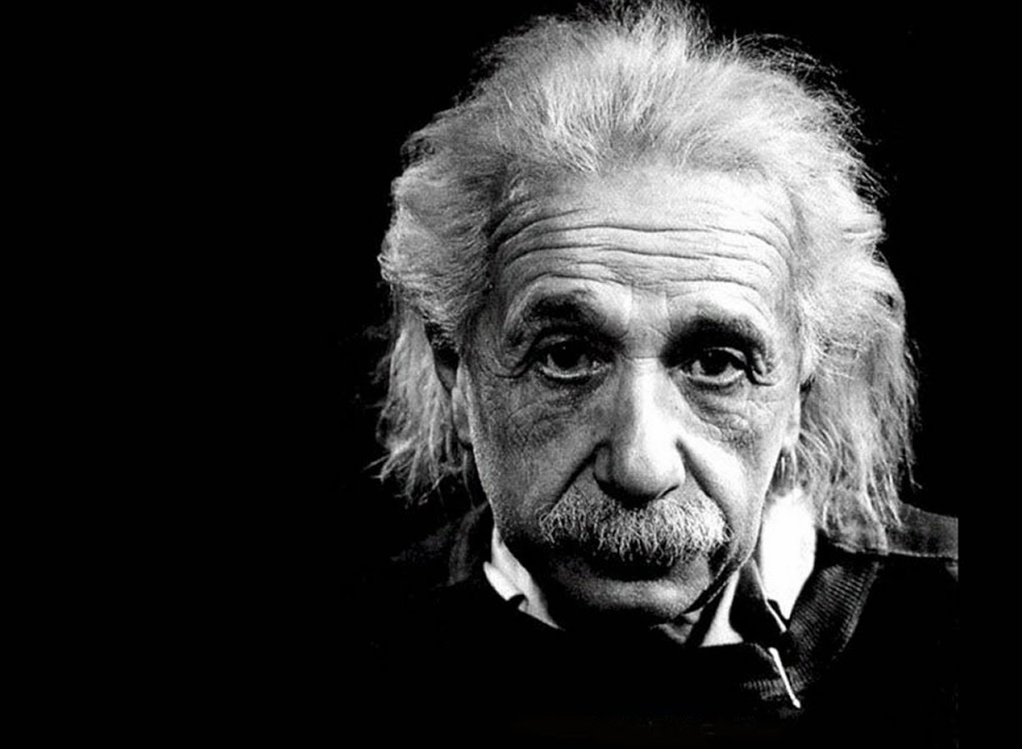
In theory, theory and practice are the same. In practice, they are not.
Albert Einstein

Slide 67
End of Session One

