Slide 1




Building Economic Models and Measures of Search ACM SIGIR BEMMS 2019 Session 2 – Economics of Search
by
Leif Azzopardi, Alistair Moffat, Paul Thomas and Guido Zuccon

Slide 2


Economics in Information Retrieval
Models of
User Behavior
Predictions of
System Performance
Estimation of
Relevance /
Ranking
Interaction
Observed
User Behaviors
System Output/Ranking
Predictions of
User Behavior
Model of
System Performance
Notes:
Session Three will be focusing on predicting user behaviour given model of system performance

Slide 3
Outline
Ecological Models of Behaviour
Economics of Carrying a Load
Economics of Prey Choice
Information Foraging Theory
Scent, Diet and Patch
Charnov’s Maximal Marginal Theorem
Economics of Foraging
Economics and Production Theory
An Economic Model of Querying and Assessing

Slide 4
Behavioral Ecology

Slide 5
Economic Decisions in Ecology
Foraging theory aims to understand the rules that shape the foraging behavior of animals.
Economic analysis of the costs and benefits is used to understand their decisions
- Load size, crop load, worm size, food choice, etc.
A key assumption is that animals aim to:
maximize energy intake, efficiency, and/or
Minimize risk of starvation, danger
as this currency is likely to increase their chances of survival and reproduction.

Slide 6
Key Constraints
Temporal Constraints
The time it takes to find and process food.
Energy Constraints
The metabolic cost of each foraging activity per unit of time e.g. carrying loads, guarding, etc.
Cognitive Constraints
The amount that can be remembered and learnt about the environment.
Processing Constraints
The size of prey that can be processed.

Slide 7





Decisions, Currencies & Constraints
Animal | Decision | Currency | Some Constraints
Starling | Load Size | Maximize net rate of gain | Travel time, loading curve, energetic costs
Bee | Crop Load | Maximize efficiency | Travel time, sucking time, energetic costs
Woodpecker | Patch Time | Maximize net rate of gain | Travel time, recognition time
Stickleback | Where to Feed | Minimize danger and starvation | Vigilance and foraging incompatible
Moose | Food choice | Maximize daily energy intake | Sodium need, digestion limit, energy requirement

Slide 8


Economics of Carrying a Load
A bird needs to forage food for her chicks
So how many worms should she collect per load?
More worms collected over the day, happier chicks!
When foraging each worm gets hard to catch.
Bird’s Nest
with younglings
# Worms
Captured
Rate of Delivery = Load /
(Travel Time +Foraging Time)
Travel
Time
Wormy Patch
Travel Time
Foraging Time
Foraging Time

Slide 9
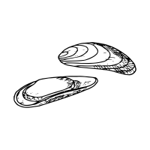

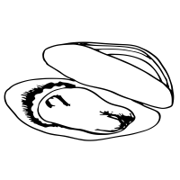
Economics of Prey Choice
A shore crab needs to decide what prey to eat
Large mussels take a long time to open, small crabs don’t have much meat.
So, should the crab go for only the most profitable?
Profitability
(energy/time)
Per Cent of Diet
Size of Mussel
Size of Mussel

Slide 10
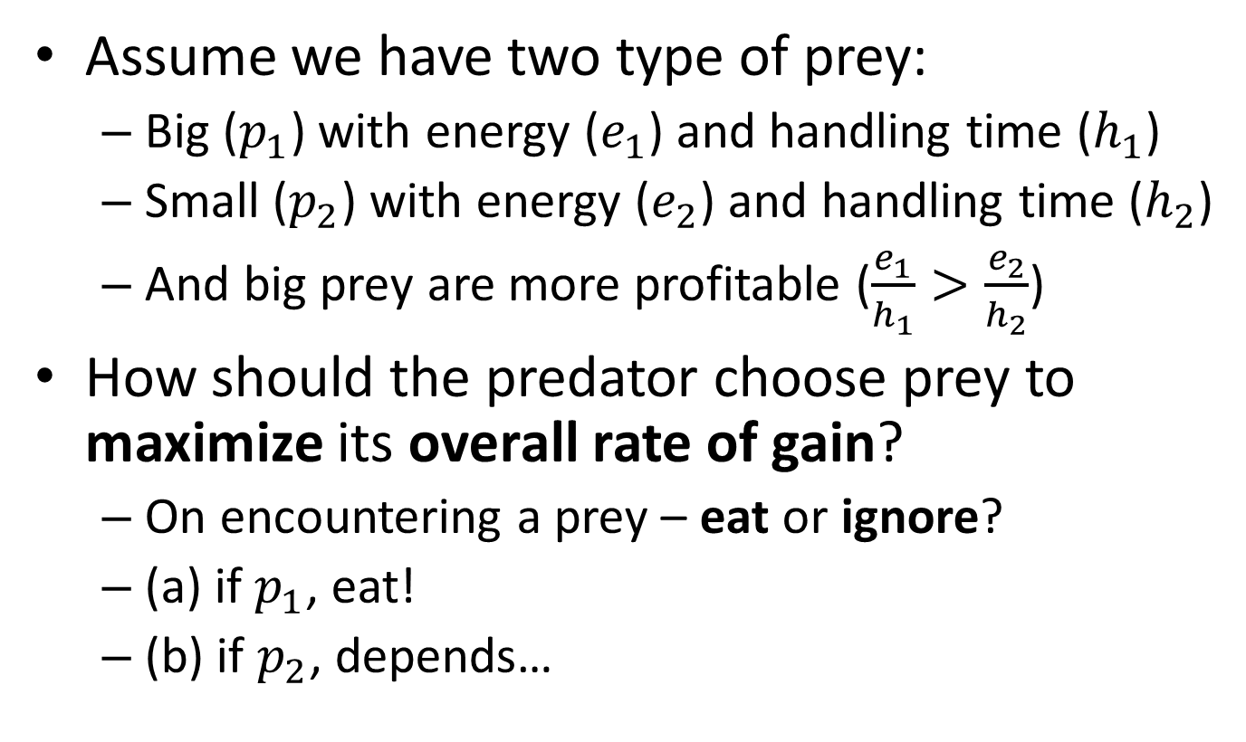
A Model of Choice b/w Prey
Assume we have two type of prey:
Big ($p_{1}$) with energy ($e_{1}$) and handling time ($h_{1}$)
Small ($p_{2}$) with energy ($e_{2}$) and handling time ($h_{2}$)
And big prey are more profitable ($\frac{e_{1}}{h_{1}}>\frac{e_{2}}{h_{2}}$)
How should the predator choose prey to maximize its overall rate of gain?
On encountering a prey – eat or ignore?
(a) if $p_{1}$, eat!
(b) if $p_{2}$, depends…

Slide 11
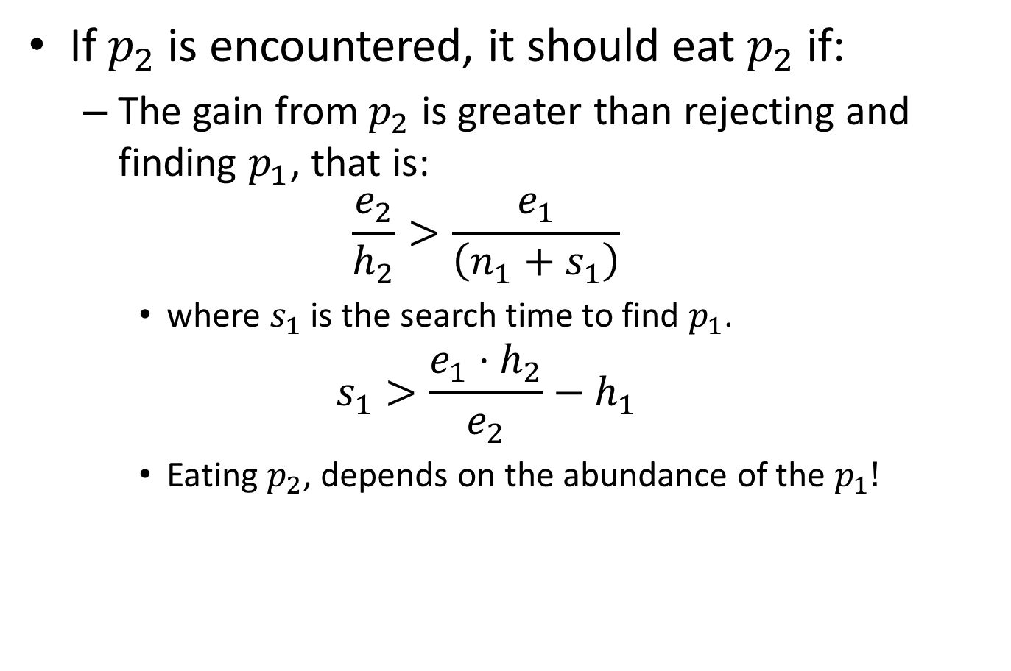
A Model of Choice b/w Prey
If $p_{2}$ is encountered, it should eat $p_{2}$ if:
The gain from $p_{2}$ is greater than rejecting and finding $p_{1}$, that is:
$$\frac{e_{2}}{h_{2}}>\frac{e_{1}}{\left(n_{1}+s_{1}\right)}$$
where $s_{1}$ is the search time to find $p_{1}$.
$$s_{1}>\frac{e_{1}⋅h_{2}}{e_{2}}−h_{1}$$
Eating $p_{2}$, depends on the abundance of the $p_{1}!$
Search Time (s1)

Slide 12
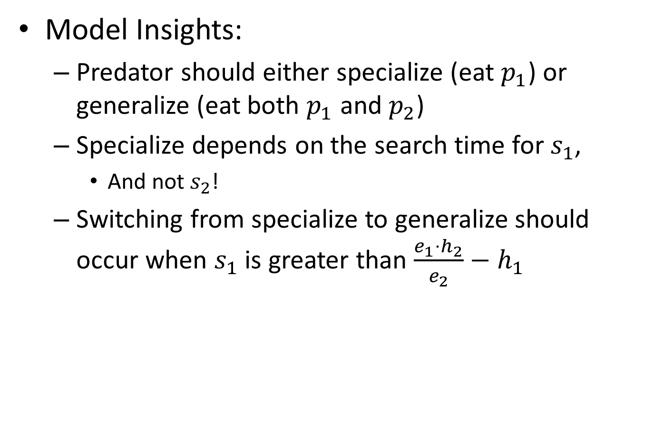

A Model of Choice b/w Prey
Model Insights:
Predator should either specialize (eat $p_{1}$) or generalize (eat both $p_{1}$ and $p_{2}$)
Specialize depends on the search time for $s_{1}$,
And not $s_{2}$!
Switching from specialize to generalize should occur when $s_{1}$ is greater than $\frac{e_{1}⋅h_{2}}{e_{2}}−h_{1}$
Search Time ($s_{1}$)
Notes:
This threshold occurs suddenly (but in reality this is not the case)

Slide 13
How might we apply this model to relevant and highly relevant items?

Slide 14
What might happen if there is very juicy items?

Slide 15

INFORMATION FORAGING THEORY

Slide 16



Bates’ Berry Picking Models
People move from patch to patch picking berries.
People move to the next patch when there are better patches elsewhere.
People weight up the costs and benefits.
Bates (1989)
Notes:
In the berry picker model of information seeking, the searcher goes from patch to patch, choosing the best documents.
While this is a very apt metaphor, it doesn’t provide any indication as to how behavior would change when circumstances change.

Slide 17
Information Foraging Theory
People will modify their strategies or interface, in order to maximize their rate of gaining valuable information.
People will learn over time through their interactions with the environment.
Resnikoff (1989)
Russell et al (1993)
Pirolli & Card (1999)
Notes:
The basic hypothesis of Information Foraging Theory is that, when feasible, natural information systems evolve towards stable states that maximize gains of valuable information per unit cost.
To provide adaptive strategies for information foraging
in a complex information environment, Pirolli and Card
(1995) [12] proposed IFT, which aims \to explain and predict
how people will best shape themselves for their information
environments and how information environments can best be
shaped for people." (P.3) [11]. The methodology of IFT is
adapted from the framework of optimal foraging theory in
biology [16]. Pirolli and Card [13] adapted two conventional
models from optimal foraging theory [16], originally applied
to the food hunting environment, to the information seek-
ing environment. Further, they proposed three information
models for IFT: information patch model, information diet
model and information scent model.

Slide 18
Information Foraging Theory
There is an expectation that information systems & interfaces will also evolve so as to maximize the gain of valuable information per unit cost.
Evaluation: One strategy, system or interface is superior to another if it yields more valuable information per unit cost.
Resnikoff (1989)
Russell et al (1993)
Pirolli & Card (1999)
Notes:
The basic hypothesis of Information Foraging Theory is that, when feasible, natural information systems evolve towards stable states that maximize gains of valuable information per unit cost.
To provide adaptive strategies for information foraging
in a complex information environment, Pirolli and Card
(1995) [12] proposed IFT, which aims \to explain and predict
how people will best shape themselves for their information
environments and how information environments can best be
shaped for people." (P.3) [11]. The methodology of IFT is
adapted from the framework of optimal foraging theory in
biology [16]. Pirolli and Card [13] adapted two conventional
models from optimal foraging theory [16], originally applied
to the food hunting environment, to the information seek-
ing environment. Further, they proposed three information
models for IFT: information patch model, information diet
model and information scent model.

Slide 19

Information Scent Model
Describe how foragers follow information cues to find patches with relevant information.
If there is a strong scent foragers are able to more directly to a patch, otherwise moves are more random.
Aims to explain how people identify the value of information based on cues.
Chi et al (2000)
Chi et al(2001)
Notes:
The information scent model describes how foragers follow the information cue to find a relevant information patch.
If the scent is strong, the forager will be able to move fairly directly. If there is no scent or it is very weak the forager will not be able to directly hone in on their target and move more randomly in order to find their target.
Information scent model is a psychological theory, which
explains how people identify the value of information based
on cues, such as result clusters shown on the interface in
order to gain an overall sense of the information space. If
the scent is strong, the forager will be able to move fairly
directly. If there is no scent, the forager will perform a
random walk [13].
The information scent model has been applied to inves-
tigate e®ective information scent cues in aiding navigation.
For instance, Chi et al. (2001) proposed two computational
methods for modeling users' information needs and actions
on the Web, based on the concept of information scent. The
¯rst situation was to predict users' sur¯ng pattern given
users' information needs. The second situation was to in-
fer users' information need given user's particular pattern of
sur¯ng. Their general ¯nding was that the two models will
help researchers better understand the usage of the Web,
help in designing of better web sites, and make users infor-
mation seeking activities more e±cient [2].
Information Foraging Theory (IFT) has been suggested
and applied to improve the design perspective for interactive
search and in turn to improve users search experience [4, 5,
9, 11, 19]. However, there is a lack of research on applying
IFT to understand user interaction from users' perspective.
Based on the experience from our task-based users study
and motivated by the ¯ndings in Mulholland et al. (2008)
[10], we consider that users can be classi¯ed into di®erent
user types based on their interaction pro¯les of search pref-
erences and search behaviors. We then decide to investigate
in depth how many di®erent user types we can get and what
search preferences and behaviors each user type has, based
on IFT and a qualitative analysis on the real user interaction
data for interactive search.

Slide 20

Information Diet Model
Describes how foragers decide which information to use/consume
What information sources should be used, or consumes?
If a forager is too generalized, then they will waste too much time on handling unprofitable information
If a forager is too specialized, then they may waste too much time searching for profitable information
Notes:
The information diet model describes how foragers decide which information to use.
And it relates to the type of diet one has.. A specialized diet or a generalized diet. Ie. Eats only specific things or will eat everything.
So if the user has a very specialize diet they will complete the task by focusing on consuming information with precise characteristcs.
While a user with a general diet will not be as fussy.
The question that the conventional diet model deals with
is: when a predator lives in an environment containing a
number of potential kinds of food sources, what kinds of
things should the predators prey on, and what kinds of
things should they ignore? One way to answer this question
is in terms of the diet concept: a generalized diet includes a
broad type of prey, but a specialized diet includes only a few
types. \If a predator is too specialized, it will do very narrow
searching. If the predator is too generalized, then it will pur-
sue too much unpro¯table prey (p.39) [11]." Thus, the diet
model in IFT can be explained in terms of the conventional
diet model: if I have a generalized diet, I will complete the
task with a wide range of relevant information with diverse
dimensions; if I have a specialized diet, I will complete the
task with only a few relevant information sources having
precise characteristics.

Slide 21
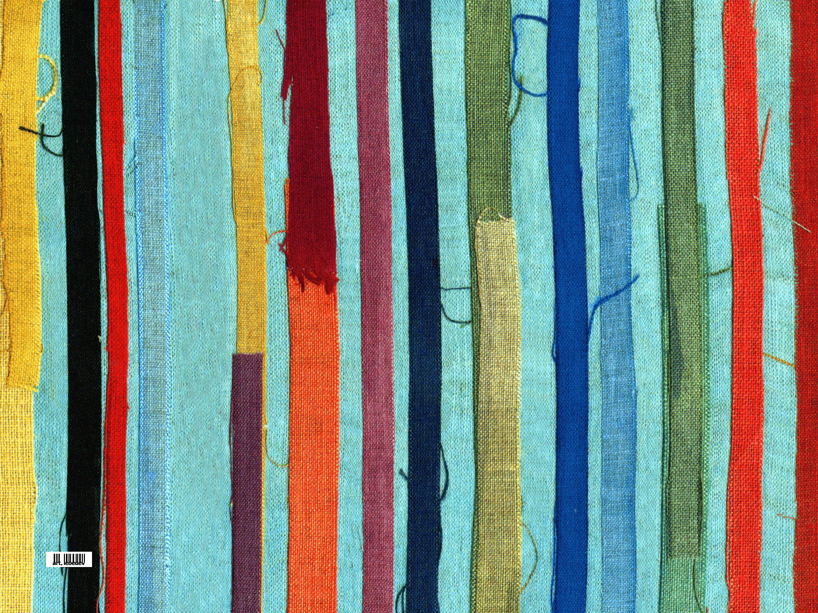
Information Patch Model
Describe how foragers move between and within information patches.
When information is distributed in a number of patches the forager needs to decide which patch to go to, and how long to stay in a patch
Predicts the amount of time a forager would/should spend within a patch
Assumes that the forager will go the patch that they expect to yield the highest profitability, first then next.
Notes:
The information patch model describes when foragers look for information within the same patch or between different patches.
This is important when information is distributed in a number of patches. For example there might be a number of information items in my office, some on my computer, some on my desk, some on my shelf, etc.
The aim of the information patch model is to predict the
amount of time a forager would spend within an information
patch before searching for new patches. This is important
when information is distributed in number of patches. For
instance, there are a variety of information items in my of-
¯ce, such as books, printed papers, notes, electronic ¯les in
my computer and an internet connection. Some of these
items are located within arms reach of my desk, and some
items are stored on the bookcase or in the ¯ling cabinet. The
relevant information to my current task can be found on the
desk and on the bookcase. If I identify the arms reachable
area as one patch and the bookcase as another patch, my
information foraging process will comprise within-patch and
between-patch activities. I will need to decide whether I
search longer on the desk or I should go to search the rel-
evant information on the bookcase. The decision will be
made depending on the prevalence and pro¯tability of the
patches. A higher prevalence of patches may contain many
relevant items to the task, and a more pro¯table patch may
contain the most relevant information to the task. All in all,
the decision on when to do within-patch and between-patch
activity will depend on the user's judgement as to which
approach will complete the task in the shortest time.

Slide 22
Example
Berry Picking

Slide 23
Bates’ Berry Picking Models
Between
Patch
Time
Within
Patch
Time
Assumes the forager has a good
estimate of the distribution of berries.

Slide 24

Applied to Search
Between
Patch
Time
Querying
Within
Patch Time
Assessing
Assumes the user has a good
estimate of the distribution of relevant documents.

Slide 25
Patch Example: Web Search
User submits a query to a search engine
Between patches
User examines the list of results
Within patch
Costs
Entering/Formulating Queries
Scanning the snippets
Interacting with the SERPs
Examining links
Given a gain function and fixed amount of time, how long should a forager stay in each patch?

Slide 26
Patch Example
As a forager spends more time in the patch they receive more gain.
But, the rate of gain will tend to zero as the patch becomes exhausted.
i.e. they will experience diminishing returns.
This is our model of system performance.
Between
Patch
Time
Within
Patch Time

Slide 27
Patch Example
To work out when gain/time is maximised, we need to draw a line from the origin to the tangent of the gain curve (the derivative).
The gain-time ratio is maximized at 4. So once the user has spent 2 minutes in the patch, then it is time to leave.
This assumes that each patch follows a similar distribution.

Slide 28
Ratio of Gain/Time over Time
Over time the ratio of Gain-Time increases to a maximum at 4, and then decreases.
i.e. stopping at any other point would not be rational.

Slide 29
The Patch Model Exercises
How will the user change their behavior:
When the time to get between patches:
Increases?
Decreases?
When the gain function:
Yields more early on?
Yields a constant amount, until a certain point
Yields a random amount?

Slide 30
Different Between Patch Times
Using the patch model, predict where the user will stop on each of these patches?
gain
gain
b/w
within
b/w
within
time
time
Stop Later
gain
Stop Sooner
b/w
within
time

Slide 31
Different Gain Curves
Using the patch model, predict where the user will stop on the different patch types?
gain
gain
b/w
within
b/w
within
time
time
gain
gain
b/w
within
b/w
within
time
time

Slide 32
But, what if patches vary from patch to patch?

Slide 33
Charnov’s Maximal Marginal Theorem

Slide 34
Patch Distribution
In the previous examples, we have assumed that all the patches are distributed in a similar fashion.
However, as forager move from patch to patch they are likely to experience different yields.
In which case, simply maximizing the rate of gain in each patch results in a local optima.

Slide 35
Charnov’s Marginal Value Theorem
The theorem was developed to deal with the analysis of time allocation for patch that yield diminishing returns.
The theorem predicts that a forager should remain in a patch so long as the slope of the gain function is greater than the average rate of gain in the environment.
Charnov (1976)

Slide 36
Applying Charnov’s Theorem
Average Patch Distribution
Current Patch Distribution
The slope of the dashed line is the Average Rate of Gain
Stopping is based on
Average Rate of Gain (blue)
Not the patch’s gain (red).
Gain
Gain
t*
Time
t*₁
t*₂
Time
1. Compute the average rate of gain.
2. In the current patch,
if the rate of gain is higher than average continue, else stop.

Slide 37
Different Between Patch Times
Average Patch Distribution
Using the patch model and Charnov’s Theorm,
predict where the user will stop on each of these patches with the given average rate of gain (left)?
And where would they stop if they didn’t stick to Charnov’s Theorem?
gain
Average Rate of Gain
time
gain
gain
time
time

Slide 38
Different Between Patch Times
Average Patch Distribution
Using the patch model and Charnov’s Theorm,
predict where the user will stop on each of these patches with the given average rate of gain (left)?
And where would they stop if they didn’t stick to Charnov’s Theorem?
gain
Average Rate of Gain
time
Patch 1
Patch 2
Patch 3
gain
gain
gain
time
time
time

Slide 39
Insights from IFT’s Patch Model
With Charnov’s Theorem
The average rate of gain determines when the forager stops.
Once the yield in the current patch falls below the average, the forager leaves.
If a patch has very poor yield
Foragers will move on (abandon)
Caveat: if the gain in patch does not follow diminishing returns the model can break.

Slide 40
Issues
Can people estimate the rate of gain?
Do they also want to max. the rate of gain?
Is rate of gain the currency that foragers use?
How quickly can they tell if a patch is poor/high quality?
How does scent play a role in time in patch?
Can people “lose” information during their search? i.e. could gain go down? Overload?
What is a patch in IR?

Slide 41

MICROECONOMICS
Some core concepts
Notes:
ECONOMICS is not about finance, stock markets, etc
It is about understanding how people behave.

Slide 42
Scarcity and Choice
People always want more! Unlimited Wants!
I want to see all the SIGIR papers
I want to see all the sights in Paris
But, people often don’t have enough resources
I don’t have enough time
There aren’t enough resources to go around to satisfy all our needs and desires.
This leads to trade-offs
Notes:
It affects individuals, nations, and the entire population
If you understand how people behave in the face of scarcity—and learn to think like an economist—economics can be an amazingly powerful tool. You can predict the behavior of individual economic agents, such as consumers or businesses—what economists call the micro level. You can predict the behavior of an economy (or economies) as a whole—what economists call the macro level. You can have a better understanding of the choices—and consequences—in your own life.

Slide 43
Scarcity and Choice
Economics is the study of how people
choose to use their scarce resources in an attempt to satisfy their unlimited wants.
And the trade-offs and choices that people make, given the fact of scarcity
I’ll go to the BEMMS tutorial but skip the keynote.
People make decisions in their own self-interest, weighing benefits and costs.
BEMMS will help me write an awesome paper, the keynote will just brag about themselves.

Slide 44




?
Today’s Trade-off
BEMMS
Sighting Seeing
Tomorrow’s Trade-off
Morning Coffee in Paris
Keynote

Slide 45
Opportunity Cost
Limited resources, means making a choice about how to use them
When you choose one option, you forego other options
Opportunity Cost
indicates what must be given up to get something else
And is the value of the next best alternative
Since people must choose, they inevitably face trade-off
Provides a means for reasoning about how the quality of a decision.
Notes:
A fundamental principle of economics is that every choice has an opportunity cost.
If you use duckduckgo , the opportunity cost is the extra effort required to find the most relevant items you would of got with google
If you build attack items, the opportunity cost is having weaker defenses.
The idea behind opportunity cost is that the cost of one item is the lost opportunity to do or consume something else; in short, opportunity cost is the value of the next best alternative.
Example.

Slide 46
Poverty of Attention
What information consumes is rather obvious: it consumes attention…
Hence a wealth of information creates a poverty of attention,
and a need to allocate that attention efficiently among the overabundance of information that might consume it.
Simon (1955)
Notes:
In 19th century England, Thomas Malthus argued
that a law of diminishing returns applied to the production
of food, and he predicted that famine was
the inevitable consequence for the human race.16
The problem was that while the amount of agricultural
land was fixed, the human population continued
to grow. Even with improved agriculture, beyond
some point the increased yield in food
production per unit of land becomes ever smaller.
Malthus’ logic was impeccable, but the human race
has survived through the 20th century and into the
21st. What Malthus did not foresee was that agricultural
technology would increase food yields at
the rate it did. Food production per capita in 1985
was 20 times greater than it was a century earlier
and outstripped the effects of a fixed supply in land
and a growing population.
Some will argue that Malthus misunderstood the capacity
for technology to improve food production
and that as long as we develop new technologies,
we will always be able to feed ourselves. Yet Malthus’
logic remains valid, and if the global population
continues to grow, a time will come (perhaps long
into the future) when the land cannot keep up with
what is demanded of it. We only evade the law if
we evade the rate-limiting step—that is, the supply
of land on the earth and our dependence on it.

Slide 47
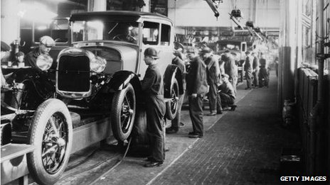
Production Theory
An economic model of production

Slide 48

Production Theory
a.k.a. Theory of Firms
Inputs
Output
The Firm
Capital
Labor
Widgets
Utilizes
Constrains
Technology
Varian (1987)
Notes:
A firm produces output (such as goods or services)
A firm requires inputs (such as capital and labor)
A firm utilizes some form of technology to then transform the inputs into outputs.
Theory of production, in economics, an effort to explain the principles by which a business firm decides how much of each commodity that it sells (its “outputs” or “products”) it will produce, and how much of each kind of labour, raw material, fixed capital good, etc., that it employs (its “inputs” or “factors of production”) it will use

Slide 49
Production Functions
Production Function
Capital
Labor
Notes:
Technological Constraints – the constraints imposed by the technology, i.e. its efficiency or ability to produce the output
Production Set – the set of all possible combinations of inputs that yield the desired output
Production Function – a set of points where the desired output is obtained for the minimum combination of inputs

Slide 50
Production Functions
Production Function
Quantity = F ( Capital, Labor )
Capital
Quantity 3
Quantity 2
Technology constrains
the production set
Quantity 1
Labor
Notes:
Technological Constraints – the constraints imposed by the technology, i.e. its efficiency or ability to produce the output
Production Set – the set of all possible combinations of inputs that yield the desired output
Production Function – a set of points where the desired output is obtained for the minimum combination of inputs

Slide 51
Cost Minimization
Given the production function
Quantity = F(C,L)
a corresponding cost function can be derived
Cost = H(C,L)
And the objective of the firm is to minimize the cost of producing quantity Q.
Which is analogous to:
for a given cost, maximize the quantity Q produced.

Slide 52
Production Theory
Applied to Search

Slide 53


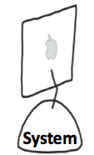



Interactive and Iterative Search
A simplified, abstracted, representation
Information Need
Documents Returned
User
System
Queries
Relevant
Information

Slide 54

Search as “Production”
Inputs
Output
The Firm
Queries
Assessments
Relevance
Gain
Utilizes
Constrains
Search Engine Technology
Notes:
Inputs: the number of queries, the length of queries, the number of documents assessed per query, etc.
Output: a number of relevant documents (or gain from the relevant information found).
Technology used: a Search engine

Slide 55
Search Production Function
The function represents how well a system could be used.
i.e. the min input required to achieve that level of gain
No. of Queries (Q)
Gain = 30
Gain = g(Q,A)
Gain = 20
Gain = 10
No. of Assessments per Query (A)
Notes:
Technological Constraints – the constraints imposed by the technology, i.e. its efficiency or ability to produce the output
Production Set – the set of all possible combinations of inputs that yield the desired output
Production Function – a set of points where the desired output is obtained for the minimum combination of inputs

Slide 56
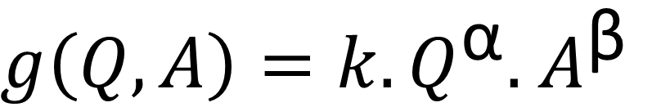
Gain Function for the Search Process
Let the gain the user receives through their interaction be:
$g\left(Q,A\right)=k.Q^{\text{α}}.$ $A^{\text{β}}$
Where:
Q is the number of queries, and
A is the number of documents examined per query.
α is the efficiency of querying
β is the efficiency of assessing
k is the efficiency of the technology/user to extract/ identify relevant information returned
Azzopardi (2014)
Notes:
Let’s think about what this formula is saying. The amount of gain or overall performance is a combination of A times Q.
Imagine if all these were relevant, and you got 1 point per relevant document, than you would essentially obtain A times Q gain.
However the inclusion of Alpha, generally means you get less as there is a trade-off between A and Q.

Slide 57

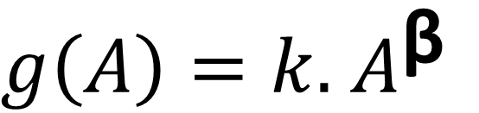

Gain Function – One Query
Consider the case when Q=1, then:
Controls how quickly diminishing returns kicks when assessing.
$g\left(A\right)=k.$ $A^{\text{β}}$
This is our model of system performance.
$$\text{β}\text{=0.5}$$
Gain
$$\text{β}\text{=0.}\text{2}\text{5}$$
Do these curves remind you of something?
Number of Assessments (A)

Slide 58
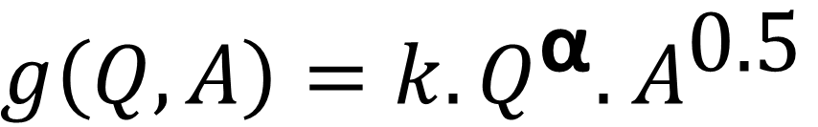

Gain Function – Over Queries
Consider how the gain over A changes with subsequent queries when $\text{β}\text{=0.5}$:
:
$g\left(Q,A\right)=k.Q^{\text{α}}.$ $A^{\text{0.5}}$
Controls how quickly diminishing returns kicks in over queries.
This is our model of system performance.
1st Query
2nd Query
Gain
3rd Query
Number of Assessments (A)

Slide 59
Gain Function
Lots of queries, few assessments per query.
Trade-off between querying and assessing.
Number of Queries (Q)
Few queries, many assessments per query.
Number of Assessments per Query(A)
Each point on the curve represents a combination of interactions that will yield the same gain.

Slide 60

Simple Cost Function
The total cost can be calculated by:
Where:
c_{q} is the cost of a query
c_{a} is the cost of a assessing a document
A.Q is the total number of documents assessed
Azzopardi (2011)

Slide 61
Gain vs Cost
Production Function
By setting the parameters and plotting the curves we can see that there is one combination of Q and A that minimizes the cost of searching.
Number of
Queries (Q)
Number of Assessments per Query(A)
Cost Function
Minimum Total Cost
Changes to the query and assessing costs, and other parameters will result in a change in the minimum total cost – and thus the combination of Q and A.
Total Cost
Number of Assessments per Query (A)

Slide 62
What does the model
tell us about search & interaction?
Notes:
Now that we have framed the search process as an economics problem, and we have an economic model that describes the output given the inputs and the technology, the big question is: WHAT CAN WE DO WITH IT?
So to explore the application of this theory to IIR we perform an economic analysis of search

Slide 63
Changing the Relative Query Cost
By varying the cost of querying, it is possible to simulate how people would adapt their behavior.
Cost Function
Cq = 60
As queries become more expensive, the model suggests that people will assess more per query, and thus query less.
Total Cost
Cq = 15
Number of Assessments per Query (A)
Notes:
Insert graph here from ECON-IIR paper.

Slide 64
A Hypothetical Experiment
What happens if
Querying
costs
go down?
More
queries
issued
Decrease in assessments per query
$$$$
Querying
costs
go up?
Decrease in
queries
issued
Increase in assessments
per query
Notes:
Now that we have a way to frame the interaction between a user and a system when searching, we can now hypothesise about the users behavior if variables or parameters in the model change. For example…

Slide 65
Refining the COST model
Adding detail to build a more useful (but more complex) model

Slide 66
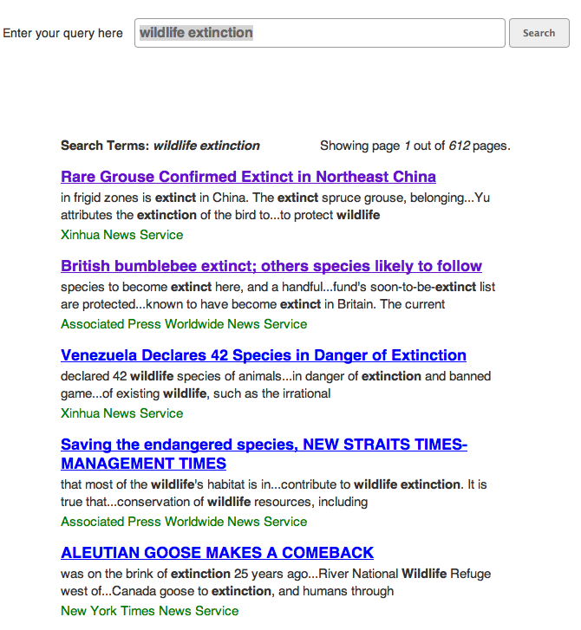
Modeling Other Costs
Cost to enter a query (c_{q})
Cost to load search page per query
Cost to examine each snippet
Cost to view a document
Cost of return back to search page
Cost to assess the document (c_{a})
Cost to view next page

Slide 67
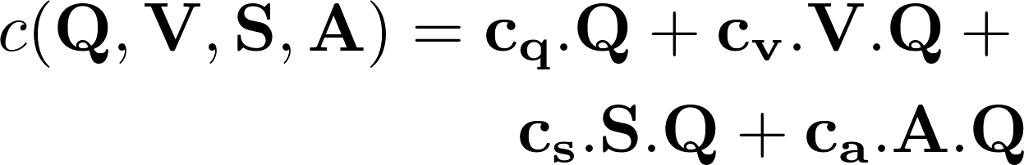
Modeling Other Costs
Let’s also include the:
cost of viewing pages (c_{v}) and
cost of examining snippets (c_{s})
in the cost model, such that:

Slide 68
Assumptions
Let’s assume that the number of page views is equal to some constant v
Typically this would be v=1
But could be the average number of pages examined i.e. v=1.1
Let’s further assume that A = S.p_{a}
Where p_{a} is the probability of assessing a document given a snippet.

Slide 69
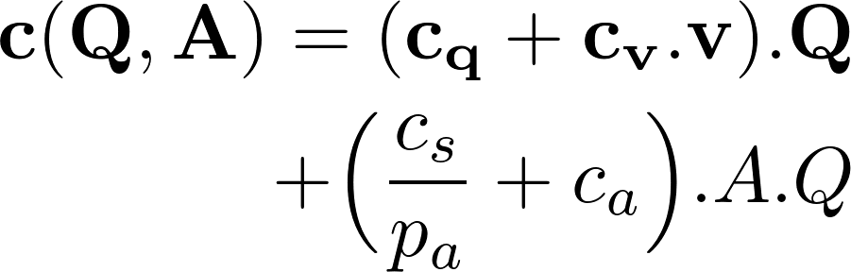
Reducing the Cost Function
Given these assumptions, the cost function can be simplified down to the following:

Slide 70
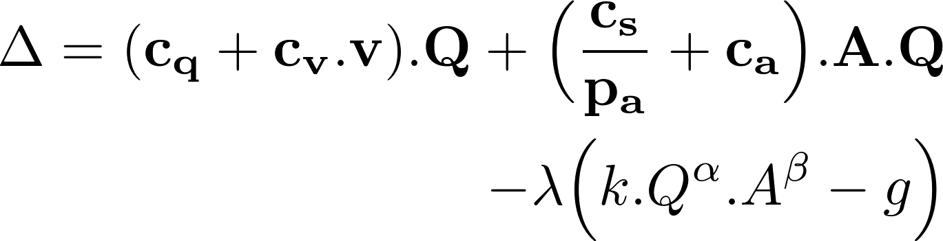
Optimization Problem
Given our model, we wish to minimize the cost c(Q,A), subject to the constraint that g(Q,A) = g
To do this we used a Lagrangian multiplier

Slide 71
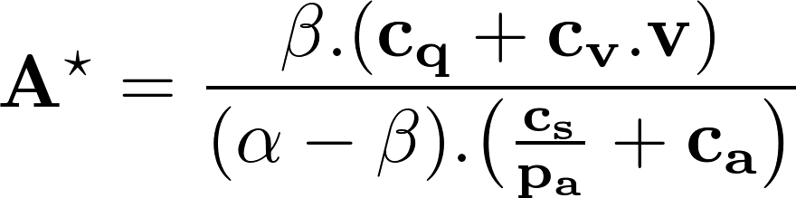
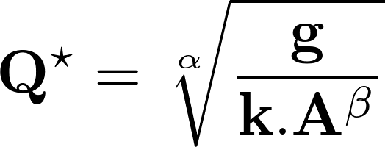
Optimal Interaction
The optimal number of assessments per query:
The optimal number of queries:

Slide 72
How does querying behavior change?
So we can say more precisely that:
If g increases then Q will go up
If k increases then Q will go down
If β increases, then Q will go down
If α increases, then Q will go up

Slide 73
Some Cost Hypotheses
Document Cost Hypothesis: as the cost of document increases, Q increase, A decreases.
Snippet Cost Hypothesis: as the cost of examining snippets increases, A decreases, while Q increases.

Slide 74
Performance Hypotheses
Beta-Performance Hypothesis:
as β increases, A will increase,
while Q will decrease.

Slide 75
Assessment Probability Hypothesis
Assessment Probability Hypothesis:
as the probability of assessment increases,
A increases, while Q decreases.

Slide 76
Limitations
These models assume that users are rational
They only model a few interactions:
What about other interactions?
What about other costs involved when searching?
They assume that the benefit the searcher recieves can be quantified by g() and that the cost can be quantified by c().
But, what about other types of costs (mental, financial, etc.)
And other types of gain (educational, entertaining, etc.)

Slide 77
What other gain might people experience?
and
How might we model them?

Slide 78
Summary
The models provides a useful explanation of search behaviours.
By framing tasks as economic optimization problems we can derive testable hypotheses!
These models provide the functional relationships between interaction, performance, and cost and how it affects behaviors.
Notes:
there is a measure of the output of the system, as well.
As opposed to measures it.
These models decouple the cost and benefit and parameterize them on the interactions. This means we can tease out how the interactions functionally related to each other.

Slide 79
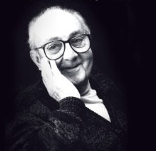
All models are wrong
but some are useful
George E.P. Box

Slide 80
End of Session TWO

Slide 81
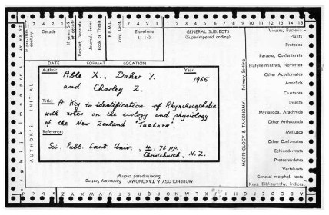
Example
User versus System

Slide 82
Time to spend searching?
Cooper wondered:
how much time a user should spend searching, and
how much time the system should spend searching?
(library) systems at the time were mechanized, also employed librarians, etc.
What is the most economic division of effort b/w user and system?

Slide 83
User-System Interaction
A user can choose from a range of information seeking strategies
The user’s time is an economic quantity
i.e. cost
The user pursues a particular strategy until the cost incurred exceeds the utility received,
At this point the user may choose another strategy
Or they stop
Cooper (1972)

Slide 84
The trade-off
A system needs to consider more than just matching, it also needs to consider:
The cost of the search to the system
The cost of the search to the user
The benefit to the user
The most economic division of effort between the user and the system to accomplish the user’s search goals and objectives
Cooper (1972)
Notes:
Cooper, 1972

Slide 85
Variables that influence cost
Time Spent
Time spent at the console
Time required to map request into query language
Time waiting for system response
System Design
The design of the console, its flexibility, responsiveness, features, etc
Results Quality
The quality of the results, their presentation, etc
Total Cost is a combination of these factors
What system (or method of accessing the relevant information) is determined by a cost-benefit function.

Slide 86
User-System Time Trade-off Model
Total Cost:
tu – time user spent in seconds
cu – cost per second to the user
ts – time system spent in seconds
cs – cost per second to the system
P – performance resulting from the user-system interaction.
where
Cooper (1972)
Notes:
Cooper makes some ruthless abstractions on what cost ends up being

Slide 87
User-System Time Trade-off Model
Let’s assume
However, the actual function is likely to be more complex, and/or a completely different shape.
Cooper (1972)

Slide 88
Optimal Division of Time
Given the model:
it is possible to determine optimal level of t_{s} and t_{u} that minimizes the total cost for a given level of performance.
i.e. This is the objective function!
Cooper (1972)

Slide 89
Optimal Division of Time
Given the model:
it is possible to determine optimal level of t_{s} and t_{u} that minimizes the total cost for a given level of performance.
Cooper (1972)

Slide 90
Insights from Model
Given:
If c_{s} goes up, then t_{u} goes up, while t_{s} goes down.
The user needs to invest more in issuing a good query
If P goes up, then t_{u} and t_{s} goes up.
i.e. to get more relevant documents you need to search more.
Cooper (1972)

