Slide 1




Building Economic Models and Measures of Search ACM SIGIR BEMMS 2019 Session 3 – Expected Utility & the C/W/L Framework
by
Leif Azzopardi, Alistair Moffat, Paul Thomas and Guido Zuccon

Slide 2
Outline
C/W/L Framework
examples: Precision, RBP,
Measurements using C/W/L
Expected Utility/Cost
Expected Total Utility/Cost
Expected Items/Depth
User Models and Continuation Functions
More examples: (E)RR, AP, INST, TBG, IFT, etc.

Slide 3
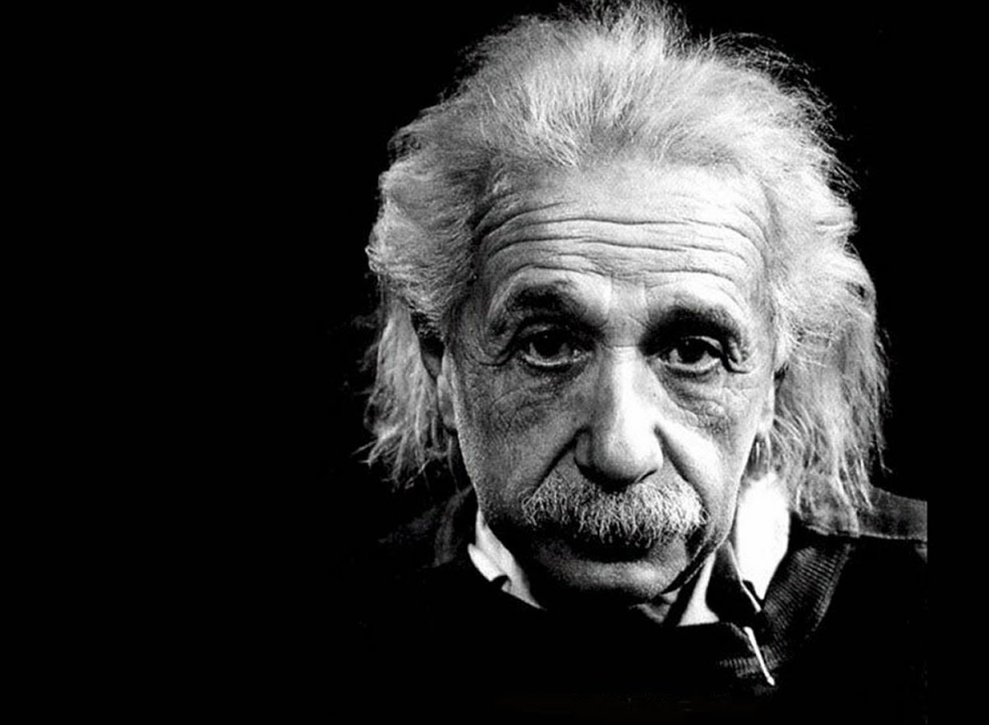
In theory, theory and practice are the same. In practice, they are not.
Albert Einstein

Slide 4
End of Session THREE

