Slide 1




Building Economic Models and Measures of Search ACM SIGIR BEMMS 2019 Session 4 – Practical Session
by
Leif Azzopardi, Alistair Moffat, Paul Thomas and Guido Zuccon

Slide 2
Outline
A quick guide to the modelling process
Using and extending CWL to build a metric
Sample Scenarios
Or we can use your own scenario

Slide 3
Building a Model
In economic models, there is an (economic) agent, who makes choices to advances their objectives.
They make choices under constraints.
So, who are these people, and
what are they tying to achieve (maximize/minimize)?
What constraints are they under?
Time, money, knowledge, skills?
What interactions are available?
And how do they interact with the system?
What assumptions are being made?
Adapted from Varian (1994)

Slide 4
Building a Model
1. Get a precise definition of the problem, and all relevant data about it
Identify the factors and variable that may affect the system
Uncontrollable factors – these are environmental and not under direct control
Controllable factors – these can be controlled by the system and/or user
What factors are stochastic i.e. probabilistic?
Murty (2003)

Slide 5
Building a Model
Assume there is some agent, who makes choices to advance their objectives.
They make choices under constraints.
So, who are these agents/people, and
what are they trying to achieve (maximize/minimize)?
What constraints are they under?
Time, money, knowledge, skills?
What interactions are available?
And how can they interact with the system?
Adapted from Varian (1994)

Slide 6
Building a Model
What benefit do they receive from the choices/interactions they make?
What costs do they incur from the choices/interaction they make?
Draw/sketch out what the process is that the person/agent undertakes.
Consider how the variables/actions relate together.
Adapted from Varian (1994)

Slide 7
Building a Model
2. Construct a mathematical model of the problem
i.e. define the objective function that needs to be minimized or maximized
Usually real world problems are very complicated – so make a simplified version by
Making assumptions
Using heuristics
And taking approximations.
Murty (2003)

Slide 8
Building a Model
3. Solve the model
This could be done:
analytically i.e. mathematically
graphically i.e. plotting out the functions
via simulation especially if there are stochastic variables
4. Implement the model
Put it into practice
Draw hypotheses from the model
Murty (2003)

Slide 9
Summary
What benefit do they receive from the choices/interactions they make?
What costs do they incur from the choices the choices/interaction they make?
Now, work through a simple (the simplest) example possible, so you can see what is going on.
i.e. One user, one query…
How does it generalize to one user, n queries.
Always remember to make it as simple as possible (KISS)
Adapted from Varian (1994)

Slide 10

Theory is not like a pair of glasses; it is rather like a pair of guns; it does not enable one to see better, but to fight better - Merquior

Slide 11
Scenarios

Slide 12
Result Page Exercise
How many result snippets should we show the user per page?
Assume the user wants to examine m snippets, where m is likely to be a number greater than 10
i.e. we want to set the number of results per page such that the user’s costs are minimized.
Hints:
Draw up a screen to represent the problem
What are the variables of interest/importance?
More Hints:
What are the constraints? What are the main interactions and interaction costs?
What if we only showed 1 results per page? Compare that to 2 results per page? Which one is better?

Slide 13
App Search
On a mobile phone, what is better: to search for the app or to browse through the apps?
Goal: Find app x on a phone in the minimum amount of time.
What is the optimal number of apps to show per screen?
Consider what interactions are associated with searching and browsing.
Consider how the time to locate an app on a screen changes with the number and size of app icons.

Slide 14
Extensions to App Search
Let’s say we swap to a tablet, where the screen size is larger.
What is the optimal number of apps to show per screen, now?
Let’s say that that we wanted to evaluate a hierarchy based menu approach for app search?
Would this be more efficient?

Slide 15
Collaborative Search
A student and a supervisor are working on a particular research topic and they need to find around 30-40 references.
How should they divide their effort?
Assume that the student’s time is cheap, and the supervisor’s time is expensive.
However, the supervisor’s search prowess is better than the student’s.
Who should spend more time searching
And under what conditions?

Slide 16
Mobile Search
You need to search for some information while walking around the mean streets of Melbourne.
Should you type your query?
Or use voice and tell your mobile what you want?
Consider how long it takes to type/talk, and how easily one can type/talk, and whether the input is correct or not.

Slide 17
Result Snippets & Cards
When a user views a search engine result page a multitude of elements are shown
Entity cards, maps, images, etc.
Each of these elements may contain relevant information
And they also require different amounts of time to process
How could we design a CWL metric that includes result snippets/cards/etc?

Slide 18
Session Search
Most metrics are designed to evaluate the performance on one query, not a session.
However, users will often issue a number of queries, and lot at a variety of elements during the course of their session
How could we extend CWL to cater for session search?

Slide 19
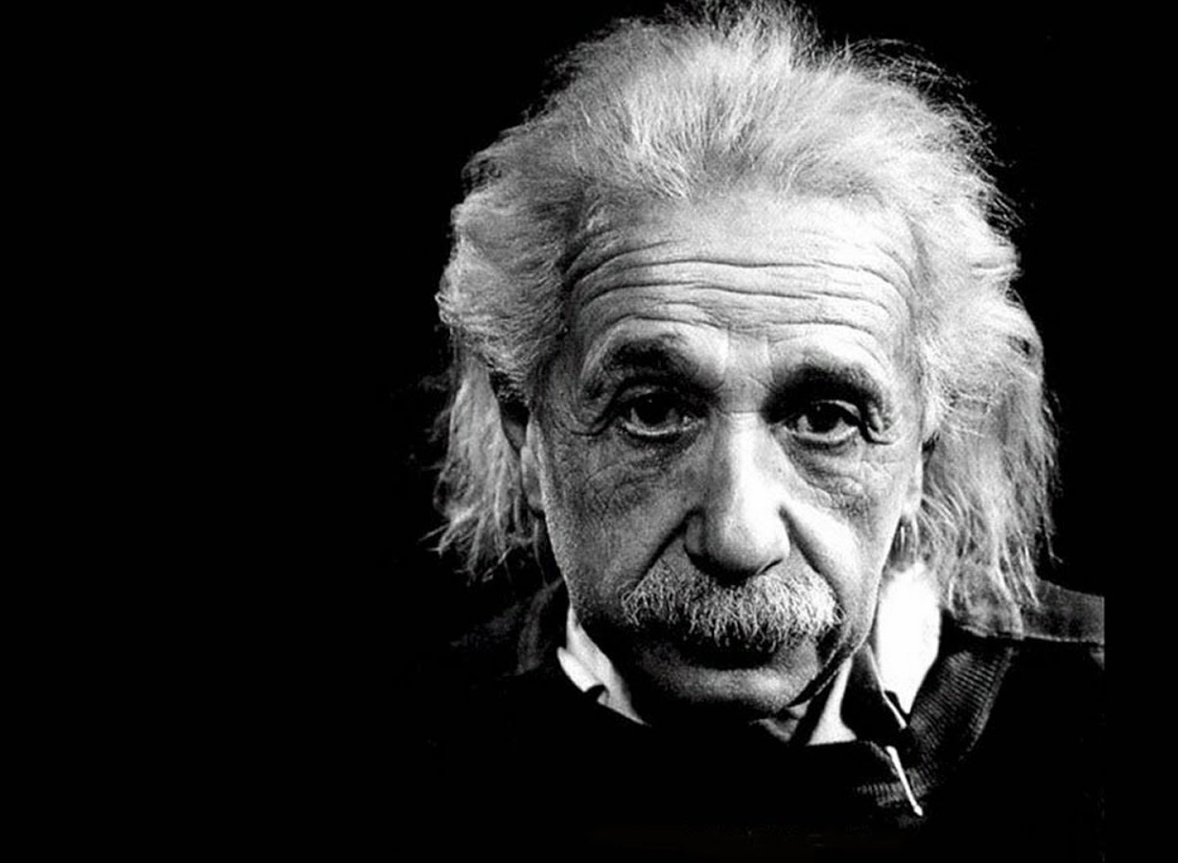
In theory, theory and practice are the same. In practice, they are not.
Albert Einstein

Slide 20
End of Session FOUR

