Slide 1
Host Microbiome and aging using 16s and metagenome approaches
Guillermo G. Torres
Ph.D. student
Genetics of Human Longevity Group

Slide 2
16S data - overview
 | ALL | Males | Females
BSP/SPC | 133 | 68 | 65
FOC | 101 | 49 | 52
AGI | 9
Samples | 241 | 117+agi_M | 117+agi_F
Age range BSP/SPC/FOC: between 21 – 83 years (mean 60 years).
(samples from Femkes and Maltes project)
These 230 samples have their metagenomes sequenced - we expect to use it later
For 40 BSP/SPC/FOC samples we got new 16S sequencing data from Femke (to use the same aliquots now that went into the new metagenome sequencing)
AGI: 9 centenarians are recruited and sequenced by now

Slide 3
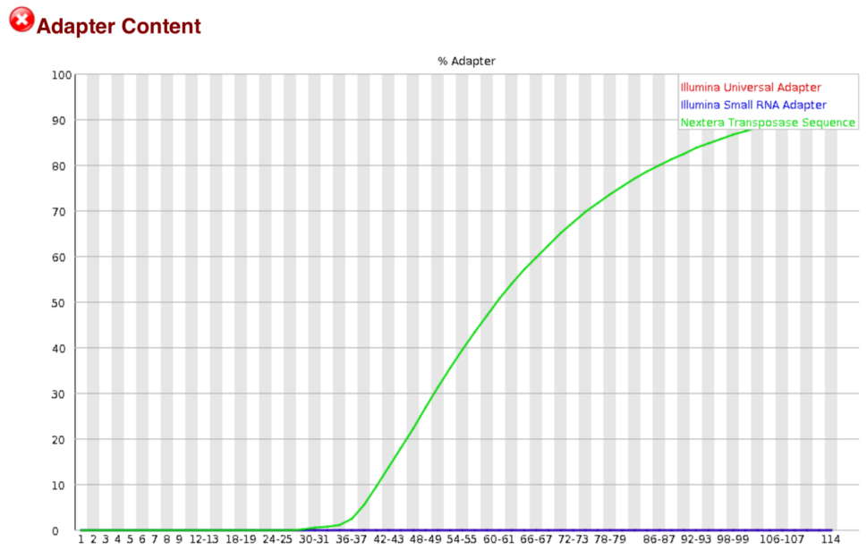
New metagenome data
New BSP/SPC metagenome data: two sequencing sets (26 samples with more than 80 years - mean 81 years; 12 samples between 68 – 79 years - mean 73 years; 9 centenarians). These 47 libraries were financed by our cluster budget - right now we are performing the quality control.
We have no access to the other 194 metagenomes yet.
The general quality of the 47 libraries looks good, but 4 samples show unusual adapter content distribution, probably due to a long time on the fragmentation step in the library preparation.
We will try to overcome this issue with a second sequencing run. But if we still won’t have enough good quality read counts afterwards, we would prepare new libraries and sequence them.

Slide 4
16S data analysis – aims
Identify co-occurrence patterns due to ecological relationships using presence/absence and abundance information.
The interactions will be represented as a network (mathematical representation of real-world complex system).
Assess whether the age correlates with co-occurrences (network serial time).

Slide 5
16S data analysis – quality control
Malte’s pipeline | Our Modifications
Reads QC(FASTX-Toolkit) | Trimmomatic
Analysis OTUs based approach | A pre-clustering step and the Uchime algorithm in de novo mode was included to reduce chimeras and sequencing noise. OTUs were classified using Wang method against SILVA SEED reference database with 1000 iterations.
OTUs counts | Non-random picking or sub-sampling, we considered all reads.

Slide 6
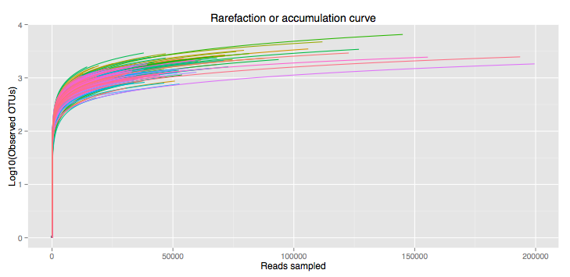
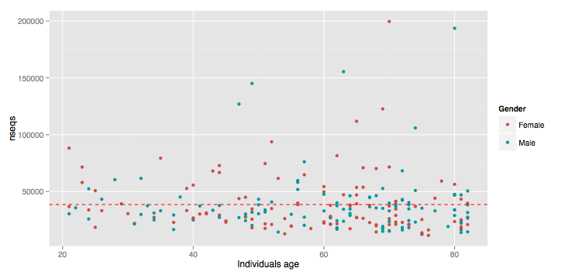
16S data analysis – quality control

Slide 7
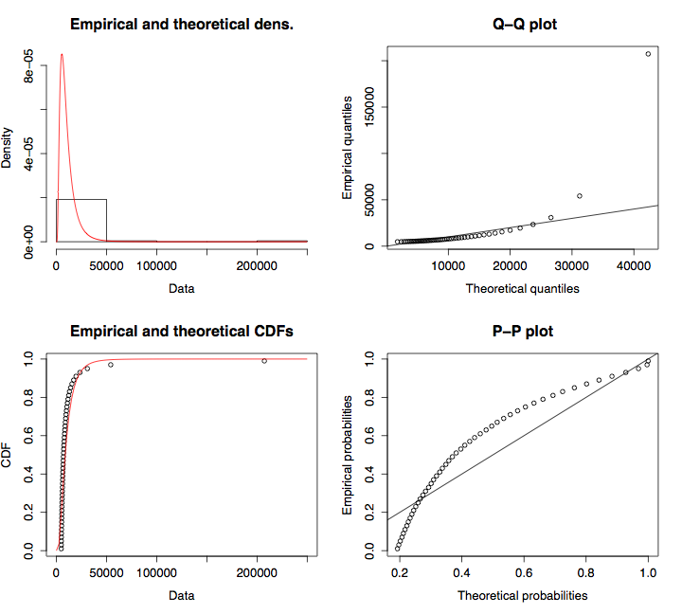
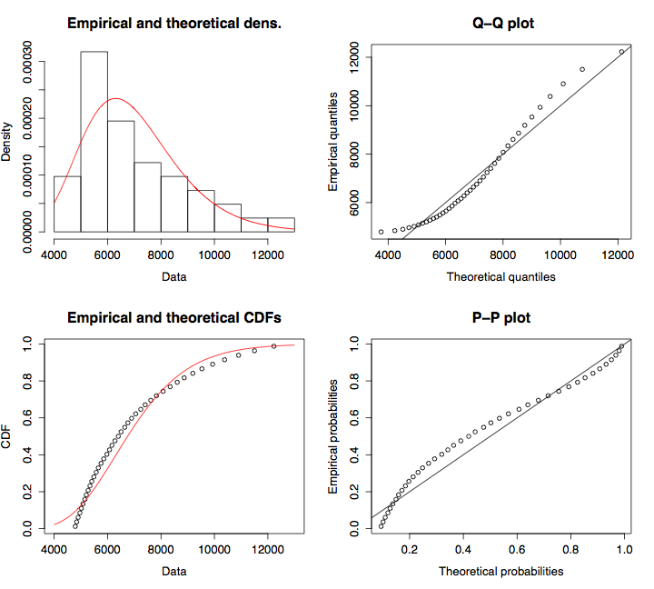
16S data analysis – data treatment
Since many OTUs have low coverage we propose a OTU size threshold = 10 read counts based on ACE and Chao estimators. Information retained 96.7%, reduction of false positive OTU prediction.
Replacement of zero counts using Bayesian-multiplicative approach.

Slide 8
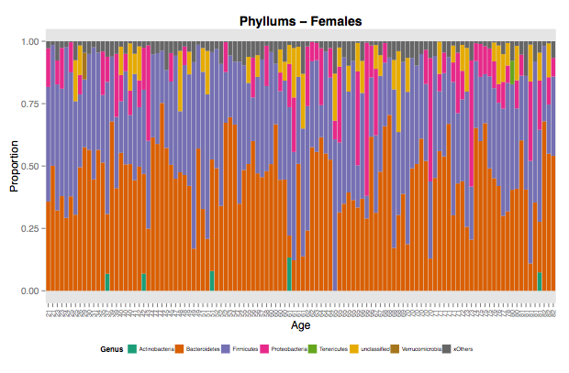
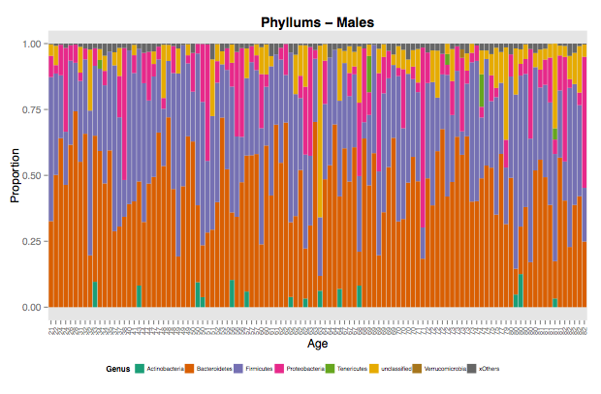
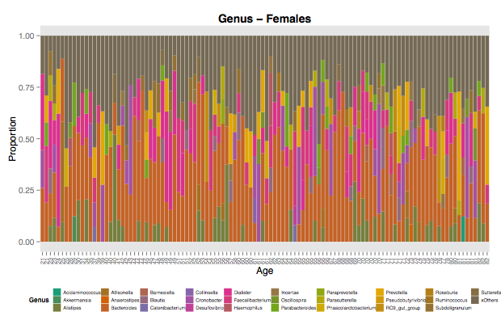
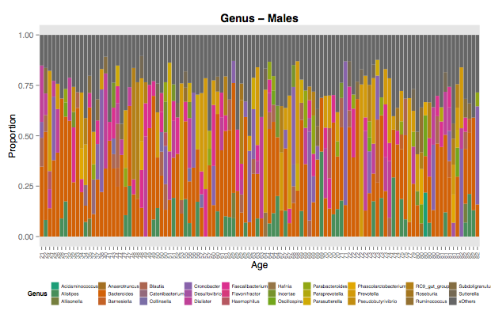
16S data analysis – OTUs taxonomical analysis

Slide 9
16S data analysis – networks approach
Calculation of correlation matrixes 2 approaches:
  We used log-ratios to measure the variance between OTUs and cosine distance as a value of correlation among individuals, but we detect that this approach is giving us many spurious values.
  John Baines suggested to use Sparcc algorithm to reduce spurious correlations.
We are also exploring to generate a covariance matrix instead to assess the OTU-OTU relationships using SPIEC-EASI algorithm.

Slide 10
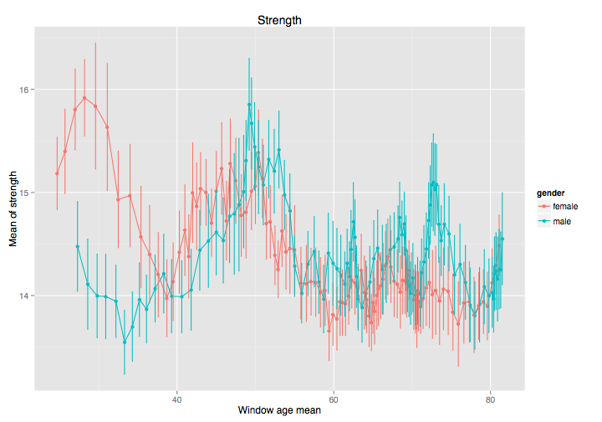
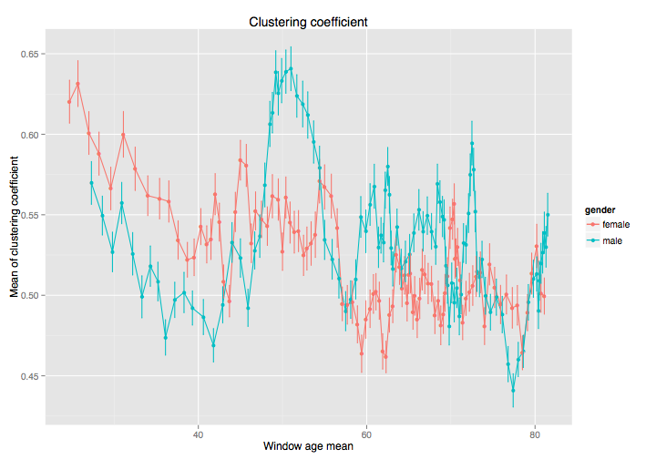
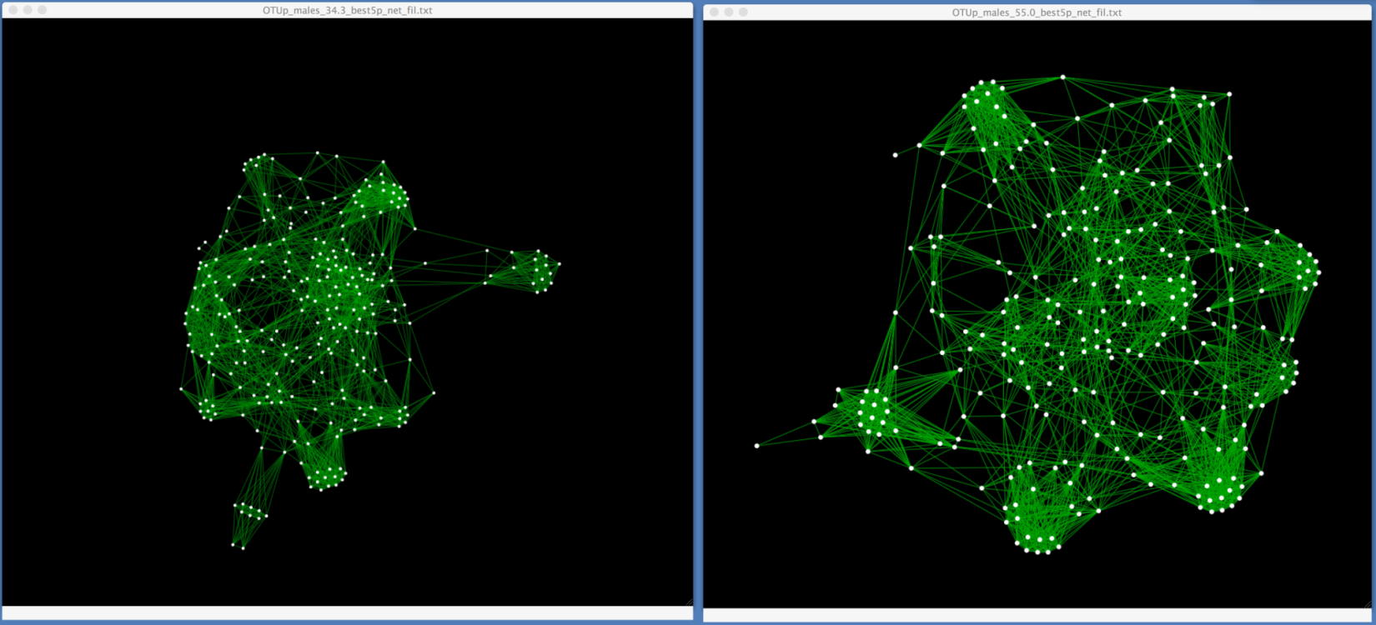
16S data analysis – network approach

Slide 11
16S data analysis – next analysis steps
Once the “relationship” matrices are done, collaborative partners from Spain ( Dr. Javier Buldú, at the Center for Biomedical Engineering of the Technical University of Madrid) will assist me to analyze this time series framework to model the dynamics in microbial relationships through aging.
For most relevant microbial clusters we are going to generate their possible functional profiles, and then with the assistance of Christoph Kaleta, we will perform a flux balance analysis to know whether the cluster has a functional dependency or not.

Slide 12
Metagenome data analysis – aims
Identify the taxonomical and functional structure of microbial community (metaorganism).
Discover patterns of change in the structure of the metaorganism genome using comparative genomics approaches. Such as mobile elements, insertions/deletions and copy number variances.
Explain how age shapes the composition and genetic diversity of microbial communities.

Slide 13
Thanks

Slide 14
<insert slide header here>
<insert slide sub-header here>
bullet point # n – text here
bullet point # n – text here
bullet point # n – text here
bullet point # n – text here
bullet point # n – text here
graph label

Slide 15
<insert slide header here>
<insert slide sub-header here>
bullet point # n – text here
bullet point # n – text here
bullet point # n – text here
bullet point # n – text here
bullet point # n – text here
graph label

