Slide 1
Host Microbiome and aging using 16s and metagenome approaches
Guillermo G. Torres
Ph.D. student
Genetics of Human Longevity Group

Slide 2
About 16S data
 | ALL | Males | Females
BSP/SPC | 133 | 68 | 65
FOC | 101 | 49 | 52
AGI | 9
Samples | 241 | 117+agi_M | 117+agi_F
The age range from BSP/SPC/FOC is between 21 – 83 years a mean of 60 years. These samples were took from Femke and Malte project.
From 40 BSP/SPC/FOC samples we got from Femke a new 16S sequencing data. Comes from the same aliquot used to sequence metagenomes.
The nine AGI are centenarians. These nine were sequenced with our budget.

Slide 3
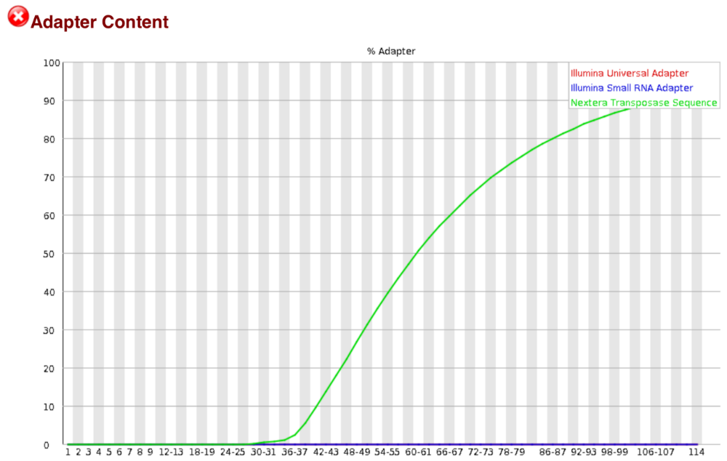
About metagenome data
From BSP/SPC batch were sequenced two sets, one of 26 samples with more than 80 years mean of 81 years, the second with 12 samples between 68 – 79 years mean 73 years, and nine centenarians. These 47 libraries were financed by our budget and we are performing the quality control.
The general quality of the 47 libraries are good, but 4 shows unusual adapter content distribution, probably due to a long time on the fragmentation step in the library preparation.

Slide 4
16S data analysis – aims
Identify co-occurrence patterns due to ecological relationships using presence/absence and abundance information.
The interactions will be represented as a network (mathematical representation of real-world complex system).
Assess whether the age correlates with co-occurrences (network serial time).

Slide 5
16S data analysis – quality control
Malte’s pipeline | Our Modifications
Reads QC(FASTX-Toolkit) | Trimmomatic
Analysis OTUs based approach | A pre-clustering step and the Uchime algorithm in de novo mode was included to reduce chimeras and sequencing noise. OTUs were classified using Wang method against SILVA SEED reference database with 1000 iterations
OTUs counts | Non-random picking or sub-sampling, we considered all reads.

Slide 6
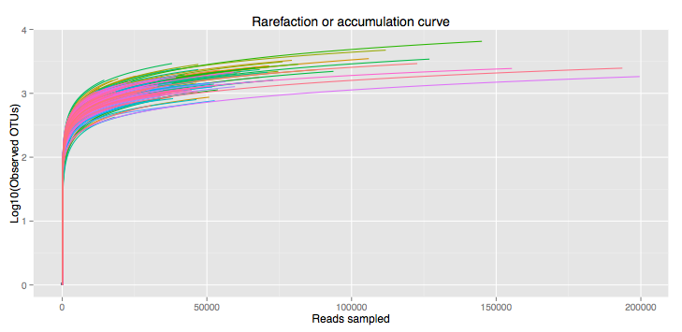
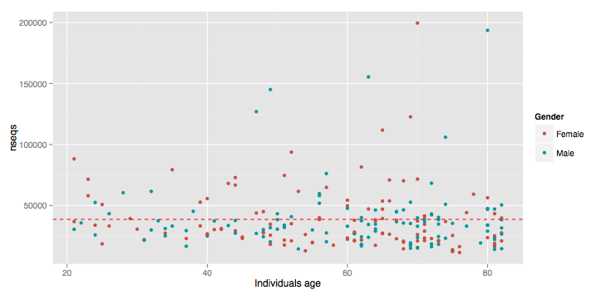
16S data analysis – quality control

Slide 7
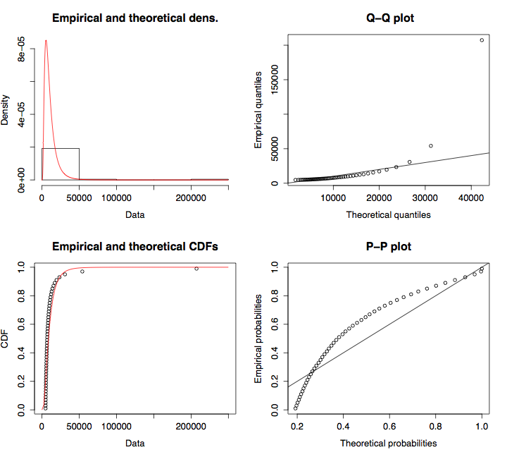
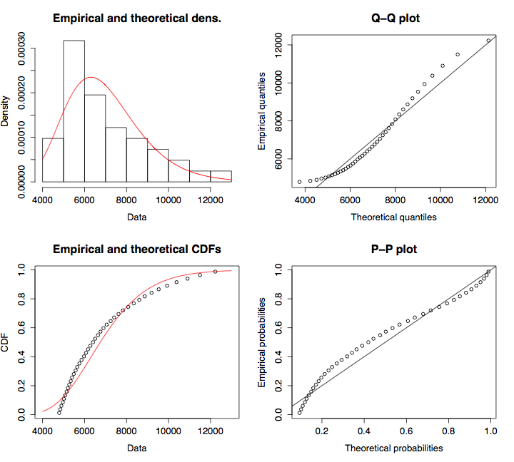
16S data analysis – data treatment
Since many OTUs have low coverage we propose a OTU size threshold = 10 read counts based on ACE and Chao estimators. Information retained 96.7%, reduction of false positive OTU prediction.
Replacement of zero counts using Bayesian-multiplicative approach.

Slide 8
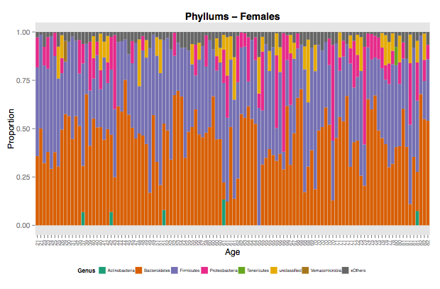
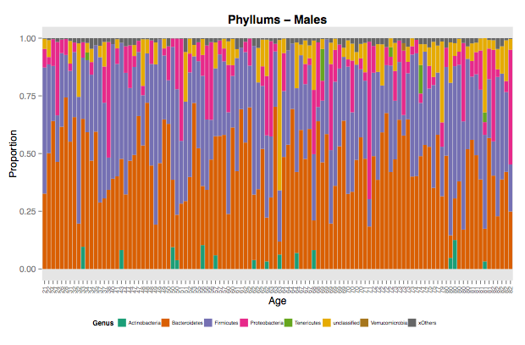
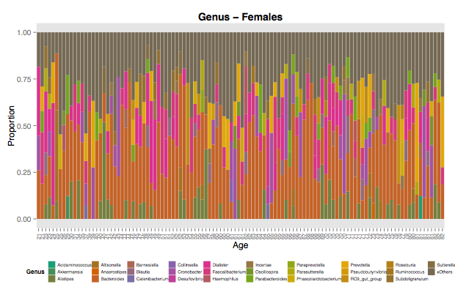
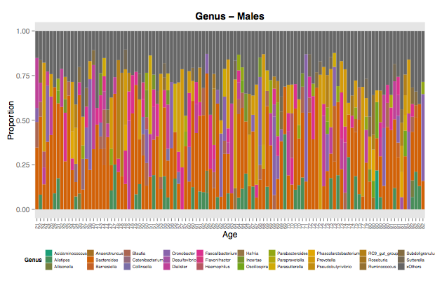
16S data analysis – OTUs taxonomical analysis

Slide 9
16S data analysis – networks approach
Calculation of correlation matrixes 2 approaches:
  We used log-ratios to measure the variance between OTUs and cosine distance as a value of correlation among individuals, but we detect that this approach is giving us many spurious values.
  John Baines suggests us to use Sparcc algorithm to reduce spurious correlations
We are also exploring to generate a covariance matrix instead to assess the OTU-OTU relationships using SPIEC-EASI algorithm.

Slide 10
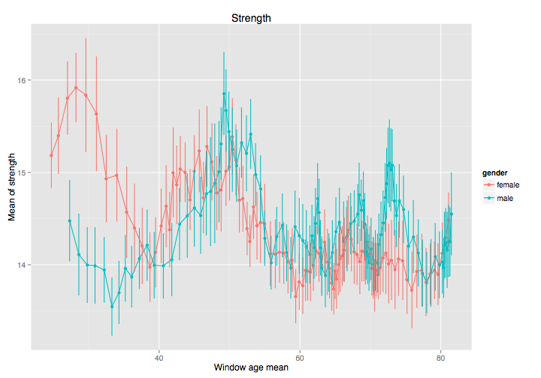
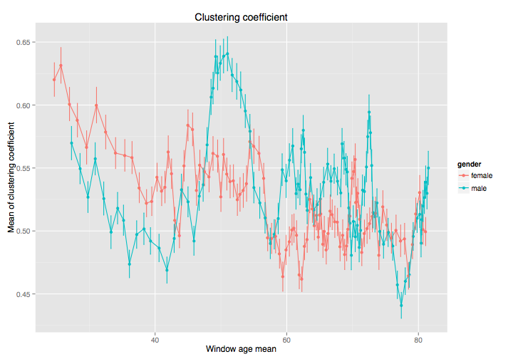
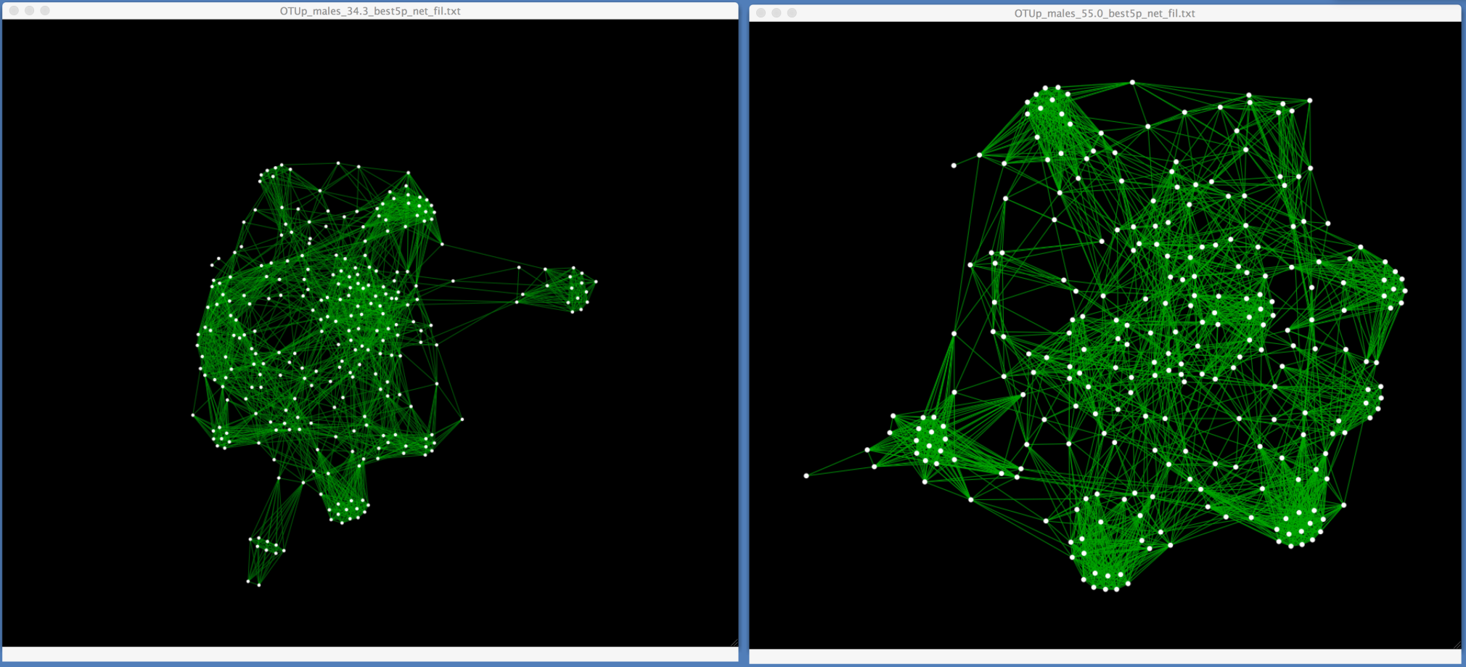
16S data analysis – networks approach

Slide 11
16S data analysis – on coming work
Once the “relationship” matrices are done, collaborative partners from Spain ( Dr. Javier Buldú, at the Center for Biomedical Engineering of the Technical University of Madrid) will assist me to analyze this time series framework to model the dynamics in microbial relationships through aging.
For most relevant microbial clusters we are going to generate its possible functional profile, and then with the assistance of Christoph Kaleta, we will perform a flux balance analysis to know whether the cluster has a functional dependency or not.

Slide 12
Thanks

Slide 13
<insert slide header here>
<insert slide sub-header here>
bullet point # n – text here
bullet point # n – text here
bullet point # n – text here
bullet point # n – text here
bullet point # n – text here
graph label

Slide 14
<insert slide header here>
<insert slide sub-header here>
bullet point # n – text here
bullet point # n – text here
bullet point # n – text here
bullet point # n – text here
bullet point # n – text here
graph label

