Slide 1
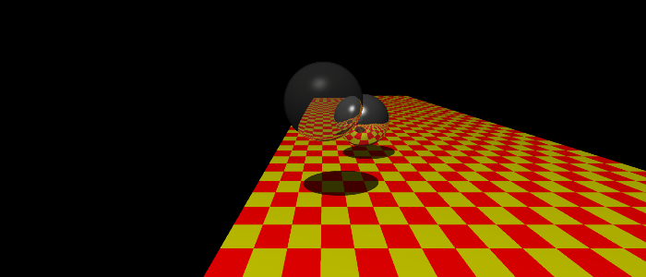
Further with the Raytracer
CGII 4003-571
Guilhem Duché

Slide 2
Further with the Raytracer
Outline
I) Lights
II) Mappings
III) More complex objects
IV) Speedup the calculations
V) Nicer complex objects
VI) Animations
VII) A word on the GUI, scene definitions and bugs

Slide 3
Further with the Raytracer
I) Lights :
I) Lights
I.1) Diffuse Light
I.2) Spot Light
II) Mappings
III) More complex objects
IV) Speedup the calculations
V) Nicer complex objects
VI) Animations
VII) A word on the GUI, scene definitions and bugs

Slide 4
Further with the Raytracer
I) Lights :
I.1) Diffuse Light
Realistically light would lose intensity with the distance
Idea :
  pass the intersection point as a parameter when we get light intensity
How does light decrease with the distance ?
    Intensity divided by : max (1, a + b * X + c * X²)
    Where X is the distance
    a, b and c constants given by user

Slide 5
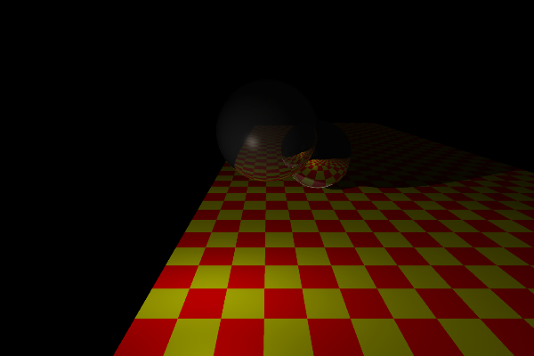
Further with the Raytracer
I) Lights :
I.1) Diffuse Light
a = 0 , b = 0.02 and c = 0.01.

Slide 6
Further with the Raytracer
I) Lights :
I.2) Spot Light
Lights comes from a cone
Idea : Once again use the intersection point

Slide 7
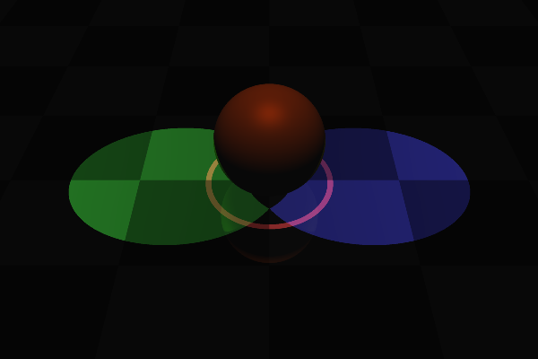
Further with the Raytracer
I) Lights :
I.2) Spot Light
3 spots lights, white sphere, checkerboard white and gray

Slide 8
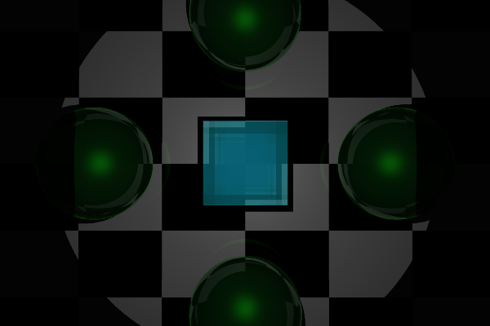
Further with the Raytracer
I) Lights :
I.2) Spot Light
Spot light can have diffuse light

Slide 9
Further with the Raytracer
II) Mappings :
I) Lights
II) Mappings
II.1) Texture Mapping
II.2) U,V coordinates on a rectangle and a sphere
II.3) Alpha Mapping and Reflection trick
II.4) Bump Mapping
III) More complex objects
V) Speedup the calculations
VI) Nicer complex objects
VI) Animations
VII) A word on the GUI, scene definitions and bugs

Slide 10
Further with the Raytracer
II) Mappings :
II.1) Texture mapping
Goal : put images on objects
Work to do to realize it :
  Load images (formats gif, png, jpg)
  When a ray intersects an object find U,V coordinates
  Transform U,V coordinates to images coordinates X,Y
  Use X,Y coordinates to find the color of the intersection point
  Modify the material of the object according to the color found

Slide 11
Further with the Raytracer
II) Mappings :
II.2) U,V coordinates on a rectangle and a sphere
On a rectangle :
sin(α)
cos(α)

Slide 12
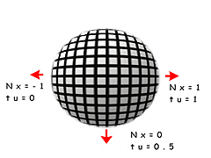
Further with the Raytracer
II) Mappings :
II.2) U,V coordinates on a rectangle and a sphere
On a sphere :
One formula possible:
  U = arcSin(Nx)/PI + 0.5
  The U coordinate is calculated from the X coordinate of the normal, which will vary from -1.0 to 1.0, representing the longitude of a corresponding point on a sphere
  With the same idea V = arcSin(Ny)/PI + 0.5

Slide 13
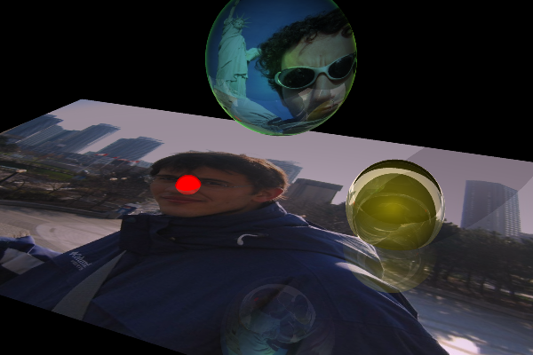
Further with the Raytracer
II) Mappings :
II.2) U,V coordinates on a rectangle and a sphere
Good results !

Slide 14
Further with the Raytracer
II) Mappings :
II.3) Alpha Mapping and Reflection trick
Alpha mapping : change transparency of an object according to the color of an image
Reflection trick : we can also change the reflection parameters of an object according to the color of an image
Work very similar to texture mapping. Instead of modifying the color of the material associated to the object touched change the translucency or the reflection of the material.

Slide 15
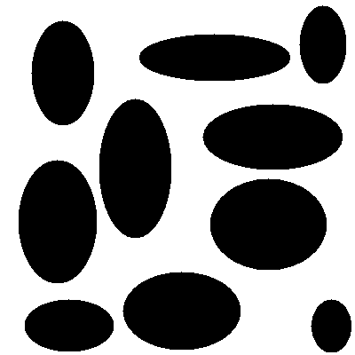
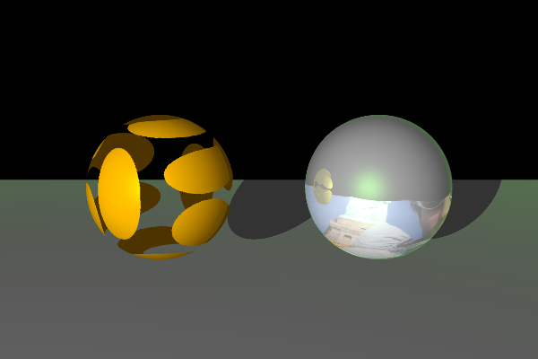
Further with the Raytracer
II) Mappings :
II.3) Alpha Mapping and Reflection trick
Good results for alpha mapping,
weird results for the reflection trick

Slide 16
Further with the Raytracer
II) Mappings :
II.4) Bump Mapping
Bump mapping : perturb normal of an object according to the color of an image
A simple way to do it :
  When the object is touched determine UV coordinates.
  Transform U,V coordinates to images coordinates X,Y
  Calculate the gradients of the X,Y point in the image
  Perturb the normal according to the amplitude of the gradients

Slide 17
Further with the Raytracer
II) Mappings :
II.4) Bump Mapping
Y Gradient = -
Vectors used to perturb the
normal on a rectangle
X Gradient = -
Vectors used to perturb the
normal on a sphere

Slide 18
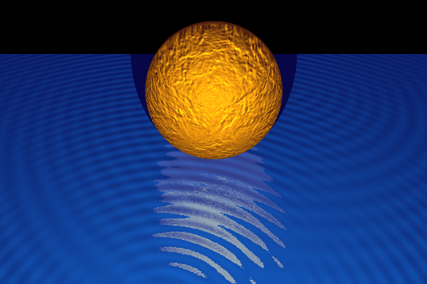
Further with the Raytracer
II) Mappings :
II.4) Bump Mapping
Very nice results. You can make fake water :)

Slide 19
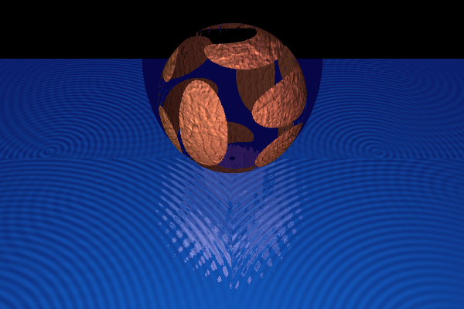
Further with the Raytracer
II) Mappings :
II.4) Bump Mapping
You can mix every mappings and repeat the texture on the object

Slide 20
Further with the Raytracer
III) More complex objects :
I) Lights
II) Mappings
III) More complex objects
III.1) Polygon with 2 sides
III.2) HeightFields
III.3) Off file format
IV) Speedup the calculations
VI) Nicer complex objects
VI) Animations
VII) A word on the GUI, scene definitions and bugs

Slide 21
Further with the Raytracer
III) More complex objects :
III.1) Polygon with two sides
Complex objects will be made with multiple polygons
Polygons could be touched by rays from both sides
Need top adapt normal according to the incoming ray
Idea :
Ray .normal > 0 => negate normal
Incoming ray
Resulting normal
Current normal

Slide 22
Further with the Raytracer
III) More complex objects :
III.2) HeighFields
Do a mesh of triangles
Use colors of an image to determine height each point
Type of mesh used :

Slide 23
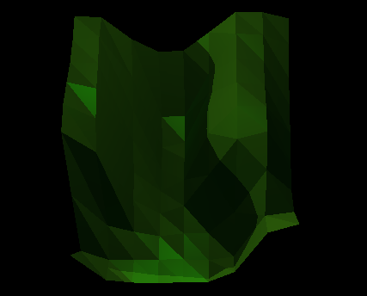
Further with the Raytracer
III) More complex objects :
III.2) HeighFields
Results with this image ( 9 x 9 => 9x9x2 = 128 triangles)

Slide 24
Further with the Raytracer
III) More complex objects :
III.3) Off file format
Simple 3D file format with text
  1st line : OFF
  Line with ' # ' : comments ignore
  2nd line to read : vertex_count face_count edge_count
  Next one line per vertex : x y z
  Then each line : the number of vertices, the vertex indices
  You can also have sometimes RGB color after a vertex or a polygon. Ignored in my implementation.

Slide 25
Further with the Raytracer
III) More complex objects :
III.3) Off file format
Example : The cube
OFF
8 6 12
1.632993 0.000000 1.154701
0.000000 1.632993 1.154701
-1.632993 0.000000 1.154701
0.000000 -1.632993 1.154701
1.632993 0.000000 -1.154701
0.000000 1.632993 -1.154701
-1.632993 0.000000 -1.154701
0.000000 -1.632993 -1.154701
8 vertices
6 faces
12 edges
Face 0 has 4 vertices
vertex 0
vertex 1
vertex 2
vertex 3
4 0 1 2 3
4 7 4 0 3
4 4 5 1 0
4 5 6 2 1
4 3 2 6 7
4 6 5 4 7
vertex 0

Slide 26
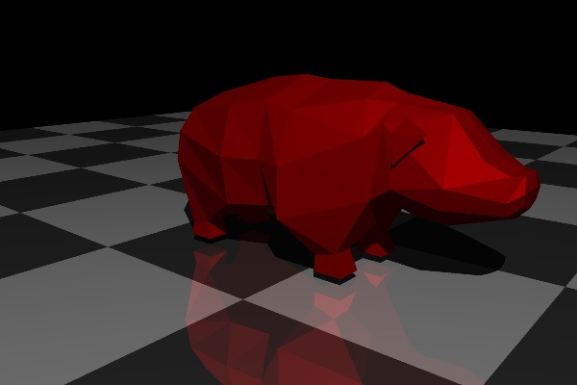
Further with the Raytracer
III) More complex objects :
III.3) Off file format
Results : a pig (127 vertices 226 faces) It's long to render !!!!

Slide 27
Further with the Raytracer
IV) Speed up the calculations :
I) Lights
II) Mappings
III) More complex objects
IV) Speedup the calculations
V.1) Bounding objects
V.2) Ray-triangle intersection
V) Nicer complex objects
VI) Animations
VII) A word on the GUI, scene definitions and bugs

Slide 28
Further with the Raytracer
IV) Speedup the calculations :
IV.1) Bounding objects
Use bounding objects on complex objects
Faster to test intersection with bounding objects than heightfields or Off objects
If a ray touch a bounding object test the intersection ray-object otherwise don't test it
Two types of bounding objects :
  Bounbing box
  Bounding sphere

Slide 29
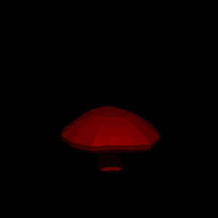
Further with the Raytracer
IV) Speedup the calculations :
IV.1) Bounding objects
Heightfield
128 triangles
2 lights
Mushroom.off
240 faces
448 triangles
1 light

Slide 30
Further with the Raytracer
IV) Speedup the calculations :
IV.1) Bounding objects
Heightfield
128 triangles
2 lights
Mushroom.off
240 faces
448 triangles
1 light

Slide 31
Further with the Raytracer
IV) Speedup the calculations :
IV.1) Bounding objects
Heightfield
128 triangles
2 lights
Mushroom.off
240 faces
448 triangles
1 light

Slide 32
Further with the Raytracer
IV) Speedup the calculations :
IV.2) Ray-triangle intersection
Polygons are too long to compute
Triangle is well know in CG
Use a fast Ray-triangle intersection algorithm
Moller-Trumbore's algorithm
  Compute barycentric coordinates
Convert all polygons in sets of triangles

Slide 33
Further with the Raytracer
IV) Speedup the calculations :
IV.1) Bounding objects
Heightfield
128 triangles
2 lights
Mushroom.off
240 faces
448 triangles
1 light

Slide 34
Further with the Raytracer
IV) Speedup the calculations :
IV.1) Bounding objects
Heightfield
128 triangles
2 lights
Mushroom.off
240 faces
448 triangles
1 light

Slide 35
Further with the Raytracer
V) Nicer complex objects :
I) Lights
II) Mappings
III) More complex objects
IV) Speedup the calculations
V) Nicer complex objects
VI.1) Idea
VI.2) Results
VI) Animations
VII) A word on the GUI, scene definitions and bugs

Slide 36
Further with the Raytracer
V) Nicer complex objects :
V.1) Idea
Complex objects (sets of polygon) are not smooth enough
Find a way to smooth it, like phong shading did
Phong shading not applicable here
My own idea (inspired by phong shading) :
  Compute average normals for each vertex of each triangle
  The closer the intersection point is from a vertex, the more similar to the vertex's normal its normal is

Slide 37
Further with the Raytracer
V) Nicer complex objects :
Red normal = average of the 2 blue normals
V.1) Idea
A
B
B x + A x
=
A + B

Slide 38
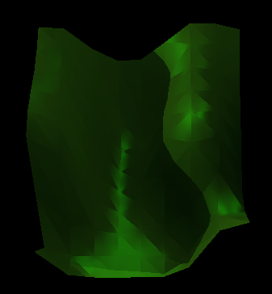
Further with the Raytracer
V) Nicer complex objects :
V.2) Results
First attempt : using distances between the intersection point and each vertex of the triangle

Slide 39
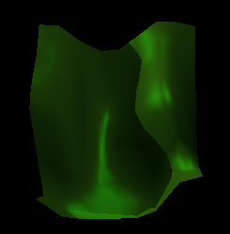
Further with the Raytracer
V) Nicer complex objects :
V.2) Results
Second attempt : using barycentric coordinates

Slide 40
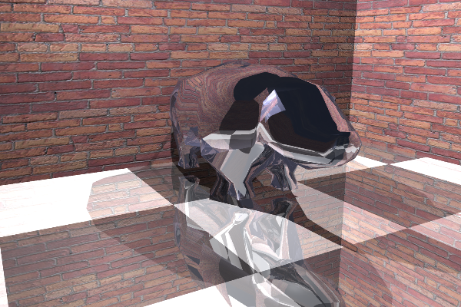
Further with the Raytracer
V) Nicer complex objects :
V.2) Results
The idea works also on Off objects

Slide 41
Further with the Raytracer
VI) Animations :
I) Lights
II) Mappings
III) More complex objects
IV) Speedup the calculations
V) Nicer complex objects
VI) Animations
VI.1) Idea
VI.2) Architecture
VI.3) Transformations
VI.4) Results
VII) A word on the GUI, scene definitions and bugs

Slide 42
Further with the Raytracer
VI) Animations :
VI.1) Idea
Animation is a succession of images
Can use the raytracer to render each image
Need to move the objects between each images
Associate transformations to each objects
Objects we want to move :
        Displayed objects (sphere, cube, ...)
        Lights
        Cameras

Slide 43
Further with the Raytracer
VI) Animations :
VI.2) Architecture
Use image number as a unit of time
All objects extend from a mother class : RaytracerObject
Define the “life of” each object
“Life” defined by :
      Dates of birth and death
      List of events (transformations)
Use only alive objects when rendering
Apply alive transformations between each image

Slide 44
Further with the Raytracer
VI) Animations :
VI.3) Transformations
Apply a modification to an object between two images
Behavior defined for all type of object
Extend from mother class => you can make your own transformation
Only two types of transformations implemented :
      Translation
      Rotation
We could modify all parameters of each object in a transformation

Slide 45
Further with the Raytracer
VI) Animations :
VI.4) Results
Small examples and a bigger one
Long to render
Example :
    60 seconds at 20 images per seconds => 1200 frames
    1 minute per frame => 1200 minutes => 20 hours
But it works

Slide 46
Further with the Raytracer
VII) A word on the GUI, scene definitions and bugs :
I) Lights
II) Mappings
III) More complex objects
IV) Speedup the calculations
V) Nicer complex objects
VI) Animations
VII) A word on the GUI, scene definition and bugs
VII.1) The small GUI
VII.2) Scene definition
VII.3) Known bugs

Slide 47
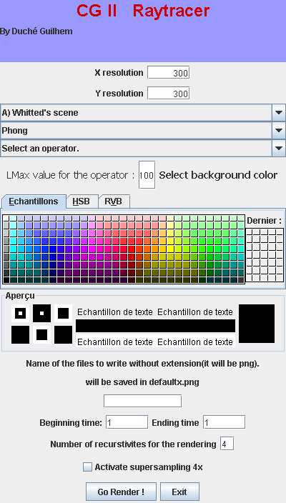
Further with the Raytracer
VII) A word on the GUI, scene definitions and bugs :
VII.1) Small GUI
Choose resolution
Choose scene
Choose illumination model
Choose operator and Lmax value
Choose background color
Filename to save image
Images to render if it is an animation
Recursivity depth
Supersampling 4x

Slide 48
Further with the Raytracer
VII) A word on the GUI, scene definitions and bugs :
VII.2) Scene Defintition
Scenes hard coded, one file to modify
Easy to make your own scene
Simple classes to use
Javadoc available for almost everything
Camera c = new Camera(new Point3d(0,1.6,-10.5),new Point3d(0,0,0),
new Vector3d(0,1,0), 1, 0.5);//create camera
Scene s = new Scene(c, "A sphere");//create scene
Material yellow = new Material(...);//create material
AmbientLight light1 = new AmbientLight(new Color(1.0,1.0,1.0));//set up ambient light
s.setAmbientLight(light1);
PointLight light4 = new PointLight(new Color(1,1,1.0), -2, 7, 2);//set up point light
s.addPointLight(light4);
s.addObject(new Sphere(1,new Point3d(-1, 0.6, 2),yellow));//add a sphere

Slide 49
Further with the Raytracer
VII) A word on the GUI, scene definitions and bugs :
VII.3) Known bugs
Camera can bug if the eyepoint is on a vertex like: 0,X,0 (matrix not inversible)
Path of ray in mixed translucent objects is not accurately calculated
A weird bug with specular color on a sphere happen (rarely)
Animations on smoothed objects don't work

Slide 50
Further with the Raytracer
Conclusion
I had a lot of fun on this project
Project quite big : 57 files
Not too many bugs
Can still be extended easily (transformations, objects, ...)
Java very efficient to develop (framework and vecmath library)
Less efficient to do a huge amount of calculation
Hard to make a scene hard coded

