Slide 1

Embedded Application
Part 7

Slide 2


Index of today’s topic
Connect WIFI for OK6410
Browse Web based WIFI on OK6410

Slide 3
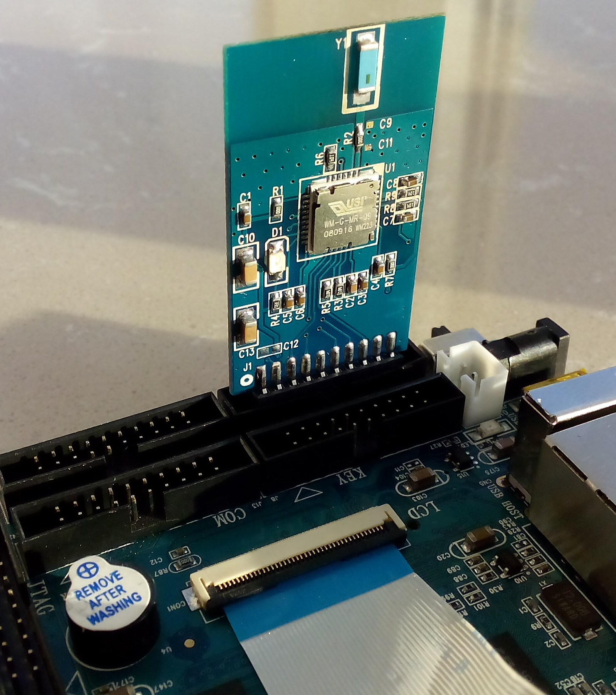
Hardware connections
Wifi plug into "SD1 INTERFACE"
Chip side of WIFI towards inside of board

Slide 4
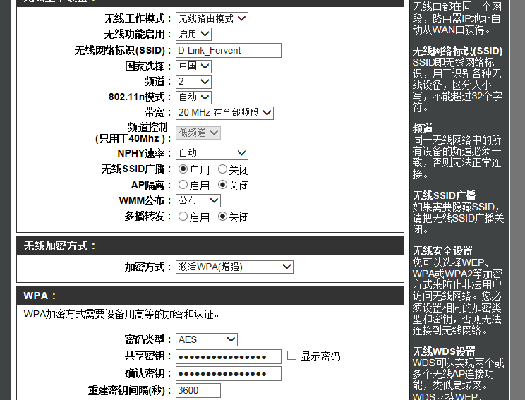
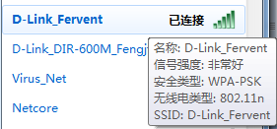
Wireless Router Configuration

Slide 5
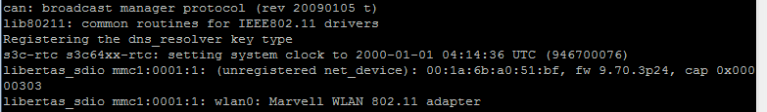
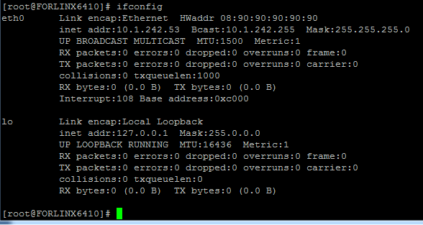
System Start Information

Slide 6
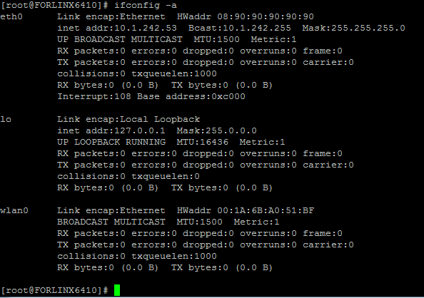

Slide 7
Configure wireless network
wpa_supplicant tool used to config wireless network。
wpa_supplicant tool include: wpa_supplicant and wpa_cli。
wpa_supplicant is core programe, which is like the server, wpa_cli like the client. wpa_supplicant should run at background，use wpa_cli to search、set and configure network。

Slide 8
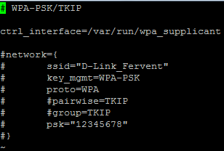
run wpa_supplicant depends on configuration file：
/etc/wpa_supplicant.conf
just keep this line

Slide 9
wpa_supplicant -Dwext -iwlan0 -c/etc/wpa_supplicant.conf &
wpa_cli -i wlan0
> add_network
> set_network 0 ssid "wireless network name"
> set_network 0 key_mgmt WPA-PSK //Network encryption
> set_network 0 psk “wireless network password"
> enable_network 0
> quit
ifconfig wlan0 192.168.0.105 //configure IP
route add default gw 192.168.0.1 //add gateway
wpa_cli:Support others commands
status:Lists the current networking status。
list：Lists all alternate networks。the current connecting network is marked with[CURRENT]，Disable network is marked with [DISABLE]。
add_network：Adding an alternate network, output a new network
number.

Slide 10
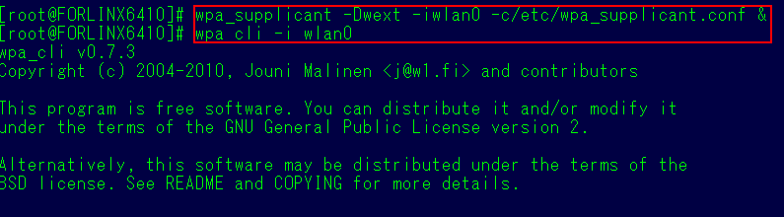
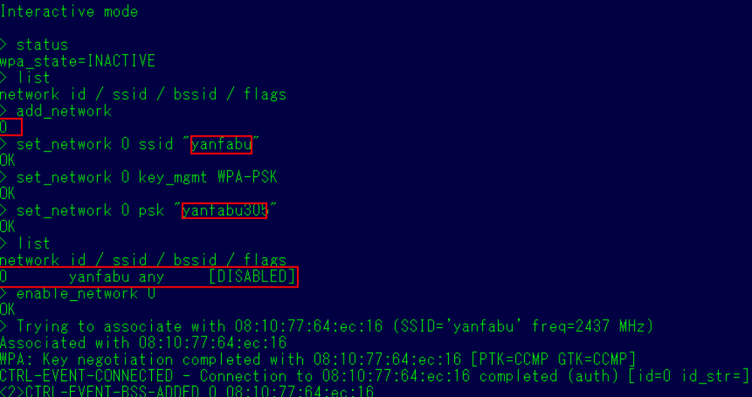

Slide 11
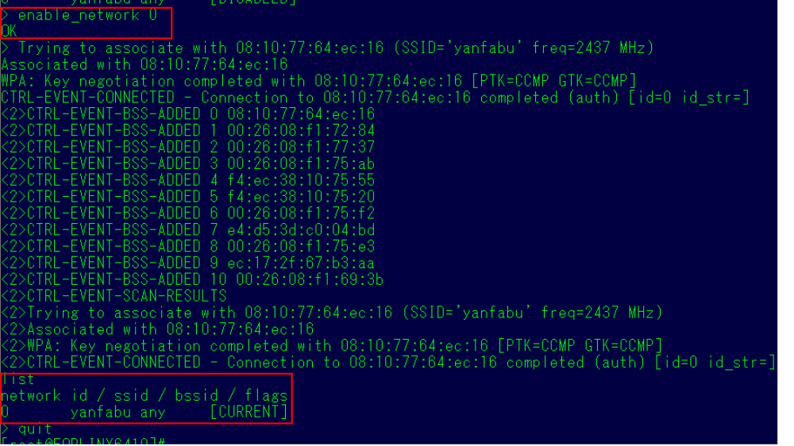

Slide 12
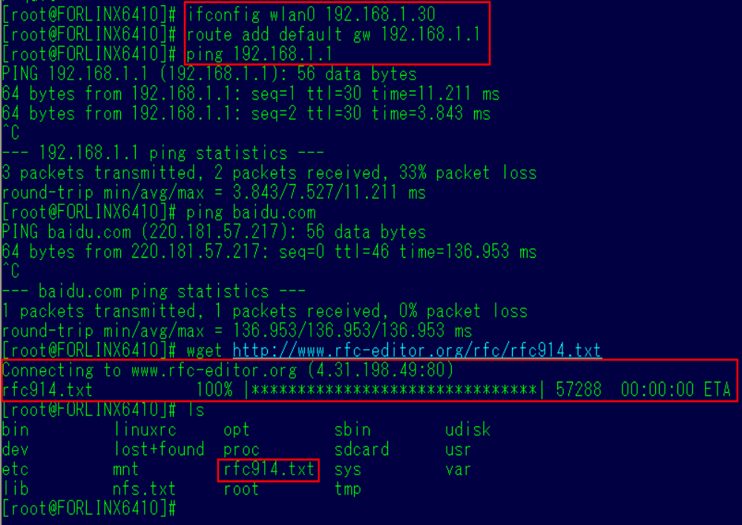
Access to the Internet, download document. Verify that the wireless Internet successfully

Slide 13
Added:
After power up, this light is not lit
WIFI working, lit.

Slide 14
Exercise
Installation WIFI in your FL6410 target
Download some file from internet via WIFI

