Slide 1
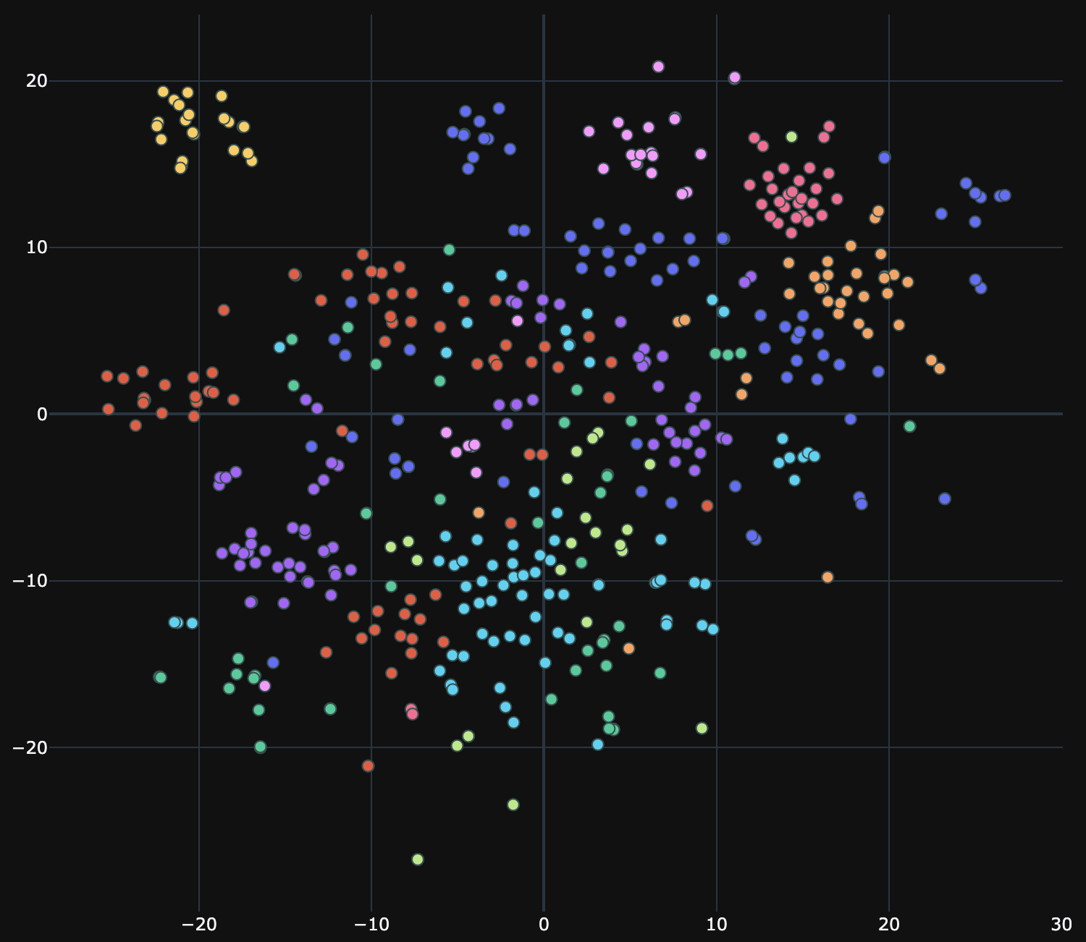
Visualizing the S&P 500: A Quantitative Approach
Decoding Market Structure through Hierarchical Clustering & Dimensionality Reduction
Team members:
Yousef Sannan
Eyad Wael
Hadi Youssef

Slide 2
The Mission
The Problem: The S&P 500 is too complex (500 stocks × 1200 days = 600,000+ data points). Human eyes cannot see patterns in a spreadsheet that size.
The Goal: To move beyond simple price charts and find the "hidden structure" of the market.
The Tools:
Python: Data ingestion & cleaning.
Machine Learning: PCA (Principal Component Analysis) & t-SNE.
Visualization: Plotly & Seaborn.

Slide 3
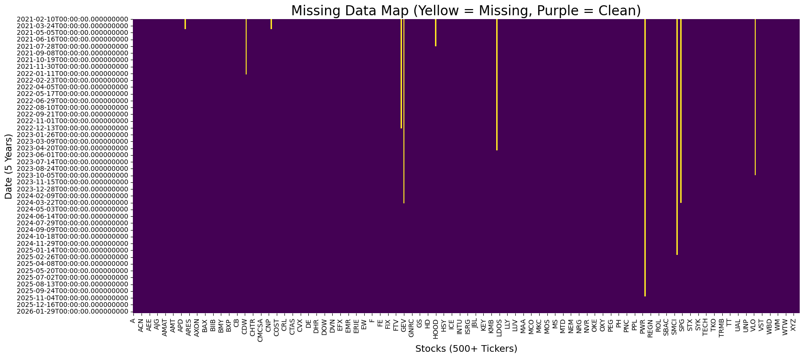
Data Integrity (The "Missingness" Map)
We downloaded 5 years of daily data for all 503 current companies. The yellow lines represent missing data—companies like GE HealthCare or Kenvue didn't exist 5 years ago. We cannot calculate 5-year correlations for 3-year-old companies, so we cleaned the dataset by dropping these inconsistent stocks.

Slide 4
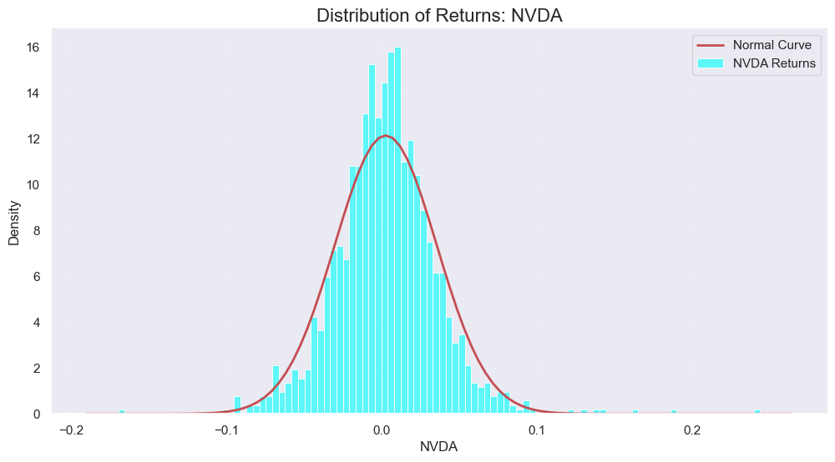
Volatility & Risk (The "Fat Tails")
Market returns do not follow a normal "Bell Curve”
You will see that the Blue Bars stick out much further to the left and right than the Red Line does. This visual gap is the "Fat Tail"—proof that extreme crashes happen more often than the math predicts.

Slide 5
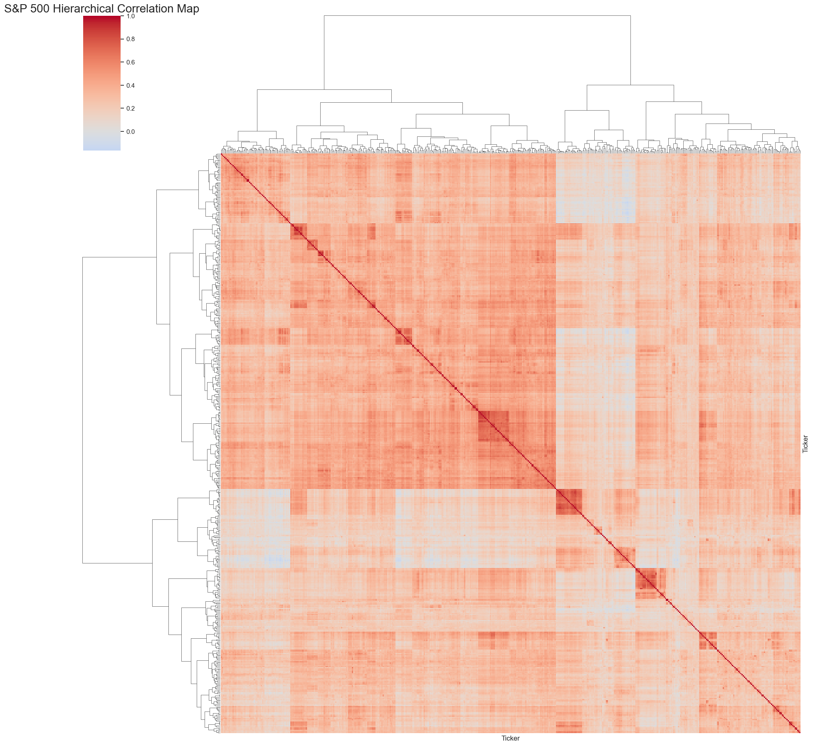
The Matrix (Correlation)
The "Tribes" of the market
We calculated how every stock moves in relation to every other stock.
Red Squares: These are sectors (Tribes) moving together.
Blue Areas: These are 'Anti-Correlations'—stocks that move opposite to each other.
Conclusion: The market isn't random; it's highly structured into tight clusters of behavior."

Slide 6
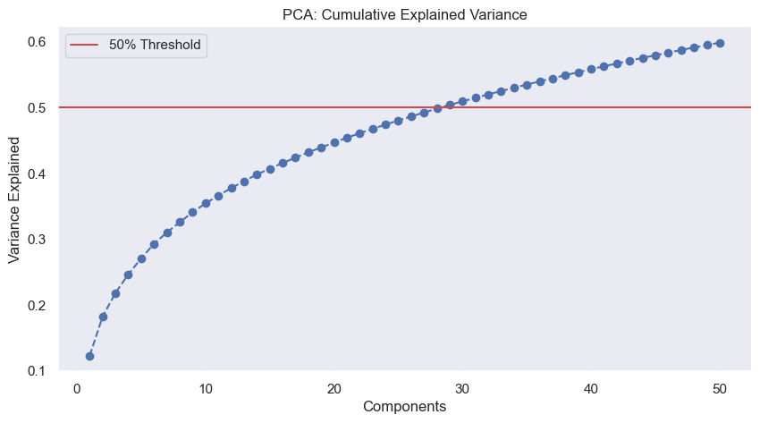
The Market Factor (PCA)
Expectation: Usually, in times of crisis (like 2008 or 2020), the first component explains 40% or 50% of the market. That is when 'everything moves together.
Reality: However, my data shows that right now, PC1 only explains about 12% of the variance (the first dot).
Conclusion: "This proves that the current market is highly fragmented. Stocks are trading on their own specific news rather than just following the macro-economic tide. It is a 'Stock Picker's Market.'"

Slide 7
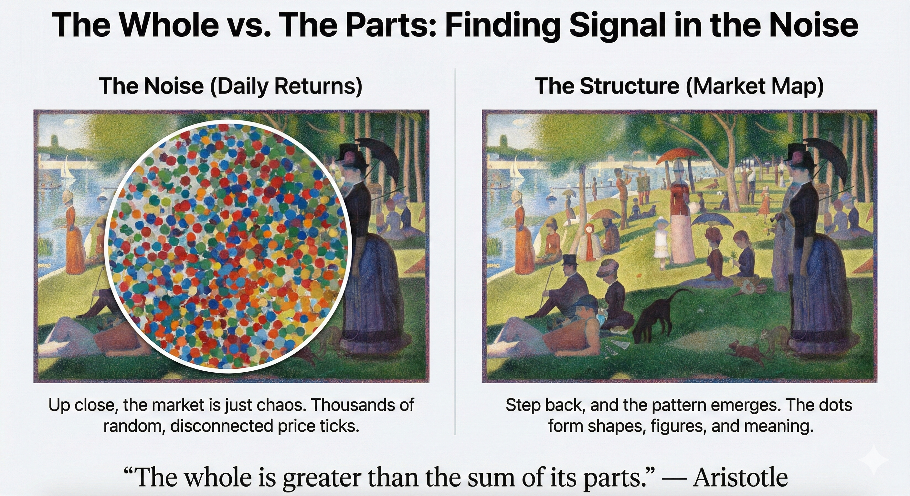
The Whole vs. The Parts: Finding Signal in the Noise
If you look at a Pointillist painting up close all you see are random dots. It looks like noise. This is what a stock ticker looks like to the naked eye.
But if you use an algorithm to 'step back,' the dots resolve into a clear picture. You stop seeing random colors and start seeing shapes and figures.

Slide 8
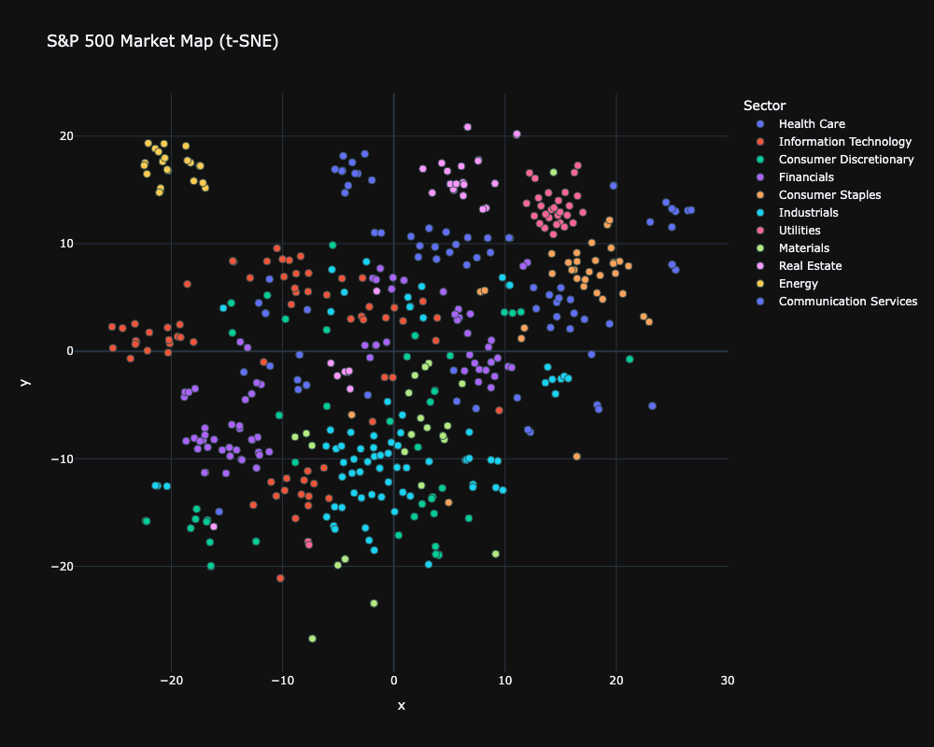
The Market Map
This is the S&P 500 compressed into 2D.
The Islands: Notice how Energy stocks (Red dots) form a tight, isolated island. They live in their own world.
The Outliers: Look at Tesla. It doesn't sit with the other car companies; it sits closer to Tech. The map reveals the true nature of the company, not just its official label."

Slide 9
Conclusion
The Myth: Textbooks teach that markets are "Normal" and "Efficient."
The Reality: Our data proves otherwise.
Risk is Underestimated: "Fat Tails" show that crashes happen far more often than predicted.
Structure is Hidden: Stocks don't move randomly; they move in rigid "Tribes" (Sectors) that we successfully mapped.
The Current Regime: Our low PCA score (~12%) reveals we are currently in a "Stock Picker's Market," where individual company performance matters more than the macro tide.
"The market is not a random walk. It is a complex system with a shape, a structure, and a pulse."

